Slide 1
Michel Foucault
History of Sexuality, vol. 1

Slide 2
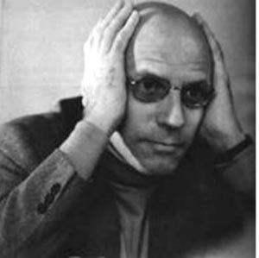
Michel Foucault, 1926-1984

Slide 3
We “other Victorians”
Relationship between sex and power as repression
Speaking about it has the appearance of transgression, defying power, being subversive
But why do we say we are repressed?
What led us to show ostentatiously that sex is something we hide, to say it is something we silence? (9)

Slide 4
Doubts about the “repressive hypothesis”
Discourse referring to “repression” may be part of same system of power, a more devious and discreet form of power
Object is to define the regime of power-knowledge-pleasure that sustains the discourse on human sexuality in our part of the world
Refusal, blockage, invalidation may also be incitement and intensification (11)

Slide 5
Repressive Hypothesis: Incitement to Discourse
Supposedly there are prohibitions on discourse about sex, prudishness, censorship
But there is really a discursive explosion
Institutional incitement to speak about it
Transforming sex into discourse (churches, medicine, psychiatry, criminal justice) (22)

Slide 6
Silence
Silence is less the limit of discourse than an element that functions alongside things said
There is not one but many silences, and they are an integral part of the strategies that underlie and permeate discourses (27)
What is peculiar to modern societies is not that they consigned sex to a shadow existence, but that they dedicated themselves to speaking of it ad infinitum, while exploiting it as the secret. (35)

Slide 7
Perverse implantation
Disparate sexualities labeled
Campaigns against epidemic of children’s onanism – surveillance
Sodomy had been a category of forbidden acts
19th century homosexual became a personage, a past, a case history, and a childhood, … with an indiscreet anatomy and possibly a mysterious physiology – a secret that always gave itself away (43)

Slide 8
The Homosexual
The sodomite had been a temporary aberration
The homosexual was now a species
The machinery of power did not suppress sexual heresy, but rather gave it analytical, visible, and permanent reality (44)

Slide 9
Pleasure <-> Power
Pleasure comes from exercising power that questions, monitors, watches, spies
Pleasure that kindles at having to evade this power, flee from it, fool it, or travesty it
Power lets itself be invaded by the pleasure it is pursuing
Power asserting itself in the pleasure of showing off, scandalizing, or resisting (45)

Slide 10
Perpetual spirals of power and pleasure
power
pleasure
pleasure
power

Slide 11
Scientia sexualis
Science sets itself up as a supreme authority in matters of hygienic necessity to ensure the physical vigor and moral cleanliness of the social body
Justifies the racisms of the state by grounding them in “truth” (54)

Slide 12
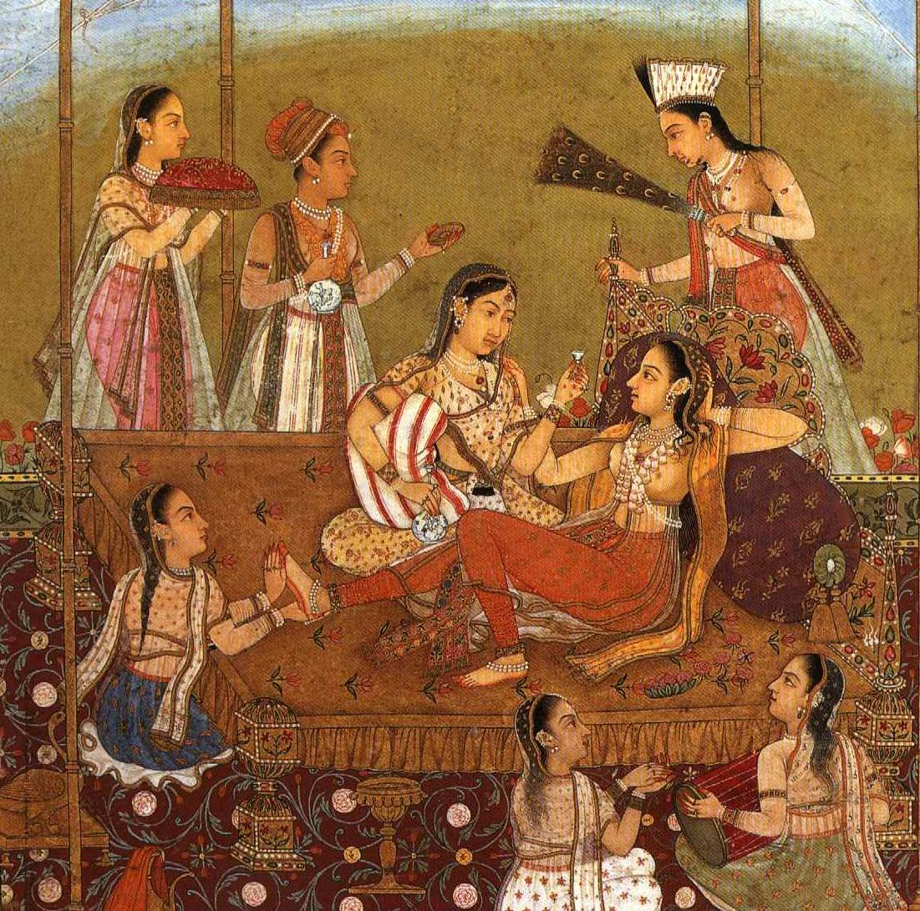
Ars erotica
Truth derived from pleasure
Master transmits secrets to initiate
China, India, Japan, Arabo-Moslem societies (57)

Slide 13
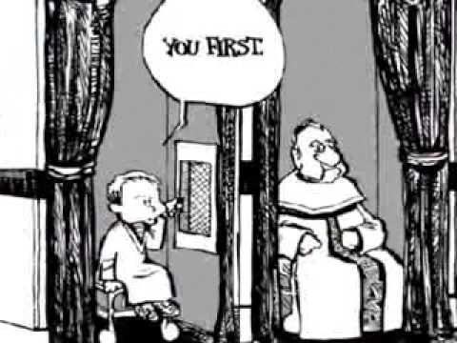
West: Confession
Authority requires confession
No longer priest – confesser (63)
Child – parent
Student – educator
Patient – psychiatrist

Slide 14
Power in confession
The one who listens must validate the truth, decipher, interpret
Scientia sexualis functions as our ars erotica
Pleasure in discovering and exposing the truth
Pleasure in the discourse on pleasure (71)

