Slide 1
Ben Frost
Jason Milan Sound Artist Presentation

Slide 2
Listen:
“Coda” (1:38) off of Theory of Machines

Slide 3
1980-2010
Born 1980, Melbourne Australia
Self-released first EP, titled “Music for Sad Children” in 2001
Released Steel Wound in 2003 on Room 40 label
In 2005, moved from Australia to Reykjavik, Iceland.
Formed Bedroom Community music collective and label with Valgeir Sigurðsson and Nico Muhly
Began to develop his signature style: “densely composed, incredibly visceral, noisy music created with electric guitars, electronics, and chamber strings.”
Released Theory of Machines in 2007, and By The Throat in 2009
Notorious for excruciatingly loud, unlit live performances during this time

Slide 4
Listen:
“The Carpathians” (2:57) “Through the Roof of Your Mouth” (4:35) from By The Throat

Slide 5
Of Late (’10-’15)
Selected by Brian Eno for personal mentorship in 2010
Brian Eno inspired a love for African music
Resulted in Sólaris, a collaboration with Daníel Bjarnason, also of Bedroom Community
Scored several films
Spent most of 2012 in the Democratic Republic of the Congo documenting the conflict with filmmaker Richard Mosse for an audiovisual art installation
Also inspired him to write music for new album, A U R O R A, which was released in 2014
Album very dense, more purely electronic than in the past, and less noisy.
Extraordinarily intricate in its composition and narrative.

Slide 6
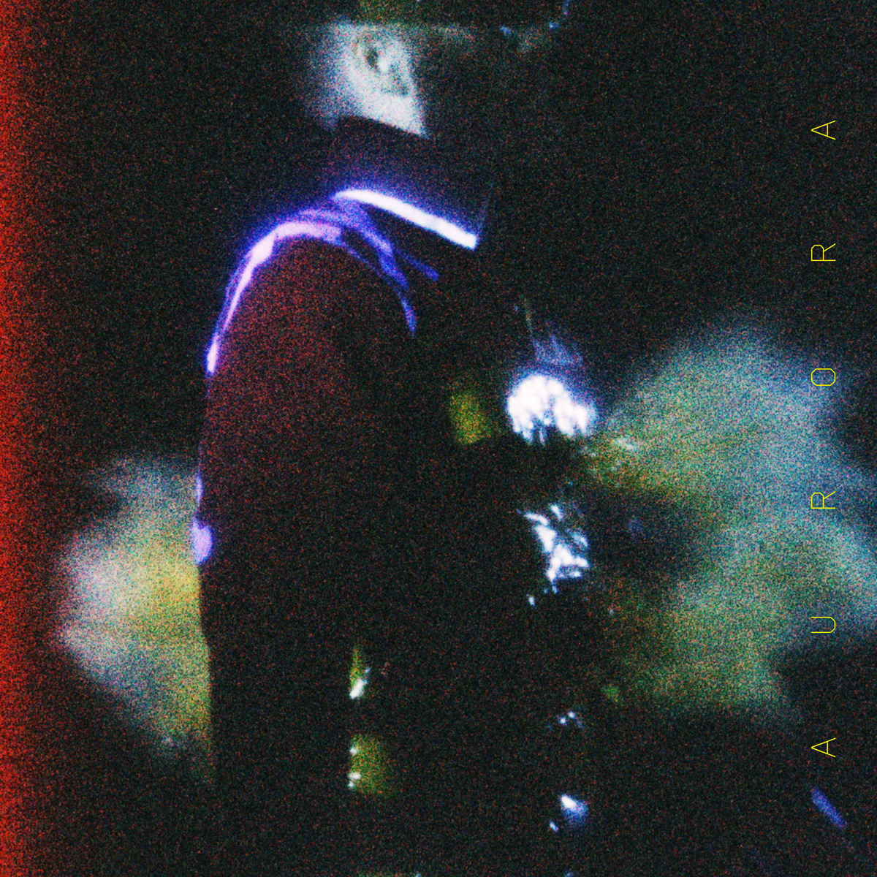
Listen:
“Venter” (6:45) and “A Single Point of Blinding Light” (3:18) off of A U R O R A

Slide 7
Sources:
Buchanan, John D. “Ben Frost - Artist Biography”
http://www.allmusic.com/artist/ben-frost-mn0001954449/biography

