Slide 1
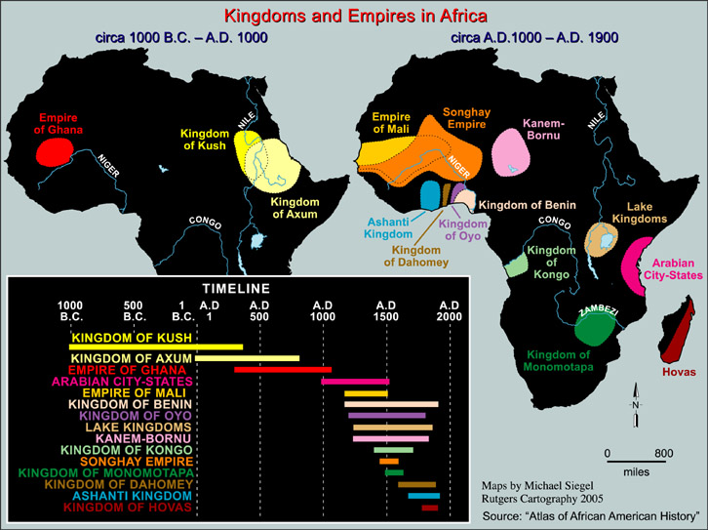

Slide 2
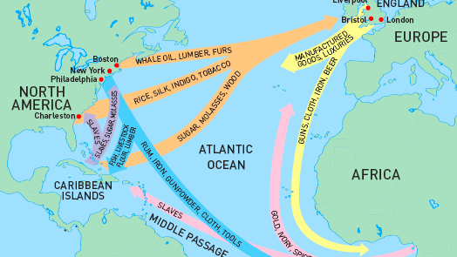

Slide 3
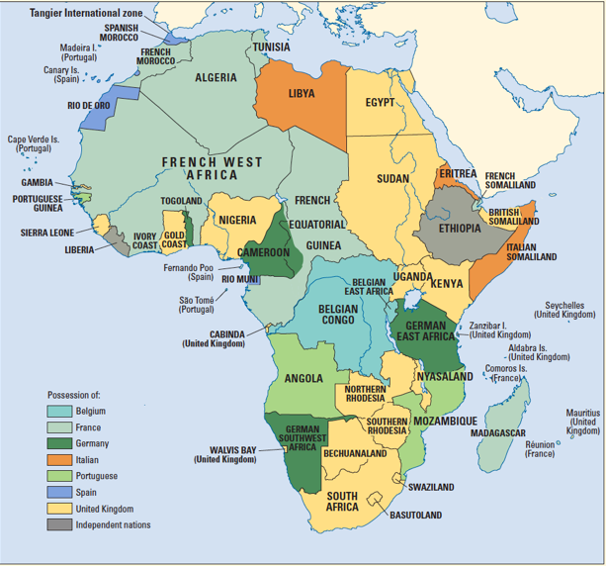

Slide 4
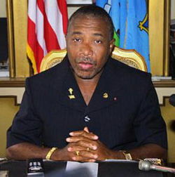
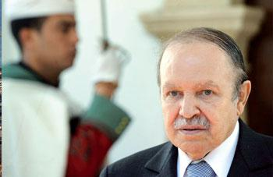
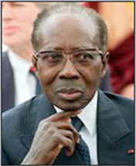
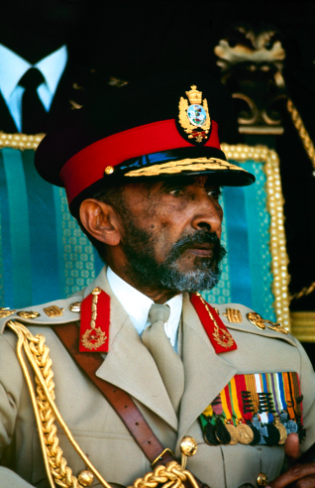
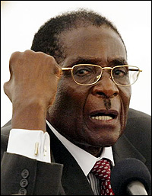
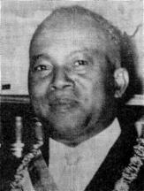
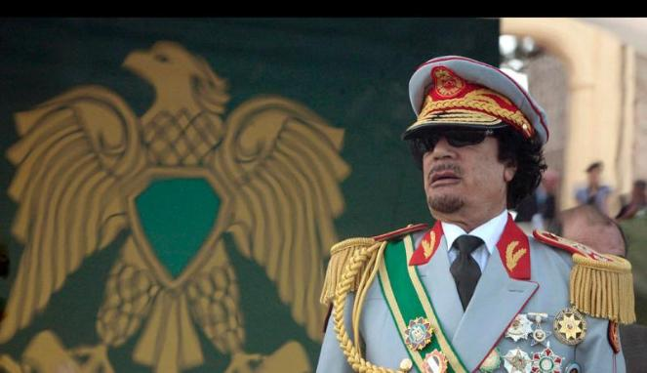
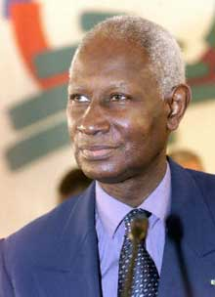
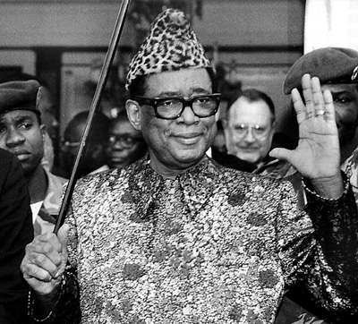
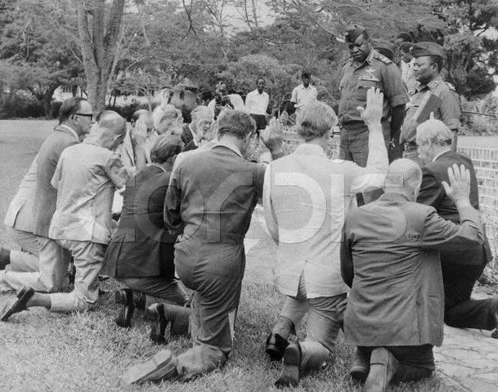
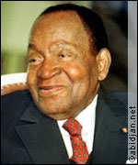
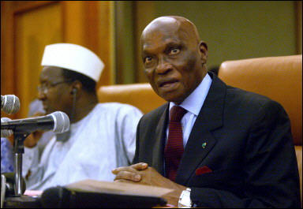
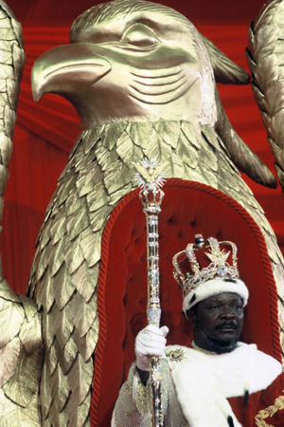
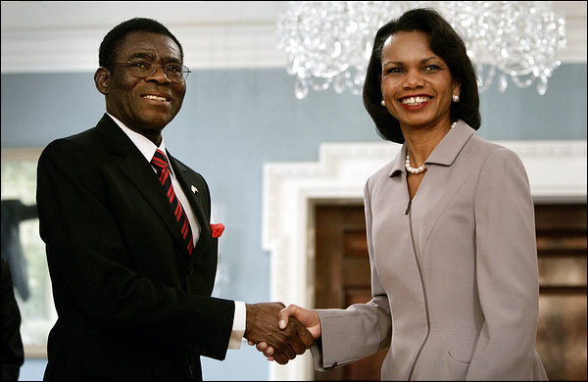
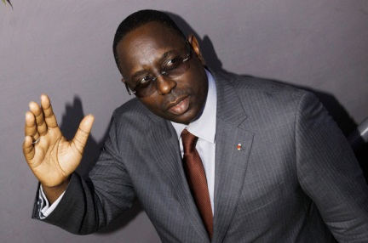
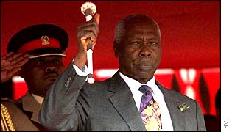
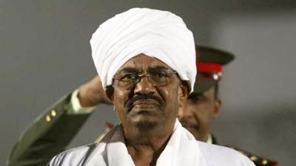
Notes:
High concentration of dictatorships in Africa post independence made” African” and “dictator” redundant. The more abusive or eccentric the ruler, the more media attention he received. But benevolent dictators and democratic rulers have also been part of the political landscape in Africa.
What we label leaders and their governments is sometimes a matter of interpretation. [Story from D&D] Take, for instance, Hugo Chavez.

Slide 5
Welfare
(Security, Prosperity)
State
(Governments)
Polity
Policies
Legitimacy
Compliance (laws)
Resources
(Human, Financial)
POLITICAL SYSTEMS: WHOSE INTERESTS DO THEY / NOT SERVE?

Slide 6
POLITICAL SYSTEMS: WHOSE INTERESTS DO THEY / NOT SERVE?
Welfare
(Security, Prosperity)
Governments
IFIs
Businesses
Private Individuals
International Recognition
Foreign assistance
FDI
Foreign Actors
Policies
State
(Governments)
Polity
Compliance (ideologies)
Resources
(Natural, Financial)

Slide 7
Tenets
Examples
Variations
Voting
Liberal Democracy
Parliamentary
Lobbying
Mixed/ Semi-Presidential
Participation
Running for
Office
Presidential
Executive
Parties
Bicameral
Political Power
(resides with the People)
Legislative
Competition
Separation of Powers
Unicameral
Judiciary
Judicial Review
Liberty
Concrete
Abstract
Assembly
Civil Society
Speech
“No bourgeoisie, no democracy” [Barrington Moore, 1966]
“Donorization” = “No democracy, no money” [Olukoshi]

Slide 8
Bottom Line: (a) rule of men; (b) rule of law; (c) rule of men under law
[Obama in Ethiopia]
Democracy
Liberalization
Transition
Consolidation
Mauritius, Ghana, Botswana, So. Africa
Pseudo-
Democracy
Authoritarianism
Senegal, Nigeria, Uganda, Burkina Faso
Reversal
(by means of a coup or elections)
2008: Mauritania
2008: Guinea (Conakry)
2009: Madagascar
2010: Niger
2012: Guinea Bissau
2013: Central African Republic
2015: Burkina Faso
2011: Mali
Notes:
“Distribution of governmental authority is one of the oldest and most abiding problems of society. By our solutions to this distributive problem we determine whether the government will be stable or unstable; whether it will be a dictatorship… whether we shall have the rule of law, the rule of men, or the rule of men under law.”
James Fessler. 1949. Area and Administration. Birmingham: Univ. of Alabama Press, p. 1.

Slide 9
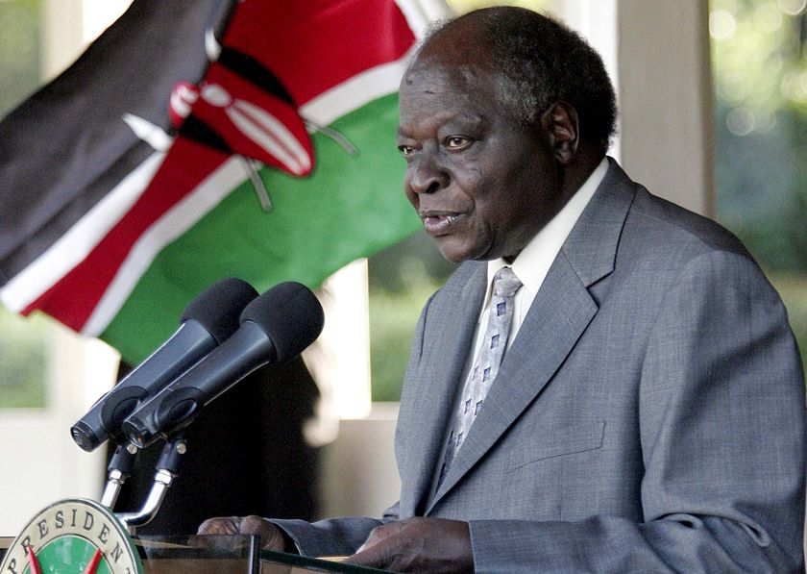
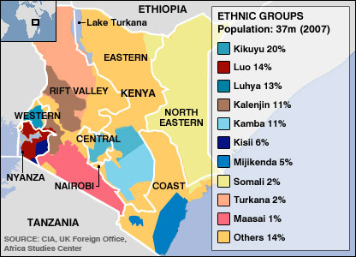
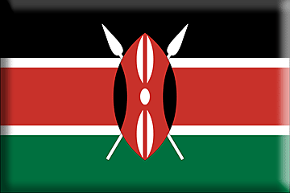
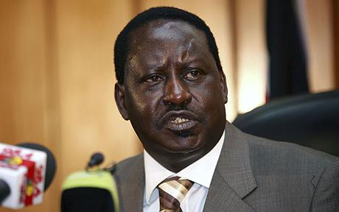
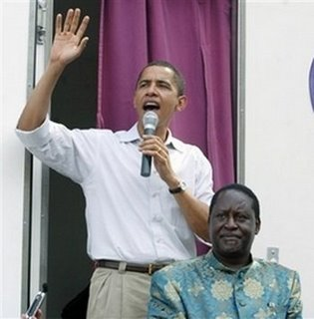
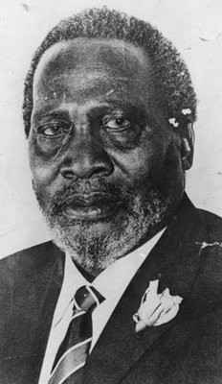
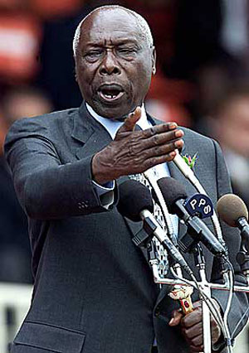
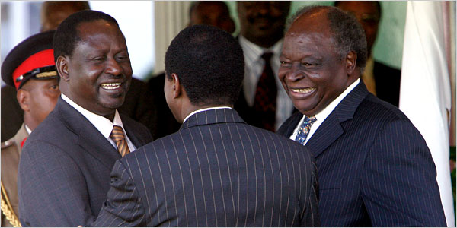
Kenya
Mwai Kibaki (pres. 2002-2013 )
Raila Odinga
Jomo Kenyatta
(pres. 1964-1978)
Daniel arap Moi
(pres. 1978-2002)

