Slide 1
How Did “Hippos” (Ayittey) Emerge in Africa?

Slide 2
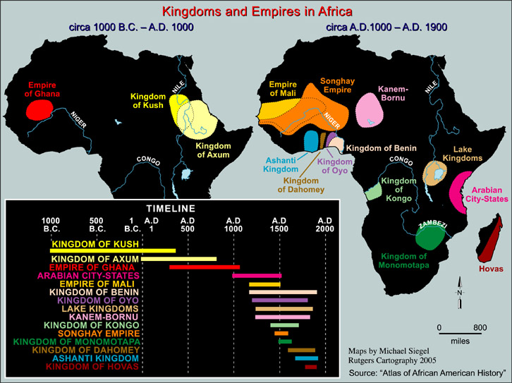

Slide 3
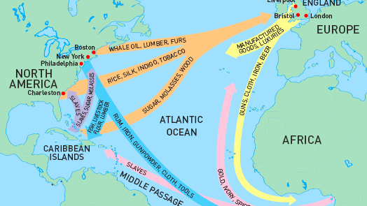
16th, 17th, 18th, 19th centuries AD (following the Arab Slave Trade 9th-19th centuries AD)

Slide 4
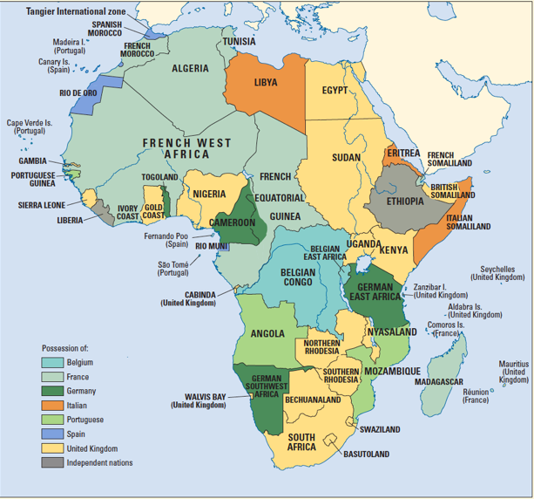
Repression
Extraction
Subjugation
The Colonial Episode: 1885 to 1950s, 1960s, 1970s, 1980s, 1994 (South Africa)

Slide 5
Independent Rule: African Leaders’ Top Priorities
National Unity in multi-ethnic societies
Development through (rapid) economic growth
3 DECADES⁺ OF AUTOCRATIC RULE
NRHorningPsci431f19

Slide 6
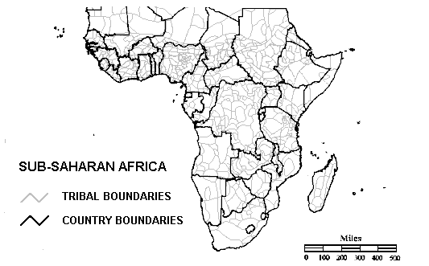

Slide 7
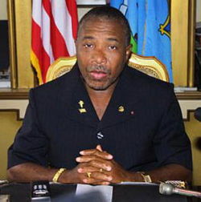
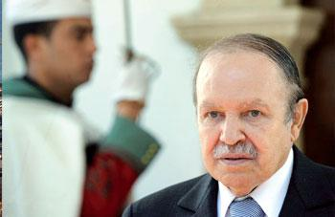
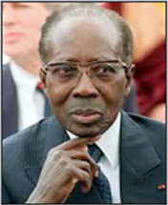
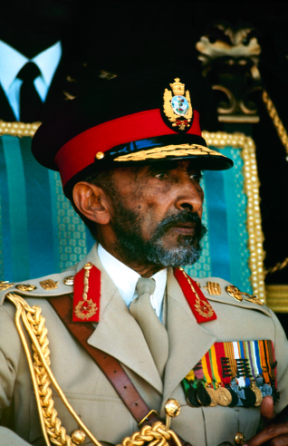
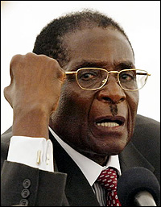
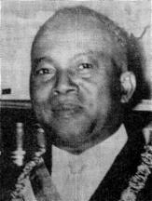
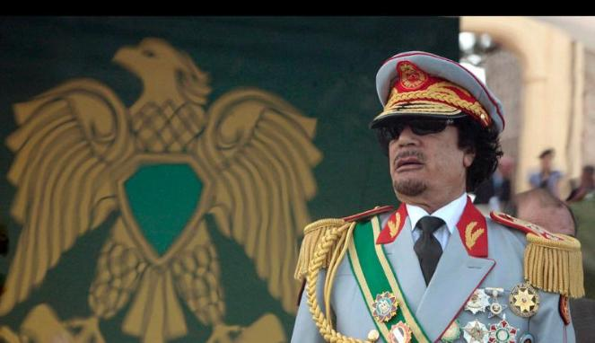
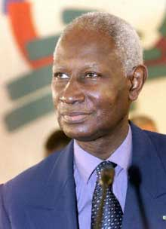
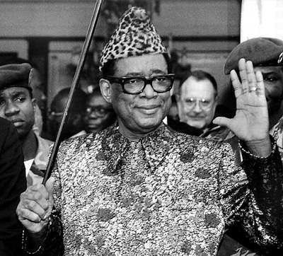
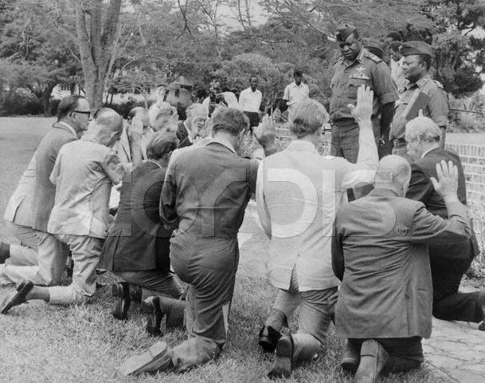
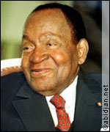
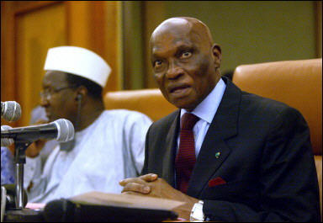
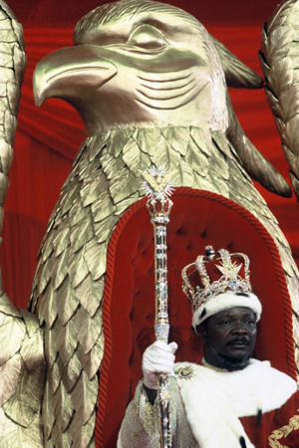
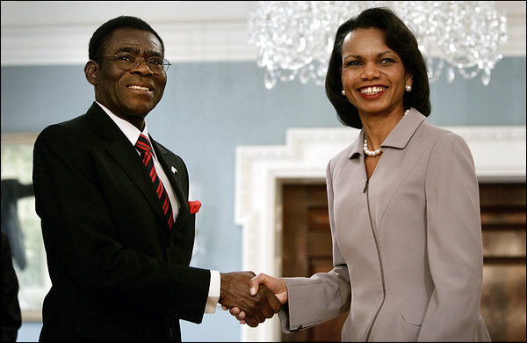
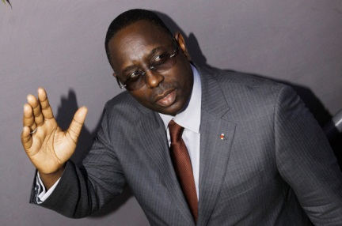
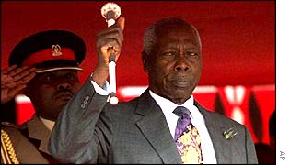
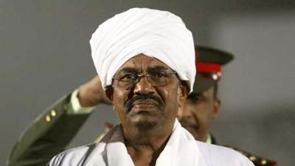
Notes:
High concentration of dictatorships in Africa post independence made” African” and “dictator” redundant. The more abusive or eccentric the ruler, the more media attention he received. But benevolent dictators and democratic rulers have also been part of the political landscape in Africa.
What we label leaders and their governments is sometimes a matter of interpretation. [Story from D&D] Take, for instance, Hugo Chavez.

Slide 8
LATE 1980s/BEGINNING 1990s: CRISIS OF THE AFRICAN STATE
+
FALL OF THE BERLIN WALL = TRIUMPH OF NEO-LIBERALISM
=
DEMOCRATIZATION
(exogenous)

Slide 9
DEMOCRATIZATION = “DONORIZATION”
(Liberalization -> Transition -> Consolidation)

Slide 10
Tenets
Examples
Variations
Voting
Liberal Democracy
Parliamentary
Lobbying
Mixed/ Semi-Presidential
Participation
Running for
Office
Presidential
Executive
Parties
Bicameral
Political Power
(resides with the People)
Legislative
Competition
Separation of Powers
Unicameral
Judiciary
Judicial Review
Liberty
Concrete
Abstract
Assembly
Civil Society
Speech
“No bourgeoisie, no democracy” [Barrington Moore, 1966]
“Donorization” = “No democracy, no money” [Olukoshi]

Slide 11
Why?
Foreign aid dependency

Slide 12
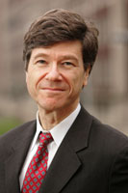
Source: Jeffrey Sachs, The End of Poverty (2005)
= Increase aid to .7 percent of GNI

Slide 13
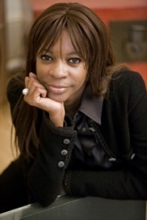
“Aid has not lived up to expectations. It remains at the heart of the development agenda, despite the fact that there are very compelling reasons to show that it perpetuates the cycle of poverty and derails sustainable economic growth.”
Source: Dambisa Moyo, Dead Aid (2009)
= scrap aid, encourage private enterprise
http://www.youtube.com/watch?v=HIPvlQOCfAQ [9’36’’]
NRHorningPsci431f19

Slide 14
William Easterly: Better Aid
“When you are in a hole, the top priority is to stop digging.”
The White Man's Burden: Why the West's Efforts to Aid the Rest Have Done So Much Ill and So Little Good (2007)
“Why does foreign aid fail?” https://www.youtube.com/watch?v=vJHdmDQehQg

Slide 15
Welfare
(Security, Prosperity)
State
(Governments)
Polity
Policies
Legitimacy
Compliance (laws)
Resources
(Human, Financial)

Slide 16
THE IMPACT OF DEVELOPMENT AID ON LEADERSHIP
Welfare
(Security, Prosperity)
Governments
IFIs
Businesses
Private Individuals
International Recognition
Foreign assistance
FDI
Foreign Actors
Policies
State
(Governments)
Polity
Compliance (ideologies)
Resources
(Natural, Financial)

