Slide 1
Political Map of Africa

Slide 2
African Ethno-Linguistic Groups
(Murdock 1959)

Slide 3
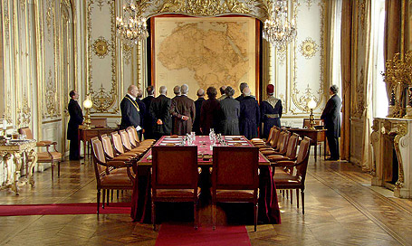
Berlin Conference: 1884-85

Slide 4
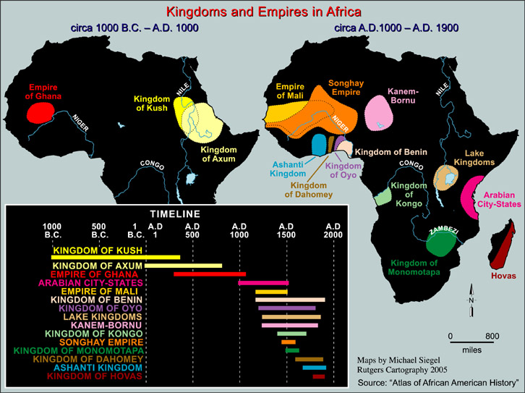

Slide 5
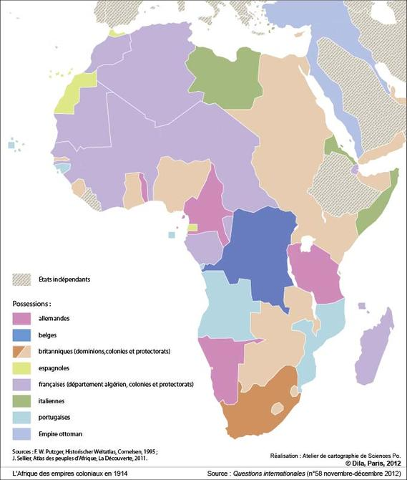
1914

Slide 6
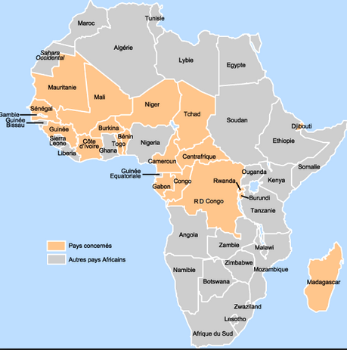
Francophone Africa

Slide 7
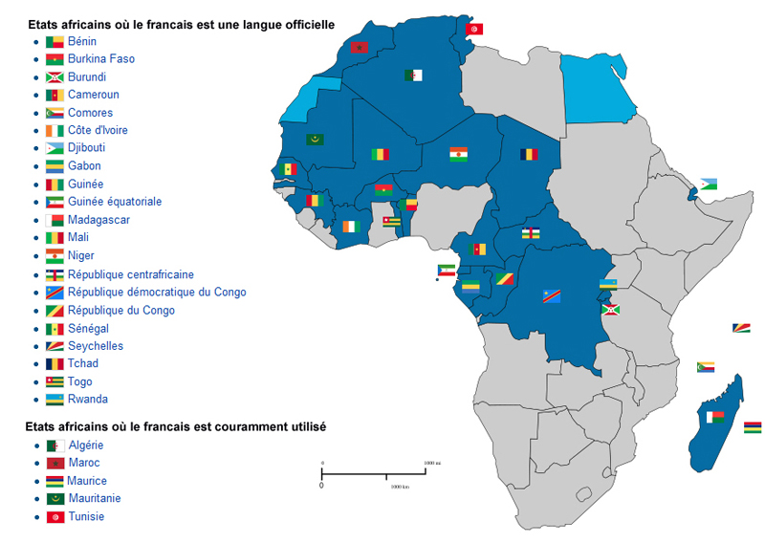
African States Where French is an Official Language

Slide 8
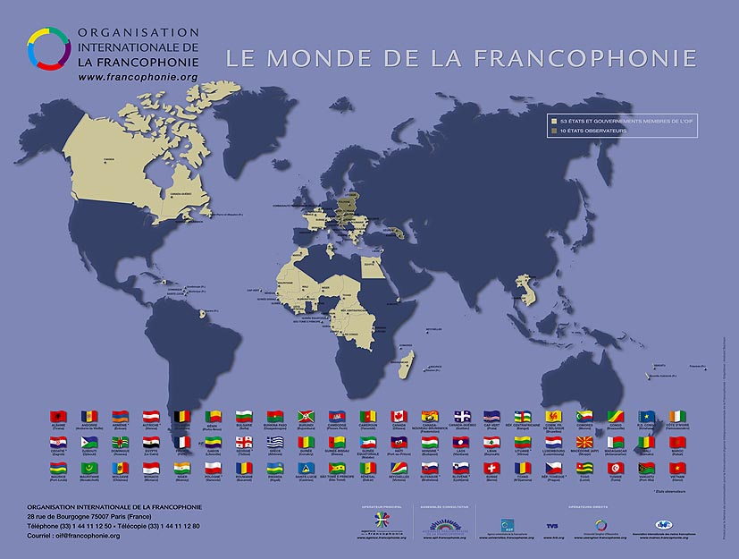

Slide 9
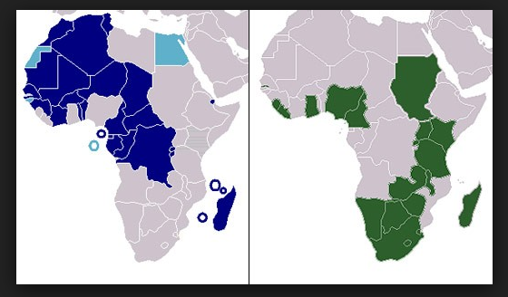
Anglophone Africa

Slide 10
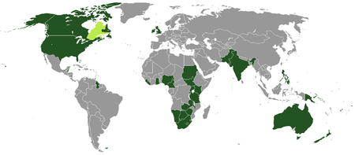
The Anglophone World

Slide 11
