Slide 1
Rule of law, rule of men, rule of men under law
Political Regimes*
Power: Norms, Understandings, Practices
* Where power resides; How power is exercised

Slide 2
Authoritarianism is a form of rule in which a small group of individuals exercises power over the state without being constitutionally responsible to the public.
A democracy is a political system in which the power to govern resides with the people (demos = “the common people” + kratia = “power”):
In direct democracy the public participates directly in governance and decision-making for the community (Athenian democracy).
In indirect democracy the public participates indirectly through its elected representatives (modern democracies).
In liberal democracy, the power to govern resides with the people according to the principles of participation, competition, and liberty.
Republicanism emphasizes (1) separation of powers within the state [Montesquieu, 1758] and (2) public participation through elected officials.
In social democracy, individual freedoms can be compromised in favor of collective welfare and
greater equality.

Slide 3
Political Freedoms in the World
https://challengepost-s3-challengepost.netdna-ssl.com/photos/production/solution_photos/000/056/319/datas/xlarge.png

Slide 4
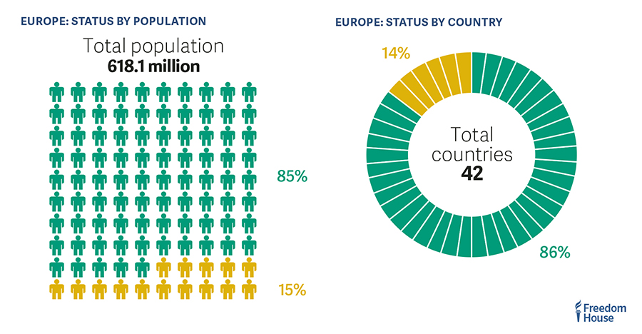
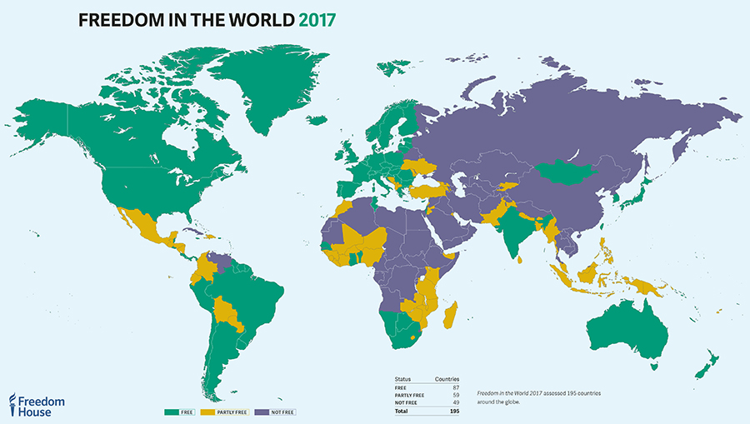
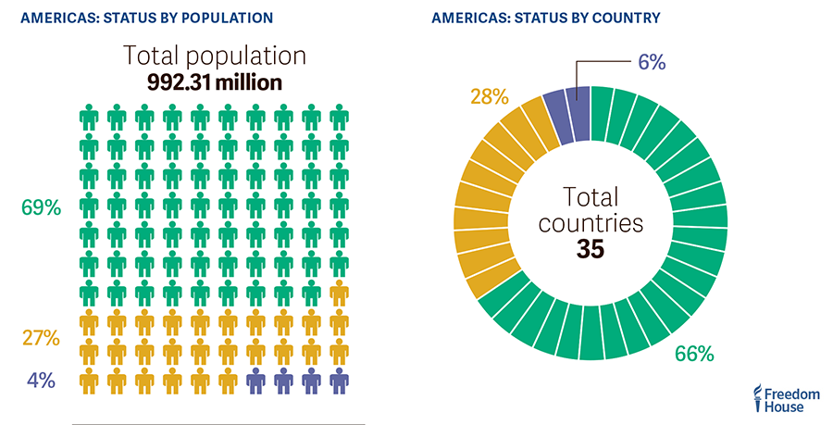
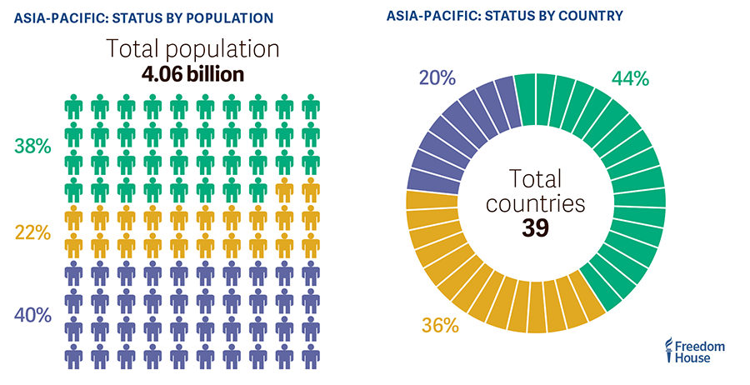
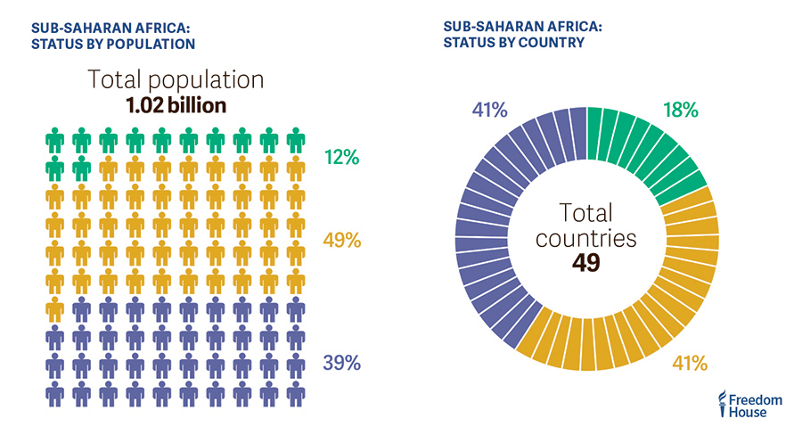
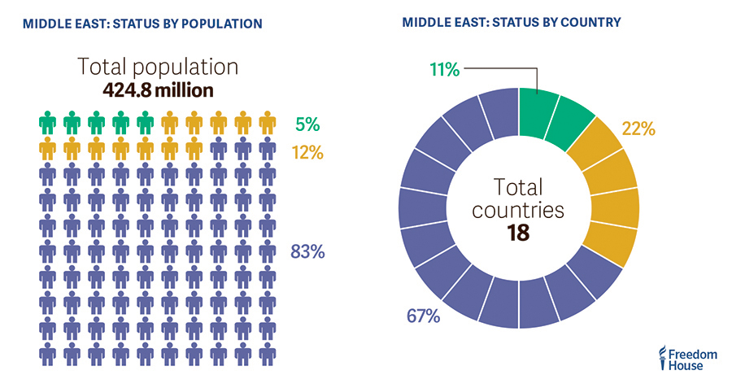
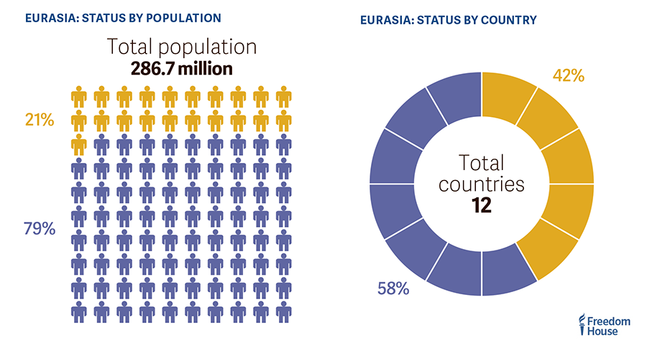
Americas, Asia-Pacific, Eurasia, MENA (Middle East North Africa, Sub-Saharan Africa, Europe
Europe
Americas
Asia-Pacific
Sub-Saharan Africa
MENA
Eurasia
https://freedomhouse.org/report/freedom-world/freedom-world-2017

Slide 5
Guillermo O’Donnell and Philippe Schmitter (1986) Transitions from Authoritarian Rule.
“Democratization (…) refers to the processes whereby the rules and procedures
of citizenship are either applied to political institutions previously governed by
other principles (…), or expanded to include persons not previously enjoying such
rights and obligations (…), or extended to cover issues and institutions not
previously subject to citizen participation (…).” (p. 8)
Liberalization
Transition
Consolidation

Slide 6
LIBERAL DEMOCRACY
Tenets
Examples
Variations
Voting
Parliamentary
Lobbying
Mixed
Participation
Running for
Office
Presidential
Executive
Parties
Political Power
(resides with the People)
Bicameral
Competition
Separation of Powers
Legislative
Unicameral
Judiciary
Judicial Review
Liberty
Concrete
Abstract
Assembly
Civil Society
Press
NGO’s
Churches
Speech

