Slide 1
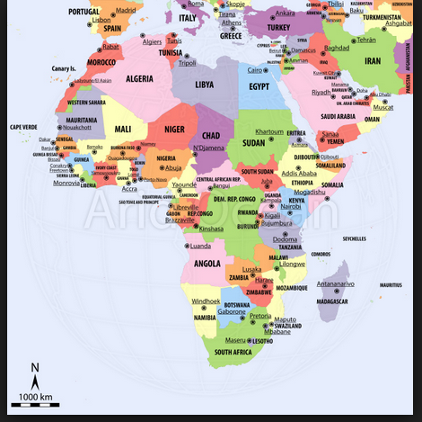
Political Map of Africa

Slide 2
Ethno-Linguistic Map of Africa
http://www.cosmovisions.com/Afrique-Carte-Langues.htm

Slide 3
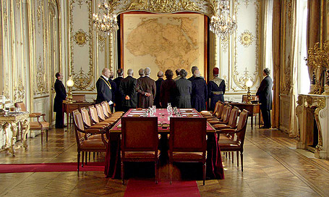
Berlin Conference: 1884-1885

Slide 4
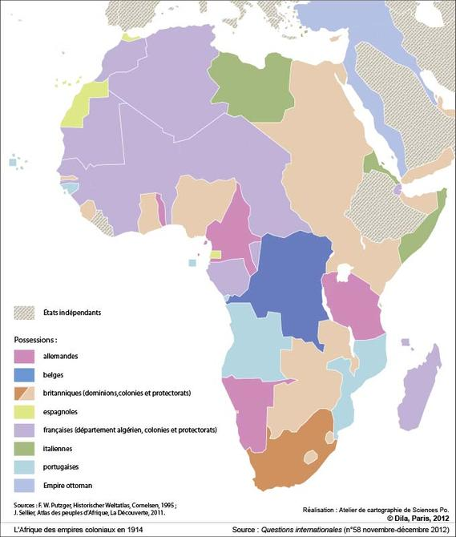
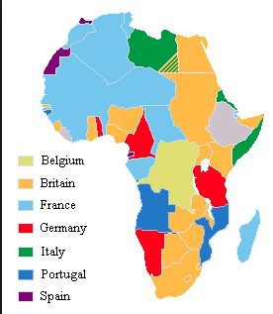
1914

Slide 5
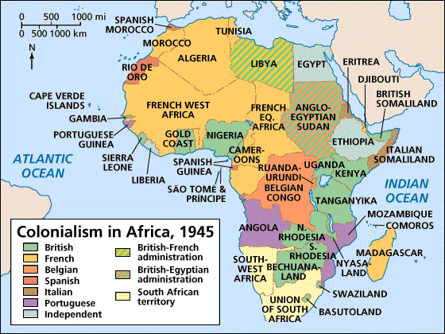

Slide 6
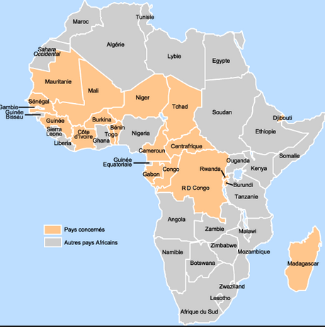
Francophone Africa

Slide 7
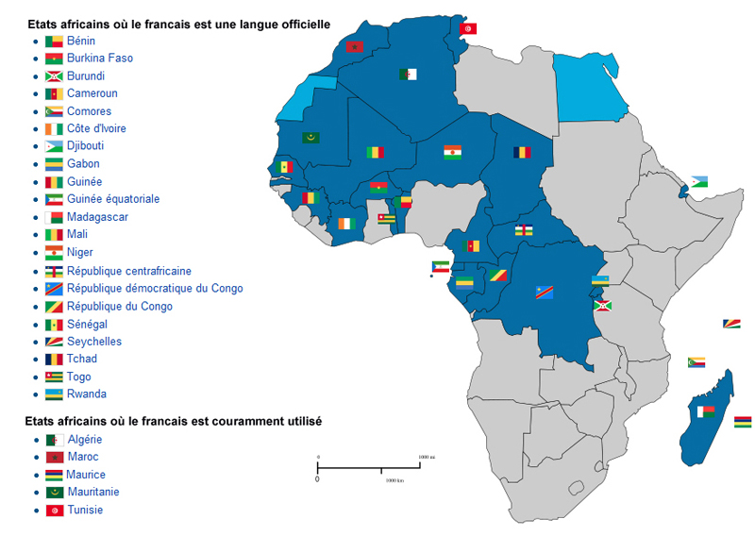
African States Where French is an Official Language

Slide 8
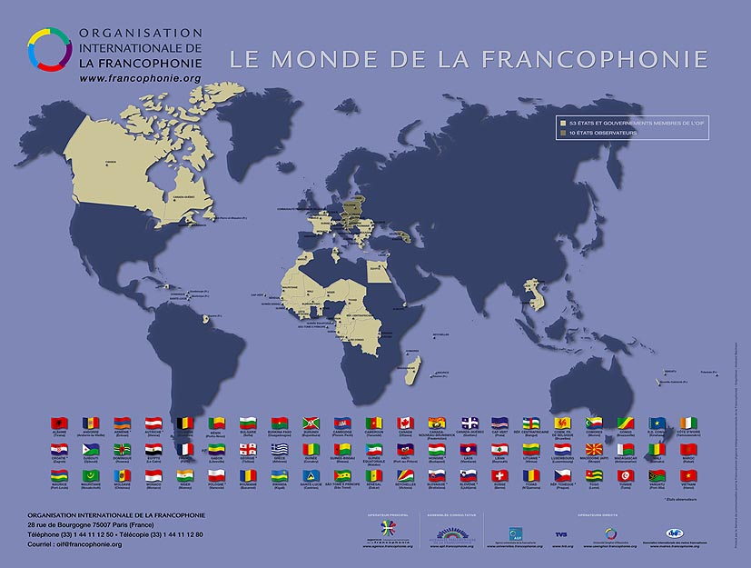

Slide 9
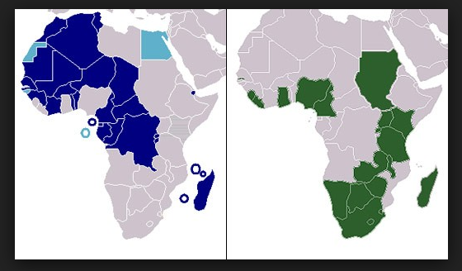
Anglophone Africa

Slide 10
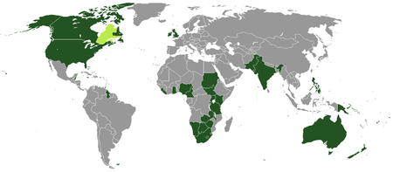
The Anglophone World

Slide 11
