Slide 1
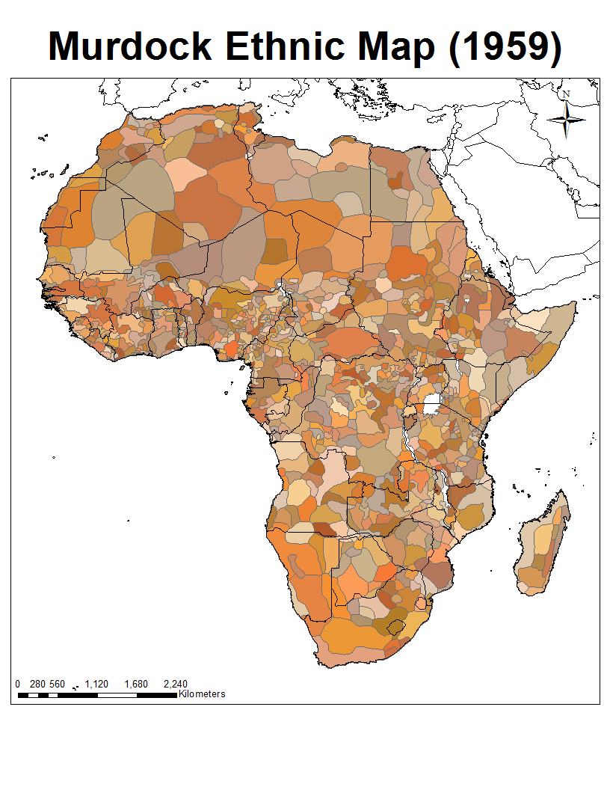
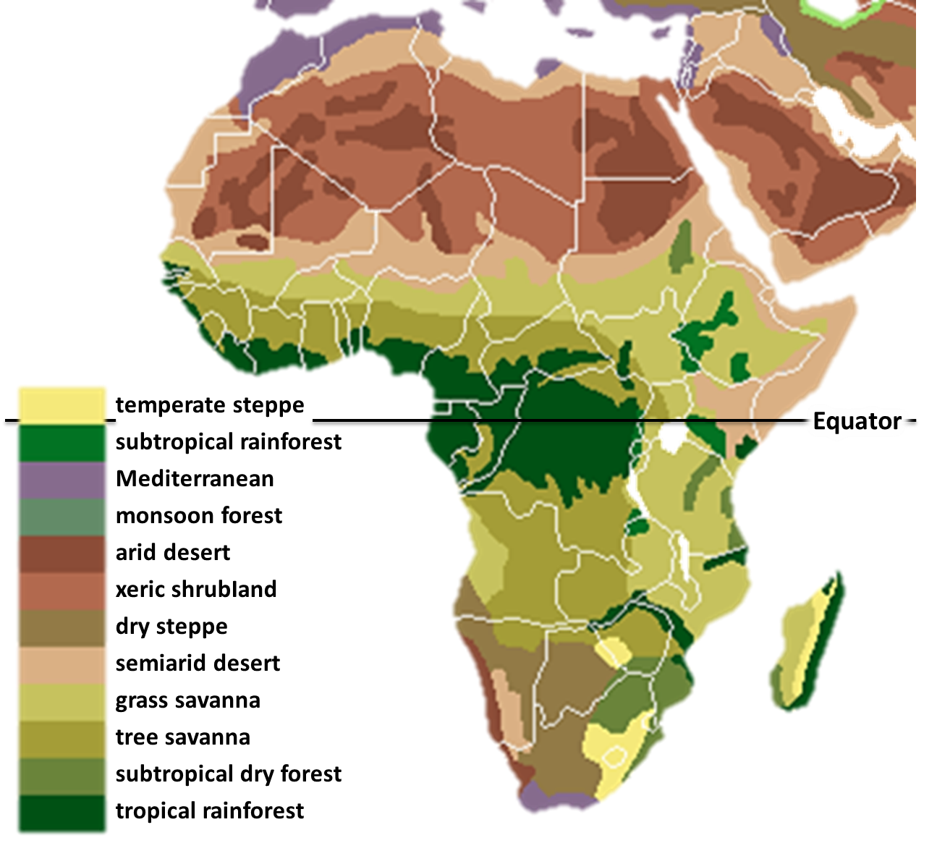
Nature & Cultures
Notes:
Previous maps based on Murdock’s classification of Africa’s ethnic groups in 1959.

Slide 2
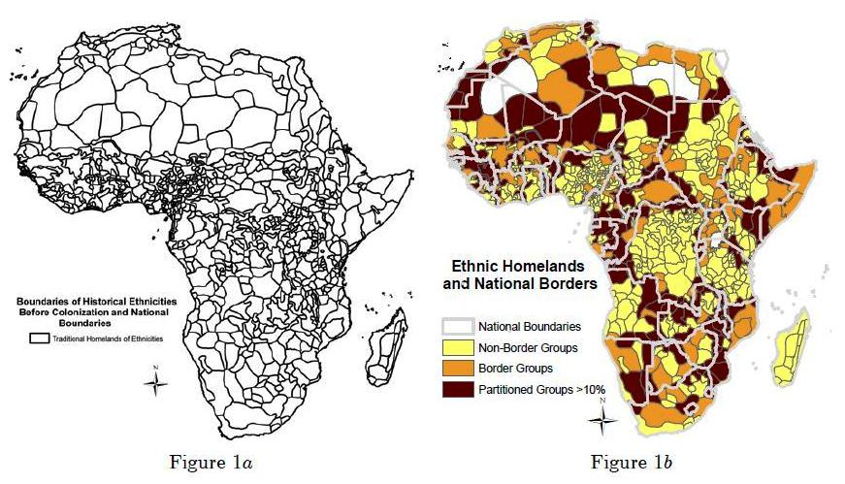
Cultures & Countries

Slide 3
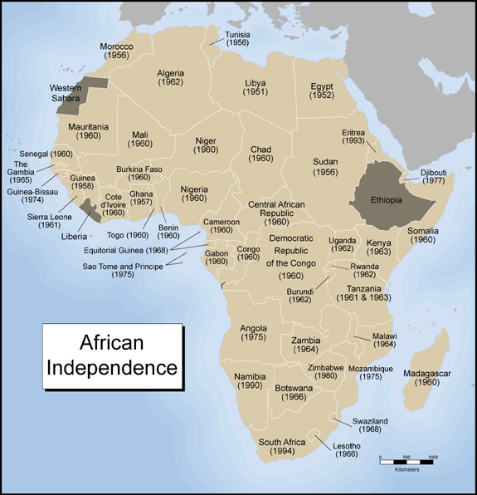
Colonial Legacy: the Nation-State
State
(Governments)
Society

Slide 4
Political Systems
Welfare
(Security, Prosperity)
State
(Governments)
Polity
Policies
Legitimacy
Compliance (laws)
Resources
(Human, Financial)
Notes:
State + Polity
Policies connect them: governments enact; people react
Through policies, what to governments seek/claim to provide? Essential political goods: Security + Prosperity
Policies enacted to secure the public’s welfare (security + prosperity)
To access/enjoy these political goods, people have to submit to the authority of the state, i.e., give up some of their freedoms
States need and expect legitimacy, compliance, and resources from the people. Revenues are needed to run the state = taxation.
Thus Exchange – Symbiotic Relationship – Reciprocity.

Slide 5
Whose Interests Does the System Serve? Africa Version
Welfare
(Security, Prosperity)
Governments
IFIs
Businesses
Private Individuals
International Recognition
Foreign assistance
FDI
Foreign Actors
Policies
State
(Governments)
Polity
Compliance (ideologies)
Resources
(Natural, Financial)
Notes:
http://www.siliconafrica.com/france-colonial-tax/

Slide 6
The Question of Legitimacy
Types: Legal Rational, Charismatic, Historical (Weber) in E&D (2013)
Transformations: Jua (1995) + Firmin-Sellers (2000) for Cameroon
What is neo-patrimonialism?

