Slide 1
African Societies

Slide 2
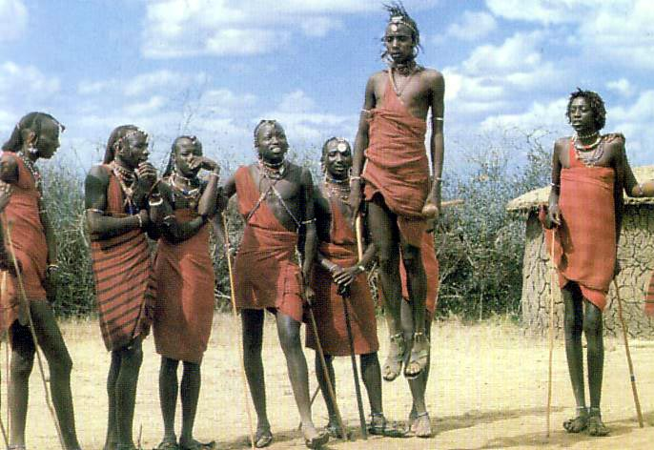
Ethnic Identity
Ethnicity refers to any specific characteristics and societal institutions that make one group of people culturally distinct from others.

Slide 3
National Identity
A nation is defined as a group of people who share a bond and a sense of belonging together. Members can speak a common language, practice the same religion, observe the same customs, etc.
National identity is based on a sense of belonging to a nation and a belief in its political aspirations.
Ethno-national independence movements

Slide 4
Citizenship
Citizenship can be defined as an individual’s or a group’s relation to the state.
The relation of reciprocity is purely political (allegiance for rights + obligations/duties) [recall political systems]
Citizenship can give rise to patriotism, i.e., pride in one’s state and citizenship and willingness to defend and promote one’s political system.

Slide 5
Nation-State
The nation-state is a state encompassing one dominant nation that the state in question claims to embody and represent.

Slide 6
Colonizers’ Motivations
Colonizers’ Means
Prosperity
Commerce
Power
Civilization
Prestige
Christianity

