Slide 1
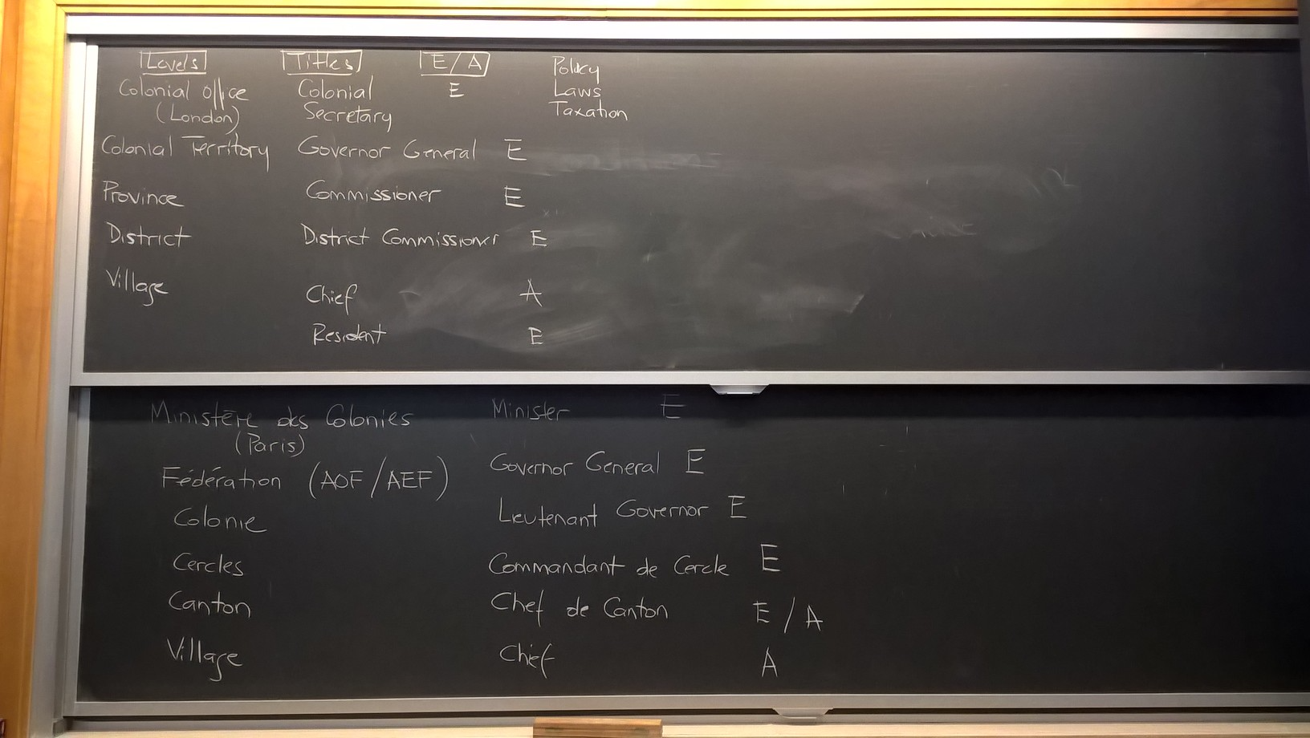

Slide 2
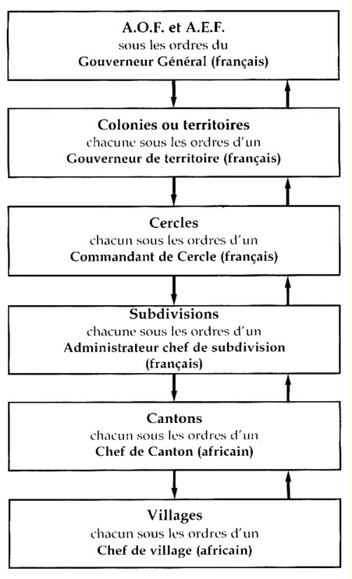
Colonial Administration: Francophone Africa
Ministère des Colonies
(Paris, 1894)

Slide 3
Portrait of a mulatto
Four “communes” of Senegal (French assimilation policy)

Slide 4
French colonial troops (tirailleurs sénégalais)

