Slide 1
Timeline of Iraqi Politics
1932: Iraq is officially declared independent
1958: Monarchy is overthrown by a military coup
1968: Major Baathist-led coup
1979: Saddam Hussein becomes president
1980-88: Iran-Iraq war
1982: Killing of 150 Shi’a in Dujail following an attempt on Saddam’s life
1990: Invasion of Kuwait
1991: Kuwaiti cease-fire and rebellions in the north and south; UN safe-haven established for the northern Kurds
1993: Attempted assassination of George Bush in Kuwait; US attacks back
1996: Oil for food program; Family politics in which Saddam’s exiled relatives come back on the promise of a pardon and are killed
1998: Iraq ends cooperation with UNSCOM; US bombing campaign targeting weapons facilities
1999: Chief Shiite spiritual leader Sadiq al-Sadr assassinated in Najaf
2002: Weapons inspectors return to Iraq backed by UN pressure of “serious consequences”
2003: US and coalition troops invade Iraq; Saddam Hussein captured
2004: Fighting with Shiite militias of Moqtada al-Sadr; handover to interim govt.
2005: First multiparty election in Iraq
2007: The US military “surge” begins
2008: Baath party reintegration law passed
2010: New legislative elections and government deadlock

Slide 2
Iraq as a republic of fear
Institutionalized insecurity
Saddam Hussein personally constructed the security apparatus
Internal Security (Amn)—trained directly by the Soviet KGB—based in surveillance
Military Intelligence (Istikhbarat)—directed operations against Iraqis abroad
Mukhabarat (Party Intelligence in Iraq) watches over the other policing networks
1/5th of the Iraqi labor force was in the security business
Ba’athist ideology
The importance of mythmaking; of playing up the stories that the state gives you
Done through party manipulation of all the media channels
Overall created few avenues for constructive thought
How did this weaken Saddam’s information on the eve of war?

Slide 3
Iraq after the 2003 invasion
Iraqi responses to the invasion
Extremely glad to be rid of Saddam
Initial euphoria, then concerns about imperialism
What are the US designs on the region?
Oil?
Military bases?
A compliant government?
Government recognizes need for US troops on the ground, public largely wants them out
Infrastructure issues
For much of the post-invasion period, about 80% of Iraq has an unstable electrical supply
Crime skyrocketed, with the initial looting of hospitals, national museum
More than 1000 people (civilians and police) a month killed in violence
100k+ Iraqi civilians killed; Iraqi security services went from over 500k down to about 150k
2/3 of the population has had problems with their water supply
Many of pledged reconstruction funds have never been disbursed
1 million Iraqi refugees still abroad; 1.5 million Iraqis are internally displaced
60% of full-time jobs in Iraq are government jobs

Slide 4
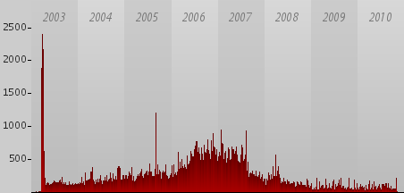
Civilian deaths in Iraq by month

Slide 5
Reconstructing the state in an insurgency
Constitutional issues
Federalism
Role of Islam
Sunni representation
Bill of rights
The insurgency
Sunni insurgency of the aggrieved—based in the Sunni triangle; mingled with Islamists
Shiite insurgency based in a couple of militias led by Moqtada al-Sadr
Role of foreign fighters?
What are the strategies of the insurgency?
What would cause the insurgency to decline?
Iraqi elections
First for an interim assembly (January 2005); led to a Sunni boycott, but successful passage of a constitution by referendum
Next for the first legislative assembly (December 2005)
Dominated by the United Iraqi Alliance, which is an umbrella of Shiite groups
Two secular nationalist groups competed
Sunni groupings, Iraqi Islamic party
Deadlock after the March 2010 elections

Slide 6
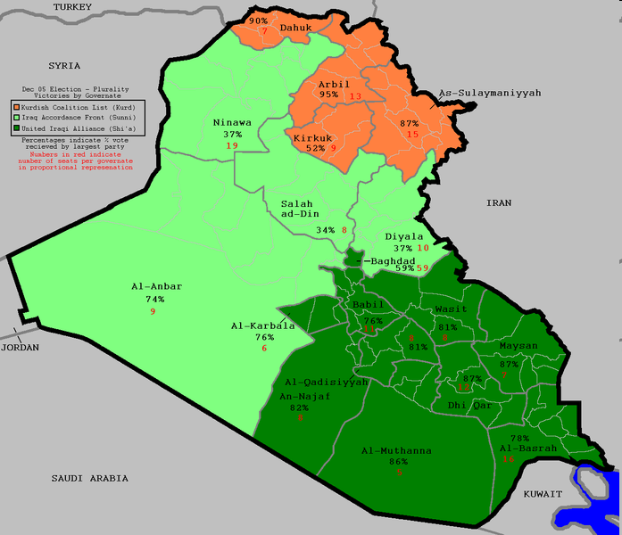
Iraqi electoral results December 2005

Slide 7
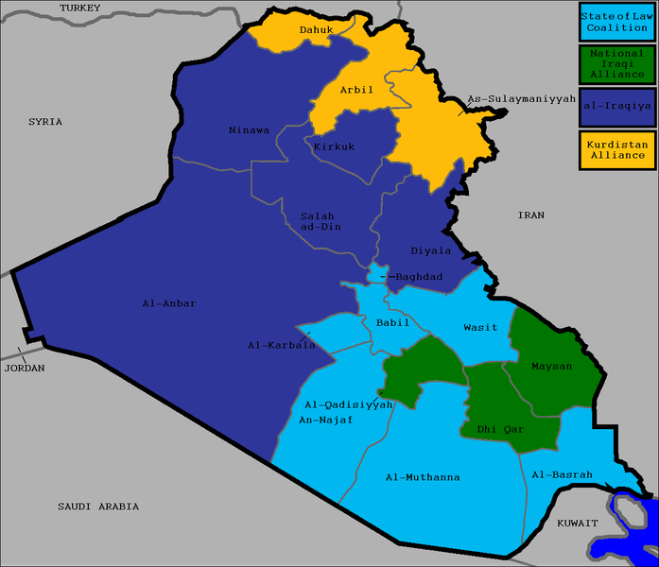
Iraqi electoral results 2010

Slide 8
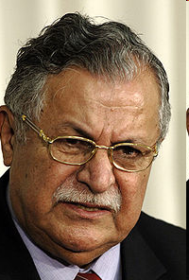
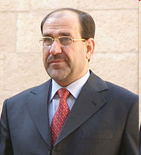
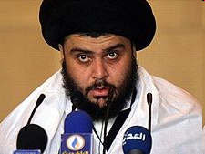
Key figures in Iraqi politics
President Jalal Talabani (PUK)
Nouri al-Maliki (Islamic Dawa)
Moqtada al-Sadr (Mehdi army)

Slide 9
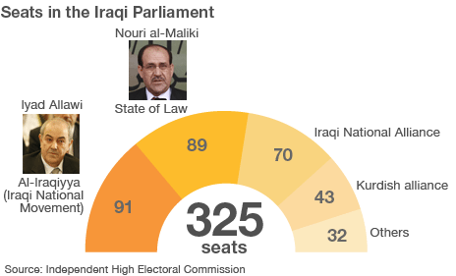
The Iraqi government as a grand, fragile coalition

