Slide 1
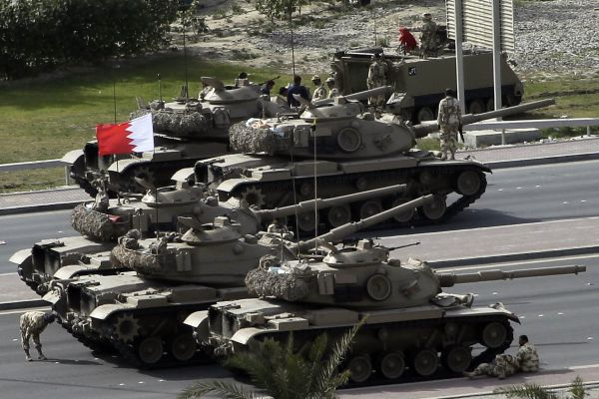
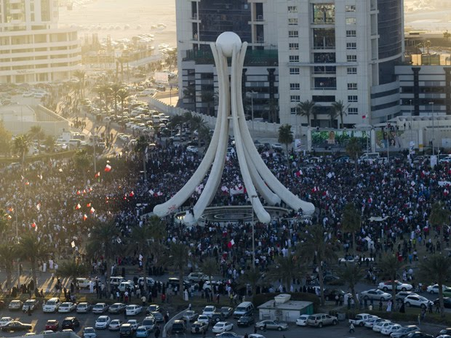
Suppressed revolution in Bahrain
February 14 Revolution
Large-scale protests at Pearl Square during February and March 2011
Aim of expanding political rights, more equality for the majority Shi’a, transition to a constitutional monarchy
Led by majority Shi’a opposition group, al-Wefaq; splinter group al-Haq wants a more radical change from the monarchy
Division within the ruling al-Khalifa family about how to respond
Saudi-supported crackdown
Saudi and UAE security forces moved in 14 March
Martial law declared and Pearl Square monument destroyed
Attacks on unarmed protestors, medical personnel, late night house raids
Large-scale political arrests (3000+ people)
National dialogue boycotted by some opposition groups
Official commission of inquiry established that criticizes security forces

Slide 2
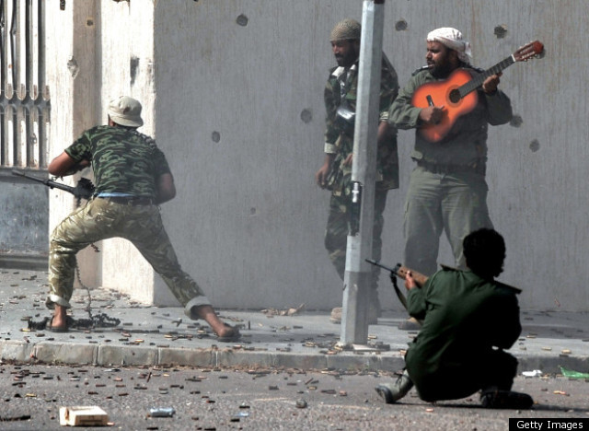
Revolution and civil war in Libya
Context
Libya tightly ruled in a personalistic manner as a jamahiriyya (republic of the masses) and theoretically guided by Qaddafi’s “Green Book”
Tribal society underneath a thin state created through oil revenues
Eastern Libya source of most historical opposition and oil wealth
Small, highly personalized military dependent on Qaddafi
Eastern revolt and immediate repression
Protests in Benghazi begin 15 February 2011; security forces attack protesters and are driven out
Rebel movement, composed of civilians, army defectors, and Islamist opposition
Government uses death squads and sub-Saharan mercenaries to support repression
NATO support and rebel victory
Extensive back and forth advances and withdrawals across Libyan territory
UNSCR 1973 promises civilian protection in March; 17 countries participate
Rebels finally take Tripoli in August; Qaddafi loyalists routed and cornered by October
Rebuilding a shattered state
Up to 30,000 killed in the civil war; some reprisal killings continue
Concern about demobilization and unification of the country
NTC plans for election to a constitutional assembly by mid-2012

Slide 3
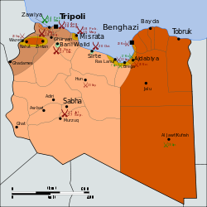
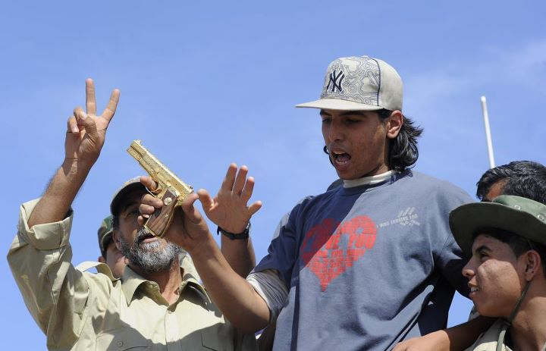
Progress of the Libyan conflict

Slide 4
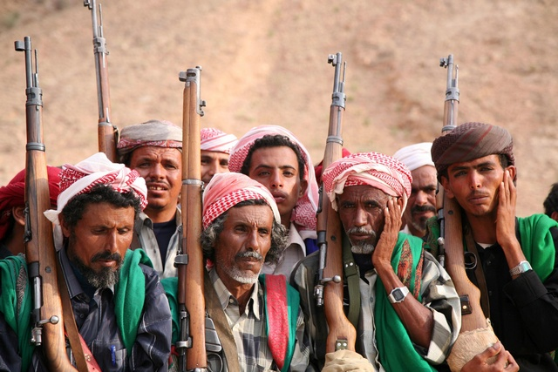
Revolution and the potential for state failure in Yemen
Context
Yemen in the poorest country in the Middle East; high population growth, rapid decline in resources
Historically two countries, with the South still discriminated against by the center
Houthi rebellion in the North; Southern movement claims in the South; al-Qa’eda
Mass protest begins
27 January 2011 protests begin in Sana’a
Early concessions by President Saleh—won’t run for re-election in 2013
Protests increase in size and spread through March
Security forces begin to repress protests; triggering defections
President Saleh steps down
GCC brokers several failed deals with Saleh April-May 2011
Tribal loyalists begin to defect; ex: Sadiq al-Ahmar (Hashid)
Civil conflict begins in May; assassination attempt wounds Saleh in June and he goes to Saudi Arabia to be treated; ongoing stalemate with the opposition
Saleh returns to Yemen in September; signs the GCC-brokered deal 23 November
Concerns about state failure
Civil conflict may continue over control of the center
Joint Meeting Parties (with Islah) set to lead in future elections
Yemen as a potential safe-haven for al-Qa’eda

Slide 5
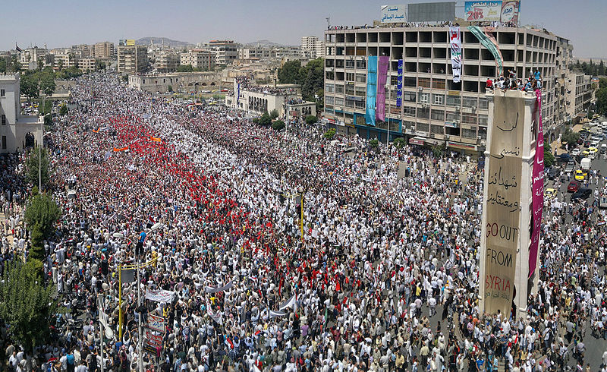
Protest and repression in Syria
Context
Syria as a police-state with Ba’athist ideology; comparative economic equality
Alawite religious minority as dominant in the military
Led by young ruler Bashar al-Assad
Patterns of protest and repression
Protests start 26 January, becoming a mass uprising by March 2011
Widespread, harsh repression, punctuated by minor concessions
Centered first in Daraa, then in Homs and Hama
Arab League attempts to negotiate a settlement; then active sanctions
Shift to a civil war
More than 4000 killed so far
Move from peaceful protest to armed rebellion in Homs
Low and mid-level army defections helped form the Free Syrian Army, which has increasingly launched attacks
Potential for widespread sectarian violence

Slide 6
Lecture terms—December 5-7
Pearl Square
Al-Wefaq
Al-Haq
Al-Khalifa
Muammar Qaddafi
Jamahiriyya
Benghazi
National Transitional Council
Ali Abdullah Saleh
Houthi Rebellion
Southern Movement
Joint Meeting Parties
Bashar al-Assad
Ba’ath Party
Alawites
Arab League
Free Syrian Army
2011 Tunisian elections
2011 Egyptian elections
2011 Moroccan elections

