Slide 1
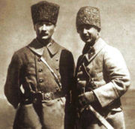
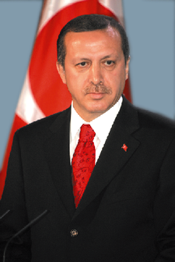
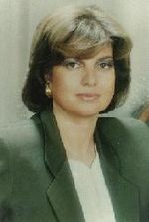
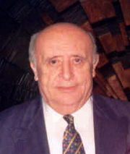
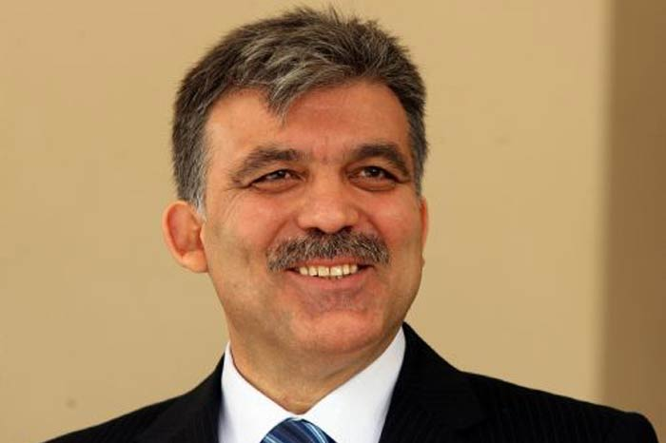
Some key figures in Turkish politics
Mustafa Kemal Ataturk
and Ismet Inonu
Recep Tayyip Erdoğan
Necmettin Erbakan
Tansu Ciller
Suleyman Demirel
Abdullah Gül

Slide 2
Timeline of Turkish Politics
1950: First democratic turnover
1960: Military coup against Menderes
1963: Association agreement signed with the EEC
1971: Military forces Suleyman Demirel’s resignation
1974: Turkey invades Northern Cyprus
1980: Military coup after violence increases; new constitution
1984: PKK launches war in the Southeast
1990: Turkey allows US to use its bases in attacks against Iraq
1993: Tansu Ciller becomes first female PM (True Path Party)
1995: Major Kurdish offensive; Welfare party wins elections and coalition haggling ensues; Enters EU customs union
1996: Erbakan becomes PM
1997: Erbakan forced to resign by the military; Mesut Yilmaz of the Motherland Party takes over
1998: Yilmaz resigns over corruption; Bulent Ecevit becomes PM; Welfare banned
1999: Ocalan captured in Kenya
2001: Virtue Party banned
2002: AK Party victory; Gul then Erdogan becomes PM
2007: AK Party wins again; Gul becomes President—dramatic secularist mobilization
2008-09: Major political standoff between the government and the courts
2011: AK Party wins a third time; senior military leaders stand down

Slide 3
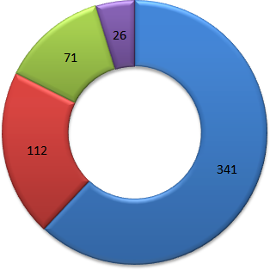
Turkish democratic development
Definition of the state
State as Kemalist
State as secular
State as Turkish?
State as European?
Turkey as a guided democracy
Who is doing the guiding?
The role of the military coup and the constitution
Key institutions
National Assembly and Prime Minister
President
Constitutional Court
National Security Council
Party system
Fragmented center-right/center-left system
Nationalist, Islamist, Kurdish parties
Role of the electoral threshold: 10%
MP distribution 2007-2011

Slide 4
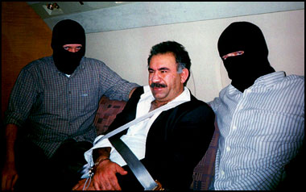
Civil conflict in Turkey
The role of minorities
Around 15% Kurdish
Around 15% Alevi
The Kurdish civil war
About 40,000 killed
The importance of Northern Iraq to the conflict
The capture of Abdullah Öcalan
A renewal of civil violence?
Right-left conflict
Battles between rightists and leftists in the 1970s
Political tensions over the role of Alevis
Abdullah Ocalan and friends

Slide 5
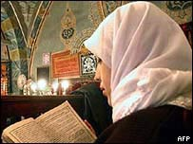
Islam and politics in Turkey
Types of political Islam
Militant: Hizbollah, Islamic Raiders of the Great East
Political parties
Islamic political development
Role of the military/schools as builders of Islamic institutions
Creation of the Welfare Party in the 1980s
Islamic parties as swing coalition parties
Rise of Erbakan as PM in 1995 as leader of the Welfare Party
Rise of the Virtue Party
The Justice and Development Party finds the sweet spot in Turkish politics
Key issues of contention
Corruption; Foreign policy
Palestine/Israel: Gaza flotilla
Veiling, Morality

Slide 6
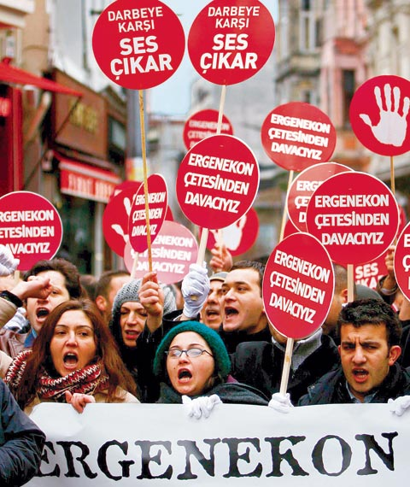
Civil-military relations
Military as constitutional guardians
Attempts to control a wayward democracy
Defend Kemalism against public threats
Attempts at constitutional reform
European Union negotiations as one catalyst
Limit punishments for insulting “Turkishness”
Reduce the autonomy of military officials
Direct public election of the President
Reduce autonomy of the Constitutional Court
The Ergenekon trial (2008-present)
Background in the Susurluk scandal (1996)
“Deep state” plans to overthrow the government
Implication of high military officers and intellectual
Accusations of AKP politicizing the trial
Strong feelings about the “deep state”

Slide 7
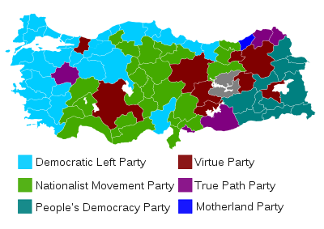
Regional voting in Turkey 1999

Slide 8
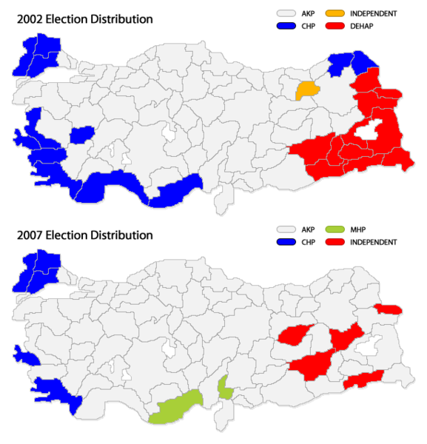
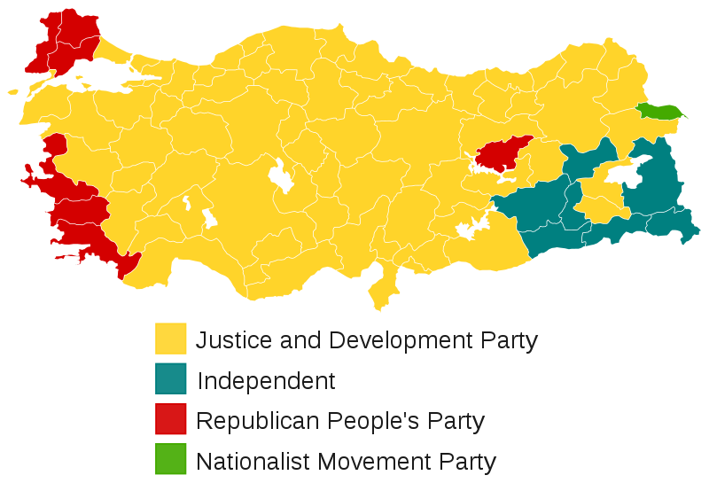
Consolidation of AKP party support 2002-2011
2011 parliamentary results

