Slide 1
Timeline of Saudi history
Ibn Saud
captures
Riyadh
and builds
a Saudi
state
Kingdom of
Saudi
Arabia is
proclaimed
after capturing
Mecca/Medina
Liberal
Princes
move to
Cairo
Two Saudi
kingdoms
formed
and collapsed
Oil is
discovered in
Saudi Arabia by
ARAMCO
Oil boycott
of the US
King Saud
takes power
Founding
of OPEC
King Saud
deposed by his
brother Faisal
1800s 1902 1932 1938 1953 1960/61 1964 1973
Islamists
seize
control of
the Grand
Mosque
Liberal and
Islamist
demands lead
to Basic Law
and Majlis
More
terrorism/
pressure
for reform
Khalid dies
and is
replaced
by King
Fahd
King Faisal
assassinated/
Khalid takes
power
First ever
municipal
elections
King Fahd dies/
succeeded by
Abdullah
SA takes
control of
ARAMCO
US troops
stationed for
Gulf War
Attacks on
US military
facilities
US
pulls out
1975 1979/80 1982 1990 1992 1996 2002/03 2005

Slide 2
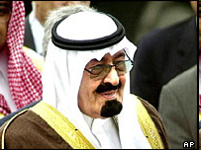
Saudi political institutions
State development
No direct experience with colonialism
Early political institutions were tribal and extremely informal
Importance of the king and tribal customs
Council of Ministers
The place where the next in line to rule have a power base
Key ministries are controlled by the royal family
Majlis al-Shura
Developed as part of the basic law of 1992
Started as 60 members, and ultimately increased to 150 members
Role: questions cabinet members and provides advice on decisions
Courts
Developed based on the shari’a and give out hudud punishments like beheading, amputations, and flogging
Municipal councils
2005 and 2011 elections filled ½ of municipal councils
2% of the population voted in 2011
Approve local budgets, suggest planning regulations, and oversee building projects
King Abdullah
The “cautious reformer”

Slide 3
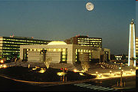
Family and distributive politics in Saudi Arabia
The family-run state
A’iliyya: familialism
Politics as doing what is right for the whole Saud family
Political relationships are based on promises of protection, a recognition of interdependence, and accountability to the family
To get things done, you need a powerful sponsor
The reputation of the family is exceptionally important as it can be traded as currency
Distributive politics
Oil wealth is distributed through the family across prominent families and reinforces family reputations
A group in the middle class is sponsored by a royal family member—they work to prevent further access to the royal distributive network
Jobs are given out by sponsors, not often by interviews
Headquarters of Saudi Aramco

Slide 4
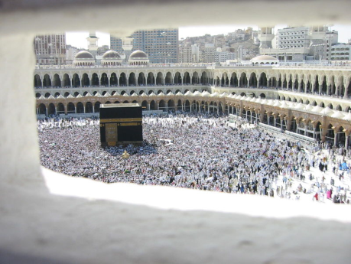
Religion and politics in Saudi Arabia
The Wahhabi alliance
Early alliance with a Wahhabi tradition of conservative politics
Saud alliance with the pious Sheikh family
Role of the ulema
Provide religious advice to the ruling family
Issue legal judgments “fatwas” in support of the ruling family
Example: fatwa given at request of the royal family to execute those who took over the Grand Mosque in 1979
Religious committees
Committee for the Promotion of Virtue and Suppression of Vice
Morality police that work to find and punish violations of shari’a
Fear as social control
Hajj/Great Mosque committees

Slide 5
Liberal and religious dissent
Shi’a riots
Minority Shi’a riots in the Eastern provinces
Iranian-sponsored Shi’a riots during the hajj on several occasions in the 1980s
Khomeini’s request for Shi’a to overthrow the Saudi state
Liberal dissent
Liberal petition “letter of demands” (1992)
Women’s drive-in
Recent women’s activism
Memorandum of Advice (1992)
Islamist critique of:
Ulema as subservient to ruling family
Lack of full application of the shari’a
Western-oriented foreign policy
Poor application of Islamic finance; skewed distribution of oil wealth
Islamist radicalism
Found the presence of US troops as a key objection
Represented foremost by al-Qa’ida
Bombed US barracks, attacks on foreigners in the kingdom
State response balances repression and “rehabilitiation”

Slide 6
The Future of Saudi Arabia
Key Issues
Will the government liberalize?
How will the country deal with Islamist challenges?
Will the country maintain its dependence on oil?
Can traditional Saudi culture be maintained?
What role will the country play in broader Arab affairs?

