Slide 1
Timeline of Moroccan politics
French
Protectorate
begins
Berber
Decree
(dahir)
Formation of
Istiqlal
(independence)
party
King
Mohammed V
Exiled
Hassan II
takes
power
Morocco
Becomes
independent
Leftist
UNFP
formed
Attempted
coups against
King Hassan
Green March
into Western
Sahara
1912 1930 1943 1953 1956 1959 1961 1971/72 1975
Free
elections
reward
opposition
PJD
Widespread
protest;
Constitutional
reform; PJD
wins elections
First full
legislative
elections
Casablanca
& Madrid
Bombings
mudawanna
Free elections
with low
turnout
Renewed
partial
elections
Mohammed VI
takes power
Widespread
protests
Union with
Libya
1981-84 1984-86 1993 1997 1999 2002 2003-04 2007 2011

Slide 2
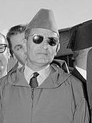
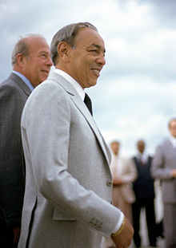
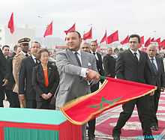
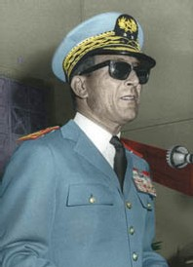
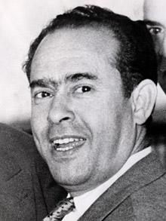
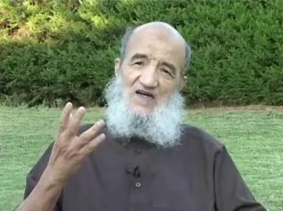
Key figures in Moroccan politics
King Hassan II
King Mohammed VI
King Mohammed V
Mehdi ben Barka (UNFP)
Abdessalam Yassine
(Justice and Charity)
General Mohammed Oufkir

Slide 3
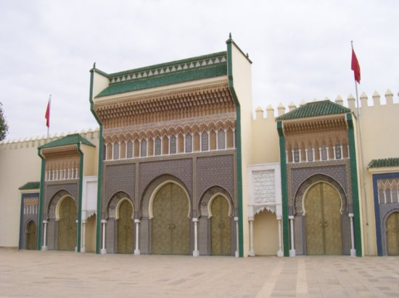
Organizing principles of Moroccan politics
Centrality of the Monarchy
King is known as a descendant of the prophet Mohammed, with religious legitimacy
“Commander of the Faithful” (amir al-mu’minin), who dispenses baraka
Controls resources and can exercise veto power over legislation
Popular patronage through the makhzen
Makhzen is a collective term for the palace its entourage: “sovereign ministries”
Access to political power and economic resources requires connections to the makhzen
Ministry of interior has dominant cabinet authority, controlled by the palace
All judges appointed by the King (mixed European and Islamic law system)
Limited legislative authority
Legislature increasingly operates freely, but can accomplish little without the support of the palace
Legislature is historically very fragmented, creating popular distrust and making it easy to control
Leads to regular stalemates on important political issues
Has led to low electoral turnout in even free elections

Slide 4
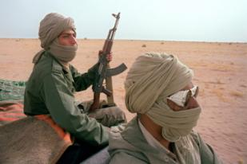
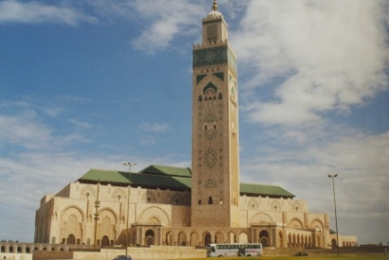
Identity politics in Morocco
Ethnic divisions: Arabs vs. Berbers
Arab conquests left them dominant over a majority Berber geography
Current estimates put Berbers at 30-50% of the population; use Amazigh language
Colonial privileges (berber dahir) gave political meaning to ethnic divisions
Berbers are dominantly rural and comparatively underprivileged
Islamic political identities
Contest over Islamic identity between the state and opposition
Small groups of radical Islamists (ex: Salafiyya al-Jihad)
Large Justice and Charity (al-Adl wal-Ihsan) movement, which rejects the rules of Moroccan politics and has openly challenged the monarchy
Participatory political movement contests elections: Justice and Development (PJD)
Nationalism in Western Sahara
Moroccan occupation of Western Sahara for both economic and political reasons
Polisario front has fought an on and off war for independence, supported by Algeria
Current stalemate over a potential UN referendum

Slide 5
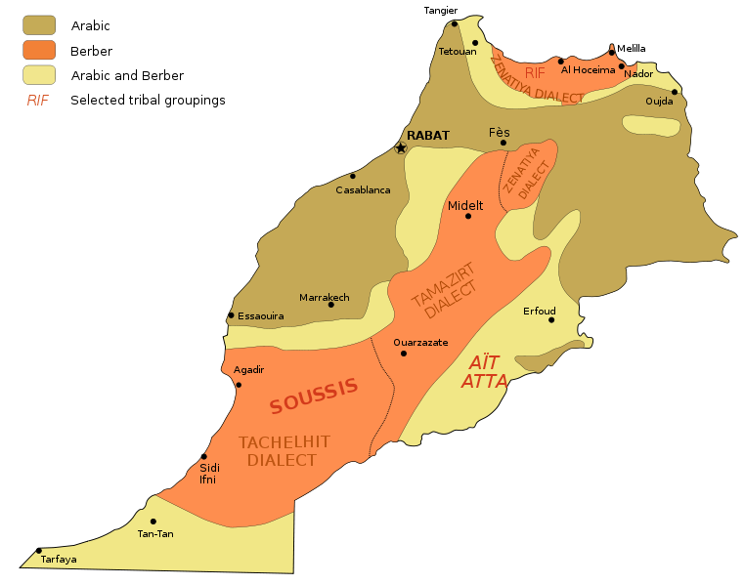
Ethnic diversity in Morocco

Slide 6
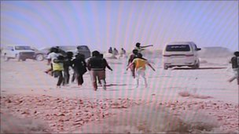
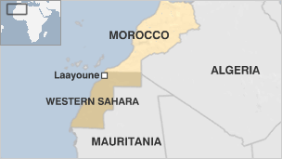
Political aspirations in Western Sahara
Protesters clash with security
forces in Western Sahara
A new round of UN-sponsored peace
talks took place in the US

Slide 7
Elections and party politics
Gradual expansion of electoral rights
Elections have gradually become more important, and increasingly free and fair
Legislative powers over policy outcomes lag behind
Fragmented party system
Divisions between loyalist (conservative) parties, leftists, and Islamists
Electoral rules have facilitated party divisions, which have been used to the advantage of the palace
A new “king’s party”: Party of Authenticity and Modernity (PAM) shows the continued use of access to the makhzen
The potential for constitutional reform
Will the monarch allow himself to be challenged by an increasingly outspoken legislature?
Can power of the sovereign ministries be reduced or distributed more evenly?

Slide 8
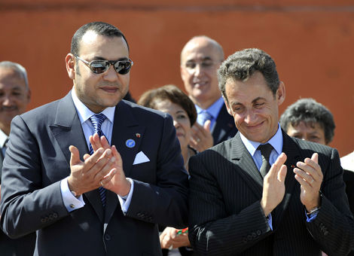
Major political issues
Human rights
“Years of Lead” under Hassan II led to repression and torture
Secret prison of Tazmamart as a symbol of regime injustice and change under new king
Women’s rights expanded under a progressive family code: mudawanna (2004)
Protest as an increasingly dominant form of challenge
Economic development
Morocco is comparatively poor and rural areas are widely impoverished
Largest economic sector is agriculture; phosphates as the principal mineral resource
Emerging manufacturing center with tourism as a key economic contributor
Experiments with free trade agreements (US-2004), Arab Maghrib Union (1989-)
Foreign affairs
Extensive ties to France and Spain
Pro-Western in most foreign policy decisions; population is more regionally focused
Longstanding rivalry with Algeria has limited the potential of the Maghrib Union
Has led to low electoral turnout in even free elections

Slide 9
Lecture terms—November 28-Dec 2
Mohammed V
Makhzen
Commander of the Faithful
Hassan II
Green March
Berbers
Polisario
Mohammed VI
Istiqlal
Justice and Development Party (PJD)
1980 Turkish coup
Abdullah Ocalan
Tansu Ciller
Necmettin Erbakan
Welfare Party
Tayyip Erdogan
Justice and Development Party (AKP)
“Republic of Fear”
Saddam Hussein
UNSCOM
Moqtada al-Sadr
Sunni triangle
United Iraqi Alliance
Nuri al-Maliki

