Slide 1
Waves of liberal reform
Economic liberalization vs. political liberalization
Liberal economic experiments were started in the late 1970s and 1980s
Can you economically liberalize without political liberalization?
Characteristics of liberal reform
Reconvening old national assemblies
Increasing the number of people who can vote
Letting up on the media
Allowing for freedom to organize and legalizing parties
Wave 1: 1985-1992
Characteristics
Examples
Closing down of reform projects by the mid-1990s
Reasons
Examples
Wave 2: 1999-2005
Characteristics
Examples
How has the Iraqi example affected broader trends in democracy in Wave 2?

Slide 2
Why reform?
Reform as a response to protest
Diversion theory: liberal reform protects the state from popular pressures
Reform as a response to international pressures
International pressure matters, but it can be dealt with without serious costs
Reform as a tool to divide and manage the opposition
Split or discredit the opposition to make them weaker
The emergence of young dynastic leaders
Their opportunity for reform
Constraints on their reform efforts

Slide 3
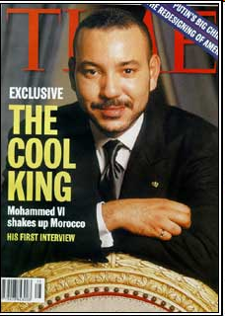
Why reform?
Reform as a response to protest
Diversion theory: liberal reform protects the state from popular pressures
Reform as a response to international pressures
International pressure matters, but it can be dealt with without serious costs
Reform as a tool to divide and manage the opposition
Split or discredit the opposition to make them weaker
The emergence of young dynastic leaders
Their opportunity for reform
Constraints on their reform efforts

Slide 4
The limits to reform
When reform becomes too risky
Importance of democratizing examples
Electoral rules as a tool to limit the opposition
Design a system that effectively constrains the opposition
Institutional powers as a tool to limit the opposition
Design constraints on parliamentary authority
Islam as a constraining factor
Major opposition groups are usually Islamist in character, but their commitment to democratic turnover is sometimes open to question
Under-institutionalized states with no horizontal accountability
State power tends to be centralized, with little horizontal accountability
Vertical accountability would not effectively reign in new leaders

Slide 5
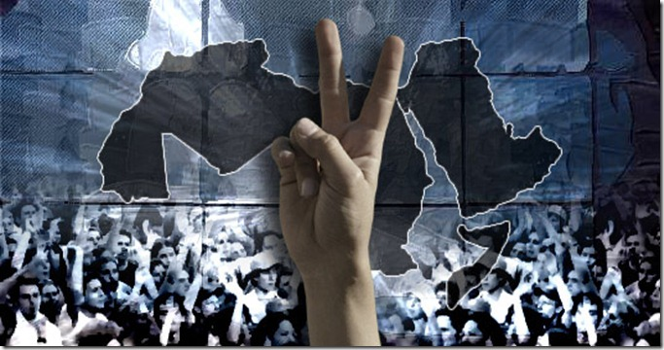
The Arab revolts of 2011
Context
They didn’t come out of nowhere, but timing and locations were a surprise
Modest reforms and rollbacks had been happening for two decades
Iran’s “Green Revolution” as a precursor
Mass Lebanese political mobilization during the “Cedar Revolution” (2005-2008)
Technological revolution in satellite news, mobile phones, and social media
Causes
Grievances
Reforms closing down and greater political repression
Expanding global economic crises, including a sharp jump in food prices
Lack of opportunity for an educated and growing youth demographic
Opportunities
Rapid sharing of new information puts more power in the hands of citizens
Aging leaders made succession battles loom large
Divisions among key government leaders made defections possible

Slide 6
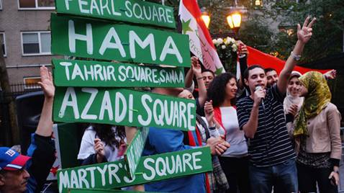
Patterns of revolt and change in 2011
Patterns
Observation effect through open media channels helps explains rapid spread
Remarkable efforts at non-violence by protest movements in most countries
Leaders respond by alternating between strategies of concession and repression
Regional interference (NATO, Sudan in Libya) (Saudi Arabia in Bahrain)
Revolts largely have a youthful, middle class dynamic
Current Outcomes
“Successful” revolutions: Egypt, Tunisia
“Repressed” revolutions: Syria, Bahrain, Algeria
“Pre-empted” revolutions: Saudi Arabia, Morocco, Oman
Civil conflict: Libya, Yemen

Slide 7
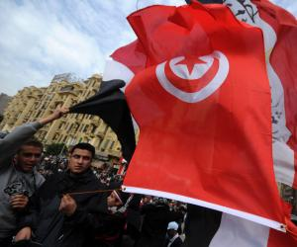
Revolution and political change in Tunisia
Context
Economic liberalization coupled with political repression and cult of personality
History of secular public values and European ties
High potential for civil society, but actively monitored
Active labor organizations; repressed and underground Islamist organizations
Small, relatively professional military; urbanized semi-professional bureaucracy
Causes
Grievances
High levels of family patronage and corruption in the ruling class
Ben Ali’s early political openings were gradually closed down with force
Lack of opportunity for expanding youth demographic
Opportunities
Clear symbol of economic and political injustice (Mohammed Bouazizi’s death)
Military defection in the wake of mass protests
Political change
“Jasmine Revolution” occurred largely peacefully
Regime fumbled to appoint a PM (Ghannouchi then Mebazaa)
Continued protests forced change to occur more rapidly
Elections for a constitutional assembly bring the Al-Nahda party to power (October)

Slide 8
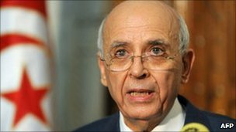
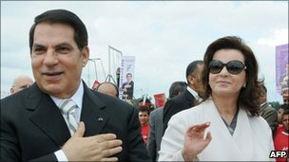
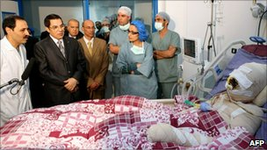
Tunisia
Timeline:
Economic protests break out
Ben Ali flees to Saudi Arabia
Mohammed Bouazizi self-immolation
Bouazizi funeral
US summons ambassador
Riots leave dozens dead
Interior minister fired
Mass protests
Ben Ali concessions
Dec 27
Dec 20-28
Jan 5
Jan 7
Jan 10
Jan 12
Jan 13
Jan 14
Jan 15

Slide 9
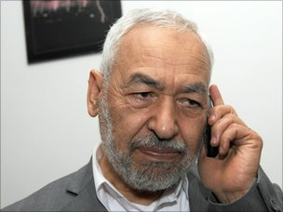
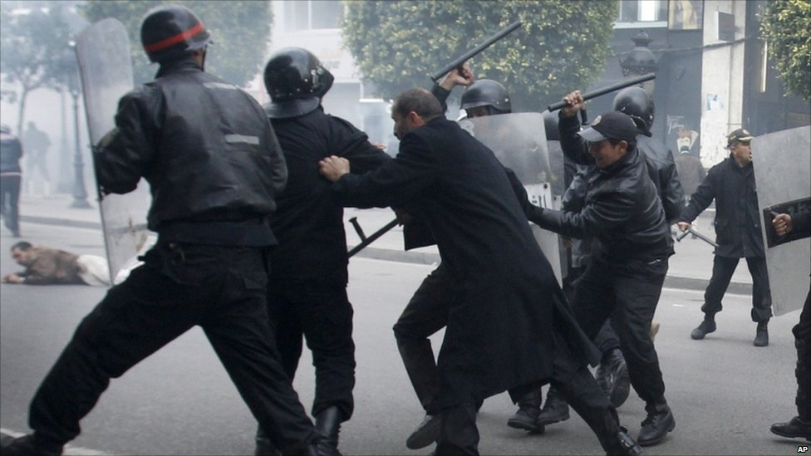
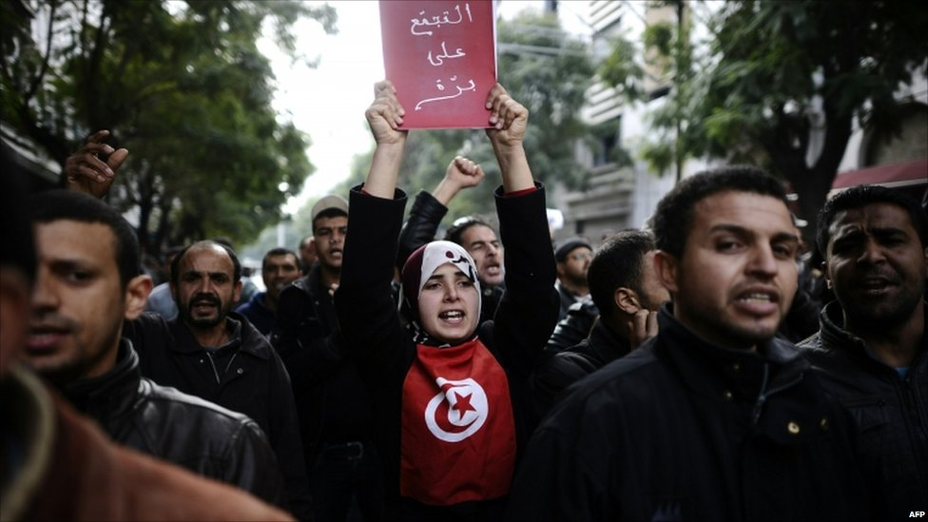
Tunisia continued
Timeline:
Fighting between security forces and loyalists
Parliament speaker Mebazza takes power
Opposition quits govt., protests resume
Police protest interim govt.
PM Ghannouchi takes power
Anti-RCD protests
Unity govt. announced
Leaders leave RCD
Party ban lifted
Protests lead to new govt.
Islamist leader returns
Jan 14
Jan 15
Jan 16
Jan 17
Jan 17
Jan 18
Jan 19
Jan 20
Jan 22
Jan 27
Jan 30

Slide 10
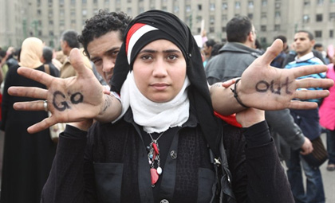
Revolution and the potential for change in Egypt
Context
National Democratic Party (NDP) dominates through managed electoral competition
Economic growth, then crisis, with rising prices
Military is popular but has entrenched economic interests
Causes
Grievances
Corruption amid economic expansion led to a 2-tier society
Stark lack of opportunity among educated youth
2010 elections were too fraudulent, causing challengers to doubt participation
Opportunities
Divisions and uncertainty over who would succeed the aging Mubarak
Collective network built around “kefaya” movement and 2004-2005 protests
Online protest networks: “April 6 Movement” and “We are all Khaled Said”
Tunisian example caught the public imagination
Development
Gradual agreement to some political reforms as popular demands kept increasing
Attempts to use vigilantes to deter the protesters
Military strategy finally fails and key officers decide to sacrifice Mubarak
Cautious rule by military tribunal in preparation for elections (SCAF)
Continued popular protest against the slow pace of reforms and lack of accountability

Slide 11
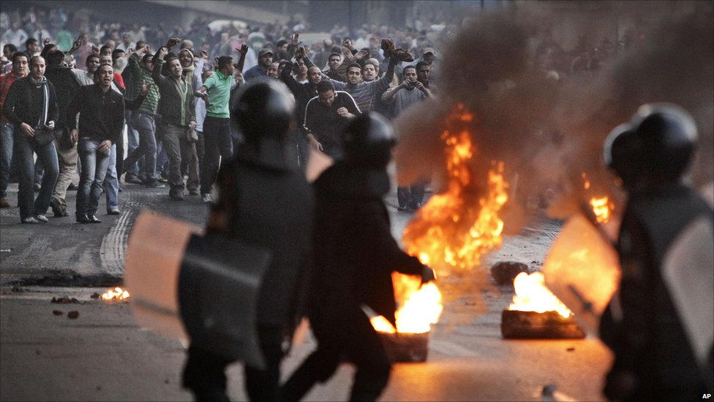
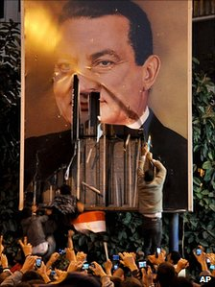
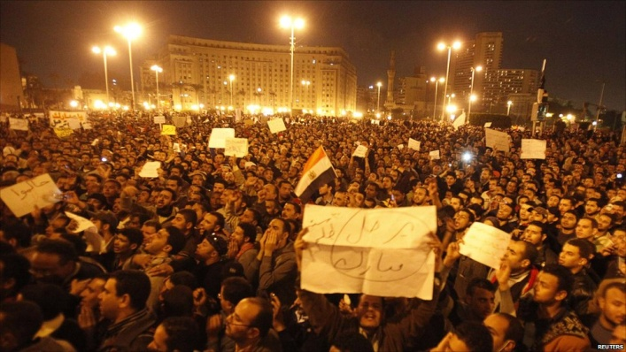
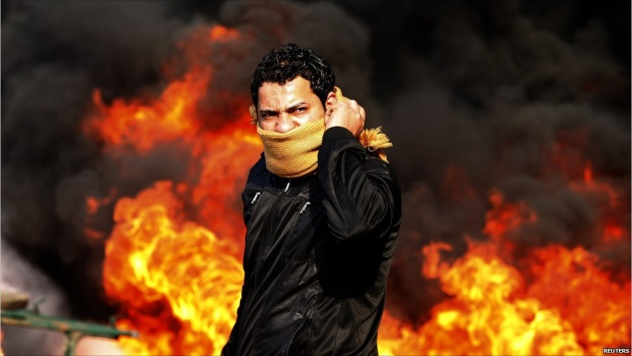
Egypt
Timeline:
Protests build; el-Baradei returns
Major clashes with riot police
Curfew broken; Mubarak dismisses govt.
Military leaves protesters alone
Mubarak says he’ll quit in Sept
Pro- vs. anti- Mubarak clashes.
NDP rulers resign; talks with opposition
1st “day of revolt”
Crackdown on protests
VP Suleiman
appointed
Mubarak ousted
Jan 25
Jan 26
Jan 27
Jan 28
Jan 28
Jan 29
Jan 30
Feb 1
Feb 2
Feb 5
Feb 11

Slide 12
Lecture terms—October 26-November 2
Shari’a
Madrasa
Ulema
Jihad
Shura
Muslim Brotherhood
Sayyid Qutb
Crisis-based reform
Generational reform
1991 Algerian elections
Electoral management
Arab Spring
Mohammed Bouazizi
Zine el Abidine Ben Ali
Hosni Mubarak
Mohamed el-Baradei
Supreme Council of the Armed Forces (SCAF)
2011 Tunisian election
Al-Nahda

