Slide 1
Islam as a political force
Relative importance
Most significant social organization outside of the family is through Islamic institutions
Islamic institutions include: mosque (Friday sermon); religious schools (madrasas)
Key concepts in political Islam
Role of the Qur’an
Apostasy
Shari’a
Jihad
Hakamiyya
Importance of piety, social justice, and order
Why does Islam become politicized?
Religious view
Protest view
Institutional view

Slide 2
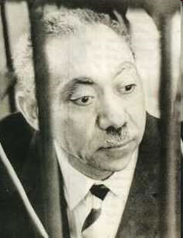
Manifestations of political Islam
Early developments
Muslim Brotherhood in Egypt
Key ideologue: Sayyid Qutb
States often supported Islamists
Key events
Arab defeat in 1967
Iranian revolution in 1979
Assassination of Anwar Sadat in 1981
War against the Soviets in Afghanistan
Sudanese formulation of an Islamic state in late 1990s
Attack in New York and DC in 2001
Iraq as the new Afghanistan
Welfare and social service provision
Education, scholarships, food, sanitation
As a protest movement
Key leaders of street protests against regimes
Use of media/Friday sermon; headscarf as a political symbol
As political violence
Assassination of government officials, judges, intellectuals; killing tourists (Egypt)
Suicide bombings of police/military (esp. Palestine/Lebanon/Iraq)

Slide 3
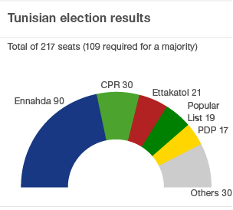
Tunisian election results

Slide 4
Islamists and the state
The Islamist threat
State-led Islamism vs. opposition Islamisms
Islamists as a competitor to the state
Attempts to co-opt Islamic institutions
Why are Islamists considered a threat to the state?
Participatory Islamist movements
Formation of Islamic political parties where available
Strategic decisions about participation vs. opposition
Increasing numbers of participatory movements
What are the effects of participation on Islamist movements?
Splits in Islamist movements
Movements often split over whether or not participation is the right way to go
Is Islamism on the rise or in decline?

Slide 5
Lecture terms—October 26-November 2
Shari’a
Madrasa
Ulema
Jihad
Shura
Muslim Brotherhood
Sayyid Qutb
Crisis-based reform
Generational reform
1991 Algerian elections
Electoral management
Arab Spring
Mohammed Bouazizi
Zine el Abidine Ben Ali
Hosni Mubarak
Mohamed el-Baradei
Supreme Council of the Armed Forces (SCAF)
2011 Tunisian election
Al-Nahda

