Slide 1
World War II
Turkey
Neutral until the very end of the war
Iran
Divided between Russian and British troops
Arab states
Axis marched through North Africa to try to cut off British supplies and entered Egypt; were forced back and ultimately defeated in Tunisia
Britain made Egypt a focal point for stationing troops in the Mediterranean
Anglo-Iraq war of 1941, in which Iraq tried to assert full sovereignty during the war and forced Britain to occupy the country for the rest of the war
Syria and Lebanon taken over by the Germany-allied Vichy French regime
North Africa
Massive numbers of North Africans were recruited into the war to fight for the French
Led to high expectations for independence or new rights after the war
1945 Setif revolt turned into a massacre of civilians by the French; political repression and huge development discrepancies between the pieds noirs and native Algerians
By 1954, the Front for National Liberation (FLN) was created as an Algerian independence movement
Britain took over Italy-controlled Libya in 1943

Slide 2
Palestine and the Birth of Israel
Palestine
Jews sided with Britain during the war, but prepared to fight them and launched attacks against British interests
By 1947 Britain just wanted out and turned Palestine over to the United Nations
The UN recommended that Palestine become independent as two states
Britain pulled out of Palestine rapidly in 1948, leaving a power vacuum; Jewish forces attacked Arabs within the borders of the proposed Jewish state
The next day, Egypt, Syria, Lebanon, Transjordan, and Iraq invaded Israel, starting a war that lasted 6 months; the attack was poorly coordinated and the Arab armies were smaller than the Jewish defense force; considered a disaster (nakhba) in Arab states
As a ceasefire was concluded, Israel had expanded its borders and there were 700,000 Palestinian refugees outside of Israel

Slide 3
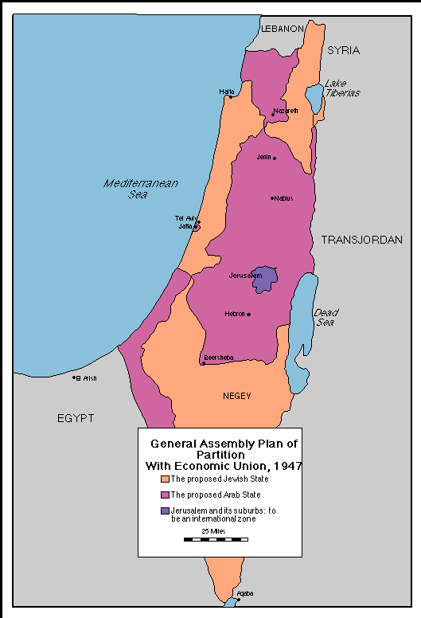

Slide 4
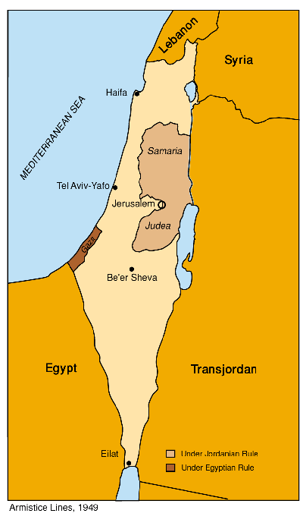

Slide 5
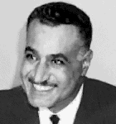
Rise of Nasser
The Coup of 1952
Increasing social unrest in the early 50s, with militant activities by the Muslim Brotherhood, and open conflict between the British and Egyptians
A coup was led by a group of young military officers (Free Officers), with a senior officer as the official head of the group (Mohammed Naguib)
Overthrew King Faruq, and targeted severe economic inequalities
An attempt to avenge the disaster of 1948
Arab Socialism
Led by Nasser and the Revolutionary Command Council
Initiated land reform as its first big project, then industrial and educational reform
Extensive nationalization of industries, commercial enterprises, and media
New constitution with a new national assembly, guided by a very powerful Nasser, elected only in a plebiscite
Egypt became increasingly a police state

Slide 6
Suez Crisis and Arab Military Coups
The Suez Crisis of 1956
Nasser negotiated a British withdrawal by 1956, as well as the independence of Sudan
Nationalized the Suez canal in an attempt to defy the West and to generate income for his development projects
Britain, France, and Israel invaded, but the UN (backed by the US and Soviets) firmly intervened, forcing a ceasefire
Nasser emerged a hero, and grateful especially to the Soviet Union for its support
Implicated Western Europe as military allies of a hostile Israel
Other Arab Military Coups
Syria: Military coups started in Syria in 1949 and continued until 1954
In the 1954 elections, two forces emerged: a nationalist/socialist Ba’ath (Resurrection) Party, and the Communists
Iraq: Under King Faisal and his son until 1958; pro-Western orientation
Military coup in 1958 by Abd al-Karim Qasim killed off the royal family; subsequent military regimes until 1968—tried unsuccessful revolutionary land reform
Military was challenged by two political forces, Communists and Ba’athists
Coup led in part by Saddam Hussein and other Ba’athists took power in 1968

Slide 7
Arab Nationalism and the Cold War
Arab Nationalism and the United Arab Republic
Nasser dreamed of uniting Arabs under a common nationalism and government
A continuation of a nationalist trend going on since the fall of the Ottoman Empire
United Arab Republic created with Syria in 1958
By 1963, Alawite military officers, including Hafez al-Asad staged a coup in Syria
The Impact of the Cold War
Nasser turned away from the British and sought Soviet arms and help in constructing the Aswan High Dam
In 1958 the USSR agreed to finance the Aswan Dam project and provide ongoing military assistance
Eisenhower Doctrine (1957) tried to create regional allies for the US by promises of economic and military aid
Strong US support for Israel, Turkey, Iran, and Morocco

Slide 8
War and independence in North Africa
The Algerian War of Independence (1954-1962)
France lost a long war to keep Vietnam by 1954
National Liberation Front (FLN) was formed to press for armed revolt in 1954
By 1962, the French settlers decided it was a losing battle, and moved en masse back
Staggering losses: somewhere between 300k and 1m war dead
Suffered an early military coup, then led by Boumedienne as a military socialist state
Qaddafi’s revolution in Libya
Libya became independent under King Idris in 1953; recovering from the Italian occupation in which up to 1/3 of the population of Libya had died
Qaddafi led a coup and tried initially to follow Nasser’s Free Officer script; got the British and Americans to withdraw their military bases, nationalized the oil company
Independence in Tunisia and Morocco
Active revolutionary movement in Tunisia led by labor unions and a political party called the Neo-Destour (New Constitution) led by Habib Bourguiba
Because it was not their highest priority, the French offered Tunisia autonomy and Bourguiba turned this into independence by 1956
He led a socialist, modernizing, secularizing campaign in Tunisia—had himself declared President for Life
The Moroccan Sultan, Mohammed V, was a key force for independence, in conjunction with the Moroccan independence party (Istiqlal)
Hassan II took over after Mohammed V’s death in 1961

Slide 9
Israel and the Palestinians
Growth of the Israeli state
Dominated by the figure of David Ben Gurion, the first Prime Minister, until about 1963
Established a parliamentary democracy, with a unicameral legislature (Knesset); became a very fragmented party system
Law of Return: Huge amounts of immigration post-WWII
Big debates over the role of religion in the Jewish state
Increasing orthodox control over the religious apparatus and functions of the state
Siege mentality of security, required military service
The issue of Palestinian refugees
A million Palestinian refugees registered with the UN in refugee camps in Jordan, Lebanon, Syria, Gaza
The Birth of the PLO
Formed by the Arab League in 1964 in Cairo to deal with the Palestinian situation
Active Palestinian guerrilla activity based out of Jordan after the 1967 war
Umbrella organization for militias like al-Fatah, led by Yasir Arafat; Arafat became chairman of the PLO in 1969—focused on Palestinian nationalism w/armed resistance
Clashes between Palestinian guerrillas and the Jordanian military in 1970
PLO moved its base from Jordan to Lebanon and increasingly became involved in international terrorist activities
Also tried diplomatic activities, like coming before the UN (1974)

Slide 10
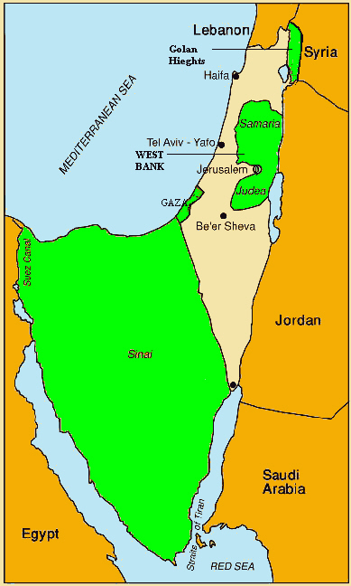

Slide 11
Israeli-Arab Wars and the rise of the Likud
June War of 1967
A result of a long-standing tense situation of threat and counter-threats
Arab states formed a mutual defense pact with Egypt (Syria, Iraq, Jordan)
Israel struck first, destroying the Egyptian air force on the ground
The war lasted all of six days and redrew the map of Israeli control
About 400,000 new Palestinian refugees were created
Israel now administered territory over 1.5 million new Palestinians
Huge psychological shock for the Arab world; inflation of Israeli confidence
UN resolution (242) called for the Israeli withdrawal from conquered territory was not implemented—objections to recognizing Israel and differing interpretations
War of 1973
In October 1973, Egypt and Syria launched coordinated attacks on Israeli positions, moving into the Golan Heights and the Sinai peninsula with much success
The Sinai peninsula was returned to Egypt in 1979
The rise of Likud in 1977
Success of the Likud coalition led by Menachem Begin over the long dominant Labour coalition
“Revolt of the Sephardim;”
Expansionist idea of Israel—important role of expanded Jewish settlements in Gaza and especially the West Bank

Slide 12
Independence in Yemen and Persian Gulf States
Civil war and division in Yemen
In 1962, the military ousted the imam of Yemen and declared a republic
Turned into a civil war fought between the Imam and Republican rebels
In 1967 Britain withdrew from Aden and was replaced by a Marxist government in South Yemen
The Yemens thought about uniting in 1979, but waited until 1990
Independence in the Gulf and merger of the Emirates
Most of the Gulf states gained independence in 1971
Kuwait became independent in 1961 and created a national assembly under the ruling family
Family coup in Oman
Oman under Sultan Sa’id was very removed from the world
Sai’d overthrown by his son Qabus in 1970 and ultimately stopped the rebellion and expanded modern services, schools, etc.

Slide 13
Key lecture terms—September 22
Confessional system (Lebanon)
Setif Massacre (1945)
War of 1948
Gamal Abd al-Nasser
Suez Crisis
Ba’ath Party
United Arab Republic
Hafez al-Assad
Saddam Hussein
National Liberation Front (FLN)
Muammar Qaddafi
Jamahiriyya
Habib Bourguiba
Mohammed V
Hassan II
Green March
War of 1967
Law of Return
Sephardic vs. Ashkenazi Jewry
Palestinian Liberation Organization (PLO)
Black September (1970)
Yasir Arafat

Slide 14
Key lecture terms—September 28
War of 1973
Anwar Sadat
King Hussein
Menachem Begin
Sultan Qabus
Democratic Party (Turkey)
Mohammed Mossadeq
White Revolution
Ayatollah Khomeini

