Slide 1
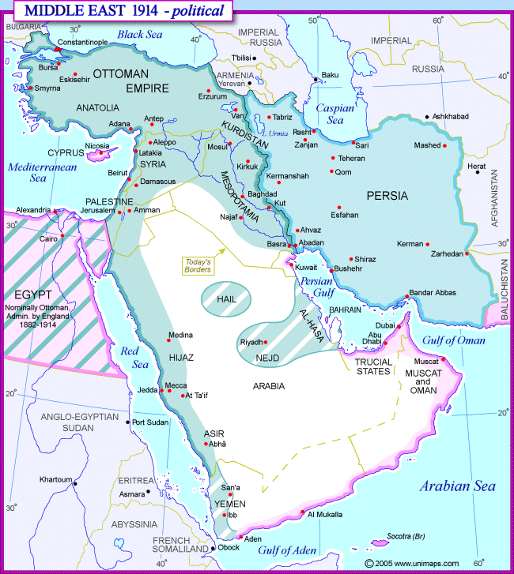
The Middle East in 1914

Slide 2
North Africa in 1914

Slide 3
World War I and the end of the Ottoman Empire
Ottoman decision to side with Germany against Russia (1914)
Stresses and reform during the war
One million soldiers activated
Elimination of capitulation agreements
Mobilized Islamic symbols and called for a jihad
Authoritarian control and repression in the Arab provinces
Key fronts and battles
Constant warfare with Russia in the East
Mass relocations and killing of Armenians
Battle of Gallipoli to capture Istanbul and open Russian supply lines
Battles with the British in Iraq and Egypt
Sharif Husayn of Mecca made agreements with Henry McMahon, British High Commissioner of Egypt for an Arab Revolt and a future Arab state

Slide 4
Territorial agreements
McMahon’s agreement with Sharif Husayn
Ambiguity around Palestine; coastal Syria possibly excepted
Sykes-Picot agreement (1916)
Secret treaty between Britain and France
Divided the Middle East between them (France—Syria/Lebanon region; Britain—Iraq; International—Palestine)
Contravened the McMahon promises to Husayn
Balfour Declaration (1917)
From the British foreign secretary to Zionist leaders pledging to support Jewish settlement in Palestine
Required British support in Palestine to make it work
Treaty of Sevres (1920)
Disposition of Ottoman territory after the war
Recognized an independent Armenian state, and Kurdish autonomous zone
Created the mandate system, designed by the League of Nations
British over Palestine and the new State of Iraq (based in 3 Ottoman provinces)
France to govern over Syria

Slide 5
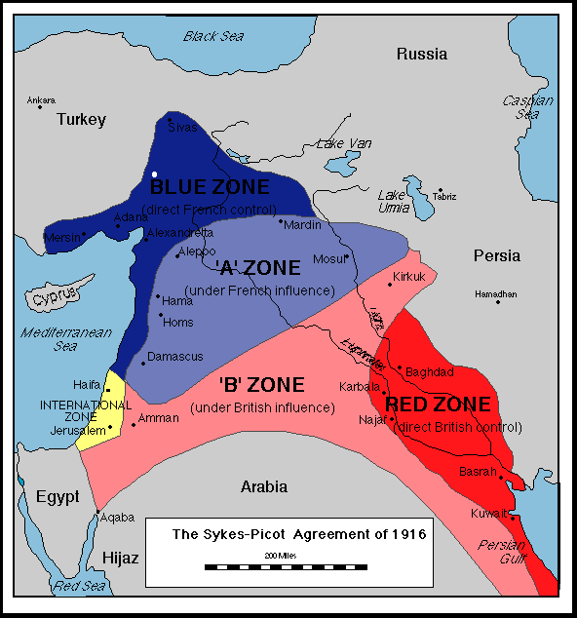

Slide 6
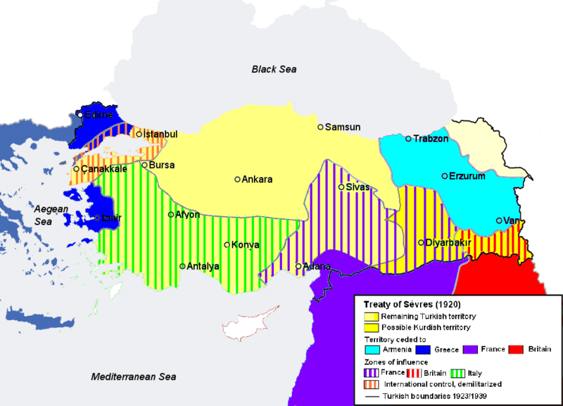

Slide 7
Mandate territories
The Syrian Kingdom and Transjordan
Amir Faisal vs. the French for control over Syria
Britain has an idea of how to use Faisal and his brother Abdallah
Governing Structure
Traditional leaders during the Ottoman period retained influence
New identities created and new bureaucracies to match the new borders
Pressure for fragmentation/regionalism, pan-Arabism, and pan-Islamism
British Indirect Rule
Allowed official independence for Egypt (protectorate) and Iraq, but required a British military presence and British control over foreign policy
French Direct Rule
Importing of bureaucracies; marginalization of Ottoman era elites, gave natives little experience in self-governance

Slide 8
Mandate territories: Britain
Britain in Egypt
Egyptian resources were crucial to the WWI effort, and so Britain wanted to stay in Egypt, but Egyptians resented the extraction of resources in the war
Wafd delegation and protest movement by Sa’ad Zaghlul—nationwide upheaval known as the Revolution of 1919 that the British put down by force
Britain declared Egypt as independent in 1922, with major caveats on foreign affairs
Britain in Iraq
Arbitrary conglomeration of 3 separately administered Ottoman provinces
Over half Shi’a, with ties to Iran; remaining Arabs Sunnis—whom the British supported in their rise to power; 20% Kurdish; many tribal confederations of various types
Large uprising in 1920 against the British, suppressed with significant loss of life
After 1920, Britain had a strong interest in very indirect rule and installed King Faisal
Gradually increased Iraqi autonomy, with “independence” in 1932
Britain in Palestine
Palestine was initially an international zone under Sykes-Picot, but was given to Britain as a mandate territory with the Treaty of Sevres (1920)
Emerging Zionist movement in Europe found a sympathetic ear in Britain
Palestine was under British military occupation during WWI
Attempts as an arbiter between the Zionist movement and a large Arab population
Palestinian leadership organized under a weak Arab executive
Zionist organizations were much more significant, well-organized and managed

Slide 9
Mandate territories: France
French in Syria
Divided Syria up administratively into geographic and ethnic regions
Political life was dominated by Sunni Muslims; minorities went into other areas (military)
Massive revolt against the French presence in 1925-27
Formation of a native political organization called the National Bloc from the old Ottoman elite
French in Lebanon
Thought of themselves as the protectors of the Maronite Christians in Mount Lebanon; created Greater Lebanon in 1920, which gave the Maronites the largest state in which they would be a plurality (30%)
Composed of Maronites, Shi’a Druze, Sunni, regular Shi’a
National Pact (1943): Confessional political system
Independence
French forces reluctantly left Syria and Lebanon in 1946

Slide 10
French colonial possessions
Algeria
Divided between those French Algerians who wanted greater integration into France, and those who rejected French control over Algeria
French rejection of proposed measures giving a number of native Algerians the vote, created increasing nationalism and the Islamic salafiyya movement
Tunisia
Formation of the Neo-Destour (new Constitution) party which led mass protests against the French presence
Morocco
Tribal revolt against the French in the Rif mountains that lasted 14 years (1921-1935) led by Abdul Krim
Quiet until an independence movement started emerging in the 1940s

Slide 11
Reform in Turkey and Iran
Turkey
Turkish “war for independence” based in Anatolia and led by Mustafa Kemal (Ataturk)
Wrote the National Pact, that defined Turkish sovereignty over the Turkish majority
Treaty of Lausanne (1923) ultimately gave Turkey sovereignty
Abolition of the Sultanate, and later the Caliphate
Mass exchange of Greek and Turkish populations
Ideology of Kemalism
Abolishment of shari’a and replacement with the Swiss civil code
Introduction of a new alphabet; free and compulsory elementary education
Iran
Strong British presence helped create anti-foreign nationalism
A Colonel, Reza Khan, forced the Shah to abdicate and started the Pahlavi dynasty
Built the military up and expanded state bureaucracy; controlled the tribes
Secularization program; incorporation of the French civil code (1928)
Dress and hat legislation; banned the veil
Programs of state industrialization
Couldn’t control British oil interests

Slide 12
State-building in Saudi Arabia
Saudi Arabia
Sharif Husayn lost out at the end of WWI
Ibn Saud emerged to unify Arabia as a tribal chief
Ibn Saud created an alliance with Wahhabi religious leaders and conquered Mecca in 1924, driving Sharif Husayn into exile
Britain established treaties with Ibn Saud, became a recognized state in 1932
Ibn Saud had 41 sons, making it possible so he could staff his government with family
Was a poor desert kingdom until oil was discovered in 1938
Built a legal system on the shari’a; distinctively independent from Europeans

Slide 13
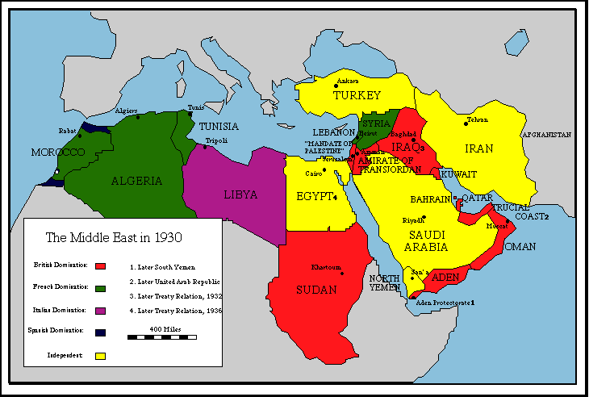
The Middle East and North Africa in 1930

Slide 14
Key lecture terms—September 26
Bazaaris
Majlis
Sharif Husayn
Sykes-Picot agreement
Balfour declaration
Treaty of Sevres
Mandate
Amir Faisal
Amir Abdullah
Mustapha Kemal Ataturk
Kemalism
Republican People’s Party (RPP)
Reza Khan
Wafd
Muslim Brotherhood
Arab League
Ibn Saud
Zionism
Aliyah
Peel Commission
David Ben Gurion
Maronite

Slide 15
Key lecture terms—September 28
Confessional system (Lebanon)
Setif Massacre (1945)
War of 1948
Gamal Abd al-Nasser
Suez Crisis
Ba’ath Party
United Arab Republic
Hafez al-Assad
Saddam Hussein
National Liberation Front (FLN)
Muammar Qaddafi
Jamahiriyya
Habib Bourguiba
Mohammed V
Hassan II
Green March
War of 1967
Law of Return
Sephardic vs. Ashkenazi Jewry
Palestinian Liberation Organization (PLO)
Black September (1970)
Yasir Arafat

Slide 16
Key lecture terms—September 27
War of 1973
Anwar Sadat
King Hussein
Menachem Begin
Sultan Qabus
Democratic Party (Turkey)
Mohammed Mossadeq
White Revolution
Ayatollah Khomeini

