Slide 2
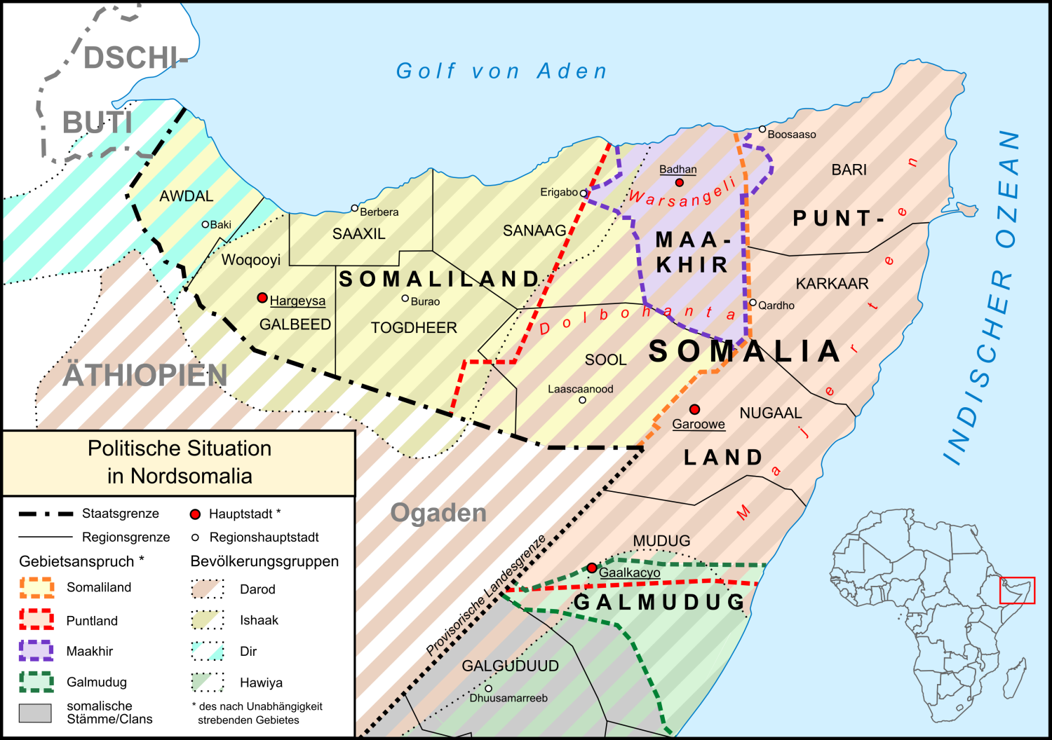
https://www.youtube.com/watch?v=XhILxtQYSxw
[Short version 3’]
https://www.youtube.com/watch?v=w4UhZZQNrw4
[Longer version 25’]

Slide 5
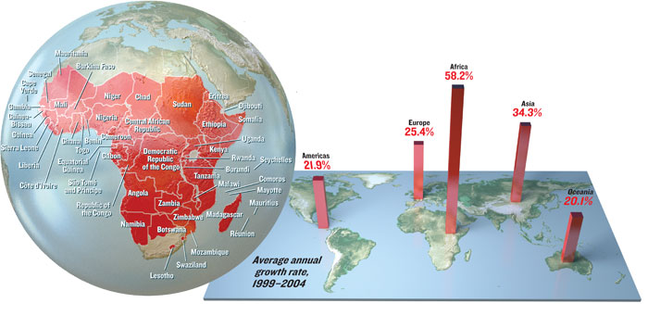
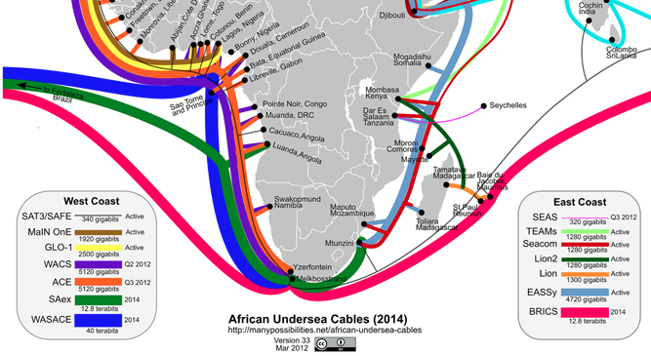
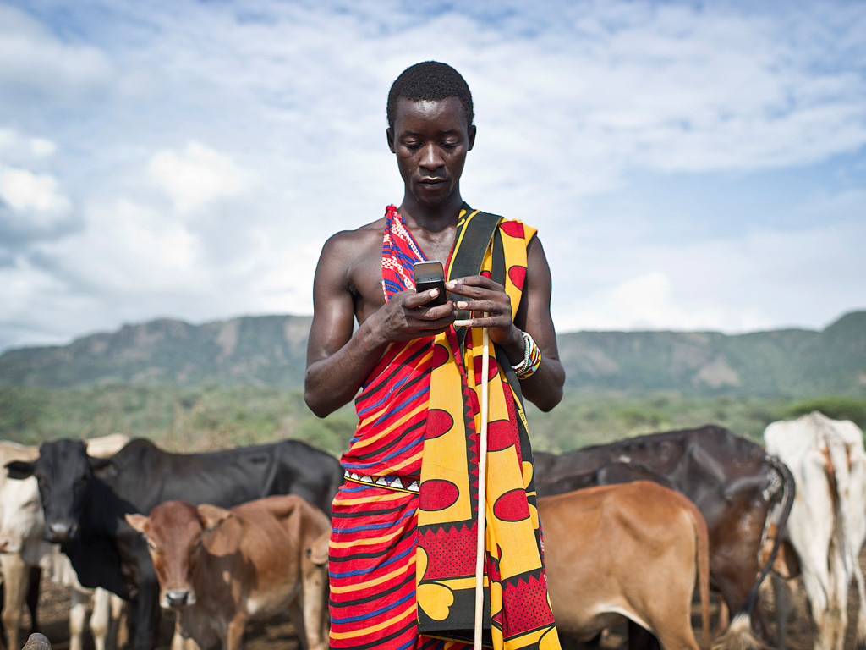

Slide 6
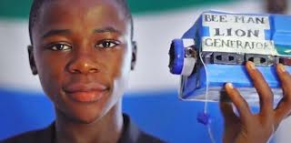
Innovation in Africa: Turning Challenges into Opportunities
Faso Soap (Burkina Faso) [2’]
http://www.faso-soap.info/?lang=en
Bottling Up Houses (Nigeria) [1’49”]
https://www.youtube.com/watch?v=hQp7Kp477Wg
Kenya’s Water Women
http://www.aljazeera.com/programmes/women-make-change/2015/09/kenya-water-women-150907100720512.html
Zimbabwean Farmers (Kwara State, Nigeria) [10’]
https://www.youtube.com/watch?v=Atpvxh-1Oms
Patrick Awua, Founder of Ashesi University (Ghana) [7’]
https://www.youtube.com/watch?v=eQbftT9OX1s
Fred Swaniker, Founder of ALA and ALU (PanAfrican) [13’]
https://www.ted.com/talks/fred_swaniker_the_leaders_who_ruined_africa_and_the_generation_who_can_fix_it?language=en
Inventors in Africa (Boot Camp, Togo) [4’23”]
https://www.youtube.com/watch?v=SRFs_S4eDjI
William Kamkwamba (Wind energy, Malawi) [6’]
https://www.youtube.com/watch?v=6QkNxt7MpWM
Kelvin Doe (DJ Man Focus, Sierra Leone) [10’]
https://www.youtube.com/watch?v=XOLOLrUBRBY

