Slide 1
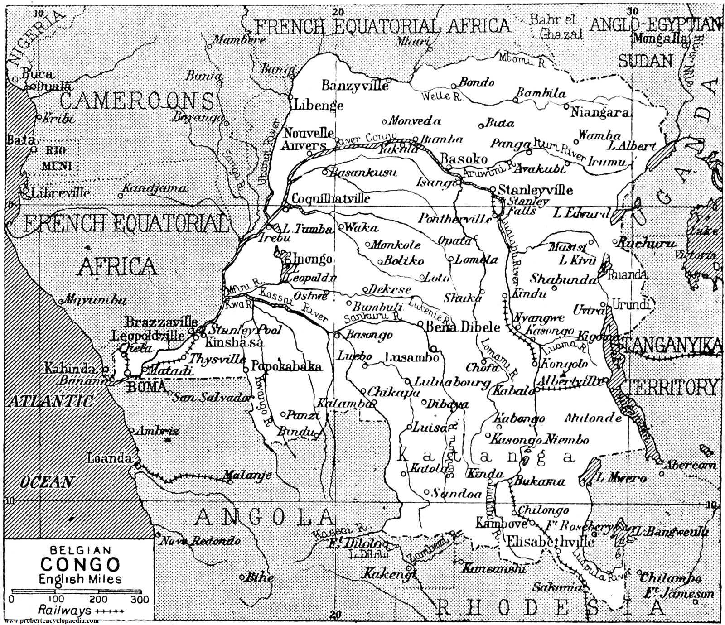

Slide 2
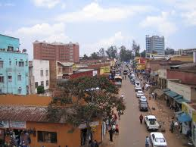
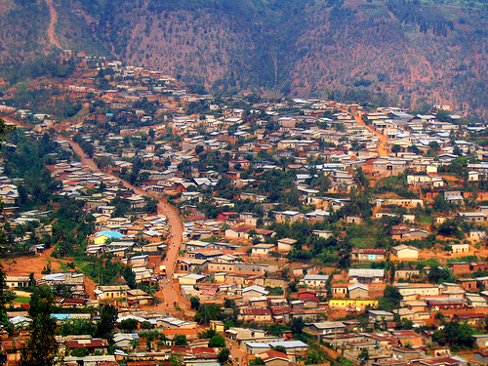
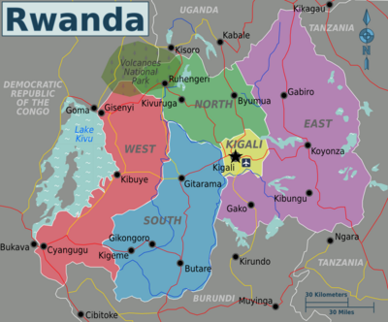
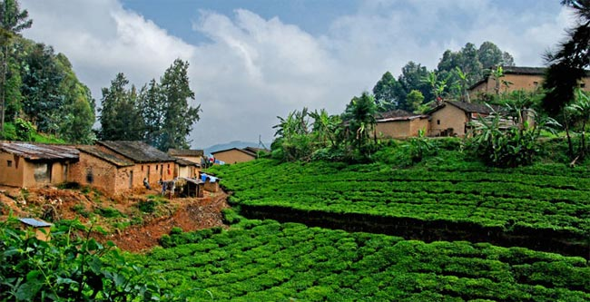

Slide 3
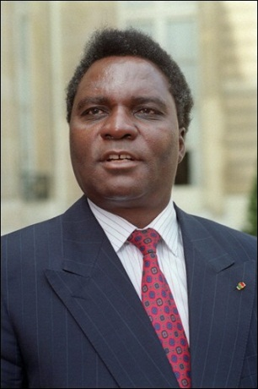
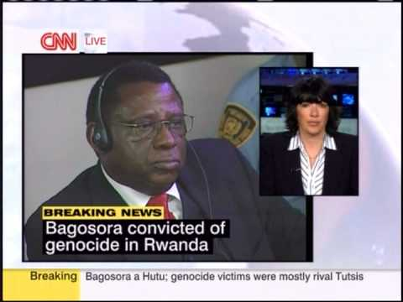
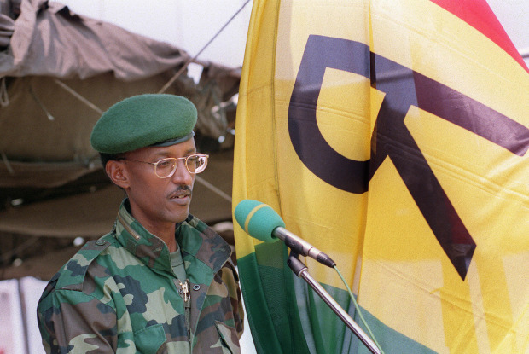
Background on the 1994 Genocide—Part 1 [9 mn]
https://www.aljazeera.com/programmes/general/2010/11/201011298744520338.html
How the 1994 Genocide Unfolded—Part 2 [16 mn]
http://www.aljazeera.com/programmes/general/2010/11/2010112913104428579.html
President Paul Kagame’s Comments on the Post-Genocide Rwanda (2011) [25 mn]
https://www.aljazeera.com/programmes/rizkhan/2011/01/201113175946750414.html
Juvenal Habyarimana
Paul Kagame, RPF

Slide 4
THE 1994 RWANDAN GENOCIDE
Events: Washington Post, 2014 [4’47”]
https://www.youtube.com/watch?v=KqJr46_yUH8
BBC Rwanda’s Untold Story, 2015 [1 hour, esp. 6:15-11:35 for LT causes]
https://vimeo.com/107867605
PROSPECTS FOR/PERSPECTIVES ON RECOVERY
Road to Recovery: NTV (Uganda), 2012 [4’12”]1
https://www.youtube.com/watch?v=nU4iPF35RU8
Rwanda’s Opportunities, 2011 [4’56”]
https://www.youtube.com/watch?v=KGMenQfl5XM
Entrepreneurs of Rwanda, 2011 [14’18”]
https://www.youtube.com/watch?v=a9HnojnhAUs

