Slide 2
What is post-feminism?

Slide 3
“Post-feminism is part of a corporatist and neoliberal political economy that encourages women to focus on their private lives and consumer capacities for self-expression and agency” (Anderson, 5).
“focus on self-transformation rather than structural transformation” (Anderson, 10)
Notes:
IMDB: Four female New Yorkers gossip about their sex lives (or lack thereof) and find new ways to deal with being a woman in the 1990s.
Creator:
Darren Star
Stars:
Sarah Jessica Parker, Kim Cattrall, Kristin Davis , Cynthia Nixon
1998-2004

Slide 4
“Postfeminist rhetoric and texts commodify the language and attributes of feminism, co-opting catchphrases like ‘Girl power!’ as advertising slogans as they frame the ‘freedom to choose’ as the freedom to choose one’s lipgloss color.” (Petersen, 343)

Slide 5
Embedded feminism: “ the assumption that women’s achievements are now simply part of the media landscape.”
(women appear on TV as police captains, doctors, lawyers)
Enlightened sexism: “takes the gains of the women’s movement as a given, and then uses those gains to resurrect retrograde images of girls and women as sexual objects still defined by their appearance.” (Anderson, 12)
Notes:
Enlightened sexism, continued: “Now that women have it all, they should focus their energy on their true power—their bodies, attire, and sexuality—power that is fun, power that will not alienate men. “
the battle for equality has been won, so there's nothing wrong with resurrecting sexist stereotypes―all in good fun, of course. She shows that these portrayals not only distract us from the real-world challenges facing women today but also drive a wedge between baby-boom women and their "millennial" daughters.

Slide 6
“Postfeminist Media Culture”
Gill: Postfeminism is “a sensibility” (2007, p. 254) whose messaging includes:
femininity is a bodily property
from objectification to subjectification
self-surveillance, monitoring and discipline
focus on individualism, choice and empowerment
dominance of a makeover paradigm;
entanglement of feminist and antifeminist ideas
emphasis upon consumerism and the commodification of difference.
(Gill, “Postfeminist Media Culture,” 2007)
Notes:
Gill, R. (2007). Postfeminist media culture: Elements of a sensibility. European Journal of Cultural Studies, 10(2), 147–166. https://doi.org/10.1177/1367549407075898

Slide 7
Rosalind Gill,
“Supersexualize me! Advertising and ‘the midriffs,’”in Attwood, et al., Mainstreaming Sex: The Sexualization of Culture (2007).
Notes:
Ariana Grande at 22
the construction of a young, heterosexual woman who knowingly and deliberately plays with her sexual power and is for ever 'up for it': the midriff.
History:
It is not surprising, then, that in the wave of feminist scholarship and activism that swept through western countries in the 1960s and 1970s, advertising was a key target for analysis and critique. The short, condensed nature of adverts predisposed their creators to rely heavily on crude, easily-recognisable stereotypes, and research highlighted the narrow range of degrading and trivialising images of women: the dumb blonde, the unintelligent housewife, the passive sex object, and so on. Throughout the 1970s and 1980s, content analytic studies documented the same consistent pattern of gender stereotyping in adverts: women were predominantly shown in the home (indeed, in the kitchen and bathroom); C - voice-overs were generally done by men, indexing their greater authority. In contrast, men were portrayed in a range of settings and occupational roles; as independent and autonomous; and were presented as objective and knowledgeable about the products they used. (Dyer 1982; Livingstone 1986; Lovdal 1989; Furnham and Bitar 1993; Gunter 1994).

Slide 8
Femininity as Bodily Property
Nike ad, 2010

Slide 9
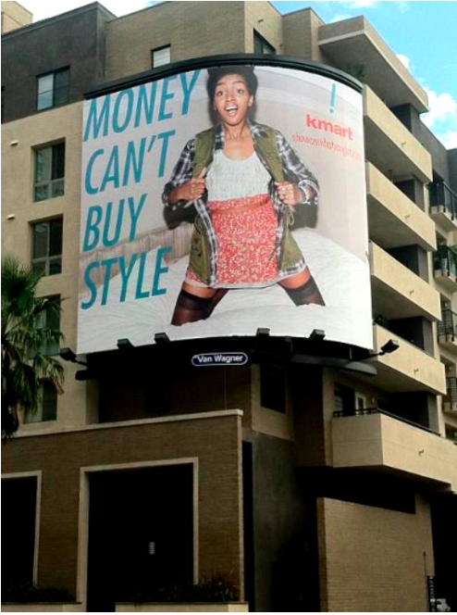
Focus on Individualism, Choice, and Empowerment
Empowerment and choice have become synonymous with purchasing power and being sexy (Anderson, 1).
Notes:
empowerment and choice have become synonymous with purchasing power and being sexy (p. 1).

Slide 10
Choice
“[M]odern misogyny discourages collective action in favor of individual, consumer choice” (Anderson, 2).

Slide 11
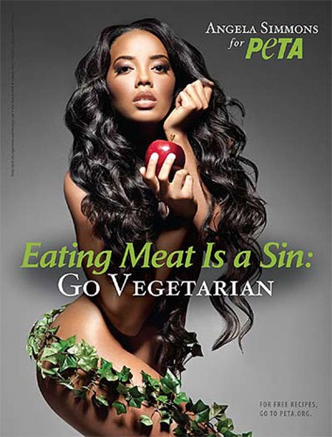
Hypersexualization
In the context of post-feminism, an era in which feminism is taken into account but then swiftly dismissed and debased, women’s sexual freedom manifests in porn culture and the hypersexualization of women and girls. The sexually affirming woman of the 1960s and 1970s has turned into a sexually objectified woman of post-feminism. (Anderson, 14)
Notes:
Hotness – pole dancing
sexual harassment and assault become problems for the individual victim, and are ignored as systemic issues of inequality (p. 9).

Slide 13
Consumerism as Empowerment

Slide 14
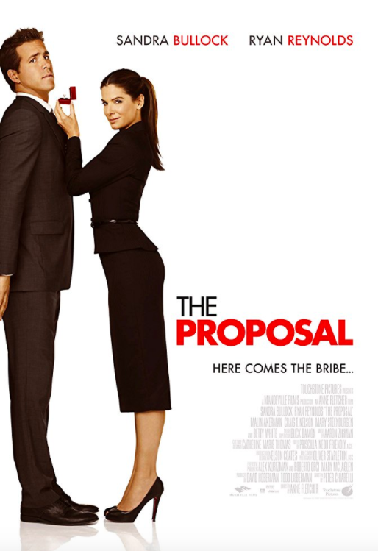
A pushy boss forces her young assistant to marry her in order to keep her visa status in the U.S. and avoid deportation to Canada.
Notes:
The Proposal 2009
main character -- independent career woman
portrayed as self-loathing, bossy, uptight, without personal life
what she needs is a man
“Before they can get a man, they must experience a “mortifying comeuppance” – a debasing punishment for their independent relationship-less lives. Under post-feminism, these modern shrews must be tamed. (Anderson, 3)

Slide 15
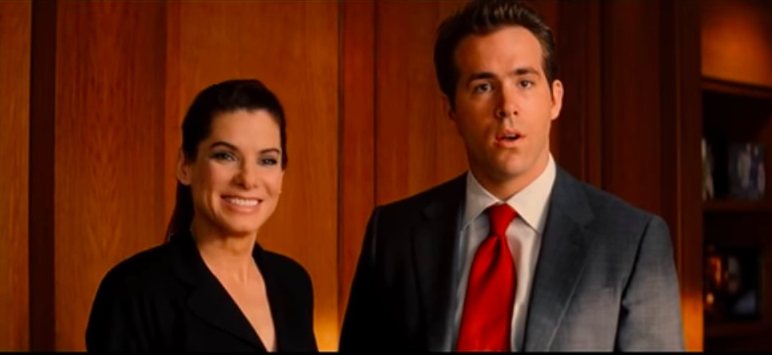

Slide 17
An uptight television producer takes control of a morning show segment on modern relationships hosted by a misogynistic man. (imdb.com)
Notes:
A romantically challenged morning show producer is reluctantly embroiled in a series of outrageous tests by her chauvinistic correspondent to prove his theories on relationships and help her find love. His clever ploys, however, lead to an unexpected result.Written by Anonymous (imdb)

Slide 18
Katherine Heigl in The Ugly Truth (2009)
“Post-feminism reduces women to white, middle- and upper-class, heterosexual women.” (Anderson, 4)
Notes:
The Ugly Truth 2009

Slide 19
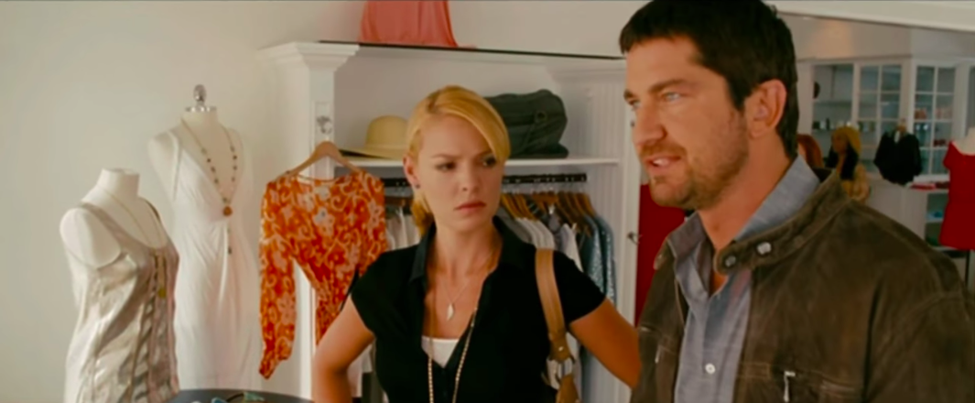
“Post-feminism is part of a corporatist and neoliberal political economy that encourages women to focus on their private lives and consumer capacities for self-expression and agency.” (Anderson, 5)

Slide 21
PCU (1994)
Male dominance is also partly achieved through attempts to obscure women’s resistance by characterizing collective female resistance as negative and unfeminine, implying that feminists are unattractive to men. Once such a negative category is in place, feminism can be used as an accusation, and a means of silencing assertive women. No reasonable woman would want to identify as a feminist as long as the extremist caricature exists. (Anderson, 11)
Notes:
A high school senior visits college for the weekend, and stays at the wildest house on campus in this classic tale of anti-political-correctness.

Slide 22
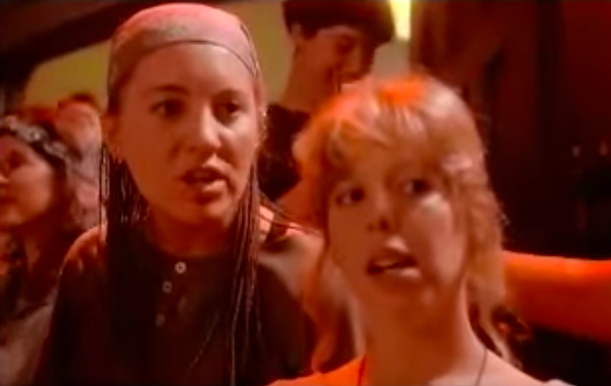
Jock #1: [at a party] What's up, babes?
Womynist #1: Pack up your rape culture and take a hike!
Jock #1: [holds up a beer] You want a brewdog?
Womynist #1: We're not interested in your penis!
Womynist #2: Wait, wait, I think he's offering us a beer.
[turns to jock, speaks slowly]
Womynist #2: Um... Yes. We, would like, a beer.
Jock #1: Okay!
[turns around to get a beer]
Womynist #1: So it's like, if you're nice to them, they *bring* you things?
Womynist #2: Exactly.
Notes:
Jock #1: [at a party] What's up, babes?
Womynist #1: Pack up your rape culture and take a hike!
Jock #1: [holds up a beer] You want a brewdog?
Womynist #1: We're not interested in your penis!
Womynist #2: Wait, wait, I think he's offering us a beer.
[turns to jock, speaks slowly]
Womynist #2: Um... Yes. We, would like, a beer.
Jock #1: Okay!
[turns around to get a beer]
Womynist #1: So it's like, if you're nice to them, they *bring* you things?
Womynist #2: Exactly.

Slide 23
Aftermath of 9/11
Notes:
aftermath of 9/11
As a result of the terrorist attacks, the U.S. retreated back to more traditional standards, especially in terms of gender roles.
the post‐9/11 backlash on women:
the media portrayed helping professionals as male heroes and women as victims and widows. The reality is that both the heroes and victims were comprised of a variety of races, classes, sexual orientations and gender. Anderson paints a complicated picture of those who lost loved ones in the tragedy and who were there to help among the ruins.

Slide 25
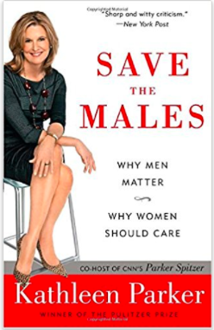
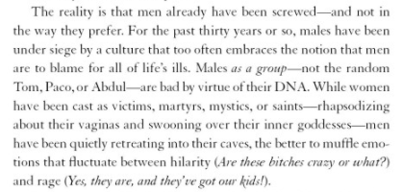
Boy/Man Crisis
Notes:
Among the myths perpetuated by modern misogyny: there is a boy/man crisis (chapter 4)
This myth suggests that because women have made such great strides in education and the workplace, men and boys are now falling behind and need to be given more attention and focus.
From Publishers Weekly
According to columnist Parker, men are an endangered species struggling against everything from mere hostility to literal emasculation. Starting in elementary school, where a teacher most likely a feminist will demand that boys sit still and listen and continuing through college, where freshmen must endure rape awareness workshops, men are besieged by disrespect. Belittled by bumbling portrayals in sitcoms, their importance as fathers is so devalued that they are perceived as little more than sperm and a wallet. Parker trots out the usual suspects—mass culture, unspecified feminists, The Vagina Monologues, Murphy Brown, metrosexuals and girlymen—to propose that a feminist campaign is afoot and eager to effeminize, denigrate and destroy American men. Although Parker's deliberate provocations make for lively reading, the majority of her claims are too fanciful and unsubstantiated to be genuinely thought provoking or even interesting (erectile dysfunction is caused by young, sexually aggressive women; women serving in the army put the nation at risk). Parker makes a poor conspiracy theorist, and her statistics and unverifiable theories are unable to make her case, however vehement or entertaining their presentation. (June) Copyright © Reed Business Information, a division of Reed Elsevier Inc. All rights reserved.

Slide 26
“Center Stage Problem”
“members of the privileged group experience a threat when attention even temporarily and briefly turns away from them and toward members of a marginalized group” (Anderson, 86)
Notes:
Anderson cites the work of Grillo and Wildman on the “center stage problem” (p. 86). The center stage problem can be summed up as occurring when “members of the privileged group experience a threat when attention even temporarily and briefly turns away from them and toward members of a marginalized group” (p. 86).
many studies dismantle the myth of boy/man crisis by demonstrating that women are still much more disadvantaged than men.
[Grillo and Wildman, 1997]).

