Slide 1
HARC0227: Indian Painting
14-Rajput Paintings from Punjab—Paintings from the Hills

Slide 2
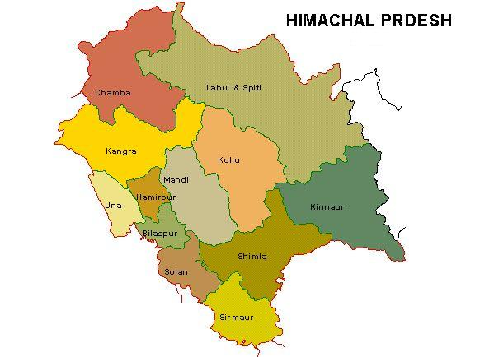
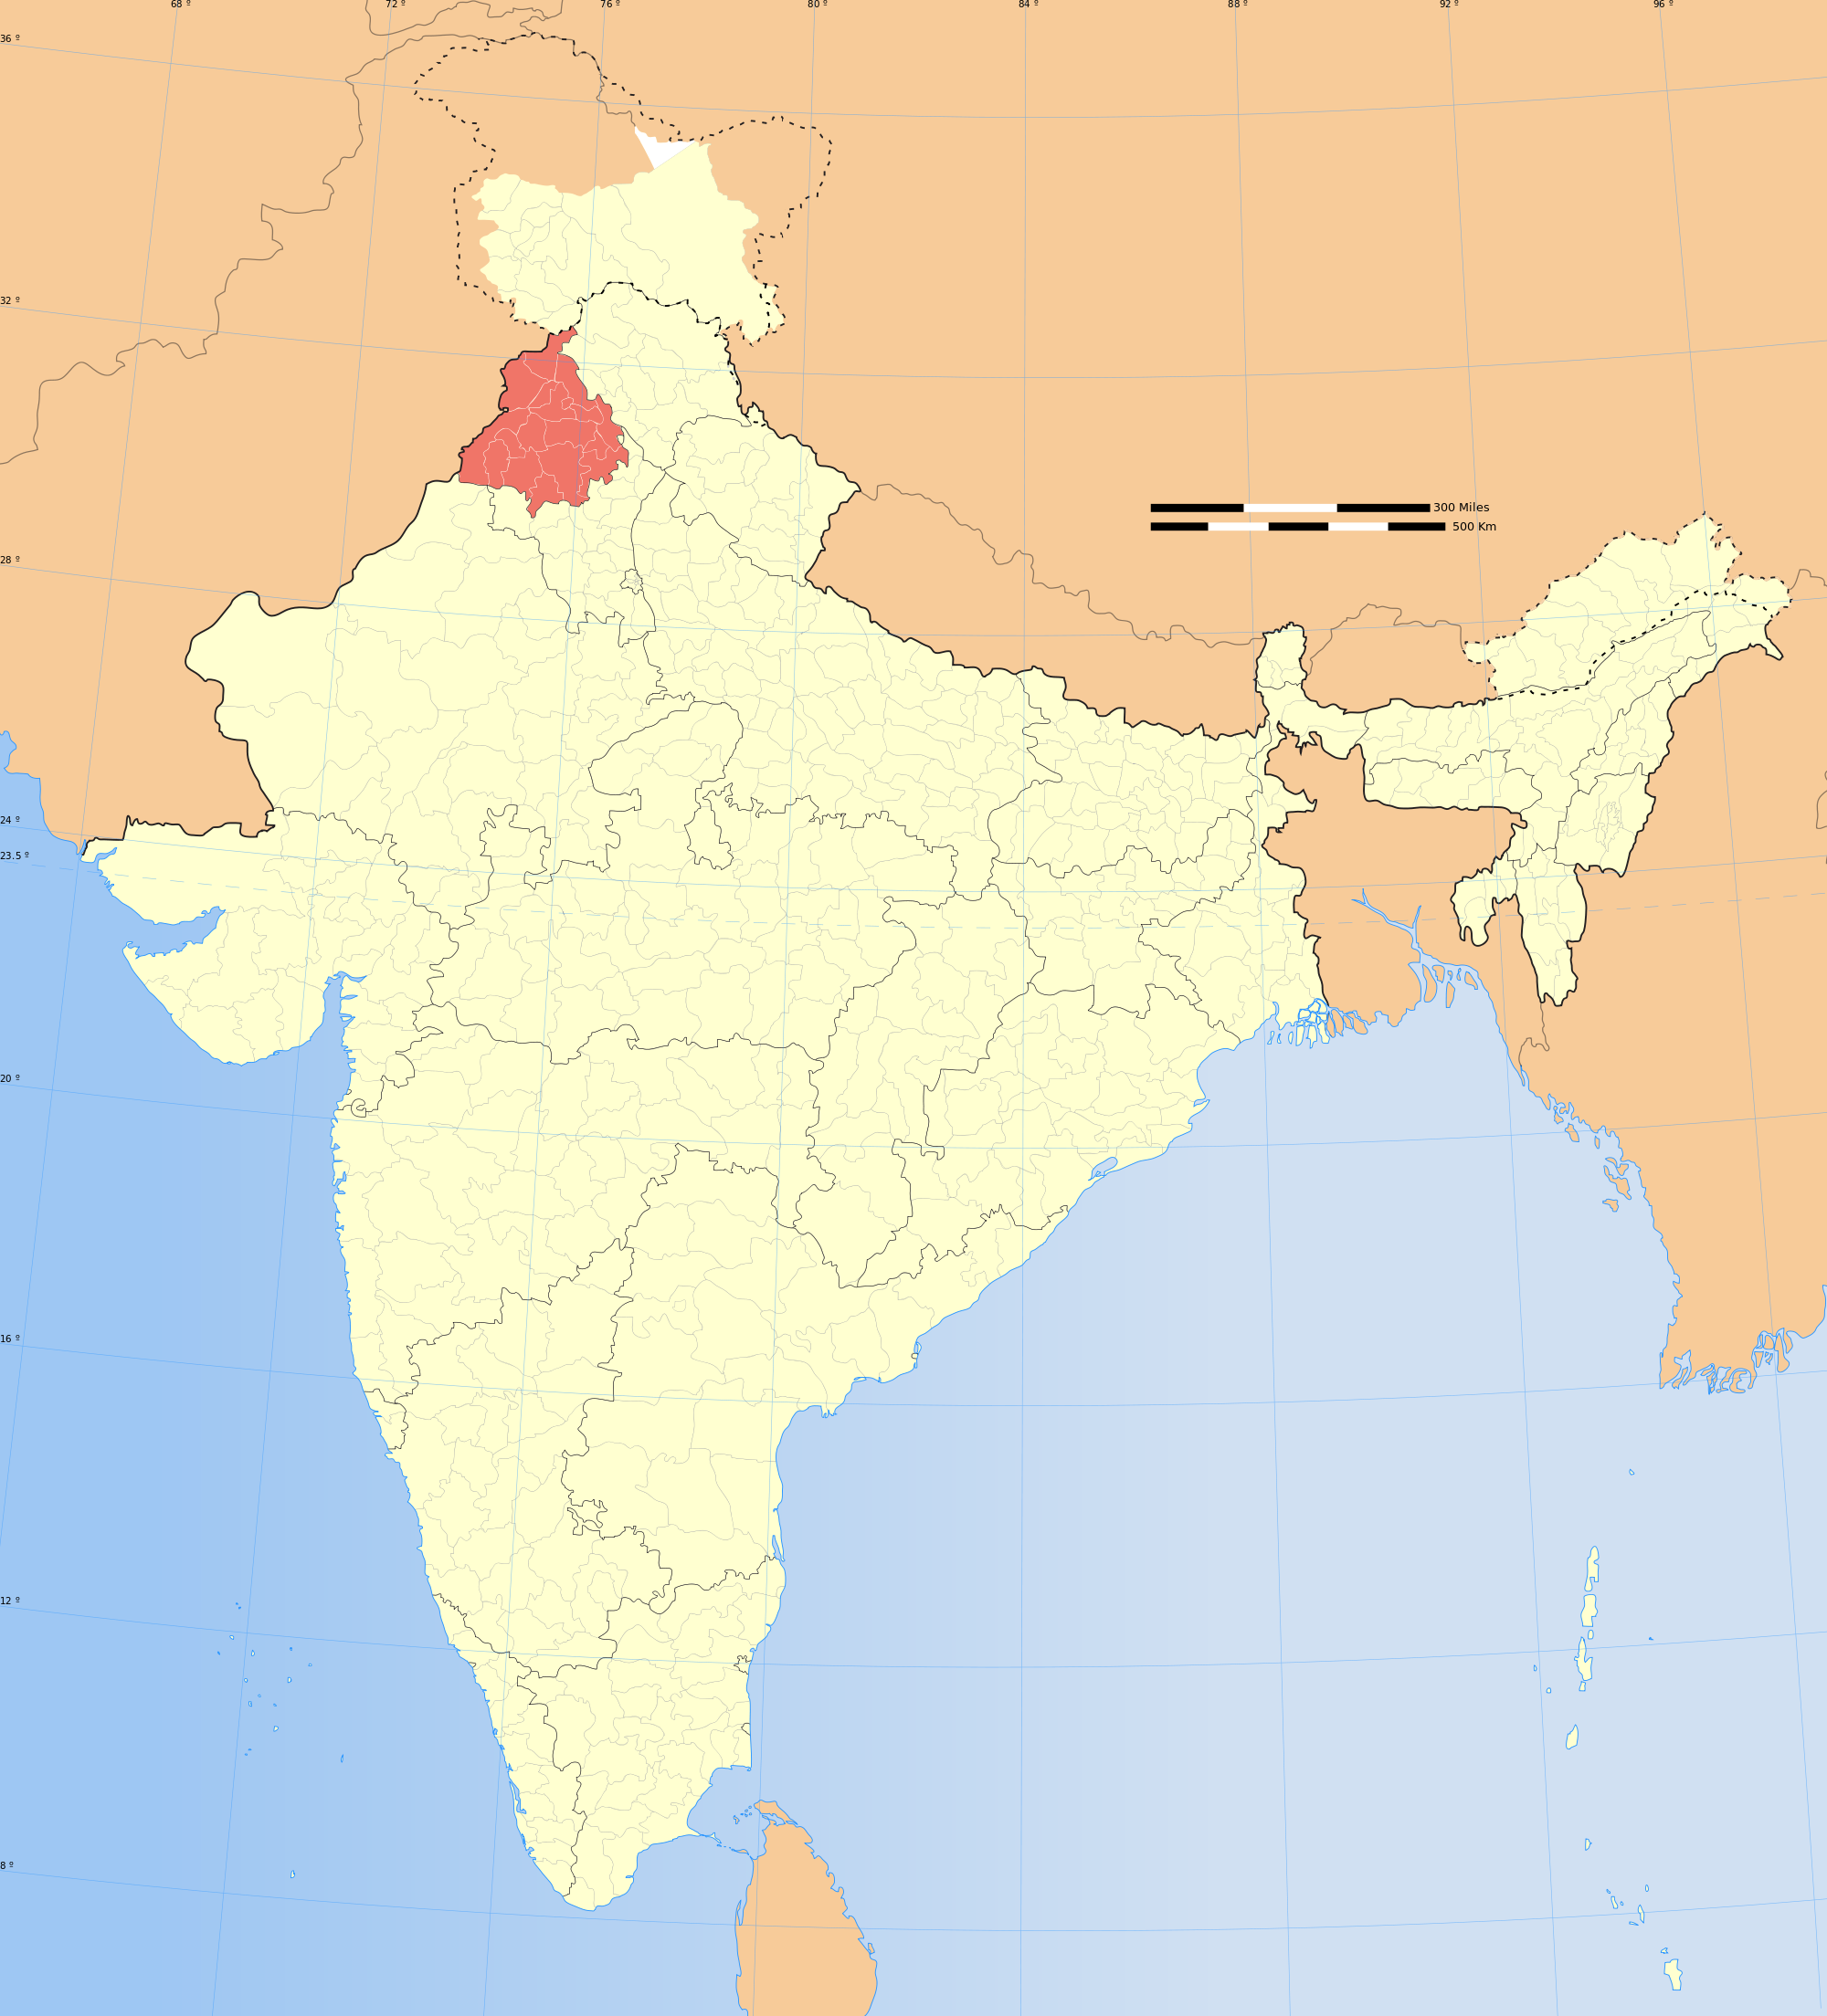

Slide 3
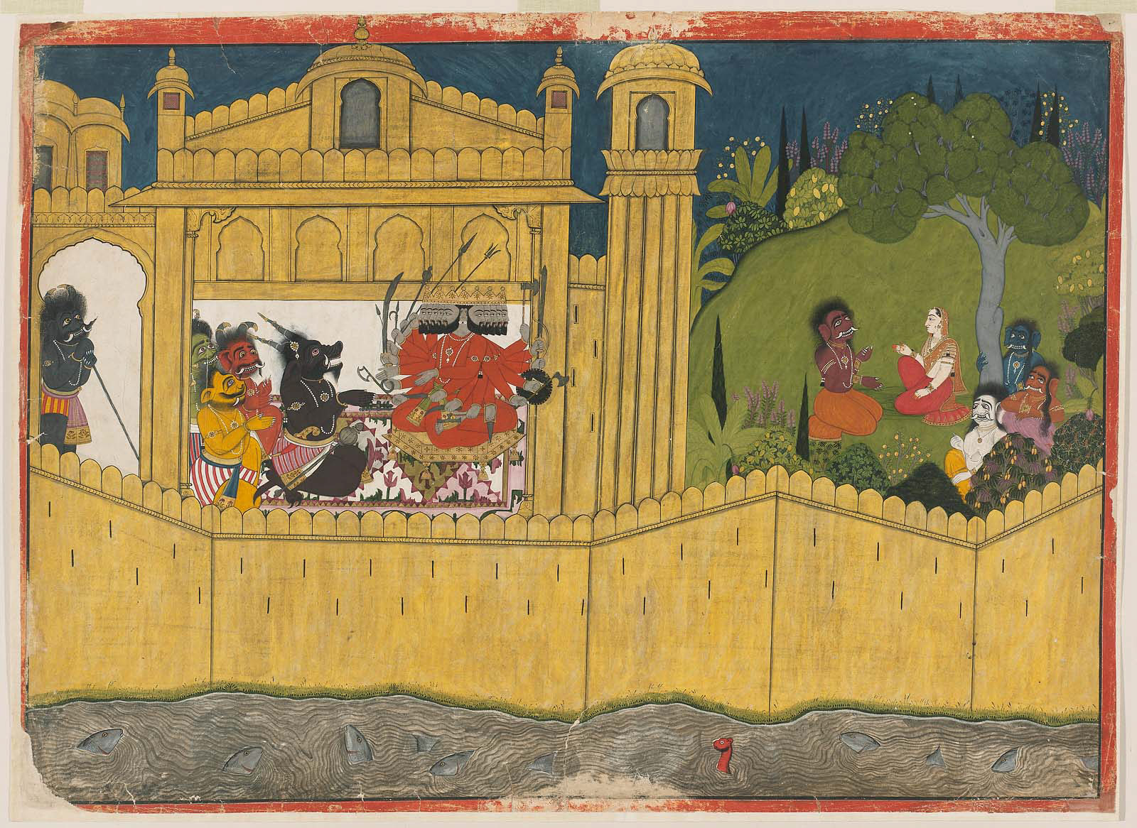
Manaku, Ravana with his Ministers; Sita in the Ashoka Grove, Guler, Punjab Hills/Himachal Pradesh (Pahari), ca.1725 (22-1/4 x ~32 in.)
Notes:
You are here
License This Image
Ravana with his Ministers; Sita in the Asoka Grove
Indian, Pahari about 1725 Attributed to Manaku (Indian, about 1700–1760 Indian)
Object Place, Guler, Punjab Hills, India
Overall: 59.7 x 83 cm (23 1/2 x 32 11/16 in.) Image: 56.5 x 80.5 cm (22 1/4 x 31 11/16 in.)

Slide 4
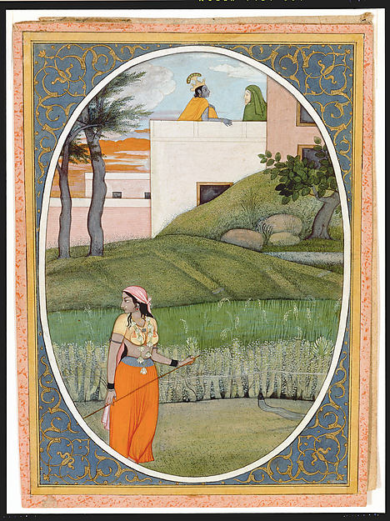
The Village Beauty: Folio from the Guler Bihari Satsai Series
First generation after Manaku and Nainsukh
Guler, Punjab Hills, ca. 1785
Notes:
The Village Beauty: Folio from the Guler Bihari Satsai Series
Artist: First generation after Manaku and Nainsukh
Date: ca. 1785
Culture: India (Guler, Himachal Pradesh)
Medium: Opaque watercolor, ink and gold on paper
Dimensions: Overall: 7 1/2 x 5 1/8 in. (19 x 13 cm)
Classification: Paintings
Credit Line: Lent by The Kronos Collection

Slide 5
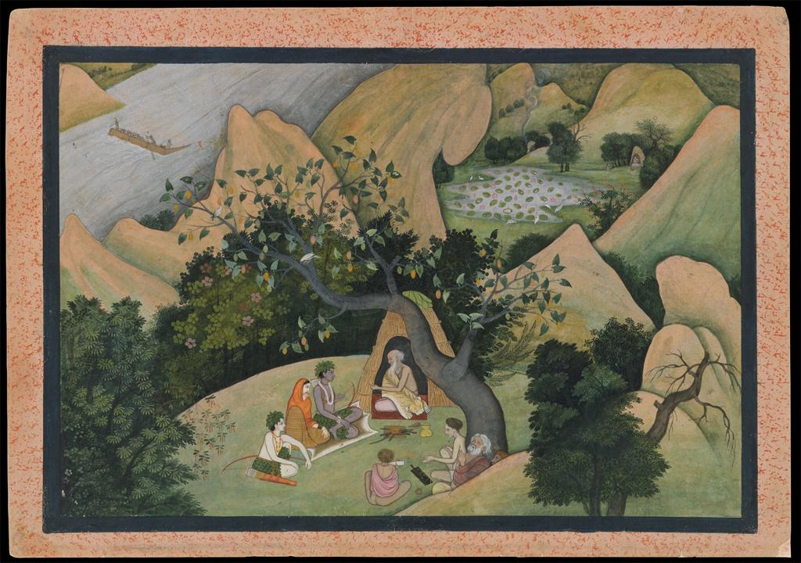
Rama, Sita, and Lakshmana at the Hermitage of Bharadvaja: Folio from a Ramayana Series, First Generation after Nainsukh, Kangra, Punjab Hills/Himachal Pradesh, ca. 1780,
overall: : 9 15/16 x 14 1/16 in,
Notes:
Rama, Sita, and Lakshmana at the Hermitage of Bharadvaja: Folio from a Ramayana Series
Artist: First Generation after Nainsukh
Date: ca. 1780
Culture: India (Kangra, Himachal Pradesh)
Medium: Opaque watercolor and ink on paper
Dimensions: Page: 9 15/16 x 14 1/16 in. (25.2 x 35.7 cm) Image: 8 1/8 x 12 1/8 in. (20.6 x 30.8 cm)
Classification: Paintings
Credit Line: Seymour and Rogers Funds, 1976
Accession Number: 1976.15

Slide 6
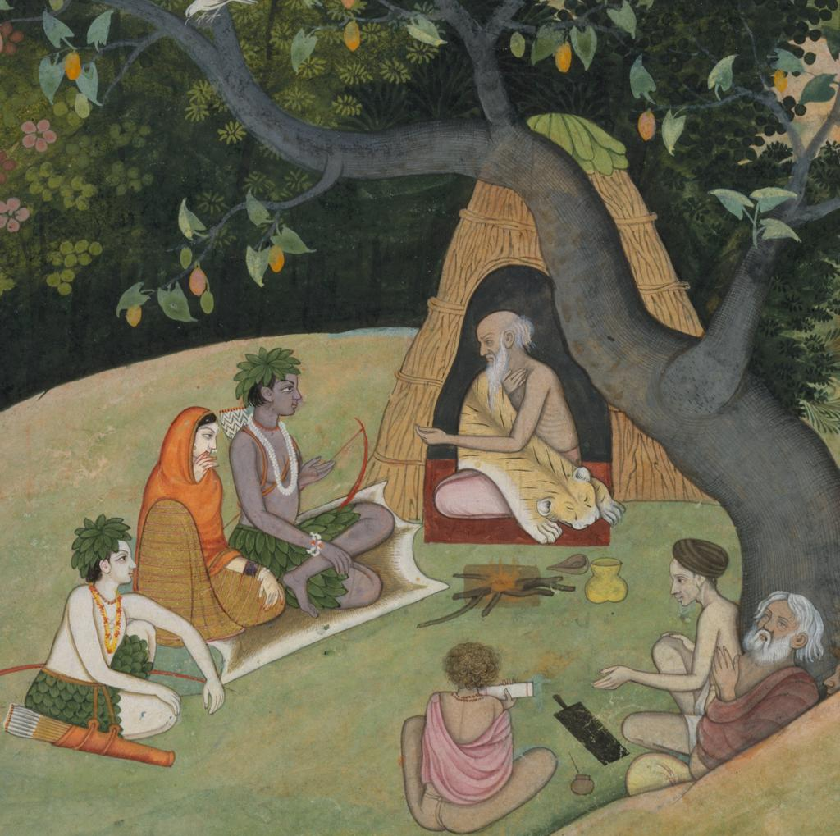

Slide 7
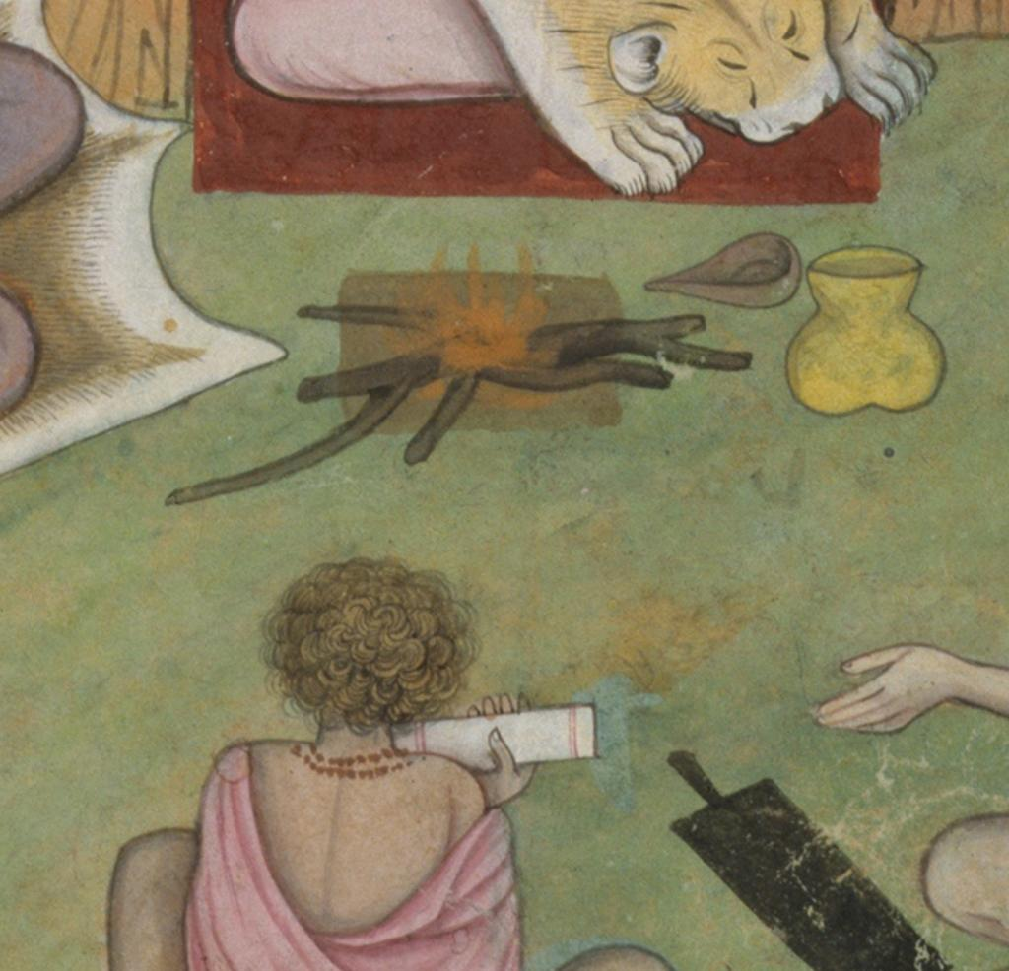

Slide 8
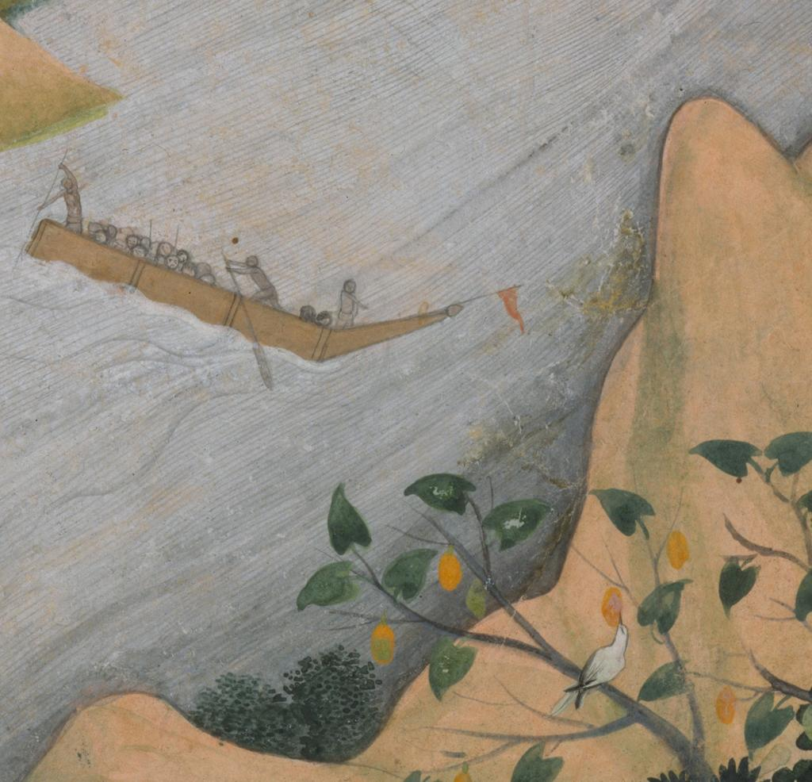

Slide 9
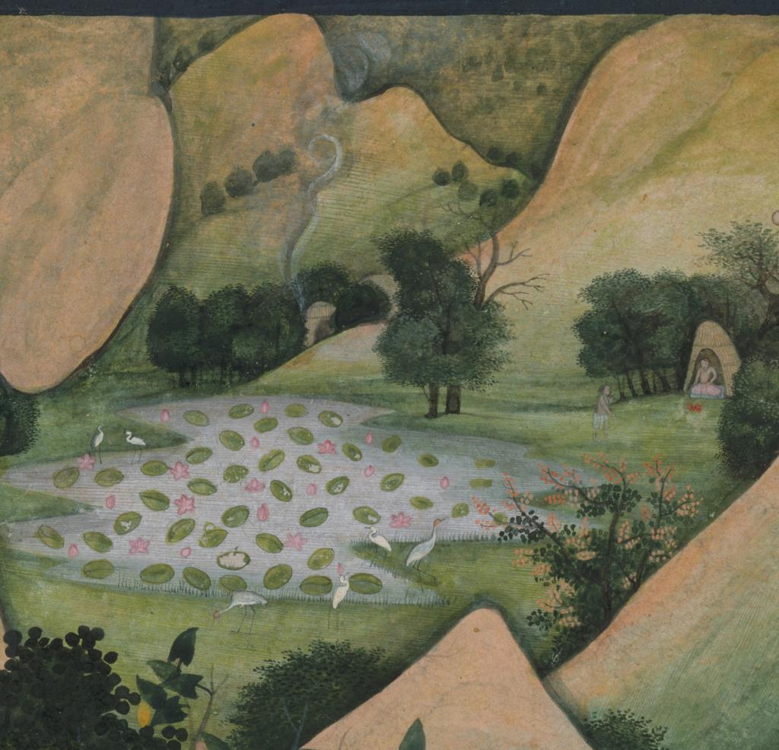

Slide 10
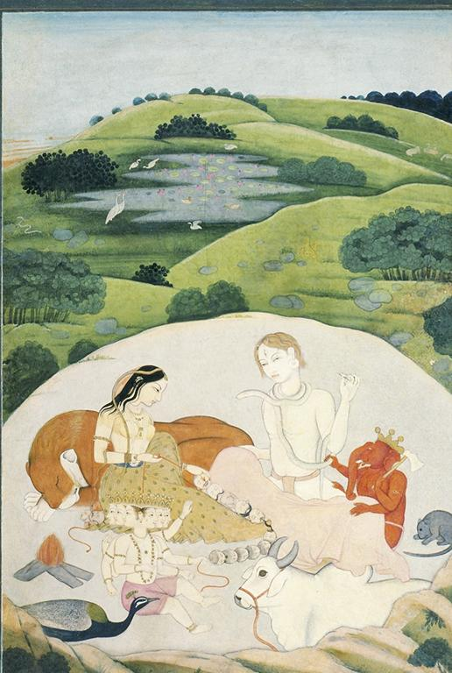
The Holy Family: Shiva, Parvati, Ganesha, and Skanda/Karttikeya
Guler, ca. 1750
Notes:
Culture: Indian Title: The Holy Family Work Type: Paintings Work Type: miniatures Date: c. 1750 Site: Punjab Hills, Guler Site: India Material: Ink and opaque watercolor on paper Measurements: 10 1/2 x 7 inches Style Period: Rajput, Pahari, Guler school Description: The holy family consists of Shiva and Parvati with Ganesha and Karttikeya (Skanda). Description: Photographer: Patrick Young Description: Set 37, Hindu Deities in Painting Repository: Archer collection Subject: Hindu, Shiva, Siva Collection: American Council for Southern Asian Art (ACSAA) Collection (University of Michigan) ID Number: 3756 Source: Data from: The American Council for Southern Asian Art (ACSAA) Source: http://www.umich.edu/~hartspc/acsaa/index.html Rights: Photo: © Asian Art Archives, University of Michigan Rights: Please note that if this image is under copyright, you may need to contact one or more copyright owners for any use that is not permitted under the ARTstor Terms and Conditions of Use or not otherwise permitted by law. While ARTstor tries to update contact information, it cannot guarantee that such information is always accurate. Determining whether those permissions are necessary, and obtaining such permissions, is your sole responsibility.

Slide 11
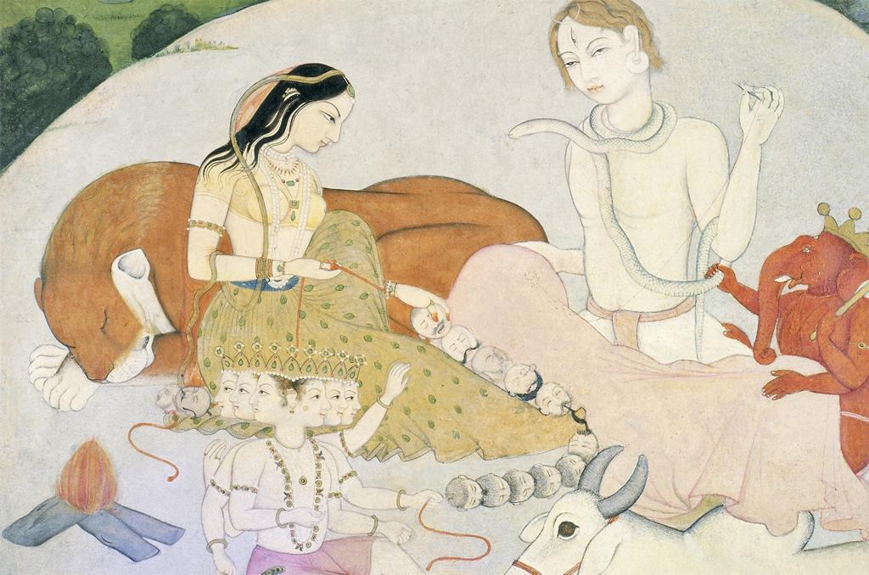
Notes:
Culture: Indian Title: The Holy Family Title: Family (Siva and Parvati with Ganesha and Karttikeya) Work Type: Paintings Work Type: miniatures Date: c. 1750 Site: Punjab Hills, Guler Site: India Material: Ink and opaque watercolor on paper Measurements: 10 1/2 x 7 inches Style Period: Rajput, Pahari, Guler school Description: The holy family consists of Shiva and Parvati with Ganesha and Karttikeya (Skanda). Description: Photographer: Patrick Young Description: Set 37, Hindu Deities in Painting Repository: Archer collection Subject: Hindu, Shiva, Siva Collection: American Council for Southern Asian Art (ACSAA) Collection (University of Michigan) ID Number: 3757 Source: Data from: The American Council for Southern Asian Art (ACSAA) Source: http://www.umich.edu/~hartspc/acsaa/index.html Rights: Photo: © Asian Art Archives, University of Michigan Rights: Please note that if this image is under copyright, you may need to contact one or more copyright owners for any use that is not permitted under the ARTstor Terms and Conditions of Use or not otherwise permitted by law. While ARTstor tries to update contact information, it cannot guarantee that such information is always accurate. Determining whether those permissions are necessary, and obtaining such permissions, is your sole responsibility.

Slide 12
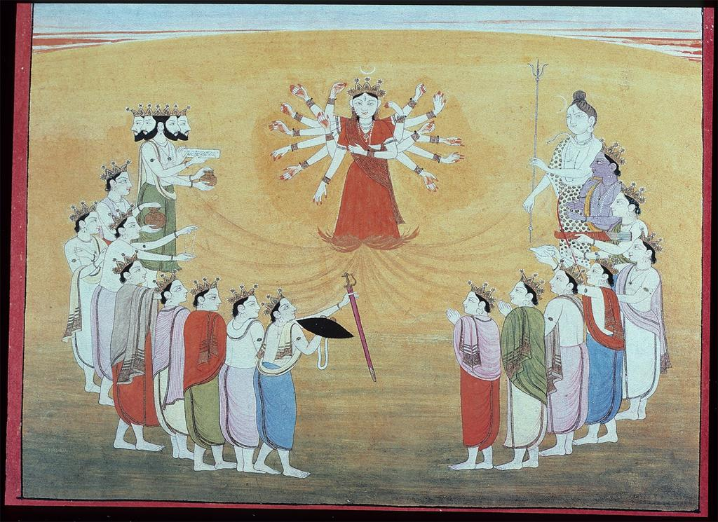
Durga Manifest Herself, Armed by the Gods, Kangra, 18th c.
Notes:
Culture: Asian Title: Durga manifests herself, armed by all the gods Date: 18th Century, ca. Style Period: Rajput, Pahari, Kangra Collection: Middlebury Visual Resources ID Number: 93_2164 Rights: This image has been selected and made available by an institutional user of the ARTstor Digital Library using ARTstor's software tools. ARTstor has not pre-screened or selected this image, and therefore disclaims any liability for any use of this image. Should you have any legal objection to the use of this image, please notify ARTstor's Contact for Legal Notices.

Slide 13
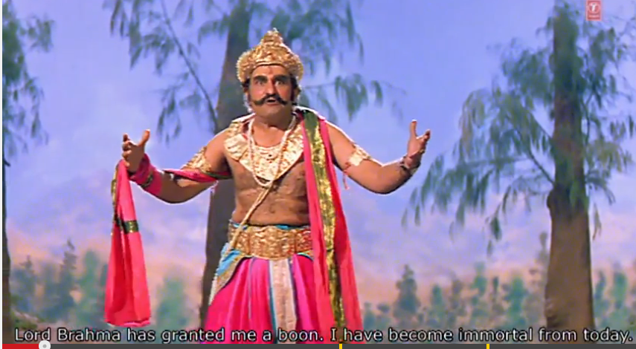
Mahishasura’s tricks Brahma in his bid for immortality
Notes:
7 minutes

Slide 14
Notes:
Culture: Asian Title: Durga manifests herself, armed by all the gods Date: 18th Century, ca. Style Period: Rajput, Pahari, Kangra Collection: Middlebury Visual Resources ID Number: 93_2164 Rights: This image has been selected and made available by an institutional user of the ARTstor Digital Library using ARTstor's software tools. ARTstor has not pre-screened or selected this image, and therefore disclaims any liability for any use of this image. Should you have any legal objection to the use of this image, please notify ARTstor's Contact for Legal Notices.

Slide 15
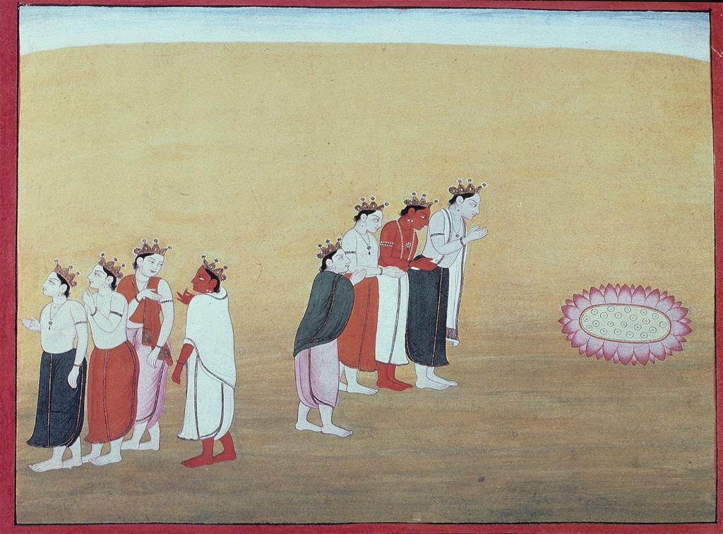
Visarjana. Departure of Durga, her task completed
Notes:
Culture: Asian Title: Visarjana. Departure of Durga, her task completed Date: 18th Century, ca. Style Period: Rajput, Pahari, Kangra Collection: Middlebury Visual Resources ID Number: 93_2163 Rights: This image has been selected and made available by an institutional user of the ARTstor Digital Library using ARTstor's software tools. ARTstor has not pre-screened or selected this image, and therefore disclaims any liability for any use of this image. Should you have any legal objection to the use of this image, please notify ARTstor's Contact for Legal Notices.

Slide 16
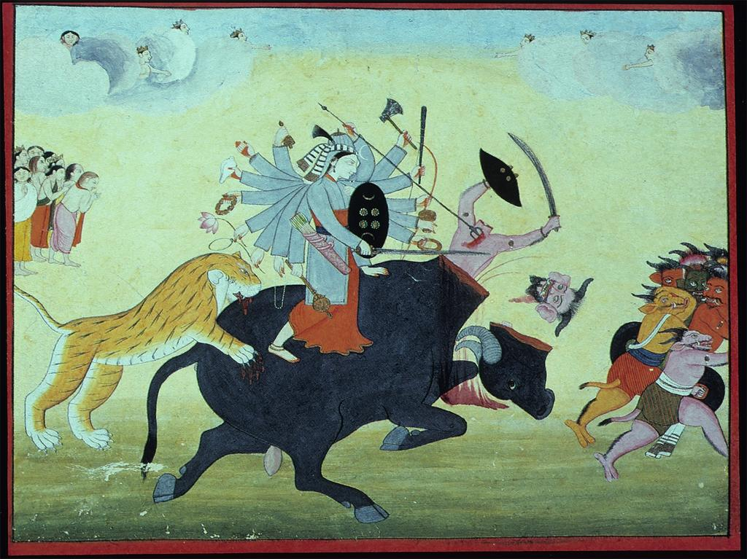
Durga Overpowers Mahishasura, the Buffalo Demon
Notes:
Culture: Asian Title: Durga Overpowers the Buffalo Demon Date: ca. 18th Century Style Period: Pahari, Kangra Collection: Middlebury Visual Resources ID Number: 93_2155 Rights: This image has been selected and made available by an institutional user of the ARTstor Digital Library using ARTstor's software tools. ARTstor has not pre-screened or selected this image, and therefore disclaims any liability for any use of this image. Should you have any legal objection to the use of this image, please notify ARTstor's Contact for Legal Notices.

Slide 17
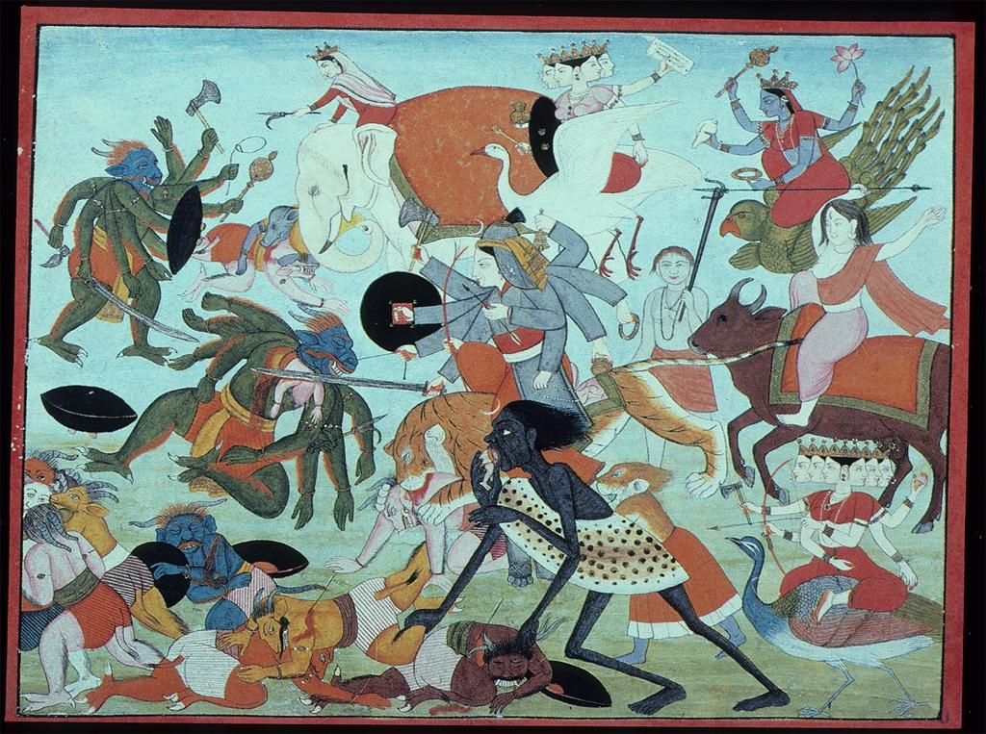
Kali and Durga triumphant in battle with the asuras (demons)
Notes:
Culture: Asian Title: Kali and Durga triumphant in battle with the asuras Date: 18th Century, ca. Style Period: Rajput, Pahari, Kangra Collection: Middlebury Visual Resources ID Number: 93_2158 Rights: This image has been selected and made available by an institutional user of the ARTstor Digital Library using ARTstor's software tools. ARTstor has not pre-screened or selected this image, and therefore disclaims any liability for any use of this image. Should you have any legal objection to the use of this image, please notify ARTstor's Contact for Legal Notices.

Slide 18
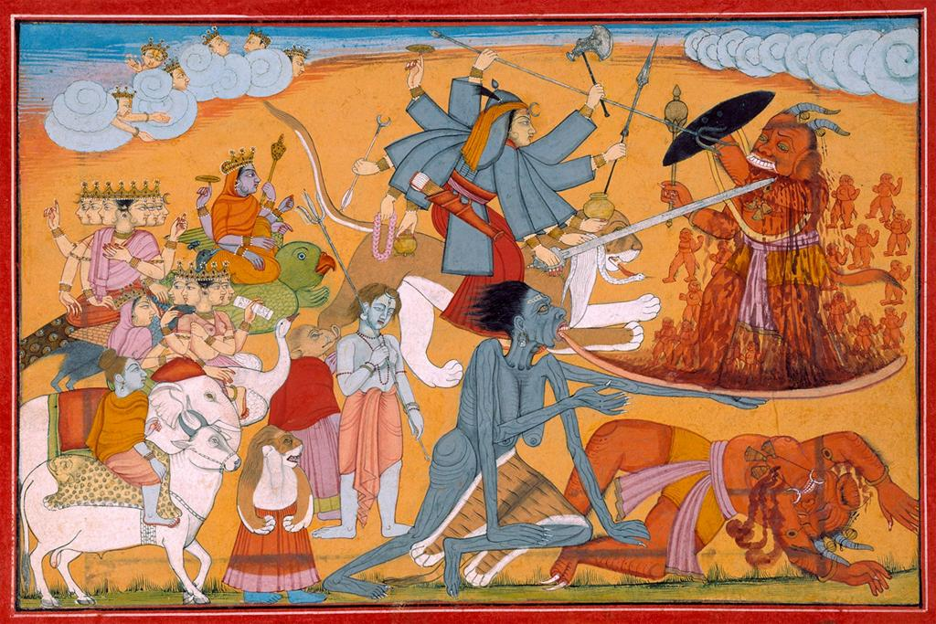
With Kali's Help, Durga Kills Rakta-bija , 18th c. Pahari
Notes:
Title: With Kali's Help, Durga Kills Rakta-bija [Mit Hilfe der Kali wird der Dämon Raktabija von Durga getötet] Work Type: watercolor Date: 18th century Material: painting on paper Material: Malerei auf Papier Measurements: 20 (16.8) x 28.5 (25.5) cm Description: Leaf from the Devi Mahatmyam, a Sanskrit manuscript formerly C.G. Kroh collection [Devimahatmya der ehem. Sammlung C.G. Krohs]. Description: Photographer: Dietmar Katz Repository: Museum für Asiatische Kunst, Staatliche Museen zu Berlin Repository: http://www.smb.museum/smb/home/index.php?lang=de Accession Number: I 5071 fol.37 Subject: Durg? (Hindu deity); K?l? (Hindu deity) Collection: Berlin State Museums (Staatliche Museen zu Berlin) ID Number: 24318 ID Number: ART189944 Source: Image and original data provided by Bildarchiv Preussischer Kulturbesitz Source: http://bpkgate.picturemaxx.com/webgate_cms/en/ Rights: Please note that if this image is under copyright, you may need to contact one or more copyright owners for any use that is not permitted under the ARTstor Terms and Conditions of Use or not otherwise permitted by law. While ARTstor tries to update contact information, it cannot guarantee that such information is always accurate. Determining whether those permissions are necessary, and obtaining such permissions, is your sole responsibility.

Slide 19
Notes:
Title: With Kali's Help, Durga Kills Rakta-bija [Mit Hilfe der Kali wird der Dämon Raktabija von Durga getötet] Work Type: watercolor Date: 18th century Material: painting on paper

Slide 20
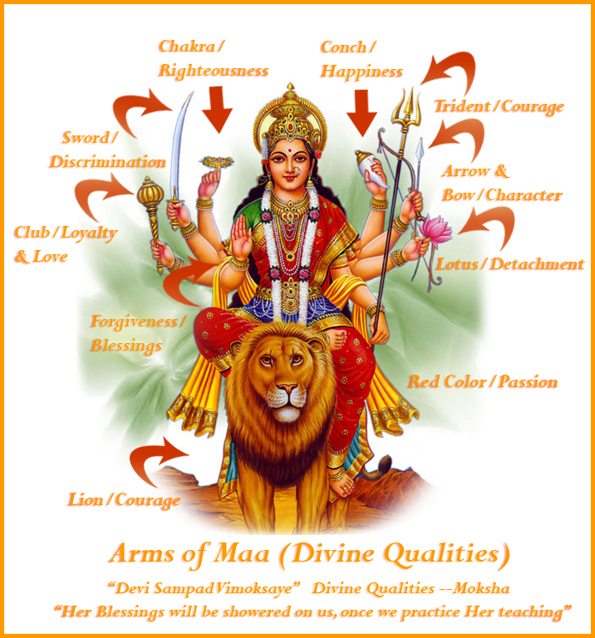

Slide 21
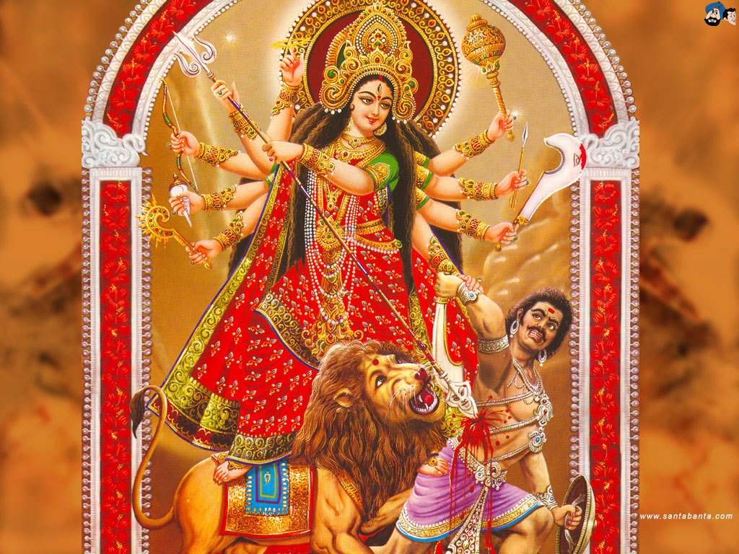

Slide 22
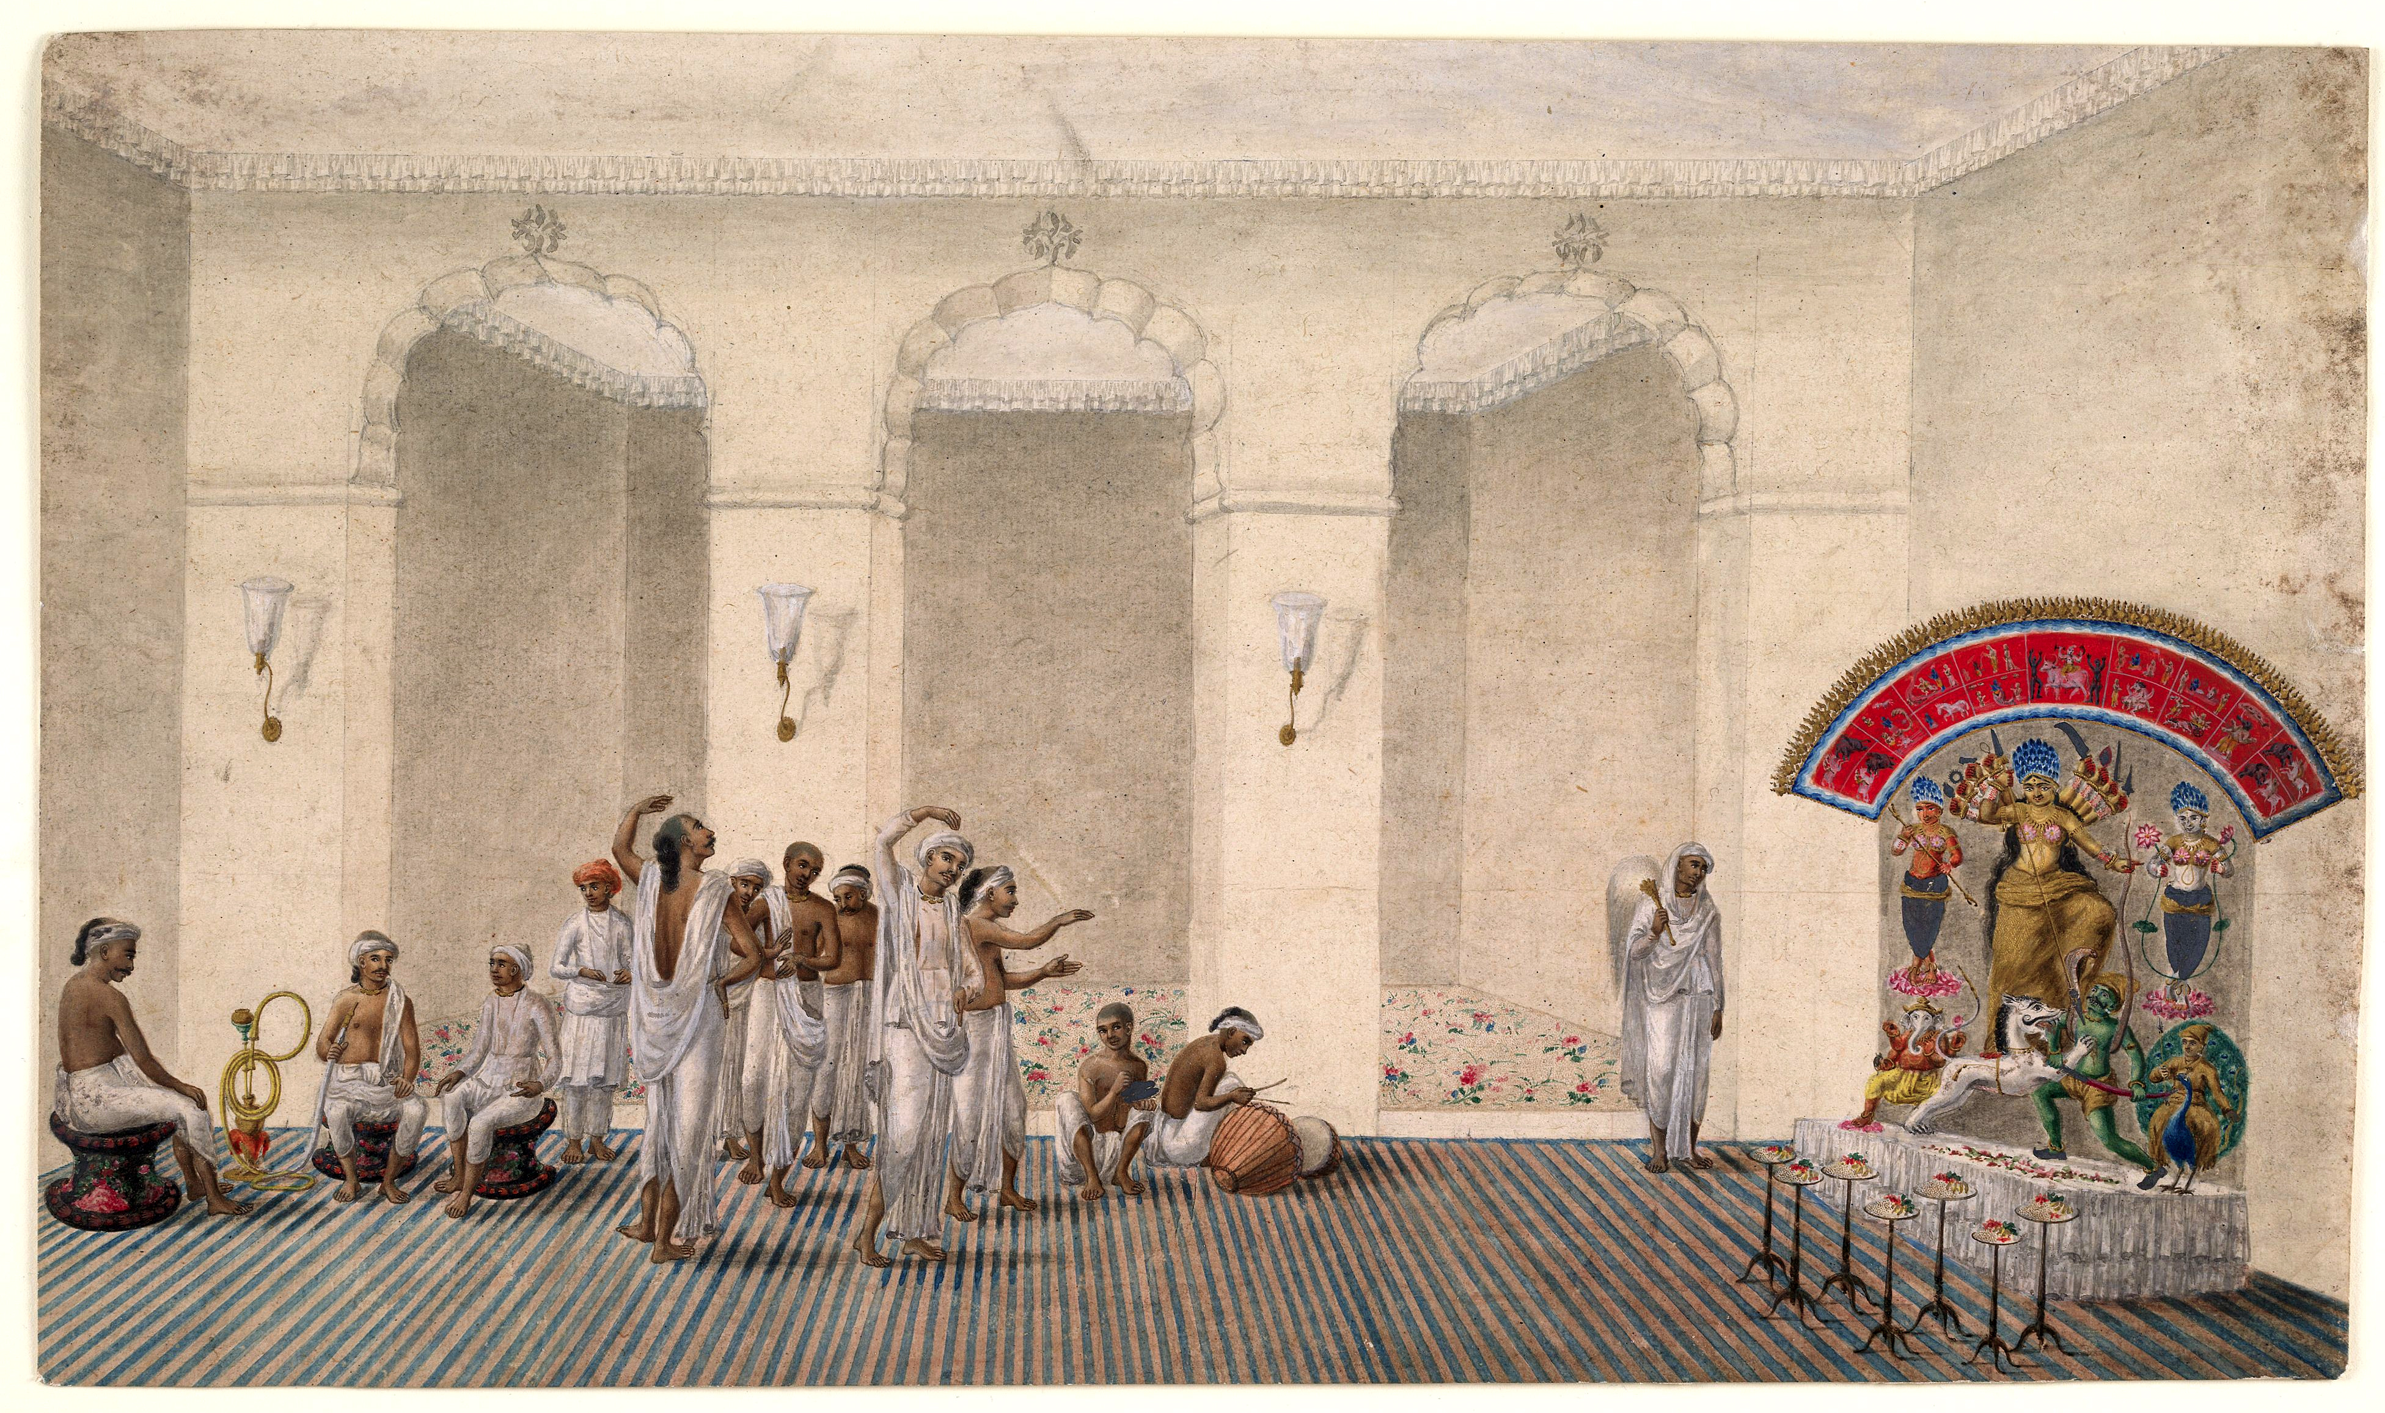
Durga Puja (Worship), Patna style, 1809
Notes:
British Library
Durga Puja, Patna style, 1809

Slide 23
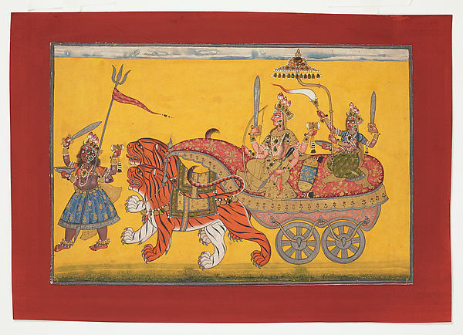
Kripal of Nurpur, The Devi (Goddess) Parades in Triumph, Nurpur, Punjab Hills/Himachal Pradesh, ca. 1660-70, 7-5/16 x 10-11/16 in. (note beetlewing cases)
Notes:
The Devi Parades in Triumph
Artist: Attributed to Kripal of Nurpur (active ca. 1660–90)
Date: ca. 1660–70
Culture: India (Nurpur, Himachal Pradesh)
Medium: Opaque watercolor, gold and beetle-wing cases on paper
Dimensions: Page: 7 5/16 x 10 11/16 in. (18.5 x 27.2 cm)

Slide 24
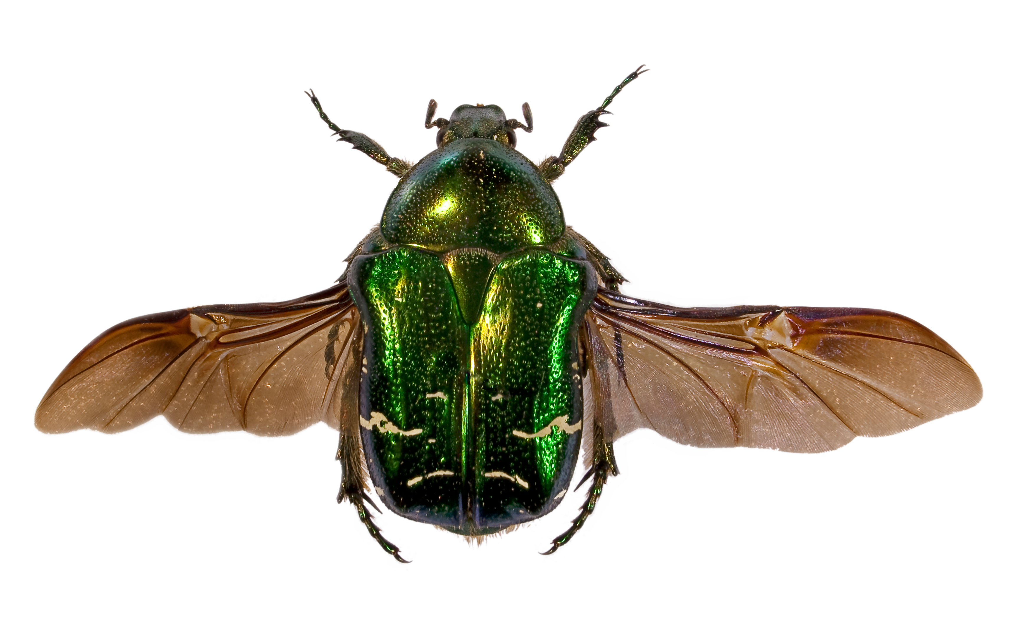

Slide 25
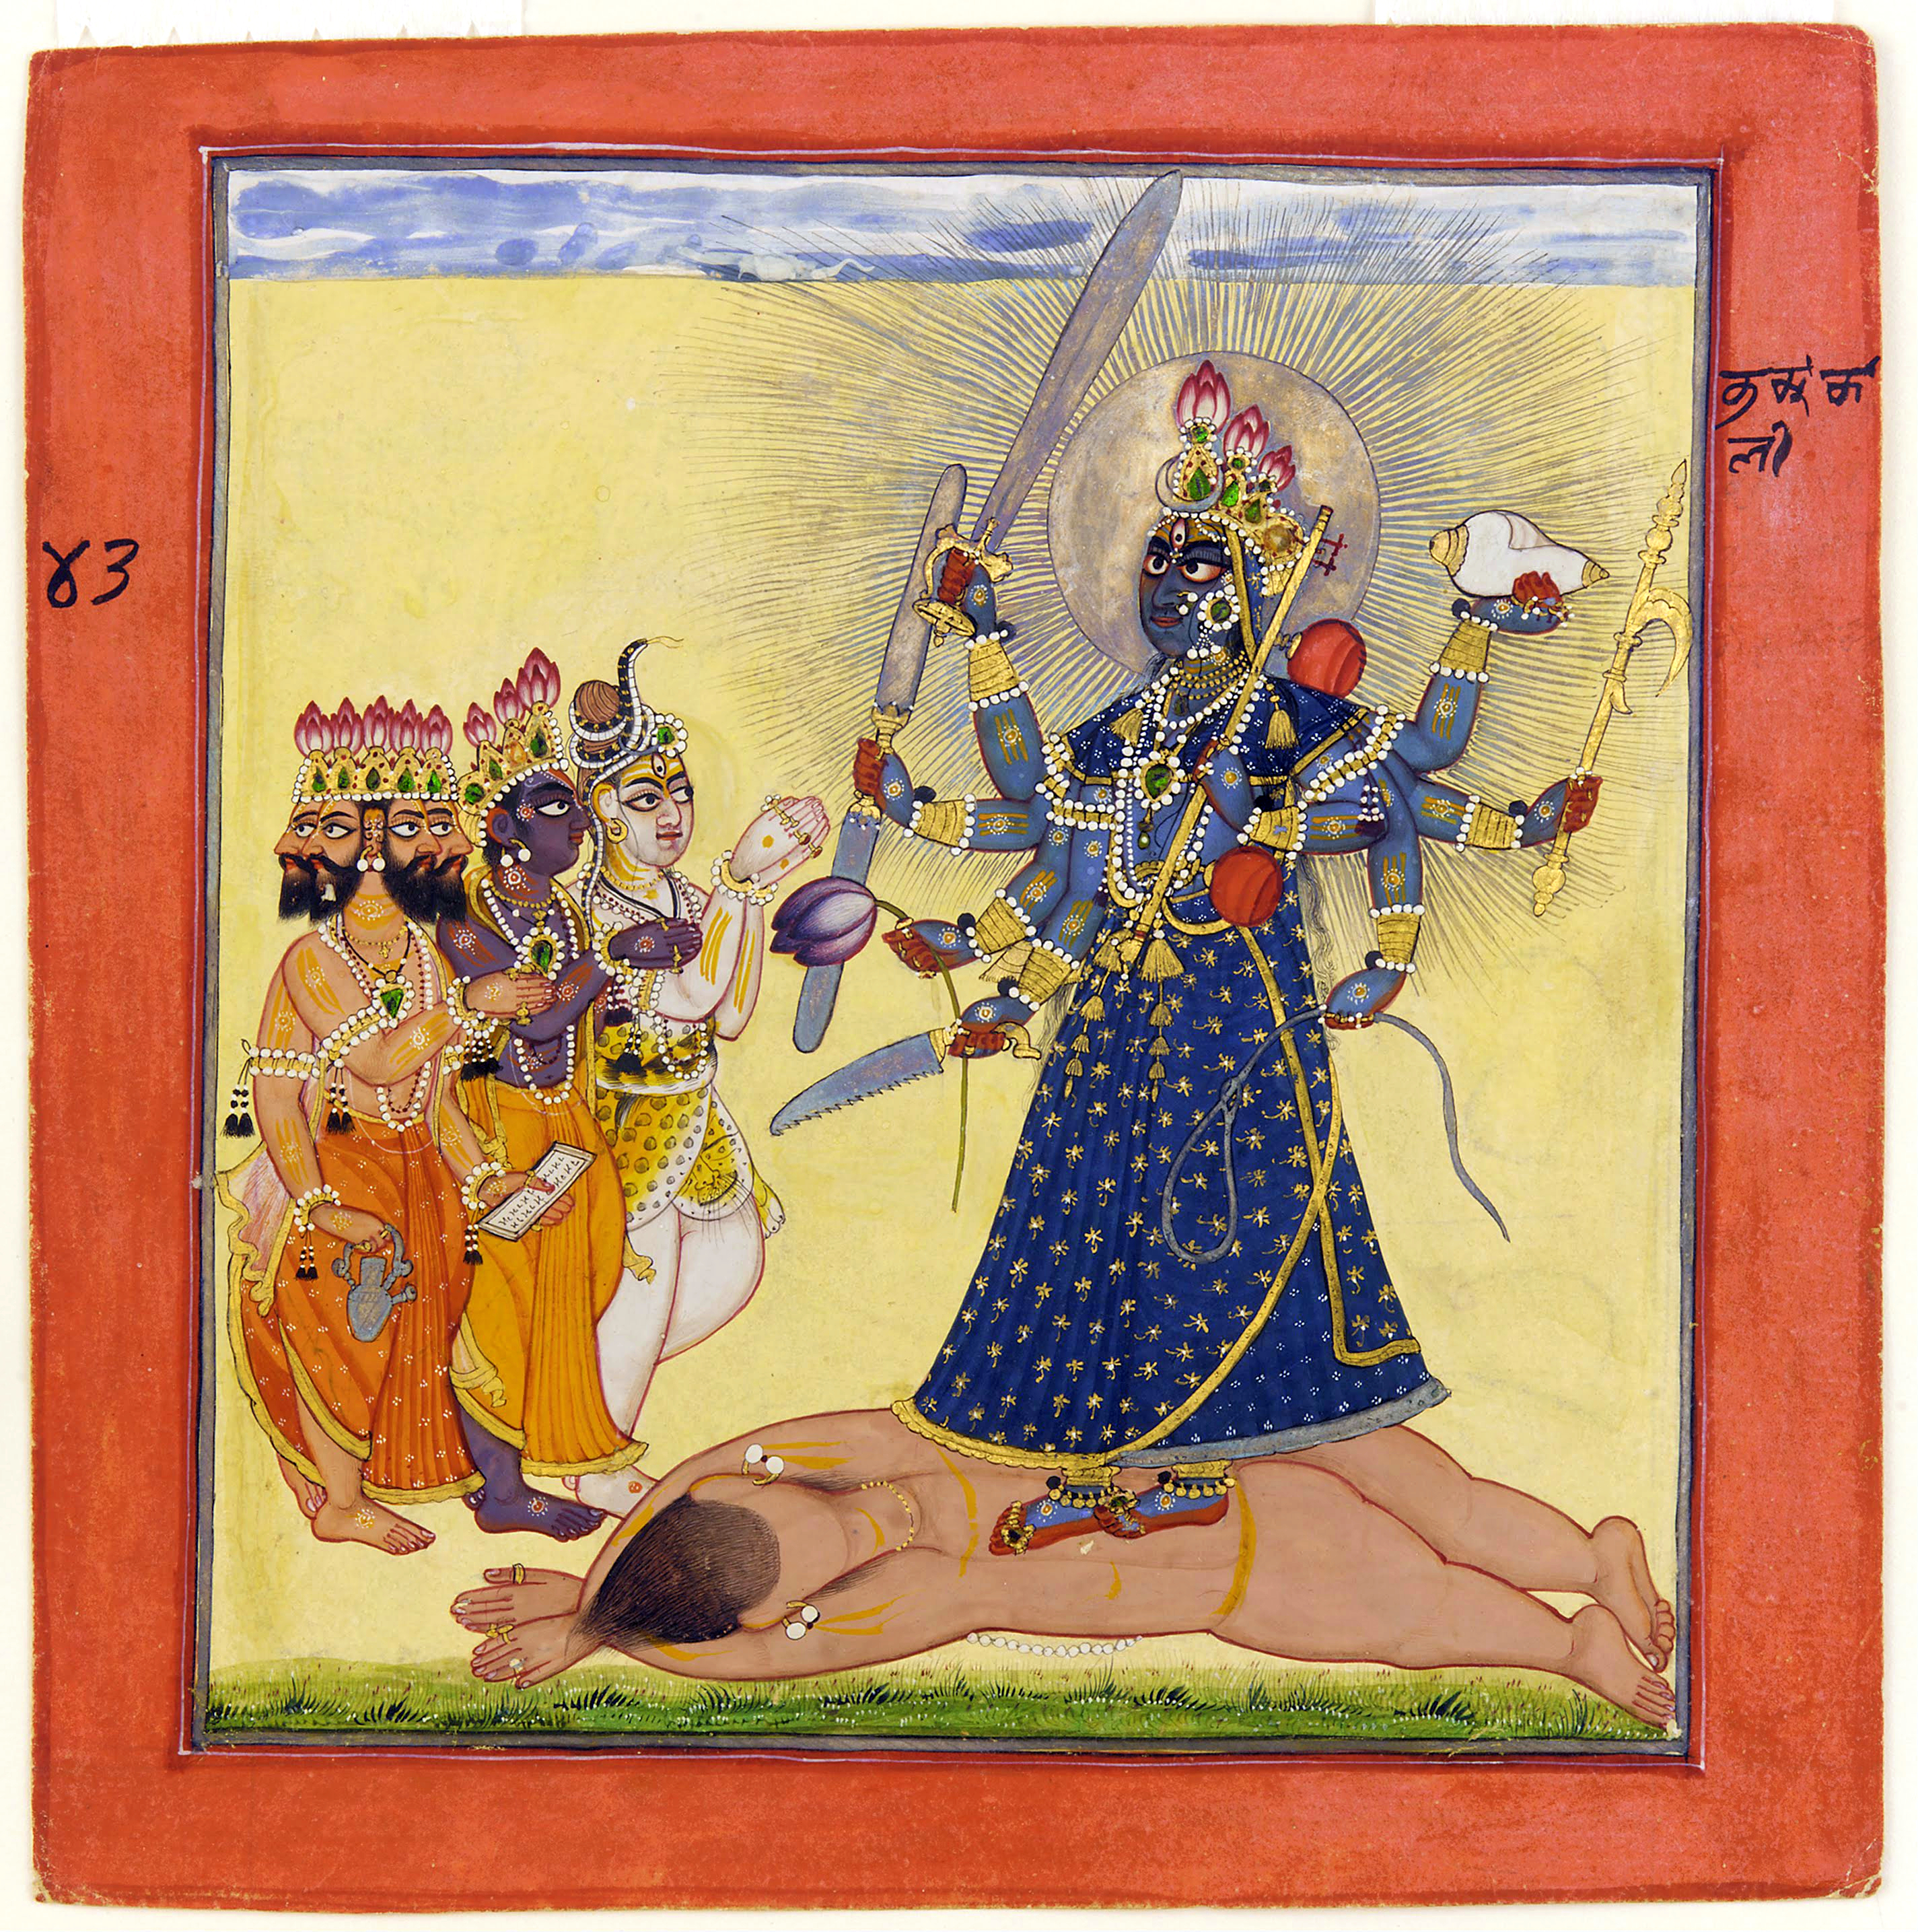
The Gods Pay Homage to Bhadrakali, folio 42 from the Tantric Devi series, Basohil, Punjab Hills, ca. 1660-70
Notes:
Bhadrakālī (Sanskrit: भद्रकाली, Tamil: பத்ரகாளி, Telugu: భద్రకాళి, Malayalam: ഭദ്രകാളി, Kannada: ಭದ್ರಕಾಳಿ, Kodava: ಭದ್ರಕಾಳಿ) (literally "Good Kali,")^{[1]} is a Hindu goddess popular in Southern India. She is one of the fierce forms of the Great Goddess (Devi) mentioned in the Devi Mahatmyam. Bhadrakali is the popular form of Devi worshipped in Kerala as Sri Bhadrakali and Kariam Kali Murti Devi. In Kerala she is seen as the auspicious and fortunate form of Kali who protects the good. It is believed that Bhadrakāli was a local deity that was assimilated into the mainstream Hinduism, particularly into Shaiva mythology. She is represented with three eyes, and four, twelve or eighteen hands. She carries a number of weapons, with flames flowing from her head, and a small tusk protruding from her mouth. Her worship is also associated with the Tantric tradition of the Matrikas as well as the tradition of the ten Mahavidyas and falls under the broader umbrella of Shaktism.

Slide 26
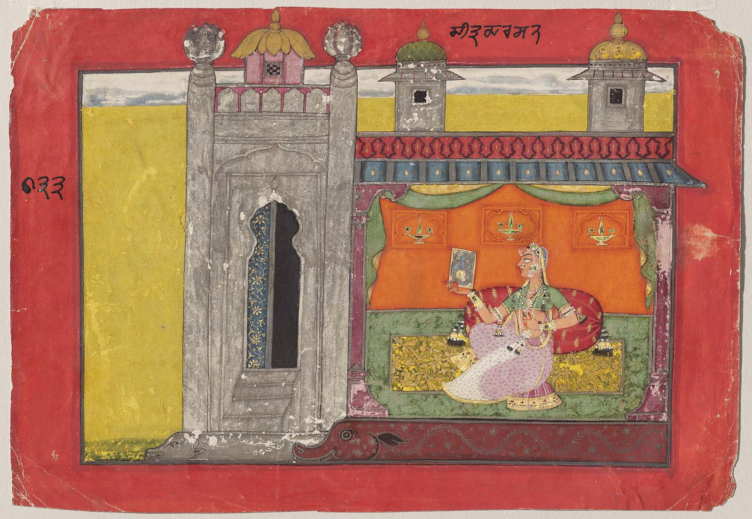
The ”Basohli Master,” Chitra Darshana Nayika (The Heroine Who Gazes at a Picture of Her Absent Beloved),
Basohli, 1660-70
Notes:
Obverse: in top margin, in Takri: "Citradarshana" and no. 133. Reverse: at bottom, 2 line inscription in Sanskrit in Devanagari: "Nivim hared urasijan-vilekhen-nakhena damtaschadamca dashanena dasheda kasmat, Itham patesa likhitam dayitam vilokya bala pureva vanaja hara vihara smakam. 133" = "Tearing at her skirt, vehemently marking her breasts with her nails and biting her lips with her teeth, and crying 'When (will he come)?' Thus regarding her lover depicted in the picture, the babe is afraid that he may be taking his pleasure in the groves."

Slide 27
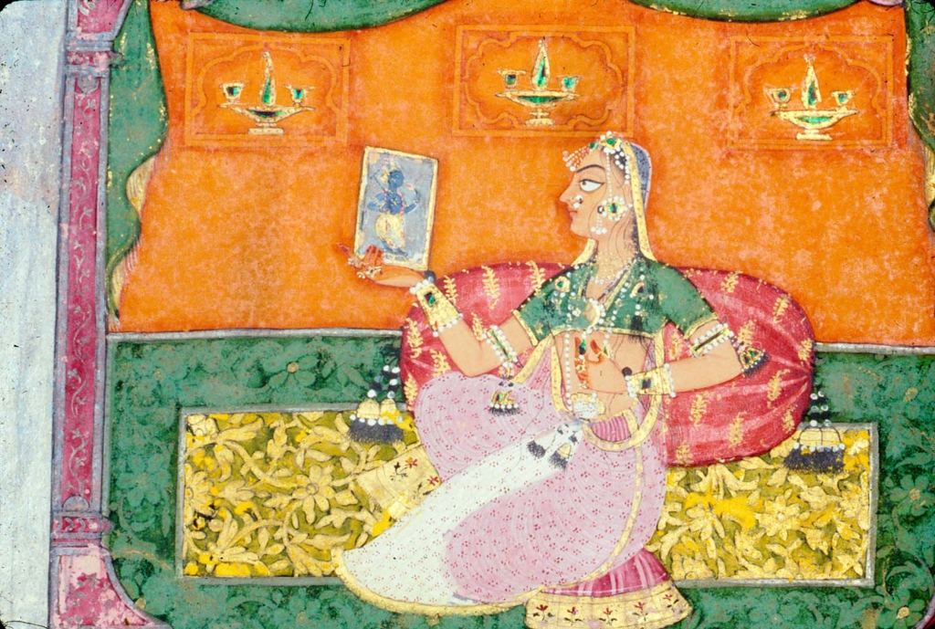
Notes:
Obverse: in top margin, in Takri: "Citradarshana" and no. 133. Reverse: at bottom, 2 line inscription in Sanskrit in Devanagari: "Nivim hared urasijan-vilekhen-nakhena damtaschadamca dashanena dasheda kasmat, Itham patesa likhitam dayitam vilokya bala pureva vanaja hara vihara smakam. 133" = "Tearing at her skirt, vehemently marking her breasts with her nails and biting her lips with her teeth, and crying 'When (will he come)?' Thus regarding her lover depicted in the picture, the babe is afraid that he may be taking his pleasure in the groves."

Slide 28
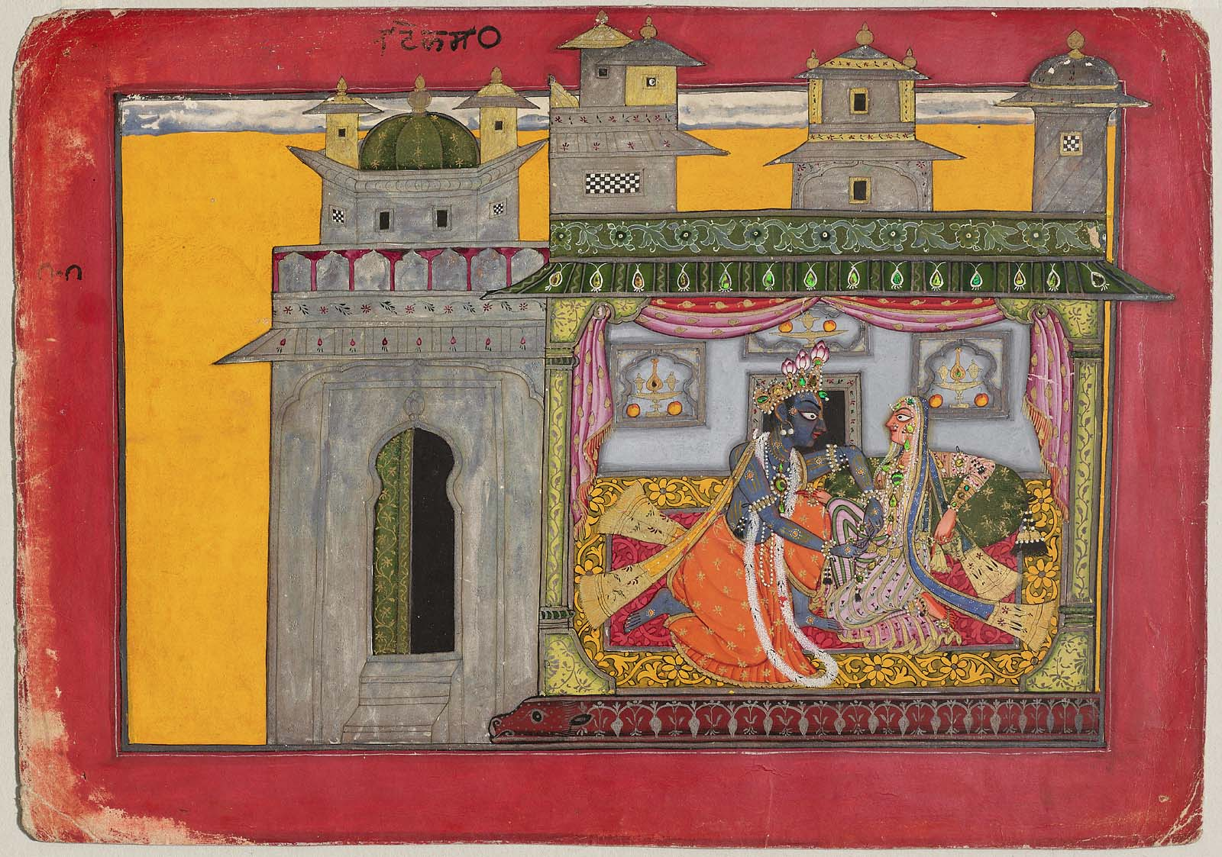
The “Basohli Master,” Krishna Loosens His Beloved's Belt, Satha Nayaka (the Deceitful Hero) Indian, Pahari, about 1660–70

Slide 29
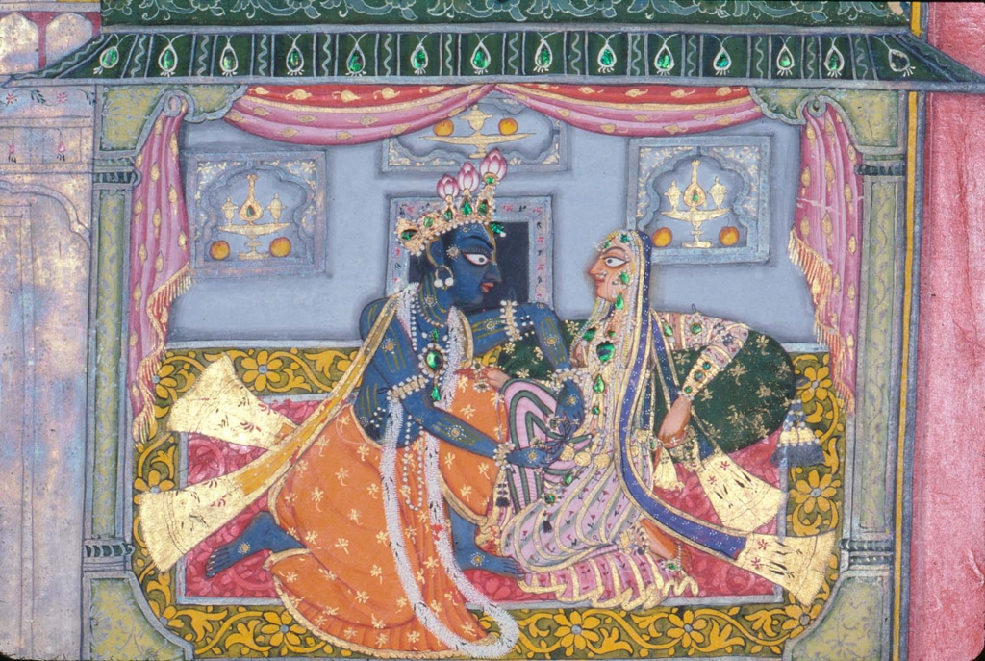
Notes:
Krishna Loosens His Beloved's Belt
Satha Nayaka (the Deceitful Hero)
Indian, Pahari about 1660–70 Attributed to The Basohli Master
Object Place, Basohli, Punjab Hills, Northern India
Dimensions
Overall: 23.3 x 33cm (9 3/16 x 13in.) Other (Without borders): 17.9 x 27cm (7 1/16 x 10 5/8in.)
Accession Number
17.2780
Medium or Technique
Opaque watercolor, silver, gold and beetle wing on paper

