Slide 1
Welcome back!

Slide 2
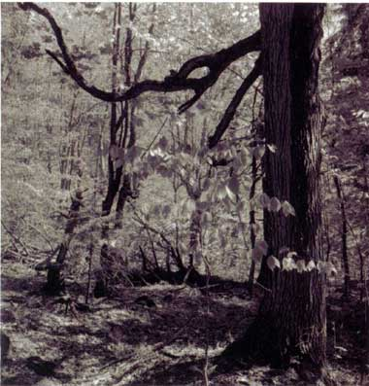
Measuring benefits and costs
The benefits and costs of wilderness preservation in Vermont

Slide 3
Measuring benefits and costs
How do we distinguish between market and nonmarket benefits of wilderness in VT?
Market benefits can be measured from market activity
Non-market benefits must be measured by ‘revealed’ or ‘stated’ preference

Slide 4
Measuring benefits and costs
The nonmarket benefits of wilderness in VT
USE value
Logging vs. recreation
OPTION value
The possibility of keystone species
EXISTENCE value
Our obligation to a ‘connected’ earth

Slide 5
Consumer surplus from preservation
Demand = WTP
Q₀
Q₁
Acres of wilderness
WTP for increase in public good ≈ Δ consumer surplus

Slide 6
Measuring benefits and costs
The benefits of wilderness in VT
The travel cost method
WTP for recreation at Bread Loaf
“Revealed preference”
The hedonic pricing method
WTP for housing prices
The contingent valuation method
“Stated preference”
WTP for option and existence value

Slide 7
Measuring benefits and costs
Five potential biases of the CV method
‘Prospect theory’

Slide 8
Consumer surplus from preservation
Demand = WTA?
Q₀
Q₁
Acres of wilderness
How might this contrast to WTA from going from Q₁ to Q₀?

Slide 9
Measuring benefits and costs
Five potential biases of the CV method
‘Prospect theory’
Free-riding
Strategic
Embeddedness
Hypothetical

Slide 10
Measuring benefits and costs
Risk assessment and the valuation of life
Epidemiological studies
Animal studies
‘Dose-response model’
Conservative modeling – the right approach?

Slide 11
Measuring benefits and costs
Risk assessment and the valuation of life
Overall risk = actual risk (1.4/10,000 for car accidents) * number of people exposed (300,000,000) = 42,000 deaths
The role of perception and control
Lack of knowledge
Risk aversion and the insurance motive

Slide 12
Measuring benefits and costs
The total costs of environmental policy
Engineering costs overstated if …
Regulation increases productivity
Creates ‘green jobs’
Engineering costs understated if ..
Regulation decreases productivity
Increases unemployment
Increases moonopoly power

Slide 13
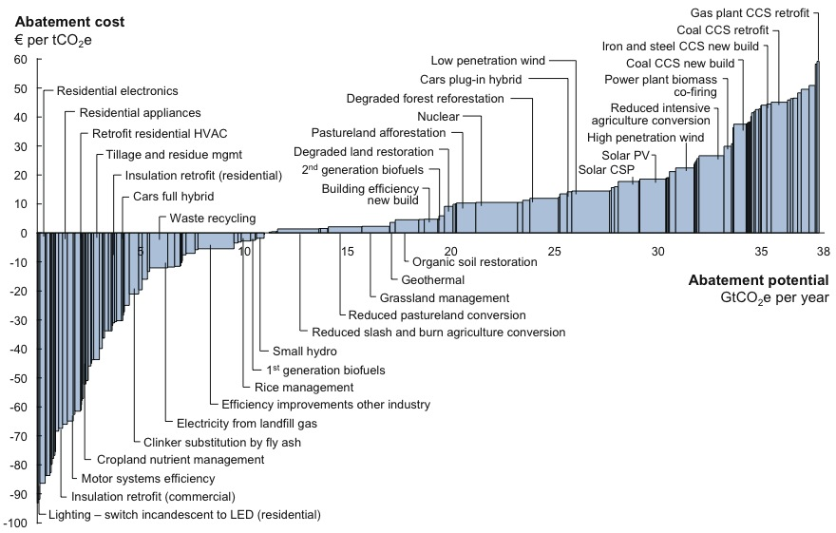

Slide 14
Measuring benefits and costs
The indirect costs of environmental policy?
Productivity impacts and the ‘Porter Hypothesis’
Very little (if any) negative effects (Meyer 1993)
The ‘jobs – environment’ trade-off?
While there are losers, this effect is way over-hyped
Pollution havens?

Slide 15
Measuring benefits and costs
The ‘hidden’ costs of environmental policy
Monopoly costs
The example of waste management
The ‘double-dividend’ controversy
1. Correcting for externalities raises prices
2. Higher prices lower real wages
3. Lower real wages means less output

Slide 16
SMC = PMC + E
Society’s net benefits = A - B
Consumer surplus
cost of externality
PMC
A
B
P₀
Total pollution
Producer surplus
Demand
C
Q₀
Corn (bushels/year)
We can show that a pollution tax increases welfare …

Slide 17
PMC (with tax)
Society’s net benefits = A
Consumer surplus
Pollution
tax
Tax revenues
PMC
P_{C}
A
P₀
DWL
P_{S}
Total pollution
Producer surplus
Demand
Q₁
Q₀
Corn (bushels/year)
BUT the pollution tax, which increases welfare, raises prices …

Slide 18
Measuring benefits and costs
The ‘hidden’ costs of environmental policy
Monopoly costs
The example of waste management
The ‘double-dividend’ controversy
1. Correcting for externalities raises prices
2. Higher prices lower real wages
3. Lower real wages means less output

Slide 19
Nominal wage ($ per hour)
D (without payroll tax)
Labor supply
W₁
DWL
W₀
D' (with payroll tax)
Q₁
Q₀
Labor (hours)
The double dividend should come from lowering the payroll tax

Slide 20
Net increase of DWL in labor market
Labor supply (higher prices)
Nominal wage ($ per hour)
Labor supply
W₂
W₀
DWL
D'' (lower tax)
W₁
D
D'
Q₂
Q₁
Q₀
Labor (hours)
But with higher prices, the last dollar earned at work is worth less ….
… so, at the margin, people will work less and relax more.

Slide 21
Measuring benefits and costs
The ‘hidden’ costs of environmental policy
The ‘double-dividend’ controversy
Benefit from lowering pollution in the goods market
‘Double dividend’
Benefit from lowering distortions in the labor market
Cost from lowering output from labor market
The current debate: how big is the output cost?

Slide 22
Benefits and costs of policies
The use of BC analysis
Not used (by statute) for air, water and hazardous waste – safety standard
Used for pesticides, insecticides, and other toxics – efficiency standard
Yet benefits and costs still estimated and part of public policy debate

Slide 23
Benefits and costs of policies
A September 2011 study from the EPI
The combined annual benefits from three major proposed rules examined here exceed their costs by $62 billion to $188 billion a year. The benefit/cost ratio ranges from 6-to-1 to 15-to-1.
When fully in effect in 2014, the combined costs of the major rules finalized by the Obama administration’s EPA would amount to significantly less than 0.1% of the economy.

Slide 24
Benefits and costs of policies
Some common sense guidelines
The eight principles of Arrow et al. (1996)
1. Useful for comparing favorable and unfavorable effects
2. Not precluded from using
3. Required for major decisions

Slide 25
Benefits and costs of policies
Some common sense guidelines
The eight principles of Arrow et al. (1996)
4. Not bound by benefit-cost tests
5. Benefits and costs quantified wherever possible, with uncertainties identified
Values of affected individuals

Slide 26
Benefits and costs of policies
Some common sense guidelines
The eight principles of Arrow et al. (1996)
6. External reviews desirable
7. Core set of assumptions
Discount rate, reducing risk of death and accidents, values of improved health
8. Distributional consequences

Slide 27
The potential use of DDT and GMOs
What standard is appropriate?
What discount rate is appropriate?
How measure benefits?
How measure costs?
Should the cost-effective solution be adopted?
What do you recommend?

Slide 28
Benefits and costs of policies
Some common sense guidelines
The eight principles of Arrow et al. (1996)
1. Useful for comparing favorable and unfavorable effects
2. Not precluded from using
3. Required for major decisions

Slide 29
Benefits and costs of policies
Some common sense guidelines
The eight principles of Arrow et al. (1996)
4. Not bound by benefit-cost tests
5. Benefits and costs quantified wherever possible, with uncertainties identified
Values of affected individuals

Slide 30
Benefits and costs of policies
Some common sense guidelines
The eight principles of Arrow et al. (1996)
6. External reviews desirable
7. Core set of assumptions
Discount rate, reducing risk of death and accidents, values of improved health
8. Distributional consequences

Slide 31
Benefits and costs of policies
The case of Obama EPA rules
What are the main conclusions of the EPI report?
What other approaches could be used to assess the effectiveness of these rules besides benefit-cost analysis?
Should these approaches be used as a substitute or a complement to benefit-cost analysis? Defend your answer.

Slide 32
Benefits and costs of policies
Controlling the impacts of consumption
Consumption tax?
Mandated vacations?
Regulation of advertising?

Slide 33
The potential use of DDT and GMOs
What standard is appropriate?
What discount rate is appropriate?
How measure benefits?
How measure costs?
Should the cost-effective solution be adopted?
What do you recommend?

Slide 34
Incentive-based regulation
A three-step approach
1. Set standard
Efficiency, safety or ecological sustainability
2. Recognize limits of governance
Imperfect information, political influence, inadequate enforcement
3. Look for ways to do better!
IB policies and clean technology

Slide 35
Incentive-based regulation
One of the most significant successes of economics since 1970
‘At Earth Day 1970, economists were ready!’
A dramatic, encouraging learning curve
In 2011, economists are wiser

Slide 36
Incentive-based regulation
The typical C&C system
Identify the polluting activity and polluters
Designate an‘ambient’ standard
Mandate types of technology
Best Available Control Technology (BACT)
Very frequent in USA since 1970
Example: the original Clean Air Act (CAA)

Slide 37
Incentive-based regulation
The cost effectiveness rule (p. 304)
‘Cost effectiveness is achieved if and only if the marginal cost of reduction is equal for each pollution source’

Slide 38
Incentive-based regulation
The evolution of IB policy instruments
Green (Pigouvian) taxes
Tradable permits
Information–based regulation

Slide 39
Incentive-based regulation
Green taxes
Calculate the marginal social damage
Tax the polluting activity at that rate
Use revenues to offset other taxes
More frequent in EU and developing world
Example: Australia’s new carbon tax

Slide 40
Incentive-based regulation
Tradable permits
Calculate the desired quantity of emissions
Issue and/or sell this amount of permits
Monitor market and enforce activity
Growing rapidly in US and developing world
Example: CO₂ emissions in the EU …. and in New England (RGGI) and California (AB 32)

Slide 41
Incentive-based regulation
The cost effectiveness rule (p. 304)
The Coase corollary (p. 311)
“If there is a well-functioning permit market, a cost-effective outcome will be achieved by a marketable permit system regardless of the initial allocation of permits.”

Slide 42
Incentive-based regulation
Costs with taxes and permits
Two firms: ‘green’ (25 tons of emissions) and ‘brown’ (150 tons of emissions)
Social goal: reduce emissions from 175 tons to 100 tons
Two alternatives: tax at $60 per ton or give 50 (per ton) permits to each firm

Slide 43
$
Costs for green firm with taxes and permits
$
Tax payments = $60*10 = - $600
Abatement cost = $60*15*1/2 = - $450
Total cost = - $1050
MAC_{G}
$100
$60
Q_{e} = 25
Q_{e}* = 10
→ Quantity of emissions
Notes:
MAC = 100 - 4Q

Slide 44
$
Costs for brown firm with taxes and permits
$
$
$150
Tax payments = $60*90 = $5400
Abatement cost = $60*60*1/2 = $1800
Total cost = $7200
MAC_{K}
$60
Q_{e}** = 90 Q_{e} = 150
Notes:
MAC = 150 - Q

Slide 45
$
Costs for green firm with taxes and permits
$
Permit sales= $60*40 = + $2400
Abatement cost = $60*15*1/2 = - $450
Total revenue = + $1950
MAC_{G}
$100
$60
Q_{e}* = 10 Q_{e} = 25 Q_{p} = 50
→ Quantity of emissions

Slide 46
$
Costs for brown firm with taxes and permits
$
$
$150
Permit cost = $60*40 = $2400
Abatement cost = $60*60*1/2 = $1800
Total cost = $4200
MAC_{K}
$60
Q_{p} = 50 Q_{e}** = 90 Q_{e} = 150

Slide 47
The brown firm asks: should we go green?
$
Should they make this investment?
If the NPV of Benefits > Initial cost
Annual cost savings
Tax ($10)
Tax payments
MAC
CA
0
→ Quantity of emissions
20
Long-run cost savings and pollution reduction with ‘green’ tax

Slide 48
Potential problems with IB-systems
Both taxes and permits
“Hot spots” (non-uniformly mixed pollutants)
Monitoring and compliance
Permits only
Thin markets and high transactions costs
Development of market power
Relocation effect
The potential of limited permit life

Slide 49
Potential problems with IB-systems
Taxes only
The need to change the tax rate
The political setting (in the USA)

Slide 50
Incentive-based regulation
How to deal with uncertainty?
When the marginal benefit of abatement is relatively steep … you want to ‘stick your landing!’

Slide 51
Taxes or permits when the marginal benefit of abatement is relatively steep?
MC of reduction is constant (<$10) but uncertain – and the authority choose a $5 tax
$
How many emissions if the MAC is $6?
$10
MAC = $6
T = $5
How many emissions if the MAC is $4?
MAC = $4
E₀ = 150
E* = 75
E = 0
Quantity of abatement
Quantity of emissions

Slide 52
Incentive-based regulation
How to deal with uncertainty?
When the marginal cost of abatement is relatively steep … you don’t want to overpay.

Slide 53
Taxes or permits when the marginal costs of abatement are relatively steep?
MC₂ (actual)
$
P₃
MB
MC₁ (estimate)
Tax =
P₁
Qª₃
Qª₂
Qª₁ = permit allocation
Quantity of abatement
Quantity of emissions

Slide 54
Incentive-based regulation
How to deal with uncertainty?
So given the uncertainties and the nature of the MB and MC curves, what would be better for GHG abatement?

Slide 55
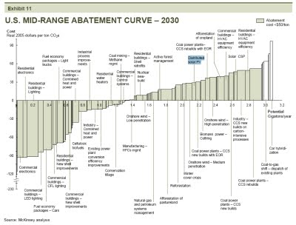

Slide 56
Equilibria with the hybrid policy (after Wilcoxen and McKibbin)
$
D₂
P₂
D₁
S
P_{T}
P₁
Qª₂
100
Quantity of permits

Slide 57
Our trading exercise
Profit-maximization under a C&C regime
Your MAC = N*(a^2), where N is the last digit of your college ID and a is the amount of abatement (e.g., a convex cost curve)
Example – If N = 5: cost of abating 0 units = 0; 1 unit = 5; 2 units = 20, and so on ….
If you’re profit maximizing quantity of abatement = 2, by how much would your costs increase under a C&C policy where you have to abate by one unit?

Slide 58
Our trading exercise
Profit-maximization under a C&C regime
Your MAC = N*(a^2), where N is the last digit of your college ID and a is the amount of abatement (e.g., a convex cost curve)
Example – If N = 5: cost of abating 0 units = 0; 1 unit = 5; 2 units = 20, and so on ….
If you’re profit maximizing quantity of abatement = 2, how much would you abate if the pollution tax = $0.50? $5.50? $20.50? $50.50? $100.50
How much did you save compared to a C&C policy?

Slide 59
Our trading exercise
Profit-maximization under a permit regime
Figure out what price you would be willing to accept to sell your single permit
Figure out what price you would be willing to pay to buy a second permit
Figure out the price range where you wouldn’t trade
GO!
How much did you save compared to a C&C policy?

Slide 60
Incentive-based regulation
What can we learn from experience?
Success of lead trading and CFCs
Internal trading, time limit, relative simplicity
The mixed-success of ETP, CA clunkers and RECLAIM
Thin markets, high transactions costs, relative complexity (hotspots, enforcement, NAAQs)
The SO2 – Acid Rain program

Slide 61
Cost-effective regulation: permits
The SO₂ trading program
How political support grew
The essence of the program
The results so far

Slide 62
Incentive-based regulation
What can we learn from experience?
Lead trading and CFCs
ETP and RECLAIM
The SO2 – Acid Rain program
Command and control vs. ITQs in fisheries
RGGI – an update
Regulation in India (final week)

Slide 63
Global challenges: energy & poverty
What do we mean by ‘energy’!?
‘The ability to do work’
The history of humanity = the history of energy use
The dilemma of technological improvements

Slide 64
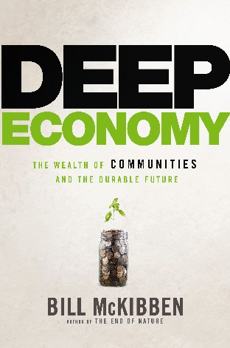
A 21st Century blueprint?
Getting the prices right
A process of ‘relocalization’
A renewed valuation of community

Slide 65
Global challenges: energy & poverty

Slide 66
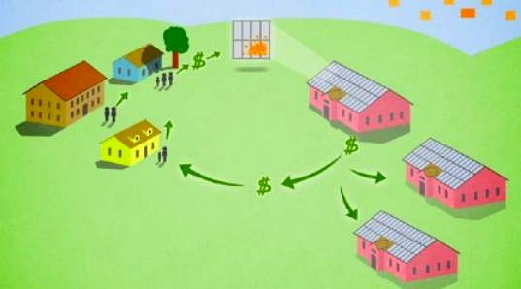
Global challenges: energy & poverty

Slide 67
Global challenges: energy & poverty
Goodstein’s 3-step approach
1. Set standard
Efficiency, safety or ecological sustainability
2. Recognize limits of governance
Imperfect information, political influence, inadequate enforcement
3. Look for ways to do better!
IB policies and clean technology

Slide 69
Global challenges: energy & poverty
Soft Energy Paths (1977) Amory Lovins
The hard energy path
Cheap electricity and petroleum – reliance on coal, oil, and nuclear power
The soft energy path
Efficient use of clean energy – promotion of renewables (solar and wind)
Energy paths and path dependence

Slide 70
Global challenges: energy & poverty
What do we mean by a clean technology?
1. Provides comparable-quality services
2. Cost competitive on a market basis

Slide 71
Economies of scale in energy production
$
“If can’t compete on basis of private costs, wont be adopted”
LRATC
C_{m}
Quantity

Slide 72
Global challenges: energy & poverty
What do we mean by a clean technology?
1. Provides comparable-quality services
2. Cost competitive on a market basis
3. Environmentally superior

Slide 73
Global challenges: energy & poverty
Are there market failures?
Potential market ‘obstacles’
Lack of information
Sunk costs
Thin markets
Limited access to capital
High discount rates
Potential government ‘obstacles’
Awful subsidy policies
Failure of regulation

Slide 74
Global challenges: energy & poverty
Other justifications?
Positive externalities
“Externalities in R & D—the fact that no single firm has the incentive to invest in research that will benefit everyone in the industry. The estimated rate of return to public spending on agricultural research has been between 45 and 60 percent” (Henderson and Isham 2010)

Slide 75
Global challenges: energy & poverty
To try to get on the winning path ..
Level the playing field
Get rid of bad subsidies and internalize negative externalities
Promote only clear environmental winners
Focus on cost-effectiveness

Slide 76
Global challenges: energy & poverty
Specific steps to get on the path
R&D funding
‘The Breakthrough Institute, a forceful advocate for “making clean energy cheap,” recommends R & D investments in the United States of at least $15 billion annually.’ (Henderson and Isham 2010)
Technology forcing standards
Recent changes in the CAFE standards
35.5 mpg by 2016
54.5 mpg by 2025 – this is huge!

Slide 77
Global challenges: energy & poverty
Specific steps to get on the path
Infrastructure investment
The promise of the ‘smartgrid’
Producer subsidies
Price preferences and procurement contracts
The leadership of the Defense Department

Slide 78
Global challenges: energy & poverty
The current energy picture in the USA
Energy consumption/capita over 20 years determined by oil shocks, economic growth, and policies
Three core problems: relative abundance of cheap dirty energy, consumer preferences, and political influence

Slide 79
Global challenges: energy & poverty
Net generation by energy source: 1997 (Electric Power Monthly)

Slide 80
Global challenges: energy & poverty

Slide 81
Global challenges: energy & poverty
Technology options: electricity and heat
1. Demand side management
Not conservation, but delivering same service with less energy
The example of Efficiency Vermont
What about the supply side?

Slide 82
Global challenges: energy & poverty
Technology options: electricity and heat
1. Demand side management
Not conservation, but delivering same service with less energy
2. Coal
Acid rain, air pollution, underground mining, strip mining, and transport .. and GHG
THE BIGGEST CHALLENGE WE FACE

Slide 83
Global challenges: energy & poverty
Technology options: electricity and heat
3. Nuclear power
No GHG emissions, but problems of safety, high-level and low-level wastes
4. Natural gas (methane)
Low sulfur and less CO₂, but also a GHG
FRACKING IS HERE TO STAY

Slide 84
Global challenges: energy & poverty
Technology options: electricity and heat
5. Hydroelectric power
No GHG emissions, but problems of ecosystem damage and social equity
6. Passive solar
Heating water and homes
GREAT NEWS – COSTS COMING DOWN

Slide 85
Global challenges: energy & poverty
Technology options: electricity and heat
7. Active solar
Solar thermal and photovoltaic power
8. Wind power
No GHG emissions, but problems of aesthetics [NOT BIRDS!]
COSTS LOW, PROMISE HIGH

Slide 86
Global challenges: energy & poverty
Policy options: electricity and heat
Step 1. Pick winners
Efficiency, wind and photovoltaics
Step 2. Level the playing field
STOP SUBSIDIZING FOSSIL FUELS!!!
Step 3. Directly promote clean technologies
The challenges of equity, strategic behavior, free riding and rebound effects.

Slide 87
Poverty, growth and the environment
Physical capital
Physical capital
Human capital
Human capital
Economic Activity
Natural capital
Sources
Natural capital
Sinks
Social capital
Social capital
Is extensive overuse of sources and sinks inevitable with rapid growth?

Slide 88
Poverty, growth and the environment
The IPAT equation (Paul Ehrlich 1971)
Environmental Impact =
Population (6 billion people)
Affluence (0.1 cars per person)
Technology (5.4 tons CO₂ per car)
→ 3.45 billion tons CO₂ per year

Slide 89
Poverty, growth and the environment
The stages of economic growth (Rostow)
Agricultural economy
Manufacturing economy
Service economy
Information-based economy

Slide 90
Poverty, growth and the environment
The Bruntland Commision
Population and human resources
Food security
Improved technology
Resource conservation
The obligation of the wealthy: to promote poverty alleviation and sustainable development

Slide 91
Poverty, growth and the environment
The link between poverty and the environment
Poverty → environmental problems
Drinking water
Sewage
Indoor air pollution

Slide 92
Population without safe water
100% 80% 60% 40% 20%
$100 $1,000 $10,000
Per capita income (logarithmic)

Slide 93
Urban population without adequate sanitation
70% 60% 40% 20%
$100 $1,000 $10,000
Per capita income (logarithmic)

Slide 94
Poverty, growth and the environment
The link between poverty and the environment
Poverty → environmental problems
Drinking water
Sewage
Indoor air pollution (Bailis et al, Science, April 2005)
Under a business-as-usual (BAU) scenario, household indoor air pollution will cause an estimated 9.8 million premature deaths by the year 2030.

Slide 95
Poverty, growth and the environment
The link between poverty and the environment
Poverty → environmental problems
The poor can not afford conservation

Slide 96
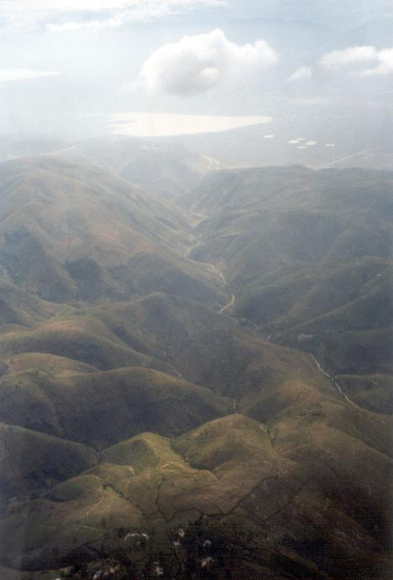

Slide 97
Poverty, growth and the environment
The link between poverty and the environment
Poverty → environmental problems
The poor can not afford conservation
The rich demand more pollution control

Slide 98
Poverty, growth and the environment
Urban SO₂
‘The Environmental Kuznets Curve’
$2500 - $3000
GDP/Capita

Slide 99
Poverty, growth and the environment
The link between poverty and the environment
Poverty → environmental problems
The poor can not afford conservation
The rich demand more pollution control
Increased income → slower population growth

Slide 100
Poverty, growth and the environment
Controlling population growth
Balanced growth and redistribution
Reduced infant and childhood mortality
Education
Family planning
Coercive policies

Slide 101
Poverty, growth and the environment
The IPAT equation: rich countries
Environmental Impact =
Population
Affluence
Technology
The need for reinvesting capital (as discussed in Goodstein and McKibben)

Slide 102
Top ten reasons to be pessimistic about GCC
10. GHG abatement is the ultimate public good
Completely non-excludable
Completely non-divisible
9. The temptation to free-ride is enormous

Slide 103
Top ten reasons to be pessimistic about GCC
8. The main constraint to free-riding is currently Hardin’s ‘appeals to conscience’
7. America is a consuming culture
6. Future generations will benefit more … and we do (and should) discount the future

Slide 104
Top ten reasons to be pessimistic about GCC
5. In the developed world, the political system is broken
4. In the developing world, the optimal choice is to not abate
3. In the developing world, the political system is broken

Slide 105
Top ten reasons to be pessimistic about GCC
2. Global solutions look like foreign aid … and Americans don’t like foreign aid.
1. Global solutions will require vigorous enforcement and ‘there is no global police’

Slide 106
Top ten reasons to be optimistic about GCC
10. Arctic ice is melting and frogs are disappearing
9. The national media FINALLY gets it (USA Today, Fox News, Time, …. )
8. The substitutes are coming, and politicians are starting to like them

Slide 107
Top ten reasons to be optimistic about GCC
7. National-level NGOs are well organized and effective (e.g., CERES)
6. State and local-level NGOs are well organized and effective (e.g., CCAN)
5. The biggest political flaw in the US is under attack

Slide 108
Top ten reasons to be optimistic about GCC
4. The biggest political flaw in the developing world is under attack
3. Durban is upon us (2011)
2. The growth of regional policies (RGGI and SB32 in California)

Slide 109
Top ten reasons to be optimistic about GCC
1. Civil society groups dedicated to building a market-friendly, clean energy future
and (in a tribute to Spinal Tap) …
… the power of Stein’s law:
“If something cannot go on for ever, it will stop” Herbert Stein

