Slide 1
Electricity
How can we provide cleaner electricity that is cost-competitive with coal?

Slide 2
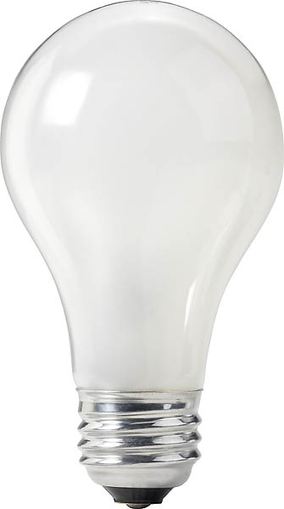
What technology will light our houses in the future?
Comparison of the available technologies for producing light.
CFLs are currently a viable option, but LEDs will likely replace them in the future.
Tim Fields

Slide 3
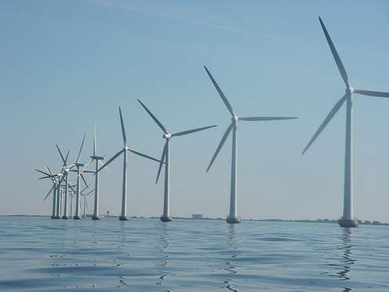
Is deepwater offshore wind an effective energy strategy for Maine that will have lasting future benefits?
DeepCwind consortium
Results
Costs: $20 billion, animal (including human) impacts
Benefits: less CO₂, bring jobs to state, energy savings
Catherine Hayes
http://www.windpowerninja.com/wind-power-government-industry-news/doe-chief-sites-gulf-spill-for-wind-power-urgency-57926/

Slide 4
Post-Fukushima: Should Japan move towards complete denuclearization?
Cost-Benefit Analysis
Japan’s dependence on nuclear energy
Japan’s goal to reduce GHG emissions
Reliability of natural/renewable energy
Complete denuclearization is an unreasonable choice for Japan
Upgrading current nuclear reactors (i.e. TerraPower, Pebble bed reactor)
More use of natural/renewable technology
Jennie Kim

Slide 5
Solar Power at Middlebury
Middlebury is considering installing a 2-acre solar array comprised of tracker photovoltaic cells near the Organic Garden in the next few years. This array will only produce about 1% of the school's energy, but will add variety to our renewable energy portfolio and offer opportunities for community education about solar energy.
Is the solar array a smart purchase for the college? Are we paying a fair price at 20 cents per kilowatt-hour of energy produced by the array?
Notes:
HI TEAM! I DIDN"T REALLY KNOW WHAT TO DO WITH CONCLUSIONS IS THAT FINE?

Slide 7
Subsidies and Education
What does the electric company pay the College and what is the subsidy?
Solar adder
current price of electricity + (20 cents -- highest price of electricity)
What if we lose it?
lose potential benefits, not add new costs
Education
example of solar energy in action
learning tool

Slide 8
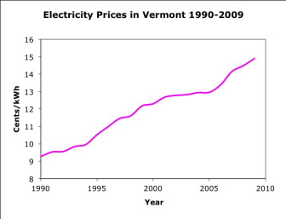
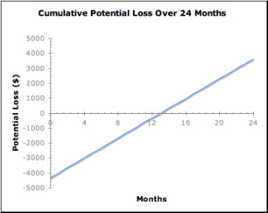
Conclusions
If you still are not convinced, we have considered some worst case scenarios.
Can energy from the grid get cheaper?
What if AER goes bankrupt?

Slide 9
Brazil & Solar Mosaic: A Relationship with Limitless Potential
Three Different Perspectives:
Economic (Why It makes sense to invest)
The rise in electricity prices and the plunge in solar prices.
The benefits versus the costs.
Potential of renewable energy in Brazil
Social (The benefits)
NGO’s and social services that strive to provide electricity to all
The possibility of providing funds for farmers who cannot compete with the dominant farms in the country. Increase in energy = Increase in productivity
Political (Possible incentives or constraints)
1. Willingness to expand foreign investment
2. Slow bureaucratic system. All legal documents are respected though.
How does Brazil compare to Italy and Canada?

Slide 10
Solar Mosaic in Canada
Price of electricity varies by province in Canada
Ontario has a well established Feed-in-Tariff system for solar developments
Canada has a 50% accelerated capital cost allowance for clean energy generation
ecoENERGY provided $1.48B investment for renewable energy development in Canada
Plethora of “green loans” offered by Canadian banks
Large number of potential partners for SM including financing, development, and management

Slide 11
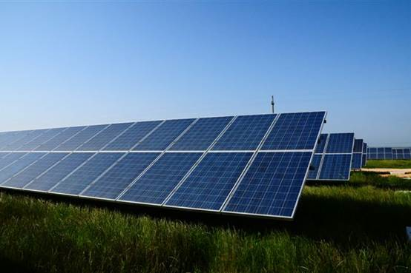
Should Solar Mosaic expand into Italy?
Mike Longo, Thomas Deakin, Nick Bondurant
Italy’s miniscule solar output has been increasing at a remarkable rate
Italian government has made growing solar a top priority
Countless financing firms specializing in green technology are available to help finance the project
Italy would be the perfect country for Solar Mosaic to expand into

Slide 12
Energy
How can we provide safe, sustainability forms of energy to households and firms?

Slide 13
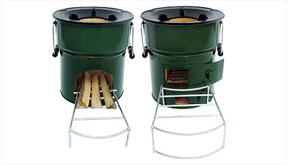
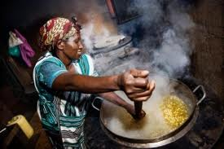
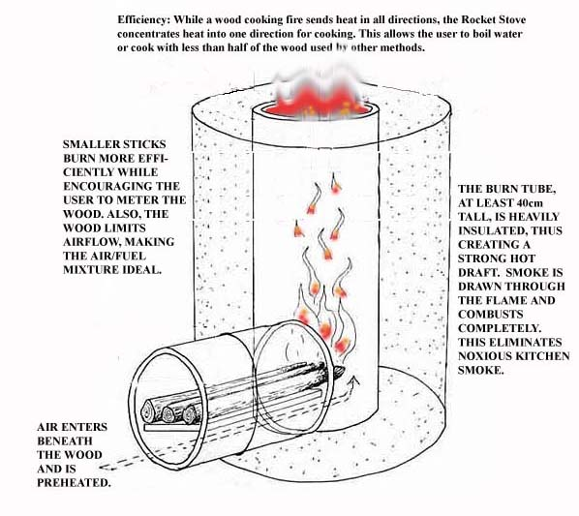
Research Question: How can we most efficiently reduce indoor air pollution in the developing world?
Methods: Combining
fuel efficient stoves and compost briquettes,
cost benefit analysis
Sunny and Harlem

Slide 14
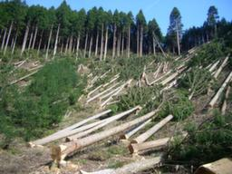
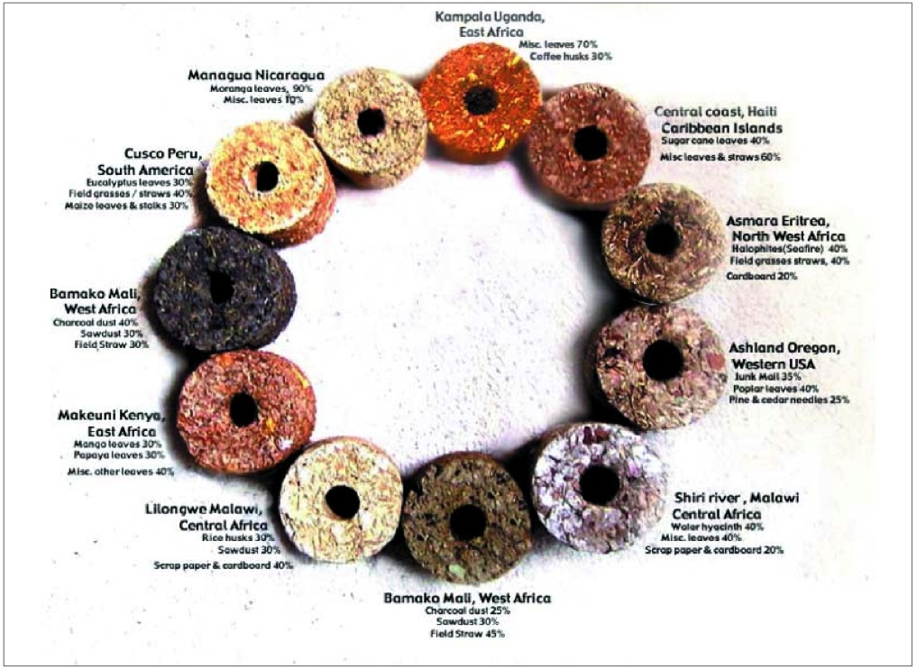
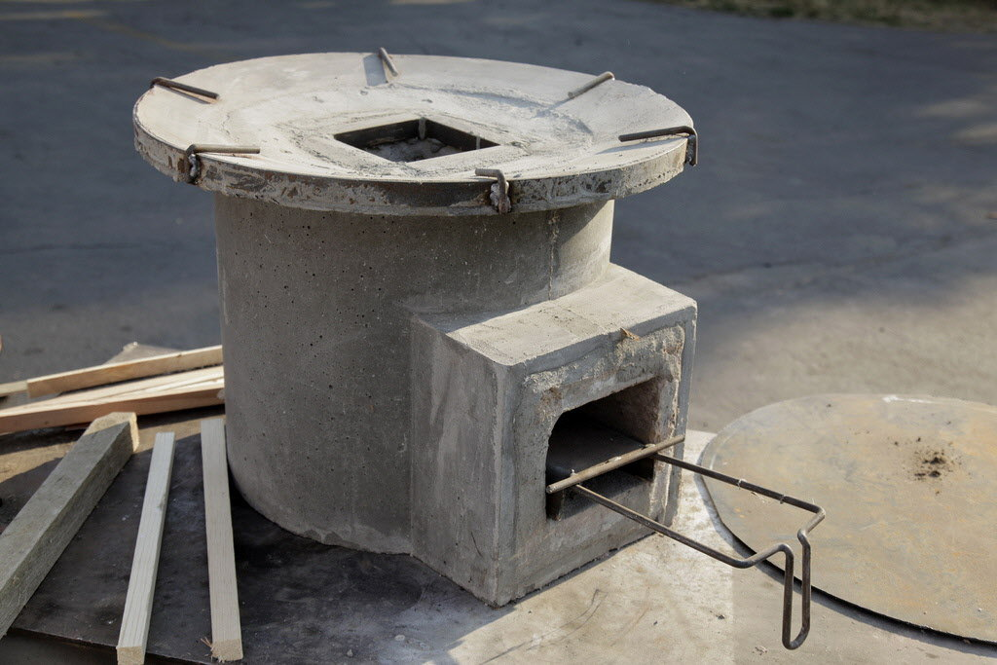
Results: More efficient - 70% reduction of indoor smoke with stoves. - Briquettes: Extra mile
Sunny and Harlem
Notes:
http://www.continentaldrift.net/2006/03/17/briquette-press-saving-trees-and-people/

Slide 15
Could the United States use a redistribution of resource rents similar to the Alaska Permanent Fund as a means of redistributing wealth in the US and narrowing the income gap?
In order to set up a model I analyzed The Alaska Permanent Fund’s functionality and structure, and its potential adverse effects on the economy concerning consumption and the labor and wage markets. I looked at the growing income inequality in the United States. And I also looked at the different forms of federal tax breaks and subsidies that the fossil fuel industry receives.
- It turns out that with the current amount of revenue that the federal government receives from natural resources this is not a viable option. A per capita dividend would end up at about$7.05/year. This dividend would yield an insignificant -0.027% change in the Gini Coefficient for US households.
Liam Mulhern

Slide 16
Food
How can we minimize the environmental impact of our food consumption?

Slide 17
Research Questions:
Is Less Meat Monday economically and environmentally cost effective?
If so, how should we implement it at Middlebury College?
Methodology:
Conversations with Matthew Biette
Review Organic Garden Survey
Investigate MeatLess Mondays at other institutions

Slide 18
Global Environmental Cost:
18% GHG emissions globally
Leading cause of biodiversity loss and water pollution
Resource intensive
Impact at Middlebury
CO2 equivalents per lb of meat
Social Cost of Carbon

Slide 19
Cost Benefit Analysis

Slide 20
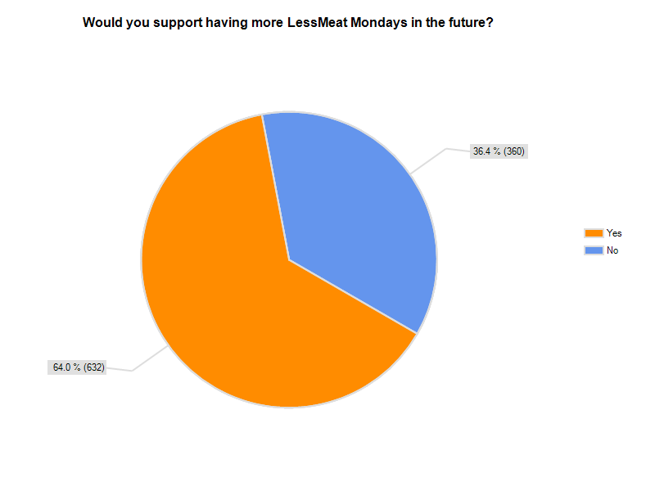
Implementation
Chose LessMeat
Focus on education
Trial Run on Monday Nov. 28
Survey
Future
Meet with Matthew
Permanent signs
Websites
Survey Results

Slide 21
Research Question:
Do potential benefits outweigh the costs of installing a greenhouse on the Middlebury College campus?
Use: MCOF, research, education and community involvement
Goals: sustainability, ecosystem integration, progressive technology
Maddie Firestone, Cat Gordon and Lauren Kelly

Slide 22
Sustainable Solutions:
Heating: geothermal, compost, vegetable oil, chickens
Electricity: solar, wind
Education: aquaponics
Maddie Firestone, Cat Gordon and Lauren Kelly

Slide 23
Methodology:
Assessing costs:
Virtual Grower 3
Upfront construction cost-estimate
Assessing benefits:
Willingness-to-pay survey (SRS, t-test, confidence interval)
Total annual tuition expenditures
Maddie Firestone, Cat Gordon and Lauren Kelly

Slide 24
Topic: The methods and effects of commodity crop production support
Process: Examination of government supply-side targeting
Income Support
Price Support
Result: Price supports dwarf income supports
Subsidies don’t make us fat
Tariffs lead to a large loss in welfare
David Dolifka

Slide 25
Housing
How can we design comfortable, modern housing that reduces our environmental impact?

Slide 26
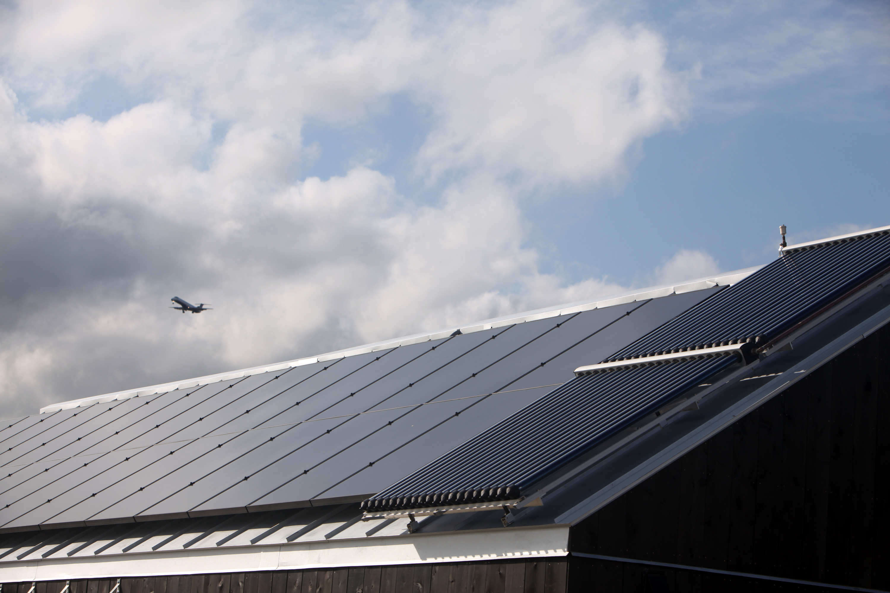
Can sustainable home design be economically feasible, and how so?
Use the Solar Decathlon house as a case study for sustainable design – measure the real value of using local materials, passive strategies, and green technology.
While some sustainable strategies are more expensive than traditional strategies others are cheaper. Together they may balance to equal and/or surpass the cost-efficiency of traditional home design.
Charlie Cotton

Slide 27
Is Green housing economically desirable for Bike and Build?
We researched the following:
Water usage
Energy efficiency
Social impacts
Health impacts
Overall cost-benefits

Slide 28
Case Studies:
South West
North East
Results:
Inhabitants of green buildings benefit greatly (both economically and socially) from this type of living.
Despite the increased cost of green building Bike & Build should adopt sustainable housing.

Slide 29
Natural resources and climate change
How can we adapt and plan as the effects of climate change accelerate?

Slide 30
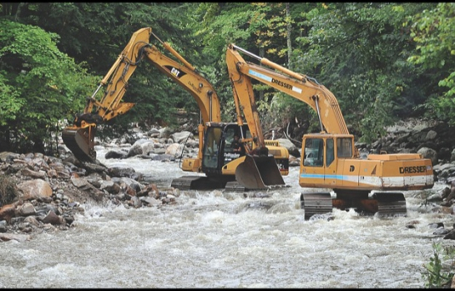
How do we prepare East Middlebury for major flood events?
Variation in management strategies
The Irene red flag
Consideration of systematic costs and benefits
Other Solutions?
Potentially Drastic
Systematic Uncertainty
Nature of weather
Climate Change
Comes down to the willingness to accept a certain degree of risk…

Slide 31
Research Question
We decided to assess the damage to VT farms, investigate the help that farmers have received from the government and donation funds, and ultimately question how VT farmers can better prepare themselves for future floods.

Slide 32
Methodology
We interviewed 2 farmers who had suffered considerable damage to their crops/livestock
We also interviewed specialists from various VT agricultural and relief agencies
Online research of the effects of Irene on Vermont agriculture

Slide 33
Results
About $10,000,000 damage incurred
Suggestions for the future
Build damage control structures
Continue loan and grant projects
Specific changes to government policies
More efficient crop testing

Slide 34
Tension over Floodwall The Sharing Cost of Thailand Flood Protection
This research aims to discuss the sharing cost of protection that is economically efficient and corresponds to the shared principles of equitable treatment of fairness toward different groups
Methodology: I use Coase Theorem, Polluter pays principle, and cost and benefit analysis theory to evaluate the issue.
Result: flood levy could lead to → more environmental justice to → more provision of public goods and better connection between firm and local community

Slide 35
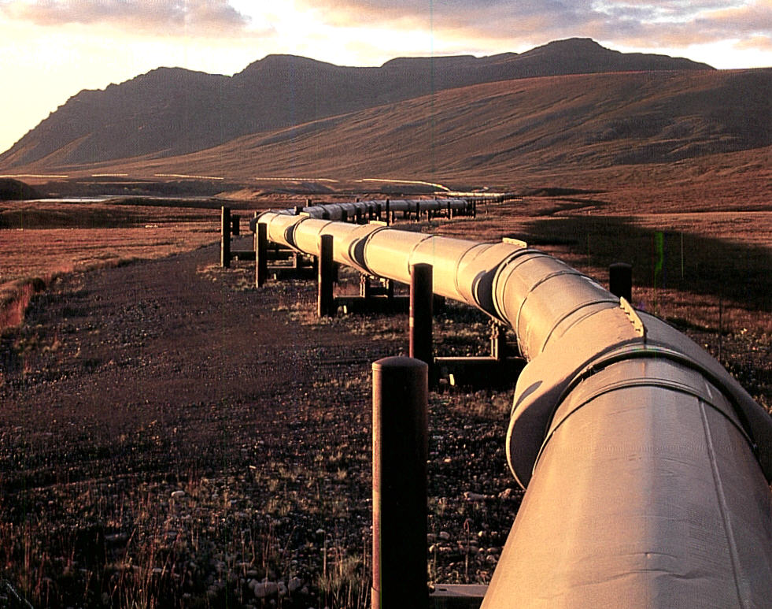
Is the Keystone XL pipeline a good project for America?
Comparing the effects in terms of job gains, energy security, changed gas prices, spills costs, and the costs of the project
Preliminary results indicate that the project will have little of the advertised positive or negative effects in terms of catastrophic spill potential, job creation (6,500), gas prices, or emissions

Slide 36
Transportation
How can we accelerate the transition to low-impact transportation?

Slide 37
Analyzing the sustainability of Obama’s EV ambitions:
Does President Obama’s goal of 1 million electric vehicles on the road by 2015 present a model of sustainability, or is it simply an optimistic dream?
Research Method: Data analysis and evaluation of data from the US Department of Energy, National Renewable Energy Laboratory, Greenhouse Gases, Regulated Emissions, Energy Use in Transportation (GREET) Model, American National Standards Institure Workshop Report
Results: Given current circumstances
weighing costs and benefits, Obama’s goal
may not be economically efficient. However,
the hopeful success of R&D measures to
reduce direct and indirect costs, and policy
measures aimed at identifying specific target
groups and increasing consumer
confidence/awareness could help make this
goal more than just a dream.
Nethra Venkatesh

Slide 38
Research question
What policies should Boston adopt to encourage bike use?
Methodology
Studies exploring the costs and benefits of specific policies
Successes in cities around the world
Boston: progress to date, potential areas of improvement
Results
No one policy is the answer: complete biking infrastructure including bike lanes, parking, integration with public transportation, and education, is key
The potential benefits of this integrated approach are significant
Samantha Gluck

Slide 39
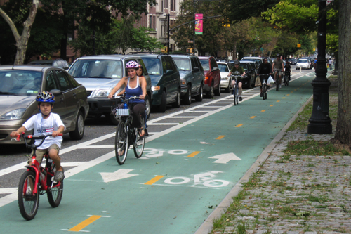
Separated Bicycle Lanes in New York City
Would separated bicycle lanes be significantly more cost effecitve than on-street lanes?
Compare data from other cities
Can be a game-changer, but it
is impractical for NYC today

