Slide 1
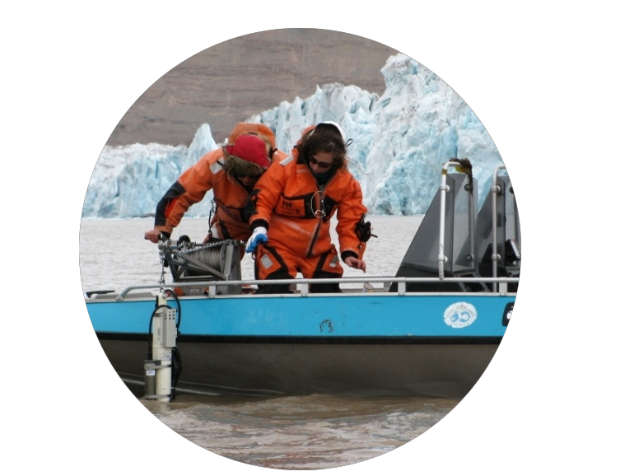
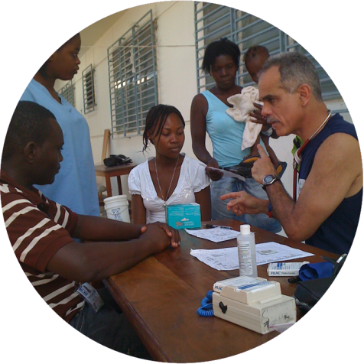
iCons ∙ Integrated Concentration in Science
Today’s Students Tomorrow’s Leaders
Clean Water
Biomedicine/
Biosystems
Climate Change
Renewable
Energy
Prof. Scott Auerbach
iCons Senior Advisor
Dept of Chemistry
Dept of Chemical Eng
Middlebury College 1/17/17
A Revolution in
Science Education

Slide 2
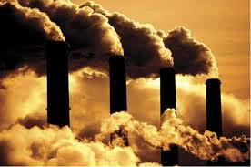
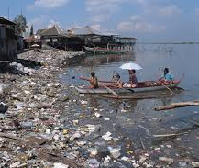
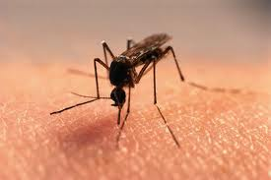
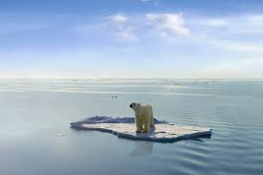

Slide 3
iCons ∙ Integrated Concentration in Science
Today’s Students Tomorrow’s Leaders
Clean Water
Biomedicine/
Biosystems
Climate Change
Renewable
Energy
Prof. Scott Auerbach
iCons Senior Advisor
Dept of Chemistry
Dept of Chemical Eng
Middlebury College 1/17/17
A Revolution in
Science Education

Slide 4
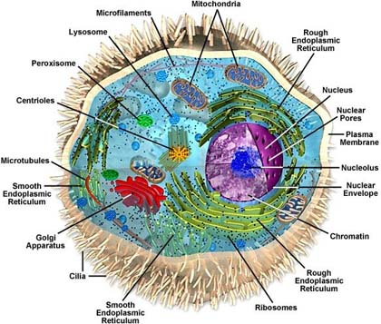
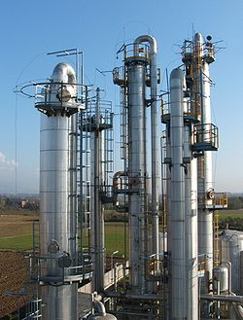
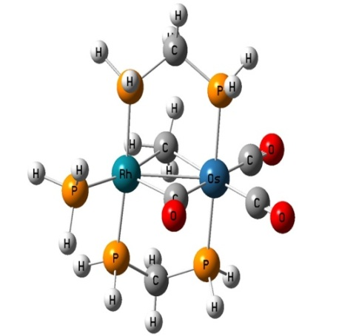
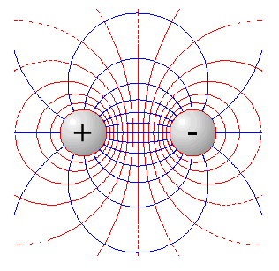
>25 Excellent Majors in Math, Engineering & Science
Knowledge / skills to solve problems that “fit” into silos
Biology
Chemistry
Physics
Mathematics

Slide 5
The Driver: How to Train Students to Solve the Big Problems?
Standard approach: The Interdisciplinary Science Major
Nobody’s An Expert

Slide 6
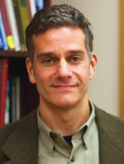
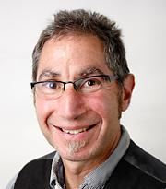
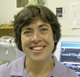
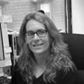
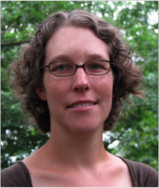
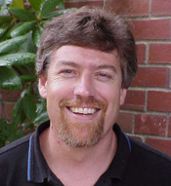
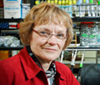
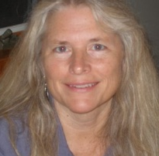
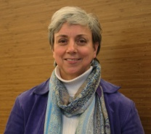
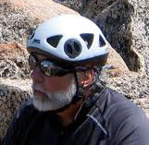
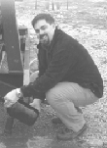
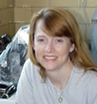
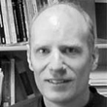
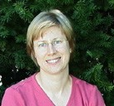
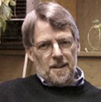
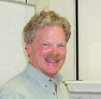
The iCons Family (ca. 2009)
S. Auerbach
Chemistry
B. Braun
Kinesiology
E. Connor
Biology
.
A. Dinsmore
Physics
.
J. Fermann
Chemistry
.
J. Glaven
Harvard Med School
S. Garman
Biochemistry
C. Lannert
Physics
M. Leckie
Geosciences
S. Leschine
Vet & Animal Sci
K. Maiolatesi
HCC Biology
J. Markarian
iCons Program Mgr
J. Mino
HCC Psychology
C. Nielsen
Program Coordinator
S. Petsch
Geosciences
M. Stassen
Assessment
J. Telfer
Vet & Animal Science
M. Tuominen
Physics
J. Tyson
Chemistry
D. Venkataraman
Chemistry
E. Walker
Biology
J. Wileden
Computer Science
G. Wyse
Biology
R. Zimmerman
Biochemistry
Notes:
"If you have an apple and I have an apple and we exchange these apples then you and I will still each have one apple. But if you have an idea and I have an idea and we exchange these ideas, then each of us will have two ideas.“ -- George Bernard Shaw

Slide 7
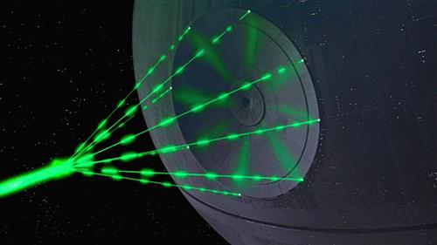
iCons ∙ New National Model for Integrative Science Ed
Diverse teams of students working on today’s big problems
Biology
Chemistry
Societal
Problems
Physics
Mathematics

Slide 8
Integrated Science Programs
2009 Study: Interdisciplinary/Integrative Science Programs
Online keyword search: ~40 universities and ~30 colleges
Some findings …
Olin College of Engineering …… Project-based learning
Princeton University ………………… Bio-Chem-Phys blend
McMaster University………………… Interdisciplinary major
Holyoke Com College ……………… Interdisciplinary mashups
Worcester Polytech Ins …………… Problem-based service
Still need a new team-based program that …
Builds from disciplinary strength (produces experts)
Frames STEM with societal problems (integrative)
Relies on student-driven inquiry (leadership)
Four years of college (life-long learners)
www.cns.umass.edu/icons-program

Slide 9
iCons ∙ New National Network for Integrative Science Ed
iCons Students Tell Their Story
Youtube iCons UMass

Slide 10
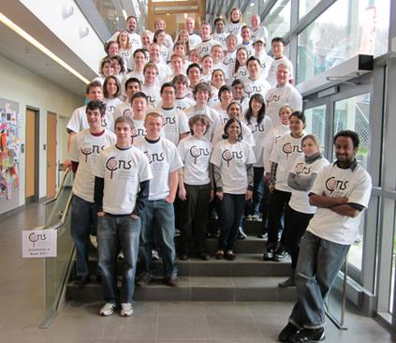
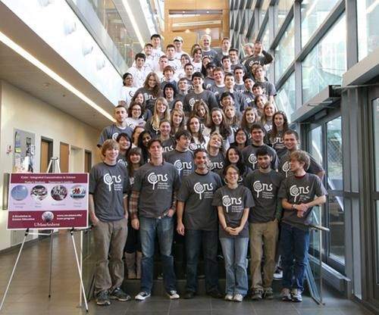
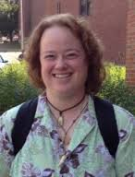
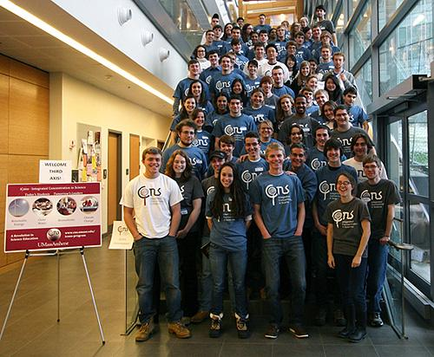
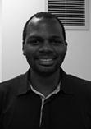
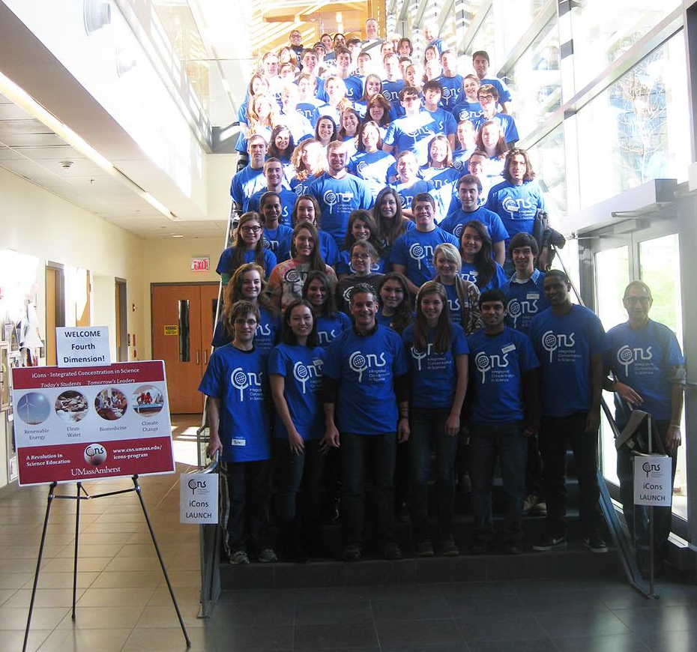
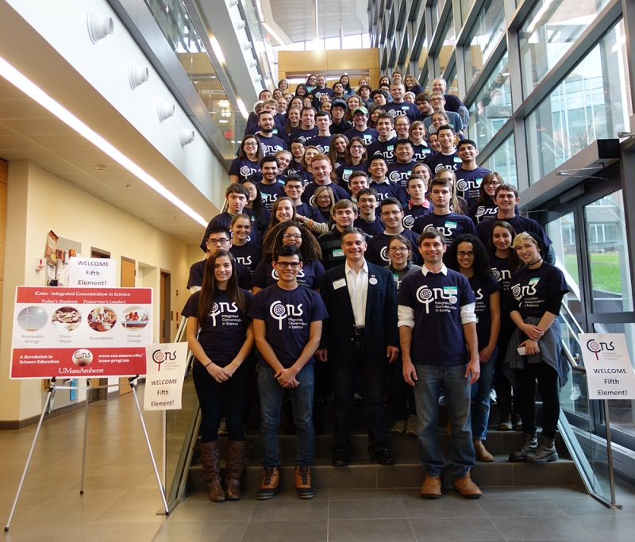
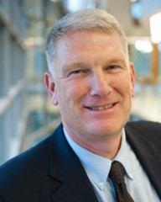
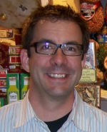
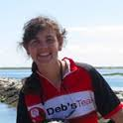
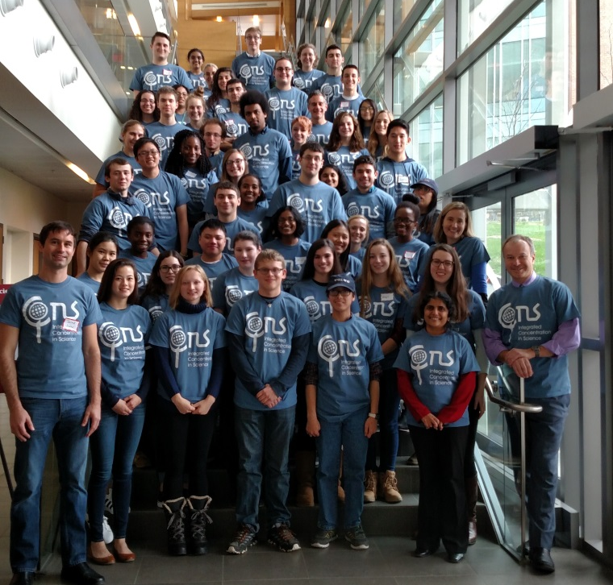
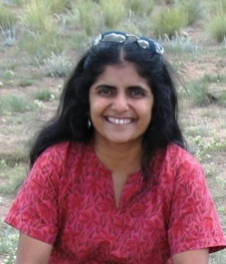
iCons Students (360+ from 25+ STEM majors)
iCons Student Mission:
To become the next generation of
– leaders in science and technology –
with the attitudes, knowledge, and skills needed to solve the inherently multi-faceted problems facing our world.
Sweet example
Ancient philosophy
Learning goals
Program structure
S. Auerbach
Chemistry
S. Compton
Biochem
A. Dinsmore
Physics
.
J. Fermann
Chemistry
.
L. Fletcher
Env Cons
.
J. Glaven
Harvard Med School
S. Garman
Biochemistry
S. Goodwin, Dean
College of Nat Sciences
M. Harrington
Biology
S. Hazen
Biology
C. Lannert
Physics
S. Leschine
Vet & Animal Sci
B. Macdonald
iCons Prog Coord
K. Maiolatesi
HCC Biology
J. Markarian
iCons Prog Mgr
J. Starr
Env Cons
M. Stassen
Assessment
J. Telfer
Vet & Animal Sci
S. Tewari
Physics
M. Tuominen
Physics
D. Venkataraman
Chemistry
J. Wileden
Computer Sci
G. Wyse
Biology
R. Zimmerman
Biochemistry
Notes:
"If you have an apple and I have an apple and we exchange these apples then you and I will still each have one apple. But if you have an idea and I have an idea and we exchange these ideas, then each of us will have two ideas.“ -- George Bernard Shaw

Slide 11
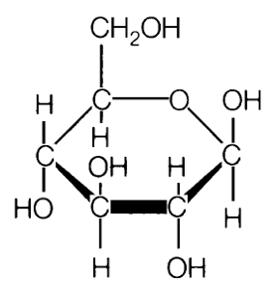
Sugar Chemistry: Before & After
Sugar Chemistry (standard O-Chem lecture)
Definition: Sugar = Carbo-hydrate
Formula Unit
Nomenclature & Examples
Mono-, Di-, Poly-saccharides
Mono: Glucose, Fructose, Galactose
Di: Lactose, Sucrose, Maltose
Poly: Cellulose, Glycogen
Structure & Stereochemistry
D & L stereo-isomers
Key: OH attached to α-Carbon
Natural Abundances
Fischer Diagrams
Chemical Reactions
Condensation / Hydrolysis
Fermentation
Applications
Nutritional value
Metabolic pathways
Refining to biofuels
Case Study: High Fructose Corn Syrup
Inception:
Princeton news, 3/22/2010 – Princeton researchers find high fructose corn syrup prompts much more weight gain.
The Atlantic, 8/13/2012 – Study: High fructose corn syrup no worse than “real” sugar.
Engagement:
Why different study outcomes? Which is correct?
Team discussions, then whole-class:
Known knowns, known unknowns → questions!
Research/Create:
Design a new study that fixes a key problem.
Likely problems:
Sample populations / statistics
Lifestyle variables / exercise and metabolism
Sweetness factor / molecular structure
Reflect:
What did I learn? How? Why? What’s next?

Slide 12
iCons Learning Goals
Constrained Outcomes
Deliver set content, e.g., Acid-Base Chem. Equil.
All students learn same content
Education by content experts
Assessment ~easy
Unconstrained Outcomes
Variable content
Each student learns different knowledge, skills
Prof as “Guide on the side”
Constructed knowledge
Assessment ~hard
Domain of iCons goals

Slide 13
iCons Learning Goals
iCons Faculty Steering Committee – Jan 9, 2009
Identify components of societal problems appropriate for scientific investigations.
Apply scientific concepts to understand societal problems.
Utilize team diversity to create solutions for societal problems.
Provide constructive criticism to others.
Utilize constructive criticism from others.
Learn from mistakes.
Write effectively using technical arguments about societal problems.
Speak effectively using technical arguments about societal problems.
Communicate science to a broad spectrum of audiences.
Pose valid scientific questions related to societal problems.
Design and carry out valid scientific studies to test hypotheses.
Explain significance of scientific studies in solving societal problems.
Critically analyze scientific literature to identify gaps in scientific knowledge.
Carry out scientific research to fill gaps in knowledge.
Integrate knowledge across fields in service of solving societal problems.

Slide 14
iCons Learning Goals
iCons Faculty Steering Committee – Jan 9, 2009
Identify components of societal problems appropriate for scientific investigations.
Apply scientific concepts to understand societal problems.
Utilize team diversity to create solutions for societal problems.
Provide constructive criticism to others.
Utilize constructive criticism from others.
Learn from mistakes.
Write effectively using technical arguments about societal problems.
Speak effectively using technical arguments about societal problems.
Communicate science to a broad spectrum of audiences.
Pose valid scientific questions related to societal problems.
Design and carry out valid scientific studies to test hypotheses.
Explain significance of scientific studies in solving societal problems.
Critically analyze scientific literature to identify gaps in scientific knowledge.
Carry out scientific research to fill gaps in knowledge.
Integrate knowledge across fields in service of solving societal problems.
1
2
3
4

Slide 15
iCons Program Structure
“Global Challenges,
Scientific Solutions”
Team Work
Case Studies, e.g.,
Zika Virus
Campus Waste …
“Integrative Communication”
Read ∙ Write ∙ Speak ∙ Debate
Bridge Disciplines
Biomed / Energy Sections
iCons 1: Gen Ed “I”
Choose
Theme
Biomed
Energy
iCons 2: “Junior Yr” Writing
(NatSci 289H Sec 1,2 – 4 cr)
(NatSci 189H – 4 cr)
“Senior Research Project”
Cutting-edge Research
Video Abstracts
Senior Exposition
“Team Discovery Lab”
Student-designed Experiments
Cutting-edge Equipment
Biomed / Energy Sections
iCons 4: Honors Thesis
iCons 3: Upper Level Elec
(NatSci 490FH/SH – 1 cr / 1cr)
(Bio 383H / NatSci 389H – 4 cr)

Slide 16
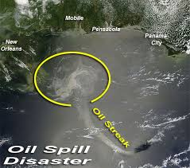
iCons 1 – Global Problems, Scientific Solutions
Natural Sciences (NatSci) 189H – Honors Gen Ed, 4 credits
Launch (frame/goals)
Case Study 1
Inception
Engagement
Research
Create
Reflect
Cholera in Haiti
Gulf Oil Spill
iCons 1 Case Studies from A to Z …
Aluminum and Alzheimers (Mt Sinai)
Antibiotic Resistance
Biofuel Refining
Cholera in Haiti
Deforestation in the Amazon
Diabetes and Exercise (AstraZeneka)
Emerging Contaminants (Waters Corp)
Fracking in Susquehana
Gulf Oil Spill
Malaria in Cameroon
Melamine in Chinese Milk (Waters)
Pacific Garbage Patch
SCF Chromatography (Waters)
UMass Waste Management (UMA)
Zika in Brazil (CDC)
iCons 1 Create Assignments
Research proposals
Epidemiological models
Physical models
Public presentations
Experimental designs
Actual experiments
Emergency plans
…
Case Study 2
Case Study 3
Build New Case and
Reflect (goals)

Slide 17
iCons 1 2011 Evals
Student Response to Instruction (SRTI) Spring 2011
12 Questions, 1 to 5=best
Comparison Group = 21 Sections Honors Intro Bio/Chem/Phys/Math/Env. Sci./Food Sci.
Freshman Spring 2011 Sample Sizes: iCons=39/41; Comp Group=41.7/section (534/875).
Even though iCons faculty typically don’t:
Lecture on targeted material
iCons faculty do:
Inspire interest, and
Stimulate participation, so
iCons students perceive they:
Meet or exceed learning goals, even though they
Are far from comfort zone
Instructor was well prepared for class.
Instructor inspired interest in subject.
Instructor showed interest in helping.
Instructor stimulated student participation.
Instructor explained course material clearly.
Instructor cleared up points of confusion.
I received useful feedback on my performance.
Methods of evaluating my work were fair.
Overall, how much do you feel you learned?
Overall rating of instructor’s teaching.
Overall rating of this course.
www.cns.umass.edu/icons-program

Slide 18
iCons Program Structure
“Global Challenges,
Scientific Solutions”
Team Work
Case Studies, e.g.,
Zika Virus
Campus Waste …
“Integrative Communication”
Read ∙ Write ∙ Speak ∙ Debate
Bridge Disciplines
Biomed / Energy Sections
iCons 1: Gen Ed “I”
Choose
Theme
Biomed
Energy
iCons 2: “Junior Yr” Writing
(NatSci 289H Sec 1,2 – 4 cr)
(NatSci 189H – 4 cr)
“Senior Research Project”
Cutting-edge Research
Video Abstracts
Senior Exposition
“Team Discovery Lab”
Student-designed Experiments
Cutting-edge Equipment
Biomed / Energy Sections
iCons 4: Honors Thesis
iCons 3: Upper Level Elec
(NatSci 490FH/SH – 1 cr / 1cr)
(Bio 383H / NatSci 389H – 4 cr)

Slide 19
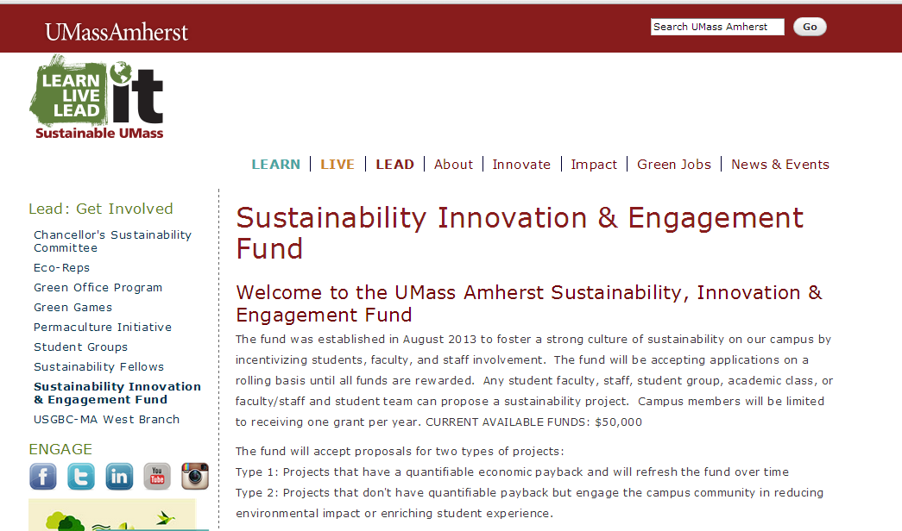
iCons 2 Energy (i2e) Communication
Launch (frame/goals)
Bootcamp (individual)
1. Personal Statement
2. Abstract
3. Slide/Speech
4-5. Research Report
6. Revision (any)
Career
7. Panel (prop/talk)
$50,000
College
Team Project
8. BCAT Explainer
9. BCAT Pros/Cons
10. PFT Explainer
11. PFT Pros/Cons
12. Position Paper
13. Debate (in/out)
i2e
Reflect (goals)

Slide 20
iCons 2 Energy (i2e) Communication
Rubrics!
Student-driven
Post before due date
Launch (frame/goals)
Bootcamp (individual)
1. Personal Statement
2. Abstract
3. Slide/Speech
4-5. Research Report
6. Revision (any)
7. Panel (prop/talk)
Team Project
8. BCAT Explainer
9. BCAT Pros/Cons
10. PFT Explainer
11. PFT Pros/Cons
12. Position Paper
13. Debate (in/out)
Reflect (goals)

Slide 21
iCons 2 Energy (i2e) Communication
Heavy Feeback
Directly on document
“Goods and Shoulds”
Launch (frame/goals)
Bootcamp (individual)
1. Personal Statement
2. Abstract
3. Slide/Speech
4-5. Research Report
6. Revision (any)
7. Panel (prop/talk)
Team Project
8. BCAT Explainer
9. BCAT Pros/Cons
10. PFT Explainer
11. PFT Pros/Cons
12. Position Paper
13. Debate (in/out)
Reflect (goals)

Slide 22
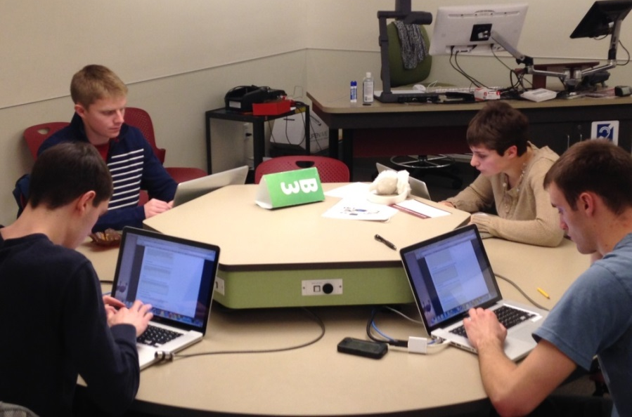
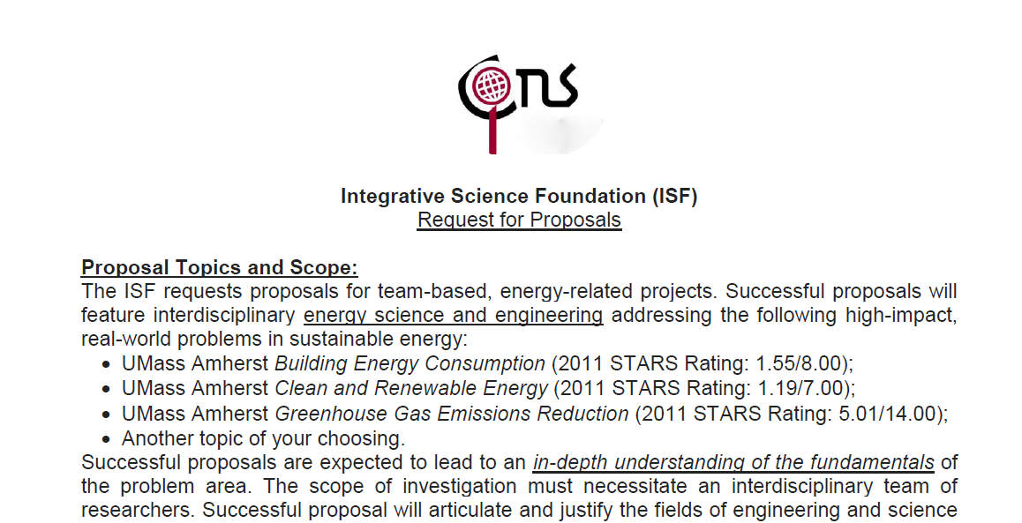
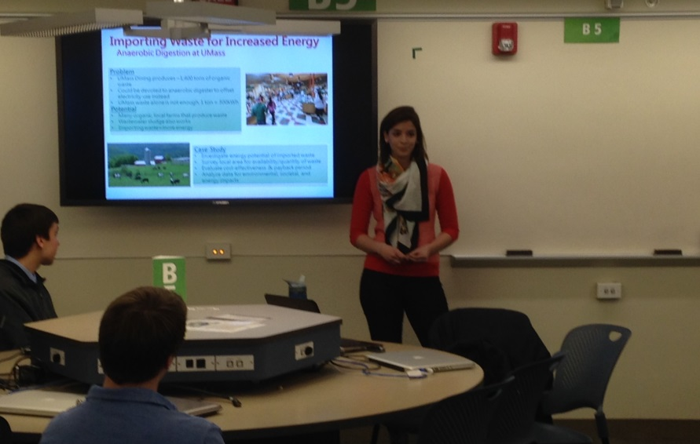
iCons 2 Energy (i2e) Communication
Launch (frame/goals)
ISF Panel Reviews
Bootcamp (individual)
1. Personal Statement
2. Abstract
3. Slide/Speech
4-5. Research Report
6. Revision (any)
7. Panel (prop/talk)
ISF “Funded” Projects (2015):
Smart Agriculture through Aquaponics
Smart Trash through Wireless Sensors
Smart Solar through Combined Heat and Power
Waste to Power through Gasifying Biomass
Waste to Fuels through De-polymerization of Wood
Team Project
8. BCAT Explainer
9. BCAT Pros/Cons
10. PFT Explainer
11. PFT Pros/Cons
12. Position Paper
13. Debate (in/out)
Reflect (goals)
ISF Panel Talks

Slide 23
iCons 2 Energy (i2e) Communication
Launch (frame/goals)
Bootcamp (individual)
1. Personal Statement
2. Abstract
3. Slide/Speech
4-5. Research Report
6. Revision (any)
7. Panel (prop/talk)
Team Project
8. BCAT Explainer
9. BCAT Pros/Cons
10. PFT Explainer
11. PFT Pros/Cons
12. Position Paper
13. Debate (in/out)
Transferable Writing Skills:
Use same rubric as above
Give one and only one draft, and emphasize this
Take off points when appropriate
Still tons of constructive criticism needed
Reflect (goals)

Slide 24
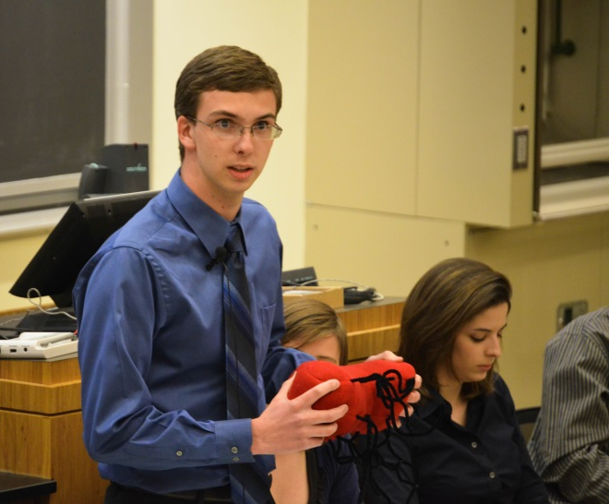
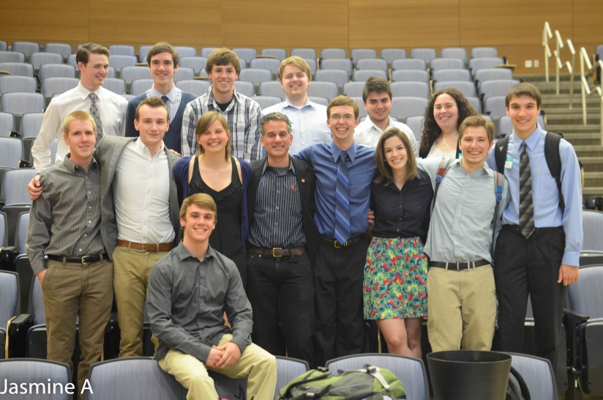
iCons 2 Energy (i2e) Communication
Launch (frame/goals)
Bootcamp (individual)
1. Personal Statement
2. Abstract
3. Slide/Speech
4-5. Research Report
6. Revision (any)
7. Panel (prop/talk)
Q: Which proposal can best use the UMass Amherst Sustainability Innovation and Engagement Fund to create:
a quantifiably positive impact
on campus sustainability
within the next 5 years?
Final Projects (2014):
Small Scale Wind Energy at UMass Amherst
Optimizing Anaerobic Digestion at UMass Amherst
Using Microbes to Reduce Radioactive Fracking Waste
Saving Heat with Smart Glass at UMass Amherst
Green Roofs Taking Root at UMass Amherst
Team Project
8. BCAT Explainer
9. BCAT Pros/Cons
10. PFT Explainer
11. PFT Pros/Cons
12. Position Paper
13. Debate (in/out)
Reflect (goals)

Slide 25
iCons 2 Energy (i2e) Communication
Launch (frame/goals)
Bootcamp (individual)
1. Personal Statement
2. Abstract
3. Slide/Speech
4-5. Research Report
6. Revision (any)
7. Panel (prop/talk)
Team Project
8. BCAT Explainer
9. BCAT Pros/Cons
10. PFT Explainer
11. PFT Pros/Cons
12. Position Paper
13. Debate (in/out)
Reflect (goals)

Slide 26
iCons Program Structure
“Global Challenges,
Scientific Solutions”
Team Work
Case Studies, e.g.,
Zika Virus
Campus Waste …
“Integrative Communication”
Read ∙ Write ∙ Speak ∙ Debate
Bridge Disciplines
Biomed / Energy Sections
iCons 1: Gen Ed “I”
Choose
Theme
Biomed
Energy
iCons 2: “Junior Yr” Writing
(NatSci 289H Sec 1,2 – 4 cr)
(NatSci 189H – 4 cr)
“Senior Research Project”
Cutting-edge Research
Video Abstracts
Senior Exposition
“Team Discovery Lab”
Student-designed Experiments
Cutting-edge Equipment
Biomed / Energy Sections
iCons 4: Honors Thesis
iCons 3: Upper Level Elec
(NatSci 490FH/SH – 1 cr / 1cr)
(Bio 383H / NatSci 389H – 4 cr)

Slide 27
iCons Program Structure
“Global Challenges,
Scientific Solutions”
Team Work
Case Studies, e.g.,
Zika Virus
Campus Waste …
“Integrative Communication”
Read ∙ Write ∙ Speak ∙ Debate
Bridge Disciplines
Biomed / Energy Sections
iCons 1: Gen Ed “I”
Choose
Theme
Biomed
Energy
iCons 2: “Junior Yr” Writing
(NatSci 289H Sec 1,2 – 4 cr)
(NatSci 189H – 4 cr)
“Senior Research Project”
Cutting-edge Research
Video Abstracts
Senior Exposition
“Team Discovery Lab”
Student-designed Experiments
Cutting-edge Equipment
Biomed / Energy Sections
iCons 4: Honors Thesis
iCons 3: Upper Level Elec
(NatSci 490FH/SH – 1 cr / 1cr)
(Bio 383H / NatSci 389H – 4 cr)

Slide 28
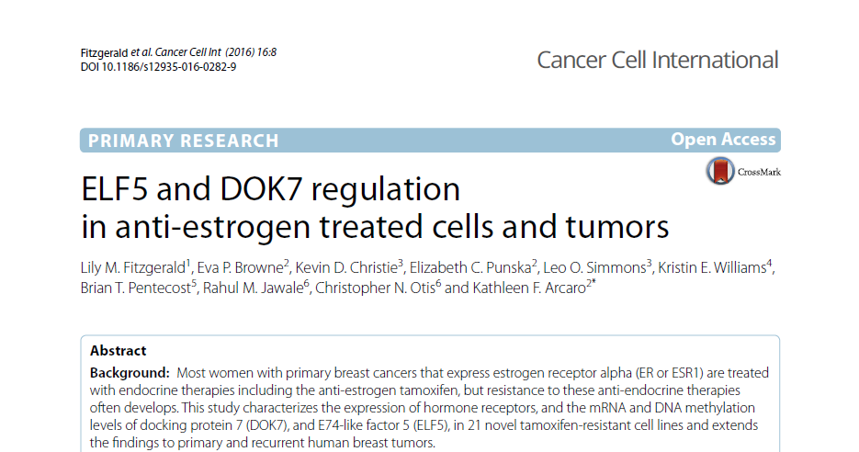
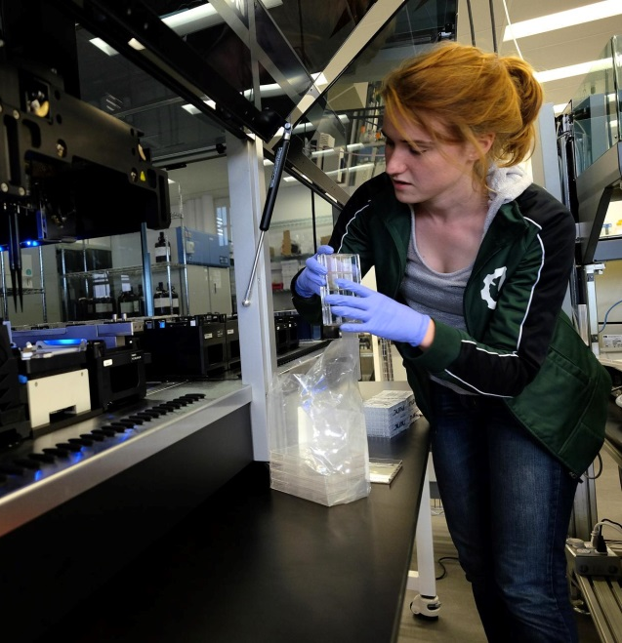
iCons 4 Student Successes
Environmental Science Major
(employed at Ginkgo Bioworks)
Vet & Animal Sciences

Slide 29
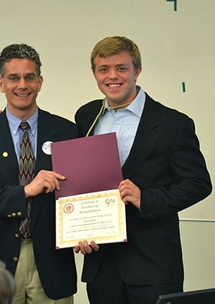
iCons 4 Student Successes
Ryan Burke (Public Health / Bio & Polit Sci)
[iCons Excellence in Research Award (May 2013)]
Thesis: “Epidemiology of Parasite-Borne Disease in Haiti”
Joined Peace Corps, Dominican Republic, Nov 8, 2013

Slide 30
What the Media Says
“Waters Corp. poses real world problem for UMass Amherst students to solve”
May 14, 2014
“Problem-Based Science Education:
The iCons Program at the University of Massachusetts Amherst”
Feb 5, 2014
“How Science Education Can Save the World”
December 21, 2015
Chemical & Engineering News
“Preparing for Real World Research”
July 4, 2011
“Universities Tailor Programs to Meet Pharmaceutical Industry’s Needs”
May 26, 2014
“STEM Teaching:
The need for wider skills”
August 20, 2015
Notes:
Somehow the PR we have generated can also play a role (more “off campus” stuff).

Slide 31
National Network of Integrative Science
The Power to Transform Science
Higher-Ed Allies:
Assessment methods
Integration schema
New case studies
Critical mass
Dreyfus Foundation

Slide 32
National Network of Integrative Science
The Power to Transform Science
Corporate Allies:
Internships
Sponsorship
Case Study IP
Consulting
K12 Allies:
(private HS, public HS, girls club)
Outreach
Recruiting
Diversity
Dreyfus Foundation

Slide 33
The iCons Family (ca. 2009)
S. Auerbach
Chemistry
B. Braun
Kinesiology
E. Connor
Biology
.
A. Dinsmore
Physics
.
J. Fermann
Chemistry
.
J. Glaven
Harvard Med School
S. Garman
Biochemistry
C. Lannert
Physics
M. Leckie
Geosciences
S. Leschine
Vet & Animal Sci
K. Maiolatesi
HCC Biology
J. Markarian
iCons Program Mgr
J. Mino
HCC Psychology
C. Nielsen
Program Coordinator
S. Petsch
Geosciences
M. Stassen
Assessment
J. Telfer
Vet & Animal Science
M. Tuominen
Physics
J. Tyson
Chemistry
D. Venkataraman
Chemistry
E. Walker
Biology
J. Wileden
Computer Science
G. Wyse
Biology
R. Zimmerman
Biochemistry
Notes:
"If you have an apple and I have an apple and we exchange these apples then you and I will still each have one apple. But if you have an idea and I have an idea and we exchange these ideas, then each of us will have two ideas.“ -- George Bernard Shaw

Slide 34
The iCons Family (ca. 2017)
S. Auerbach
Chemistry
B. Berghoff
Williston Science
S. Compton
Biochem
A. Dinsmore
Physics
.
J. Fermann
Chemistry
.
L. Fletcher
Env Cons
.
J. Glaven
Howard Hughes
S. Goodwin, Dean
College of Nat Sciences
S. Hazen
Biology
Cameron Holden
iCons Prog Mgr
C. Lannert
Physics
S. Leschine
Vet & Animal Sci
B. Macdonald
iCons Prog Coord
K. Maiolatesi
HCC Biology
J. Markarian
iCons Prog Mgr
Emeritus
J. Starr
Env Cons
M. Stassen
Assessment
J. Telfer
Vet & Animal Sci
S. Tewari
Physics
M. Tuominen
Physics
D. Venkataraman
Chemistry
J. Wileden
Computer Sci
G. Wyse
Biology
Carter Wall
Franklin Beach
Notes:
"If you have an apple and I have an apple and we exchange these apples then you and I will still each have one apple. But if you have an idea and I have an idea and we exchange these ideas, then each of us will have two ideas.“ -- George Bernard Shaw

Slide 36
Take Home Messages
Education is not filling a bucket…
It is lighting a fire.
-WB Yeats
A genius is someone who’s made every mistake, once.
-Yogi Berra or Albert Einstein
(∴ capture student passion w/ context)
(∴ value of reflecting on education)
Tell me, and I forget.
Teach me, and I remember.
Involve me, and I learn.
-Ben Franklin or Confucius
The greater danger is not that our aim is too high & we miss it.
But that it is too low
and we reach it.
-Michelangelo
(∴ value of student ownership)
(∴ promote Integration today!)
Notes:
Confucius

Slide 37
iCons ∙ Integrated Concentration in Science
Today’s Students Tomorrow’s Leaders
Clean Water
Biomedicine/
Biosystems
Climate Change
Renewable
Energy
Prof. Scott Auerbach
iCons Senior Advisor
Dept of Chemistry
Dept of Chemical Eng
Middlebury College 1/17/17
A Revolution in
Science Education

Slide 38
Explosion of Knowledge
Push Towards Increasing Specialization
Physics
Humanities
& Social
Sciences
Chemistry
Medicine
Biology
Hard Sciences
Bollen J, et al. (2009) Clickstream Map of Science. PLoS ONE 4(3): e4803. doi:10.1371/journal.pone.0004803

Slide 39
Explosion of Knowledge
Push Towards Increasing Specialization
Conventional Wisdom
So much specialized knowledge to learn!
Students must spend all their time specializing.
New/Old Wisdom
They’re never going to get it all – stop trying!
Students should commit time to integrative learning.
Bollen J, et al. (2009) Clickstream Map of Science. PLoS ONE 4(3): e4803. doi:10.1371/journal.pone.0004803

