Slide 1
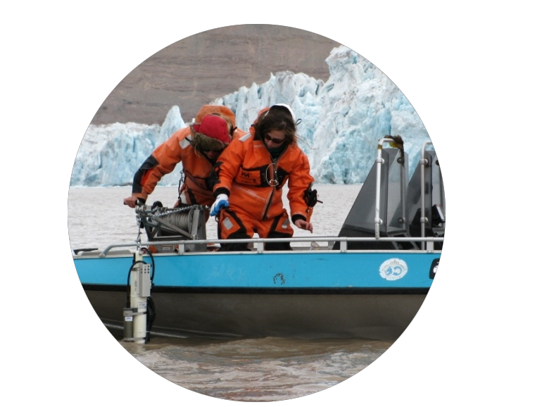
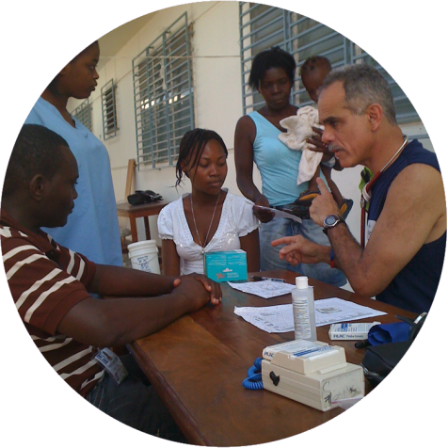
iCons ∙ Integrated Concentration in Science
Today’s Students Tomorrow’s Leaders
iCons Student Mission
To become the next generation of
– leaders in science and technology –
with the attitudes, knowledge, and skills needed to solve the inherently multi-faceted problems facing our world.
Clean Water
Biomedicine/
Biosystems
Climate Change
Renewable
Energy
Justin T. Fermann
iCons Director
Scott M. Auerbach
iCons Senior Advisor
iCons Curriculum Dev
1/17/17
A Revolution in
Science Education
Notes:
JF

Slide 2
iCons Case Study Structure
Stages of Learning
Inception:
Introduce topic, generate clarifying questions
Engagement:
Explore boundaries of our understanding → big questions
Research:
Develop skills and knowledge
Create:
Build a scientifically meaningful and useful product.
Reflect:
Analyze, critique, evaluate the product and process
Notes:
EA
----- Meeting Notes (11/14/15 07:21) -----
So now lets get into what we call the reverse design.
and what we are looking for is the transection entre a rich global problem and the scientific content and skills that are necessary to solve that problem and then the learning objectives that are associated with the application of those skills
so if you are going to designa case study that will meet that:
there is the flow and the design
the flow: is the students experience: they are being introduced to the problems, exploring the boundaries, testing the validity, growing their sills, building a tangible product, and analyzing their approach.
you as an instructor need to design it with a different point of view:
we first identify a challenge, and the associated sci prinicples and skills as well as the core learning objectives we want students to have experienced and learned with carrying out this case study
we have already articulated a few objects, so your next responsibility for today would be to break down this idea of a rich global challenge
up here we asked you to come up with some learning objective, now lets identify a rich global challenge that could meet those goals.

Slide 3
Example: Zika Epidemic – Inception Stage
Inception: Introduce Topic, Generate Questions
Notes:
JF

Slide 4
Example: Zika Epidemic – Engagement Question
Engagement: Explore Boundaries of Understanding
Systems Diagram
Notes:
JF

Slide 5
Example: Zika Epidemic – Research Stage
Research: Grow Skills and Knowledge
Notes:
JF

Slide 6
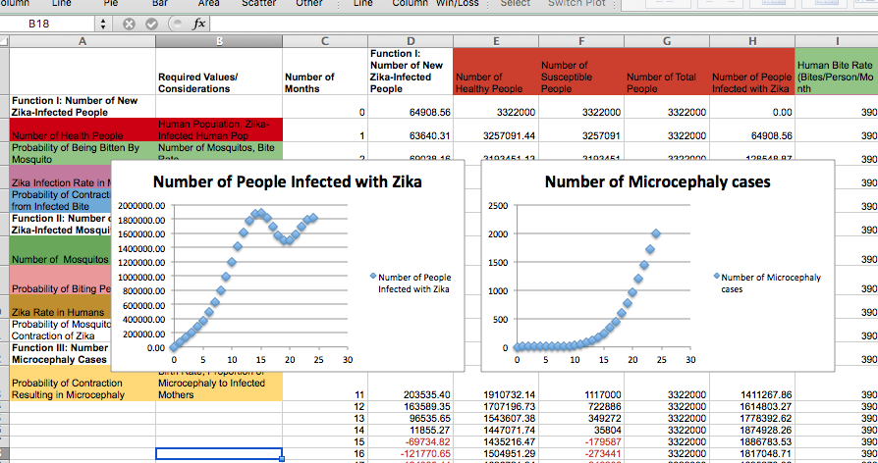
Example: Zika Epidemic – Create Step
Create: Build a (scientifically) meaningful and useful product
Notes:
JF

Slide 7
Example: Zika Epidemic – Reflection Stage
Reflect: What did the students learn?
Class,
I thought I would share with you the email I got from Dr. Mike Johansson of the CDC in response to your reports and models. He has some important points to make. (And if you see the news today, it appears the CDC is now convinced of the link between zika and microcephaly.)
--------
Hi Shubha,
Thanks for sharing these with me! Congratulations on giving your students a flavor of critical thinking through a problem in a real world context. And congratulations to the students for identifying important problems and approaches for beginning to answer address these problems. It speaks to their critical thinking that all of the problems identified by your students are also problems that researchers are currently working on.
Notes:
JF

Slide 8
iCons Learning Goals
Identify components of societal problems appropriate for scientific investigations.
Apply scientific concepts to understand societal problems.
Utilize team diversity to create solutions for societal problems.
Provide constructive criticism to others.
Utilize constructive criticism from others.
Learn from mistakes.
Write effectively using technical arguments about societal problems.
Speak effectively using technical arguments about societal problems.
Communicate science to a broad spectrum of audiences.
Pose valid scientific questions related to societal problems.
Design and carry out valid scientific studies to test hypotheses.
Explain significance of scientific studies in solving societal problems.
Critically analyze scientific literature to identify gaps in scientific knowledge.
Carry out scientific research to fill gaps in knowledge.
Integrate knowledge across fields in service of solving societal problems.
Notes:
The learning outcomes you identified from the zika epidemic model are important, and a subset of the learning objectives of the 4-yr iCons program. These are the discipline independent learning goals WE identified when designing the iCons program. You might wonder how that fits into the big picture.

Slide 9
Backward Design a la iCons
Global
Problem
Yeah, it’s a sweet spot.
Knowledge/Content:
Disciplinary Specific
Translatable Skills:
Discipline INdependent
Notes:
Global problem = zika virus
learning objectives = design effective study
content = biology of mosquito, etc

Slide 10
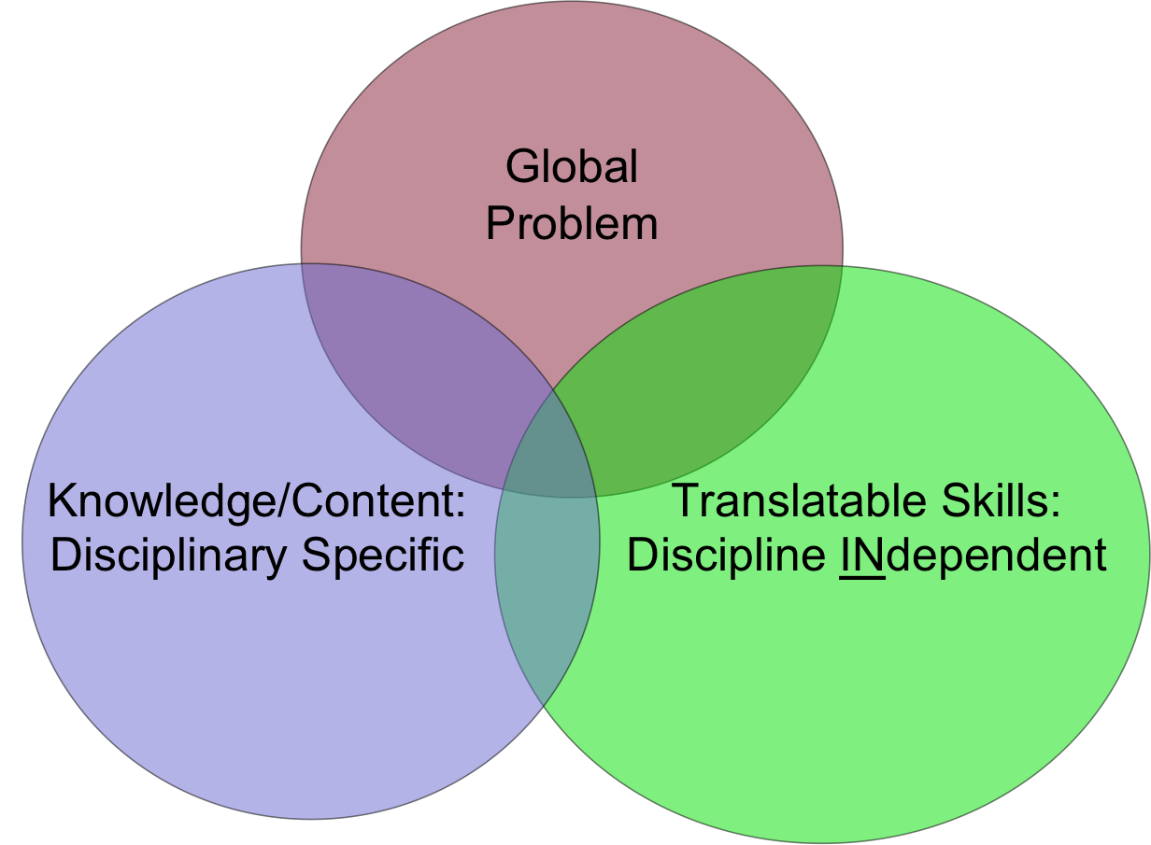
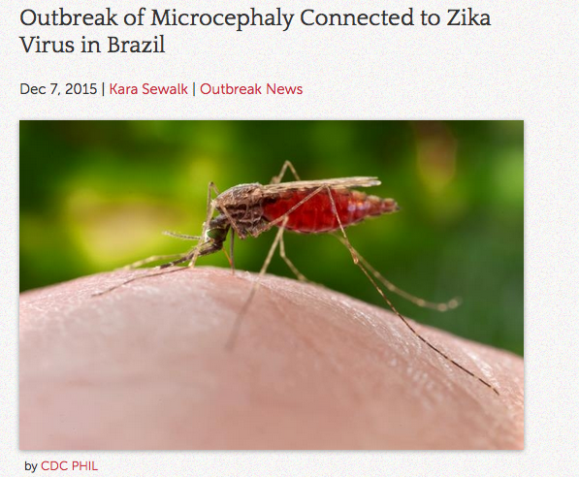
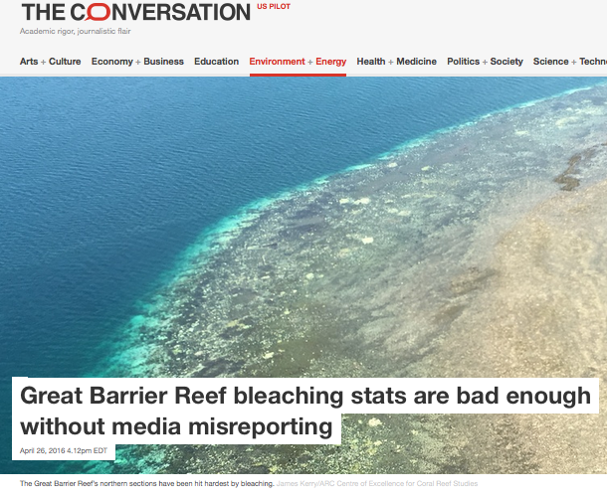
Your Turn: Inception Material
In Teams:
Identify rich global challenge, which – to assess or solve – would require the combined skills of a diverse group.
e.g. Zika epidemic
e.g. Ocean acidification
not e.g. Finding the Higgs boson
What is a time- and place-specific event that illustrates
the seriousness of this global challenge?
Notes:
Collect and give feedback on “what makes it rich?”
How will science play a role in solving these problems?
What other disciplines (economics, political science, sociology, philosophy...) will also play a role in any eventual solution?
Example: Article from a case study we ran as inception material.

Slide 11
Choosing Learning Goals
In Teams:
Choose one higher-order, non disciplinary specific, learning goal that your case study design will work toward – something you really wish your students could do well.
e.g. Write persuasively using evidence-based arguments
e.g. Design and carry out valid scientific studies
not e.g. Understand how colors are perceived
(why? how would this knowledge be used?)
Content fields:
Climate Change/skiing
Atmospheric science, meterology, snow making tech, carbon footprint of
Ski industry, clean energy generation, economics of ski towns, econ redev,
Tourism marketing,
Endocrine disruptors
Biology, endocrinology, stats, ublic health, medicine, obgyn, chem, biochem,
Anal chem, env studies,
Costs of drugs
Economics, chem, bio, ethics, govt, polisci, public policy, ppeons, stats,
Notes:
Debrief learning goals: what makes them appropriate (or not) for case study work?

Slide 12
Reverse Design a la iCons
Case Study Flow:
Student Experience
Inception:
Introduce topic, generate questions
Engagement:
Explore boundaries of our understanding
Research:
Grow skills and knowledge
Create:
Build a scientifically meaningful and useful product.
Reflect:
Analyze, critique, evaluate the product and process
Case Study Design:
Instructor (guide) Experience
Relevant Societal / Global Challenge
Associated (Scientific) Principles
Core learning objectives
Create:
Product that will demonstrate mastery of learning objectives?
Research:
Skills or knowledge to succeed? Where acquired?
Inception:
How to introduce the societal challenge?
Engagement:
How to connect the challenges to knowledge and skills?
Reflect:
Help students become aware of themselves as learners?
Notes:
EA
----- Meeting Notes (11/14/15 07:21) -----
So now lets get into what we call the reverse design.
and what we are looking for is the transection entre a rich global problem and the scientific content and skills that are necessary to solve that problem and then the learning objectives that are associated with the application of those skills
so if you are going to designa case study that will meet that:
there is the flow and the design
the flow: is the students experience: they are being introduced to the problems, exploring the boundaries, testing the validity, growing their sills, building a tangible product, and analyzing their approach.
you as an instructor need to design it with a different point of view:
we first identify a challenge, and the associated sci prinicples and skills as well as the core learning objectives we want students to have experienced and learned with carrying out this case study
we have already articulated a few objects, so your next responsibility for today would be to break down this idea of a rich global challenge
up here we asked you to come up with some learning objective, now lets identify a rich global challenge that could meet those goals.

Slide 13
Create-Step: Deliverable
In Teams: What will students create that will demonstrate that they have achieved the learning objectives, by making progress on either assessing or solving the global challenge?
e.g. Discrete time step predictive model of zebra populations.
e.g. FAQ on water contaminants downstream of fracking site.
e.g. Recommendation to FDA on gene therapy for thyroid cancer.
e.g. Research funding proposal to campus sustainability grant.
e.g. Plot analysis on soil microbe diversity in recently logged areas.
e.g. Mock Trial about liabilities regarding experimental drugs.
Present to neighboring table.
Critique w/ criteria:
Reasonable?
Align with the stated learning objective?
A signature work?
Value outside of the academic (classroom) context?
Expectation Statements?
Notes:
Examples:
----- Meeting Notes (11/14/15 07:21) -----
what will you ask them to make at the end? is it something students can make it? is it something that they will consider to be a signature work? Is this something they can take away and turn into a product outside of the classroom?

Slide 14
Create-Step: Assessment
In Teams: How do you know if students reached the goals?
Expectation Statements:
Learning goal through the lens of a particular create activity
Expectation Statements:
1) Mock Trial
Stand as expert witness; accurately
explain technical content without
jargon to a jury
2) Interpretive Dance
Choreograph and perform a set of
movements that demonstrate
molecular vibrations
Learning Objective:
Explain technical concepts
to non-expert audience
Notes:
Examples:
----- Meeting Notes (11/14/15 07:21) -----
what will you ask them to make at the end? is it something students can make it? is it something that they will consider to be a signature work? Is this something they can take away and turn into a product outside of the classroom?

Slide 15
Research: Scaffolding the Learning
In Teams: What skills or knowledge will your students need to gain in order to succeed?
e.g. Programming in Excel
e.g. Searching CDC site for epidemiological data
e.g. Mechanism of malaria transmission
e.g. Writing unbiased survey questions
For each, identify one specific resource
Human
Text
Video
Tutorial, etc.
that can provide the knowledge or training in the skill.
Notes:
Examples:
----- Meeting Notes (11/14/15 07:21) -----
what will you ask them to make at the end? is it something students can make it? is it something that they will consider to be a signature work? Is this something they can take away and turn into a product outside of the classroom?

Slide 16
Reflect
What was an important new attitude, knowledge, or skill you gained?
What is an important element we left out?
What are your next steps for completing your case study?
When will you deliver your new case study?
Thank you.

