Slide 1
Evidence-based Curricular Design: The Story of the Robert Larner (UVM) College of Medicine
Bill Jeffries
Senior Associate Dean for Medical Education

Slide 2
Overview
Medical curriculum structure
Evidence for a better way
Action plan for change
Curriculum and Pedagogy
Faculty Development
Facilities
Early results
The path forward

Slide 3
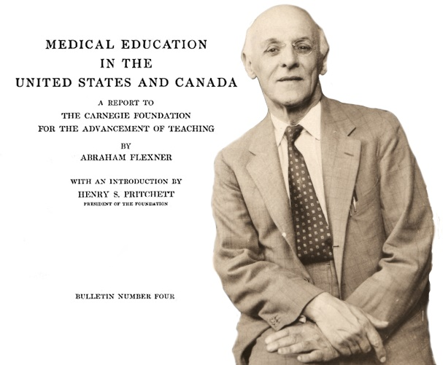
The Structure of Medical Education

Slide 4
“Allopathic” Medical Education
Premed: 4 years
Medical School: 4 years
Internship: 1 year
Residency: 2-6 years
Fellowship training: 1-3 years
CME: 63 credit hours per year (Vermont)
National Board of Medical Examiners exams (4)
Maintenance of Certification (through Boards of Specialties)
Stringent Regulatory Scrutiny

Slide 5
Curriculum Competencies
Patient Care
Medical Knowledge
Practice-Based Learning and Improvement
Interpersonal and Communication Skills
Professionalism
Systems-Based Practice

Slide 6
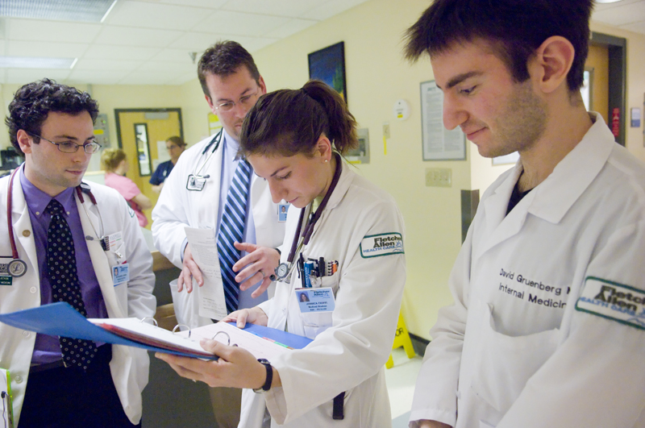
Vermont Integrated Curriculum Components
Level 1: Foundations
15 months
Integration of basic and clinical science
Introduction to clinical skills and patient care
Level 2: Clerkships
12 months
Family Medicine, Internal Medicine (ambulatory and inpatient), Ob-Gyn, Neurology, Pediatrics Psychiatry, Surgery
Bridges
Level 3: Advanced Integration
14 Months
Acting internship in medicine, surgical specialty, emergency medicine, scholarly requirement
Electives

Slide 7
The Case for Active Learning
Evidence for a Better Way

Slide 8
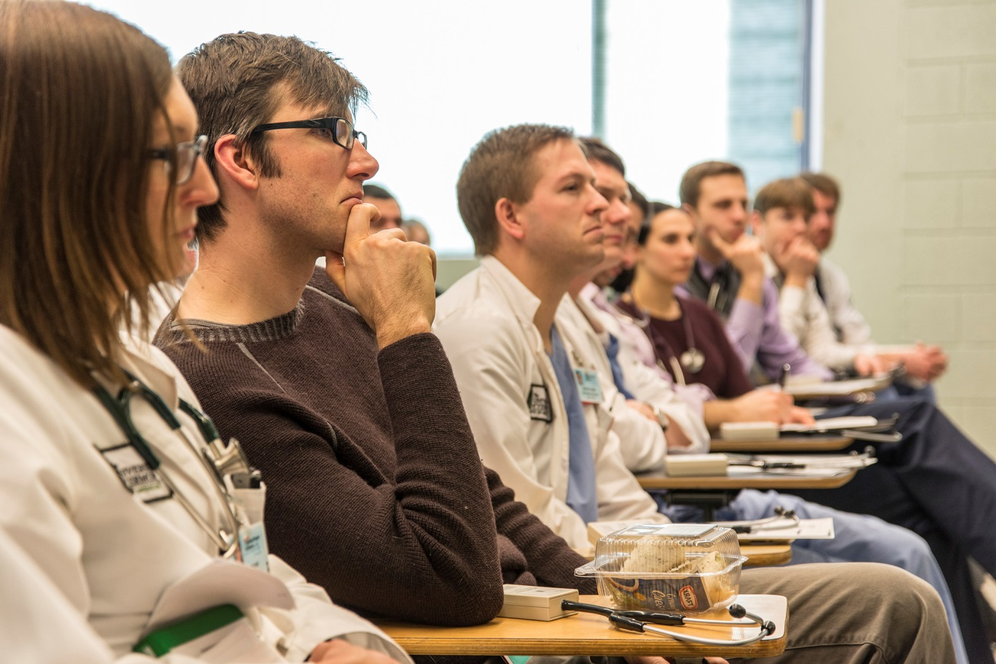
Why the Traditional Lecture?
Efficient knowledge transfer (although reading is better)
Easiest for faculty and students
Most economically and logistically feasible mechanism for institution
Bligh, 2000

Slide 9
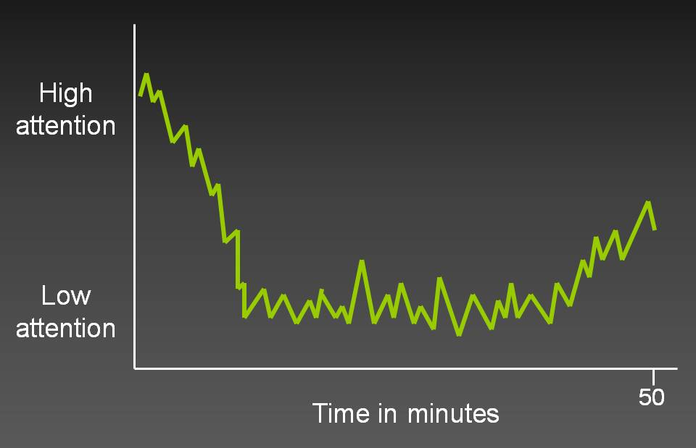
Why Not the Traditional Lecture?
“Passive” learning
Long-term retention poor
Inferior for skills development
Inferior for changing attitudes
Bligh, 2000
Hartley J and Davies I “Note taking: A critical review” Programmed Learning and Educational technology, 1978,15, 207-224)

Slide 10
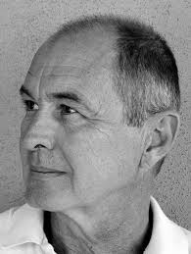
Even more compelling:
In lecture model:
Student role perception: receivers of information
Teacher role perception: providers of information
Creates a one-way passive relationship, that avoids transformative aspects of learning
Kolb (1983): critical thinking skills develop best when students transform their own experience into knowledge by acting on information that they are learning.
David A. Kolb
For more see Pelley: http://www.ttuhsc.edu/SOM/success/

Slide 11
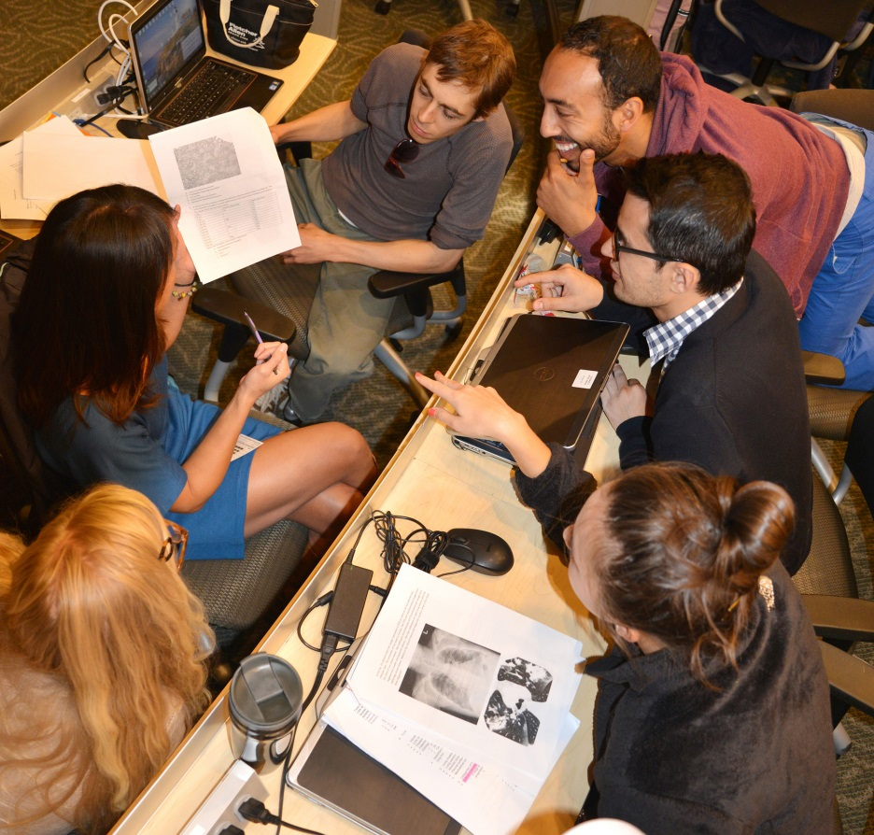
What is Active Learning?
Learner engagement in activities that force them to reflect upon prior knowledge and apply it.
Requiring students to regularly assess their own degree of understanding.
The attainment of knowledge and understanding by participating or contributing through mental and physical activity.
Michael, J. (2006). Where's the evidence that active learning works?. Advances in Physiology Education, 30(4), 159-167

Slide 12
Definition: Flipped Classroom
“A pedagogical model in which the typical lecture and homework elements of a course are reversed” (Educause 2012).
http://www.washington.edu/teaching/teaching-resources/engaging-students-in-learning/flipping-the-classroom/

Slide 13
Active Learning in Bloom’s Taxonomy
Active Learning Domains
Passive Learning Domains

Slide 14
Active learning increases student performance in science, engineering, and mathematics. Freeman, Scott, et al. Proceedings of the National Academy of Sciences, 2014
Metaanalysis of 225 studies of outcomes (grades and/or failures) of active learning vs. traditional lecturing in STEM courses in college
Results:
Student performance on examinations increased by 0.47 SDs with active learning
Exam scores improve by about 6% with active learning
Students in classes with lecturing are 1.5 times more likely to fail
Effect largest with classes <50, but all class sizes improved
Results not likely due to publication bias

Slide 15
Active learning increases student performance in science, engineering, and mathematics. Freeman, Scott, et al. Proceedings of the National Academy of Sciences, 2014
Looked at another way:
If trials analyzed by Freeman, et. al., had been randomized prospective trials of medical interventions, they would have been stopped for ethical reasons
Of the 29,300 students in studies that reported failure rates:
3516 failing students would have passed had they been in the active learning arm
$3.5 million in wasted tuition would have been saved
Data underestimated the effect of active learning because withdrawals due to impending failure or lack or success were not counted.

Slide 17
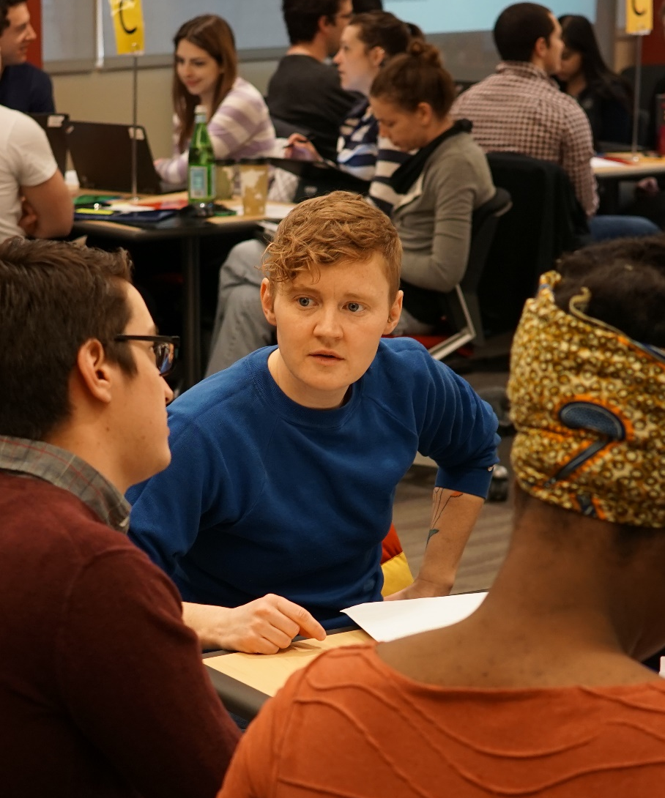
Active Learning, Gender and Underrepresented Minorities
Lorenzo, Crouch and Mazur (2006): active learning methods reduce gender gap in physics
Eddy and Hogan (2014): All subgroups improve with course structure that favors active learning, women and minorities fare best
Pennebaker and Gosling (2013): Readiness assurance reduces achievement gaps

Slide 18
Are College Lectures Unfair?
By ANNIE MURPHY PAUL SEPT. 12, 2015
“a growing body of evidence suggests
that the lecture is … a specific cultural
form that favors some people while
Discriminating against others, including
women, minorities and low-income and first-generation college students. This is not a matter of instructor bias; it is the lecture format itself — that offers unfair advantages to an already privileged population.”

Slide 19
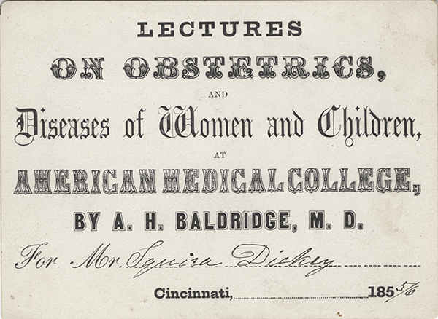
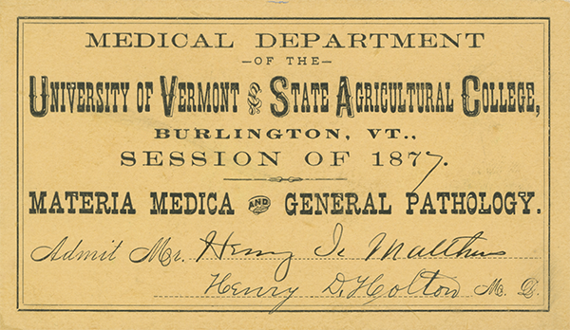
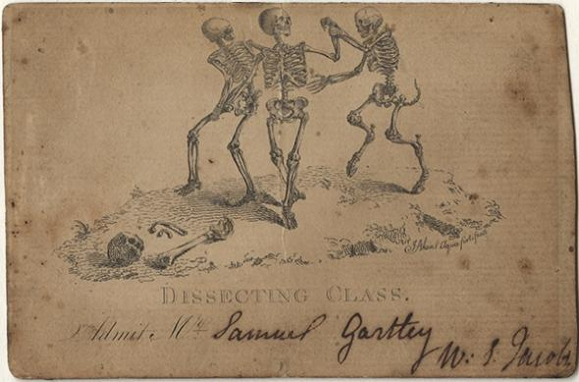
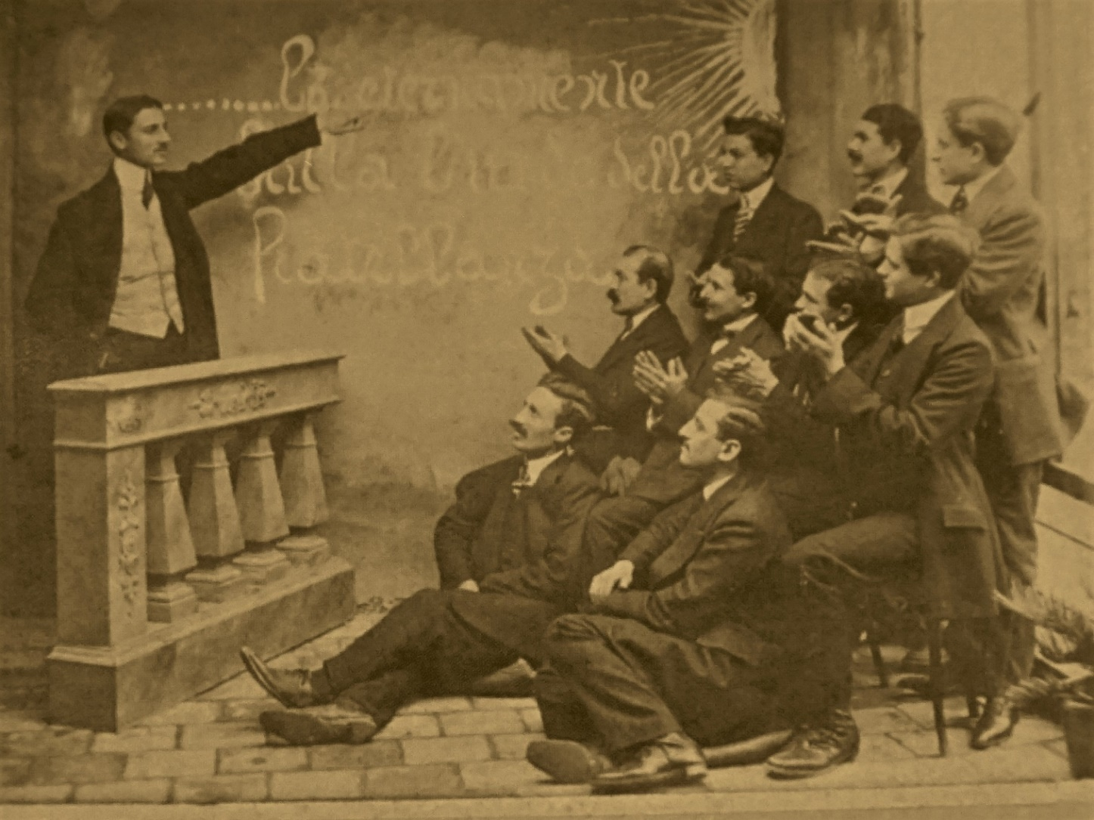
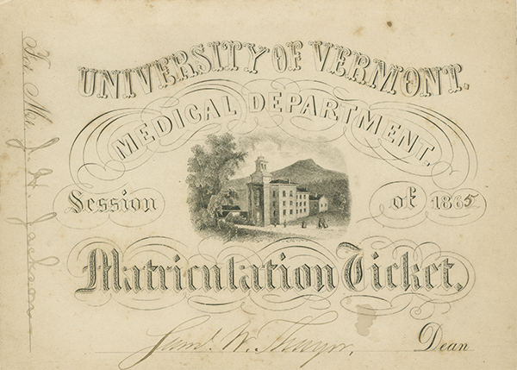
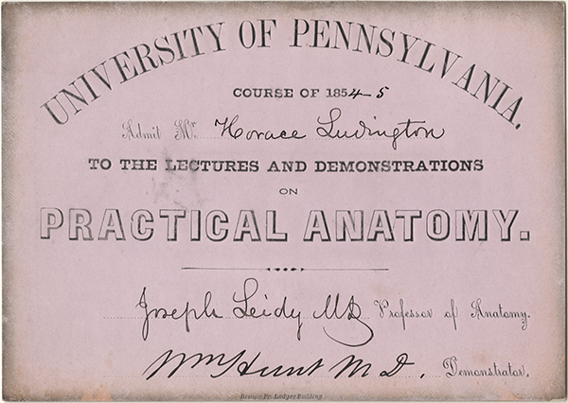
Notes:
For more than the first century of formal medical education in America, medical schools were proprietary in nature. The faculty, a collection of independent entrepreneurs, collected fees directly from medical students and in return, issued them tickets for admission to their course of lectures. Individual professors paid whatever overhead was due, such as rent, to the dean or provost and kept the remainder as profits. With few exceptions, this system prevailed at both private and university-affiliated schools. Trustees could veto the appointment of a faculty member, but otherwise medical faculty ran the medical schools, controlling admissions, the curriculum and graduation standards.
Medical lecture tickets dating as far back as the 1760s survive as physical evidence of this proprietary system of medical education. The tickets were meant to be ephemeral, a paper that admitted a medical student to a course on the road to becoming a physician, but unlike a diploma, nothing intended for longevity. Fortunately, a significant number of students kept their tickets as mementos and over time, a lesser but still significant number of those keepsakes survive in private and institutional collections, much to the delight of archivists, scholars, medical historians, interested physicians and others with curiosity.

Slide 20
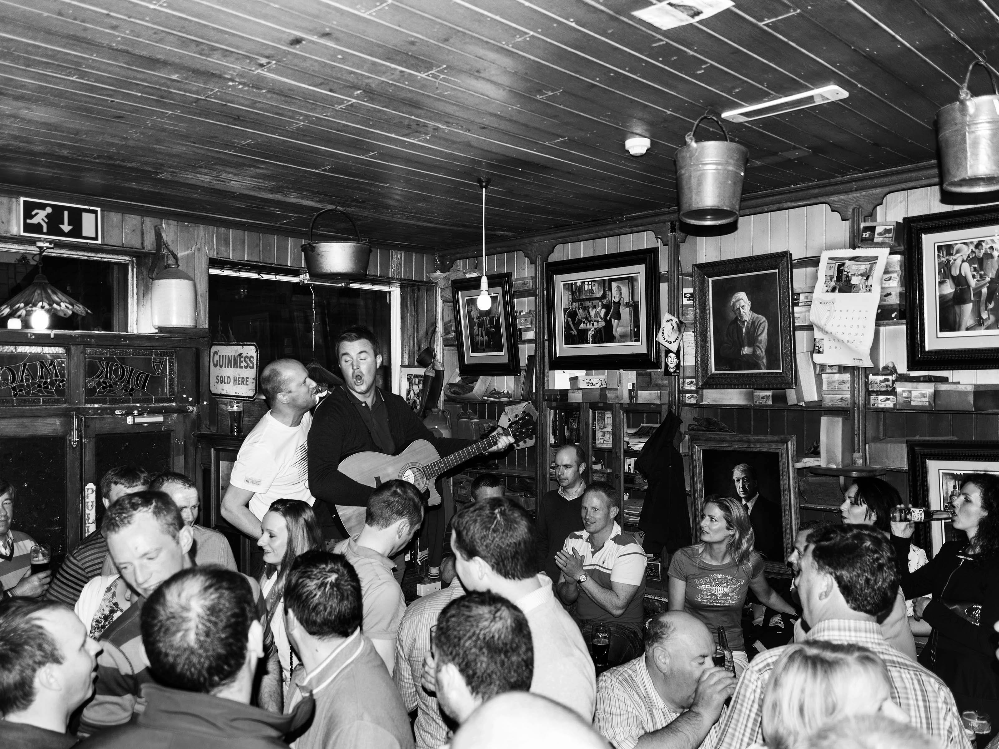
Why the persistence of lecture?
Students
Easy – can often skip in preference for podcasts, note summaries, etc.
Distillation of knowledge needed for assessments
Assessments largely limited to lower steps of Bloom’s taxonomy
Lectures can reduce curricular demand and rigor
Faculty
Inertia – easiest to update last year’s material
Time constraints, demands for clinical and research productivity
Dopamine release
Notes:
The case for stasis.

Slide 21
The Path Forward
Learning Environment
Curriculum
Faculty Development
Action plan for change

Slide 22
Early Work
Reduce Lectures in Curriculum and replace with Active Learning
Facilities Plan
Finance plan: incentives to drive better teaching
Formation of a Teaching Academy

Slide 23
Faculty Strategic Planning Task Force
Curriculum
Pedagogy
Sequencing
Environment
Physical plant
Culture
Faculty
Resources needed
“Larner method”
Workload
Assessment
Evaluation
Well-being
Technology
Holistic aspects
Teaching Academy

Slide 24
Curriculum: Essential Elements of Flipped Classroom
Preparative Assignment
Videocast
For application exercise ideas, try Googling: “Jeffries flipped classroom”
Reading
Online Module
Readiness Assurance
Online Quiz
Live Quiz
In-Class Exercises
Endless Possibilities
Jeffries et. al., 2017

Slide 25
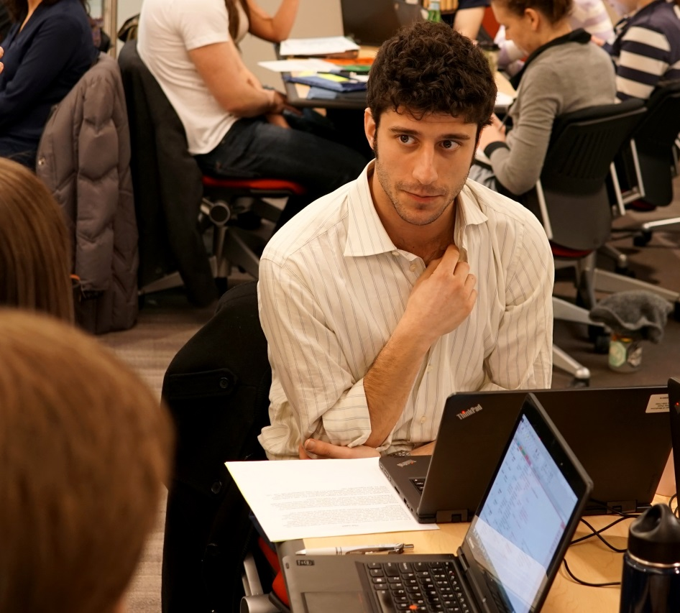
Variations
Team-Based Learning (TBL)
The Faux-Flipped Classroom
Flipping the Teacher
Just-in-Time Teaching (JiTT)

Slide 26
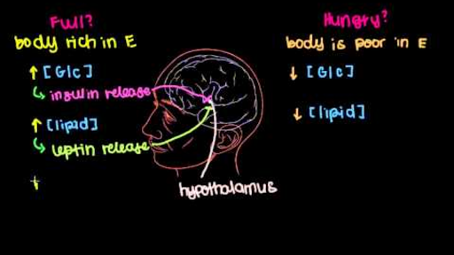
Preparative Assignment
Make your own
Old archived lecture (not recommended)
20-30 minute videocast
Or curate one:
Commercial or free video
Reading Assignment
Other material

Slide 27
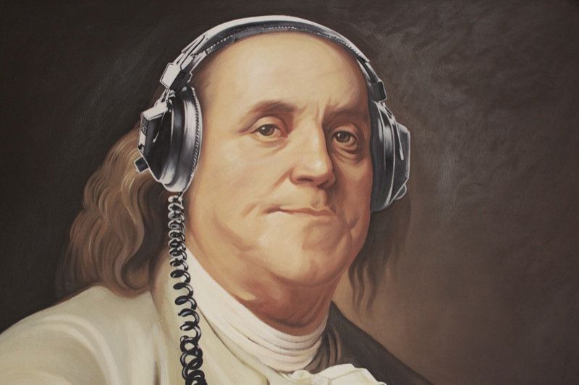
Readiness Assurance
Need:
Attendance
Precursory knowledge
Engagement
Methods:
Quiz at the beginning of the session.
Required completion of online assessments or assignments
online bulletin board, exam system, Wiki, etc.
“By failing to prepare, you are preparing to fail.” - Benjamin Franklin

Slide 28
Best Practices for In-class Work
Pre-Assign Groups (longitudinal)
Follow the 4 S’s
Peer Assessment
Match Assessment Rigor to Group Work
https://www.uvm.edu/medicine/mededucation/documents/FlippedClassroom.pdf

Slide 29
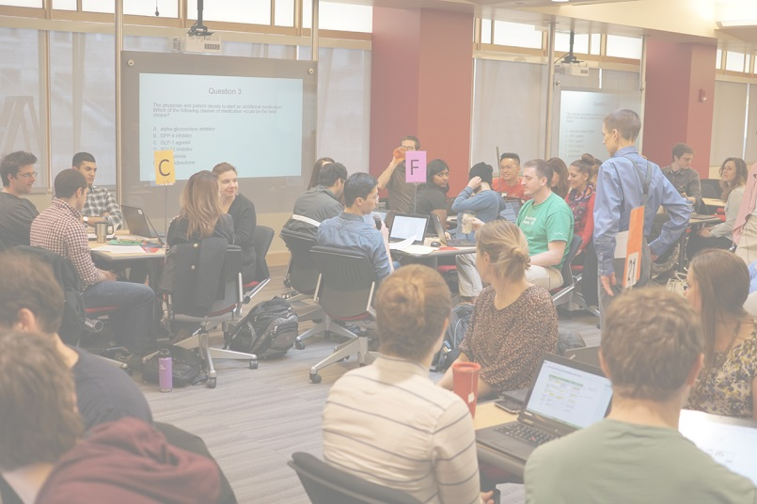
4 S’s for Group Learning
Significant Problem
Same Problem
Specific Choice
Simultaneous Reporting
Michaelsen and Sweet 2008
Notes:
Significant problem: A significant problem is one that asks students to immediately and meaningfully apply the concepts they are learning and will be using for any related assignments that will follow.
Same problem: Groups work on the same problem rather than different pieces of a larger puzzle.
Specific choice: Groups are given a specific choice to make rather than asked to answer open-ended questions.
Simultaneous reporting: Groups report their choice in simple form all at the same time.

Slide 30
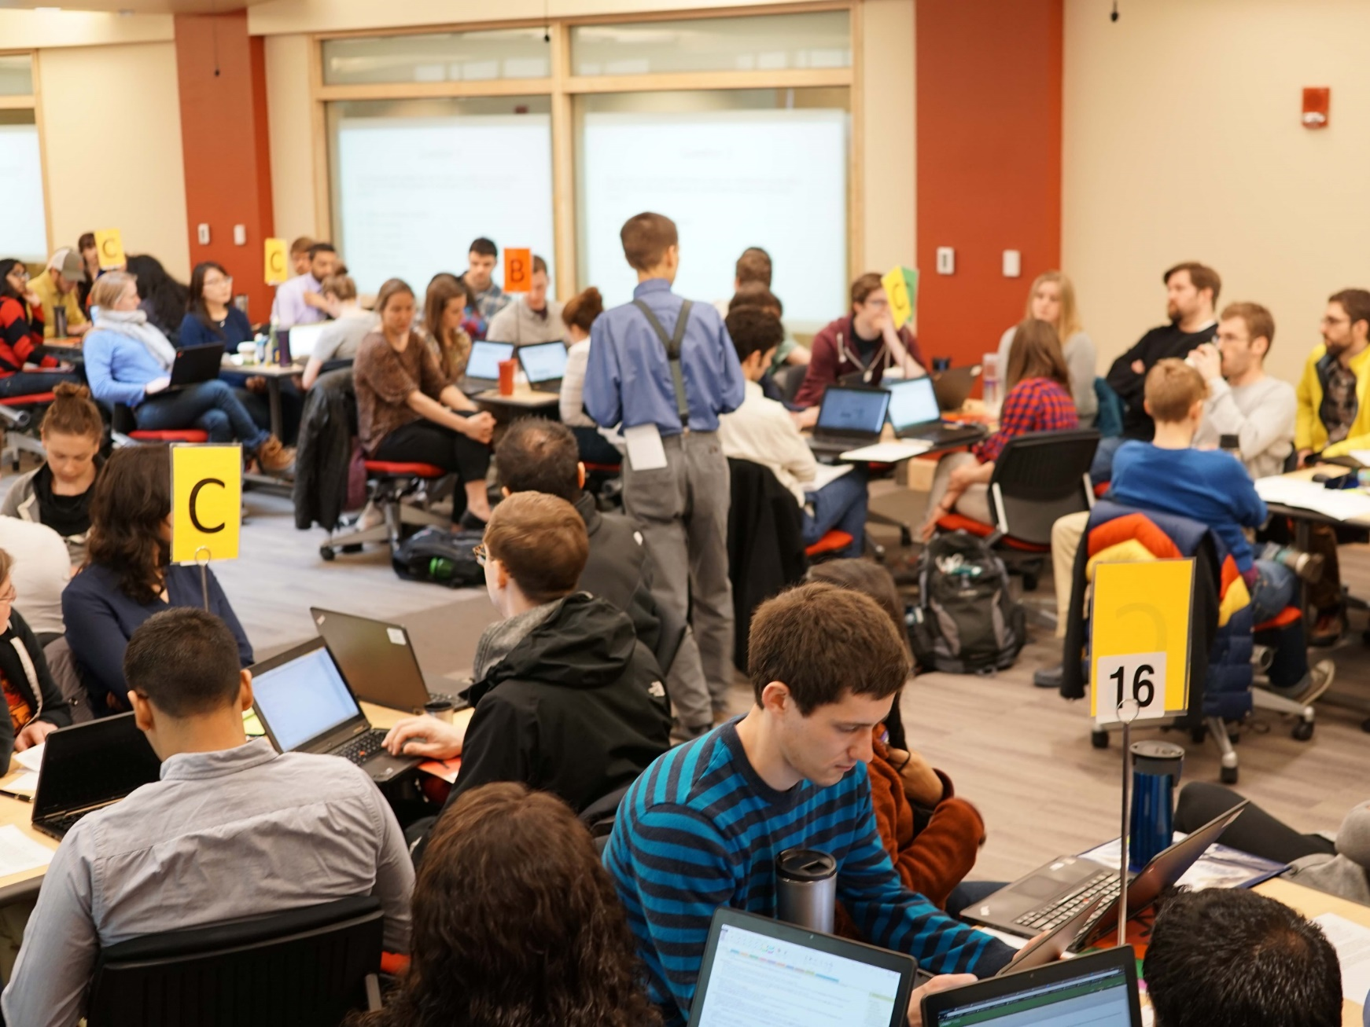
Environment: Classroom Space Principles
Flat floor
100% configurable
Collaborative work optimized
Technology-rich
Faculty “floating”
Sufficient facilities support
Student study space

Slide 31
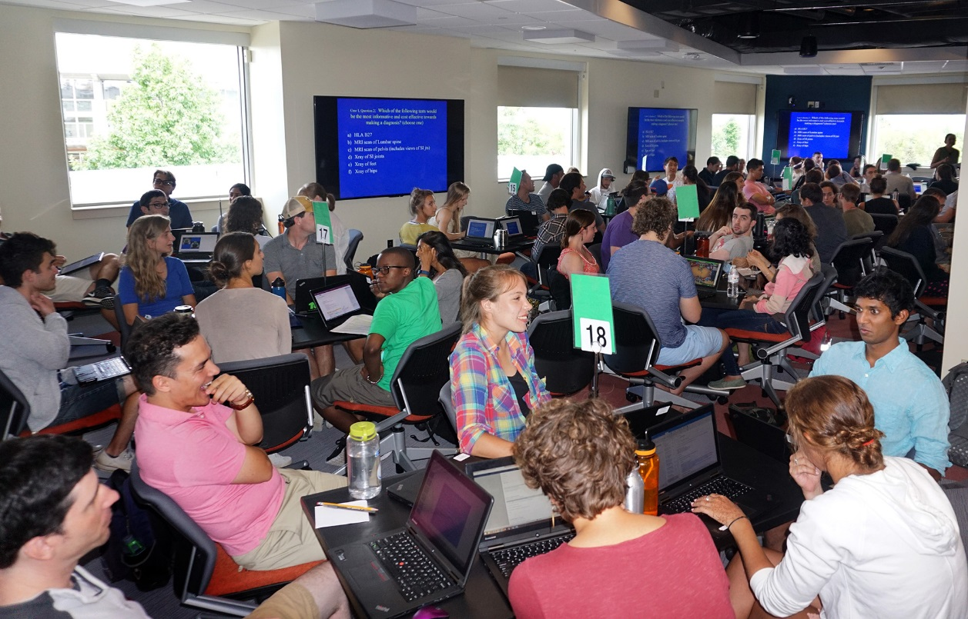
Notes:
Curriculum change

Slide 32
Brickyard

Slide 33
Larner Learning Commons
“The didactic curriculum will be transformed into specialized video presentations, exercises and learning materials that will focus on out-of-classroom knowledge acquisition. The curriculum will then be stored and accessed as needed in the curriculum in preparation for classroom active learning exercises. The faculty will be facilitated in their development in active learning by the Teaching Academy, and the curation of the online material will be handled by the Dana Library faculty and College of Medicine information technology staff. This will require equipment, space and expertise, all housed together to foster interaction…”
Components of the LLC:
The Dana Medical Library
Space for students to study and prepare for active learning exercises
An administrative home for the Teaching Academy (offices, conference space)
Alignment of the COM Information Services team and physical space with the space and staff of the Dana Medical Library
Learning studios for the preparation of online audiovisuals to replace lectures
Learning laboratory space for advanced anatomical and medical imaging

Slide 34
Larner Learning Commons

Slide 35
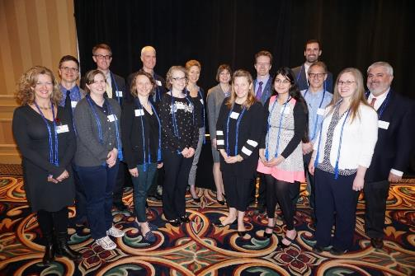
The Teaching Academy
The mission of the Teaching Academy is to become a community of educators that leads educational innovation and scholarship by promoting faculty members' pursuit of education excellence and scholarship.
As of today, 86 educators:
7 Protégés
36 Members
27 Master Teachers
16 Distinguished Educators

Slide 36
Faculty Development: The Teaching Academy
Pedagogy
Scholarship
Evaluation
Recognition
Mentoring

Slide 37
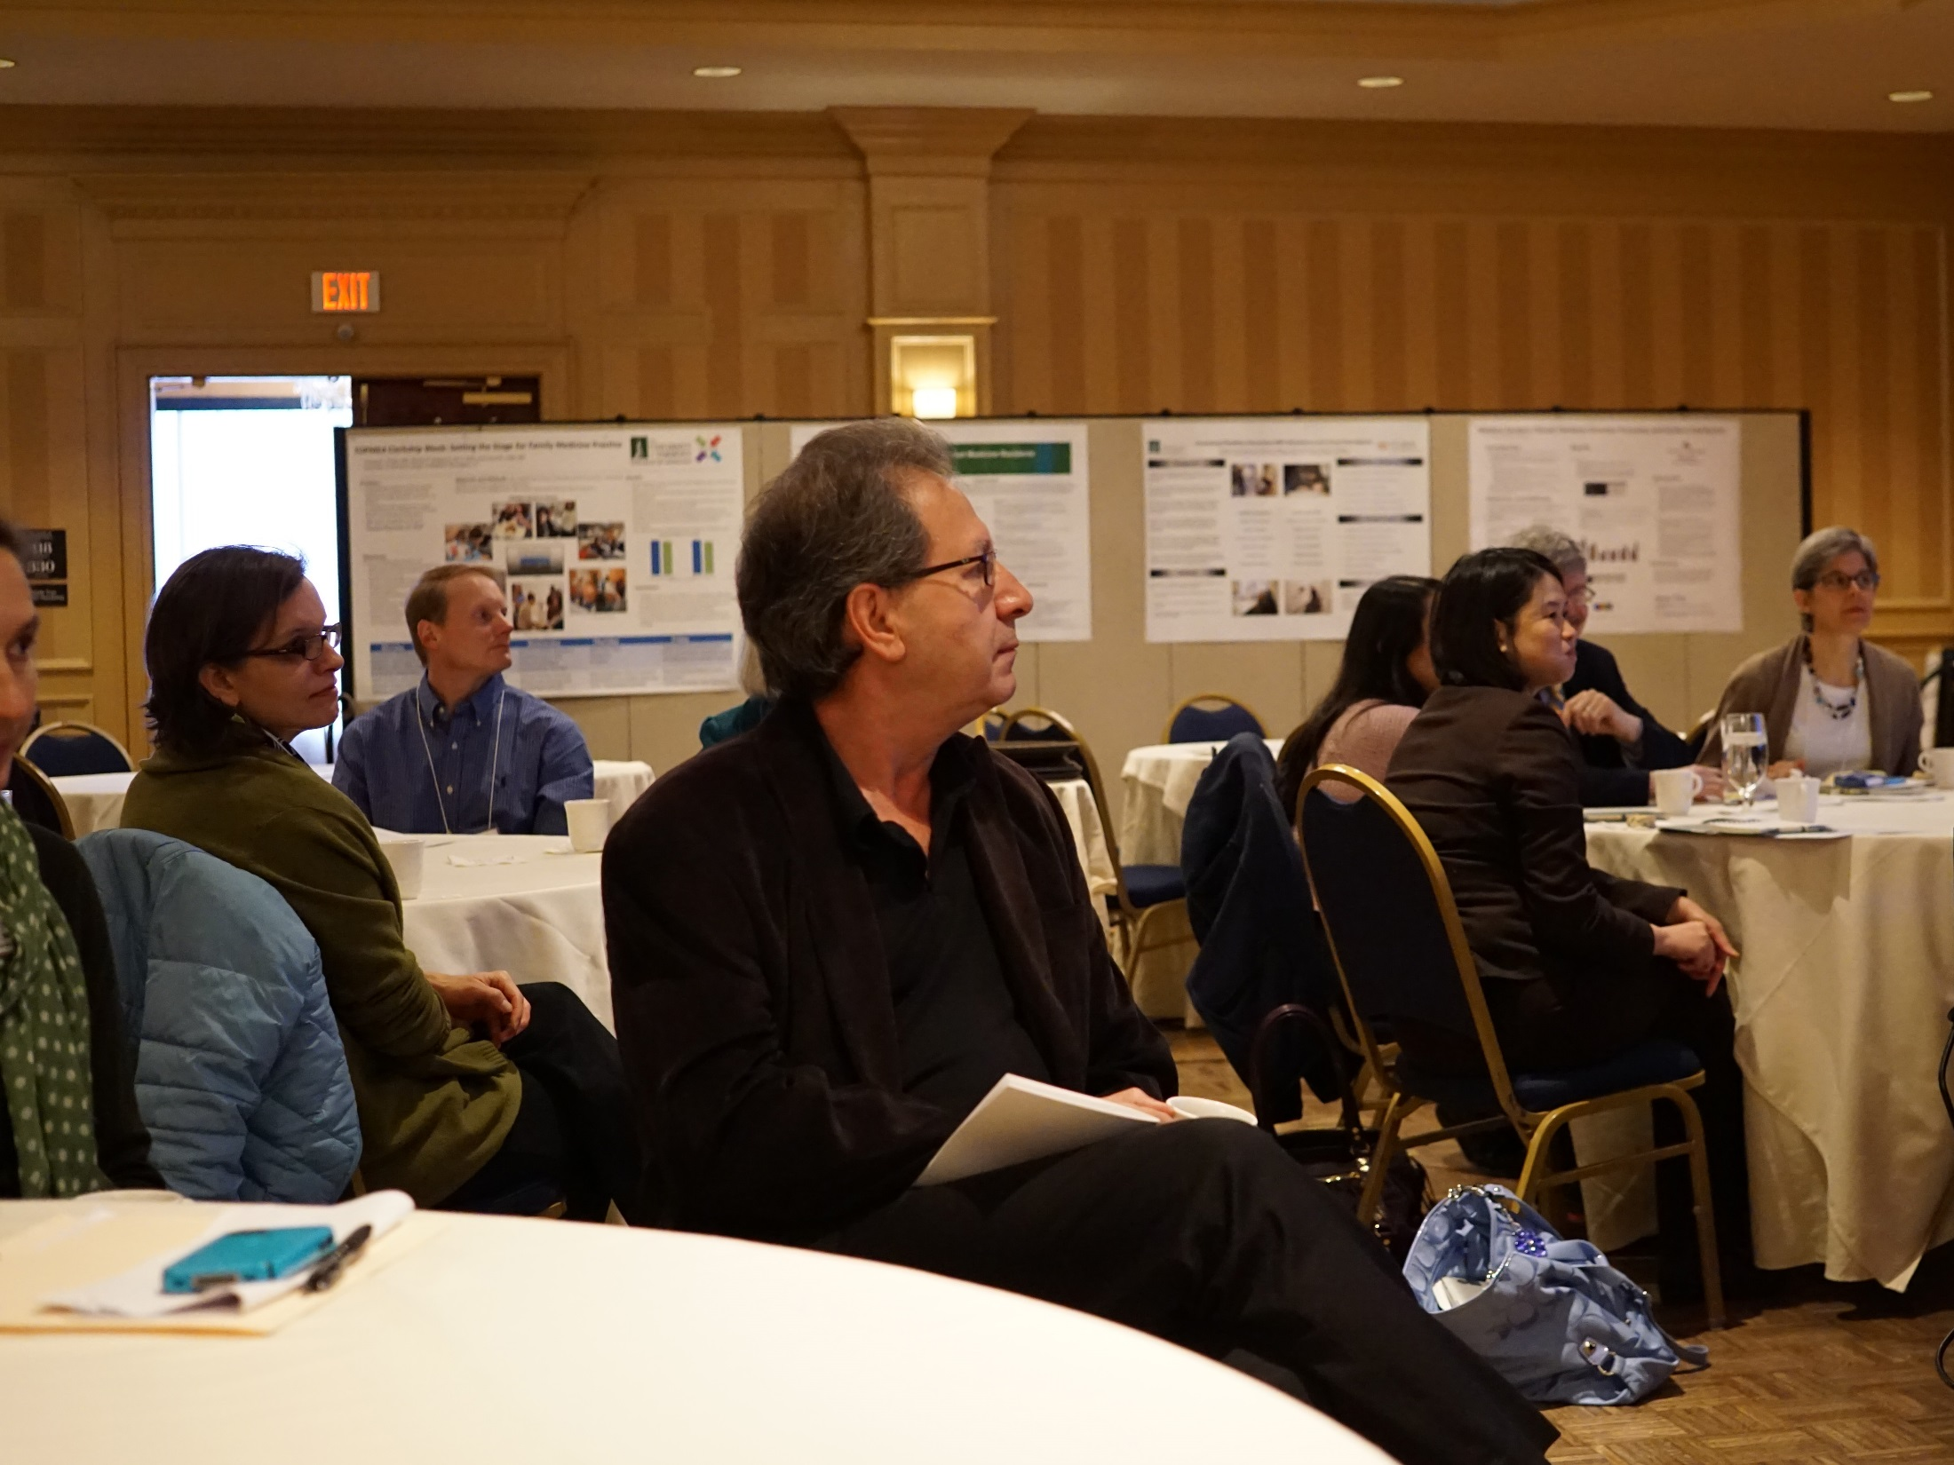
Notes:
Faculty Development

Slide 38
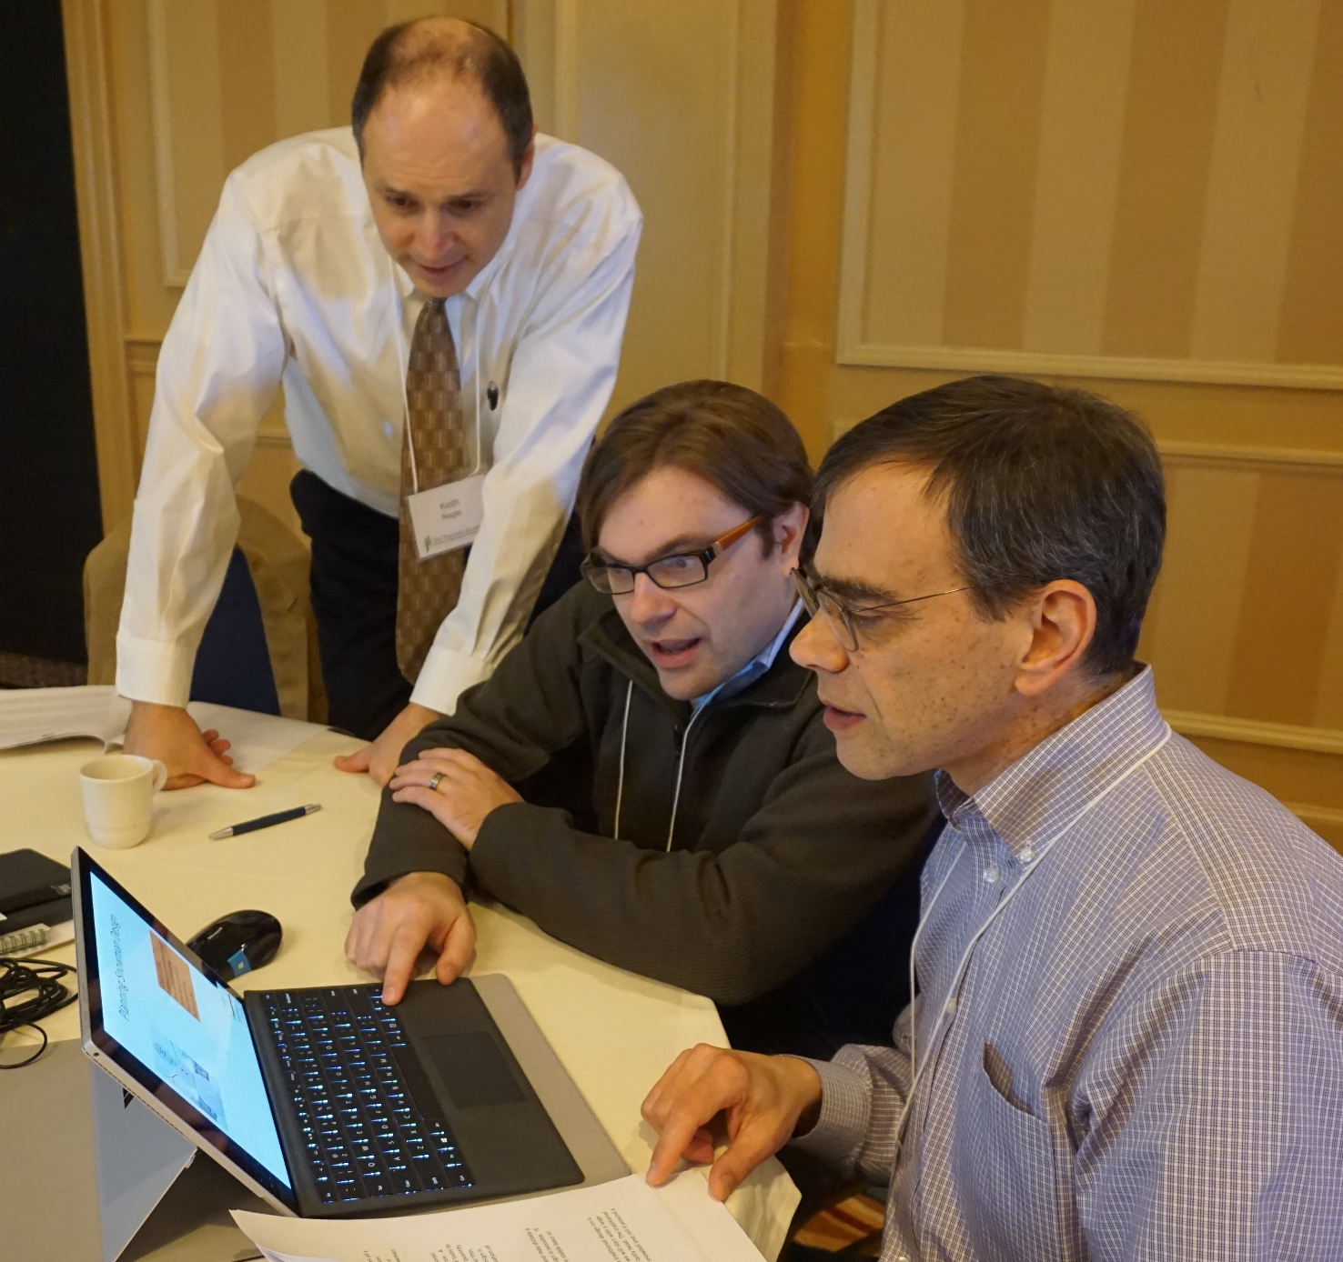

Slide 39
From Information Provider to Learning Facilitator, Ronald Harden, ed.
“As young teacher … I peppered my lectures with colorful stories and analogies. These evolved into well-crafted monologues. My students had magnificent recall on examinations, and I became an award-winning teacher – a diva! However, … despite demonstrable short-term knowledge gains, many students didn’t remember my content later in the clinic… Therefore, I put my ego aside to embrace other learning formats such as the flipped classroom… The focus is on the student’s learning, rather than the teacher’s delivery. My initial fears that students would not get all the information needed were unfounded and students actually moved well beyond simple recall. I sometimes mourn the loss of the diva on the stage, but I now recognize that the teacher’s role is to maximize student learning beyond the short-term, which is ultimately a greater reward.”
- Jeffries, in press 2017

