Slide 1
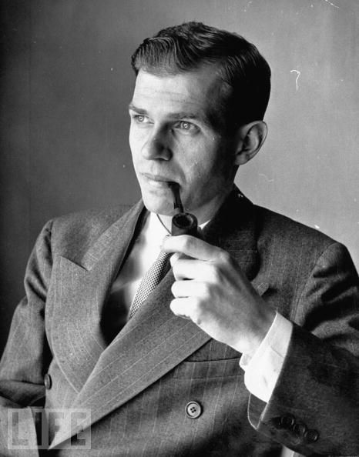
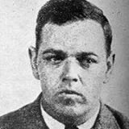
Hiss, Chambers, and the International Homosexual-Communist Conspiracy
Notes:
Chambers’s confessed homosexuality fed the imagination that linked Communism and ‘sexual perversion’ together; his mysterious friendship with Hiss tainted the latter with Chambers’s ‘sordid’ past. (44)
Hiss: claimed that “Chambers’s ‘abnormal’ advances to Hiss had been spurned. With the help of a prominent psychiatrist, the Hiss defense lawyers translated this explanation of Chambers; notives for making false carges against Hiss into what they called a’a theory of unconscious motivation.’ Hiss privately called it ‘fairy vengeance.’” (42)
Alger Hiss became, in the conservative imagination, the embodiment of the weak-willed, effete, and ultimately treacherous establishment liberal, whose “softness” left him prone to transgression of a political, moral, and perhaps even of a sexual nature. (44)
Communism, as an ideology and a way of life, somehow appealed to maladjusted individuals’ psychosexual weaknesses frustrations, and perversities, even offering an enticing life of freedom from—or rebellion against—bourgeois sexual constraints. 67

Slide 2
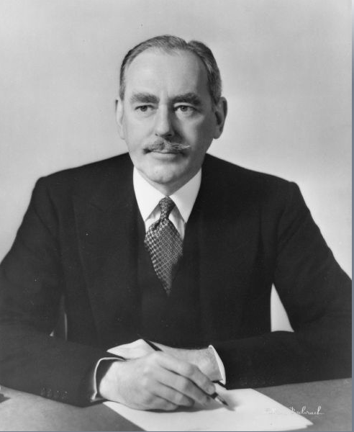
Dean Acheson
Photo credit: Wisconsin Historical Society
Notes:
Dean Acheson, U.S. Secretary of State, 1949-1952. Friend of Alger Hiss. Photo from Wisconsin Historical Society.
Image ID: WHi-48045, http://www.wisconsinhistory.org/whi/fullimage.asp?id=48045
In 1950, as the vilification of Acheson as an Anglophilic “pink” accelerated in right-wing circles, his aristocratic pretensions and waxed moustache became fraught with symbolic meaning, his loyalty to Hiss indicative of a larger conspiracy of effete eastern establishment foreign policy elites. (45)

Slide 3
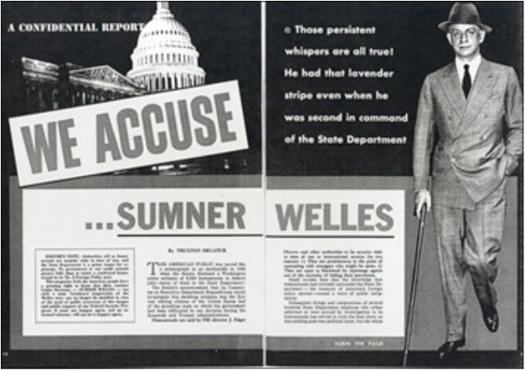
Confidential Magazine Exposé of Sumner Welles, March 1956
Notes:
http://www.reformation.org/welles-confidential-magazine.html, accessed 9-21-13
Sumner Welles, Roosevelt’s Undersecretary of State (Harvard-educated, close friend of Roosevelts) made advances to railway porters and looked for homosexual partners in parks and public restrooms – resigned in 1944
Incident resurfaced in the early 1950s to cast doubt on FDR and the Truman admin 55
The Welles story only added fuel to the notion that Democratic administrations—full of urbane, aristocratic, bohemian, dissolute internationalists—had for decades been infiltrated by sexual and political subversives. Sniffing out perverts wherever the could be found, McCarthy, Wherry, Bridges, and their allies…eagerly followed up on leads secretly fed to them by Hoover’s FBIand friends in the security division of the State Department. 56

Slide 4
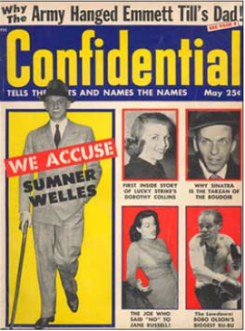
EDITOR'S NOTE: Authorities tell us homosexuals are security risks in time of war, and the State Department is a prime target for espionage. No government at war could commit greater folly than to retain a confirmed homosexual in its No. 2 Foreign Policy post.
This magazine feels the American people have a pressing right to know that their wartime Under Secretary—SUMNER WELLES—was such a man. Continued suppression of the Welles story can no longer be justified in view of the need of public awareness of this danger and public support of our Federal Security Program. It must not happen again, and an informed citizenry will not let it happen again.
Confidential Magazine Exposé of Sumner Welles, March 1956
Notes:
http://www.reformation.org/welles-confidential-magazine.html, accessed 9-21-13

Slide 5
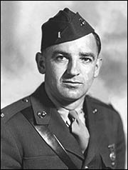
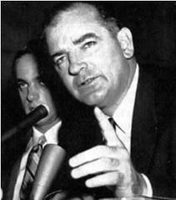
McCarthy and the ‘Lavender Menace’
McCarthy to a group of reporters:
“If you want to be against McCarthy, boys, you’ve got to be a Communist or a cocksucker.” (47)

Slide 6
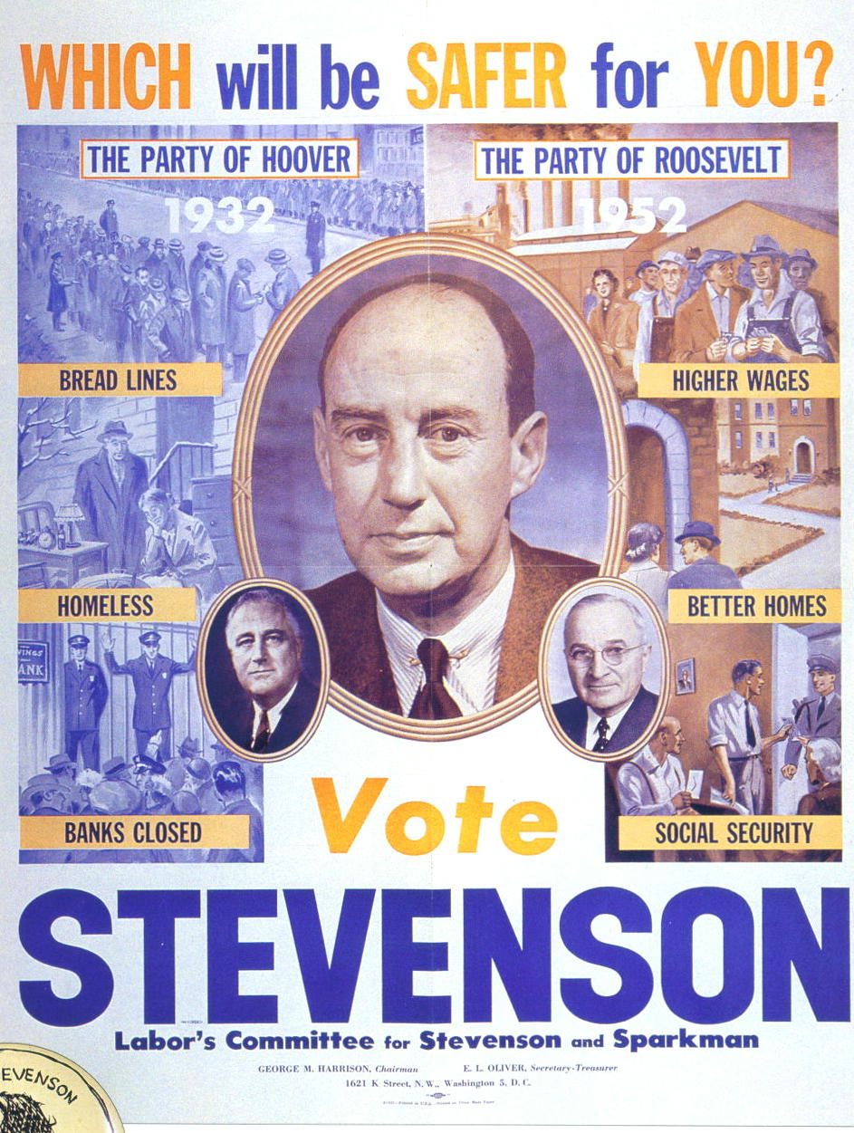
Notes:
http://suspended.tv/2010/10/political-animations/
New York Daily News called the governor “Adelaide” and claimed that he “trilled” his speeches in a “fruity voice.” His “teacup words” were said tp rese,ble nothing so much as a “genteel spinster, who can never forget that she got an A in elocution at Miss Smith’s Finishing School.” Stevenson’s liberal supporters were “Harvard lace-cuff liberals,” “pompadoured lap dogs,” and “lace panty diplomats” who, in the face, of McCarthy’s accusations, wailed in “perfumed anguish” and sometimes “giggled” about anti-Communism. 88
Egghead 48

Slide 7
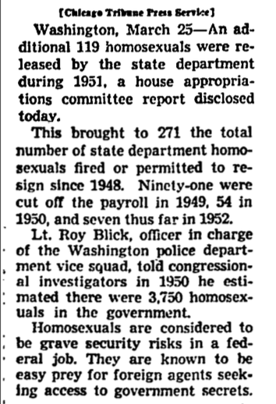
Homosexuals in the State Department
“Oust 119 More Sex Perverts in State Dept: House Member Suggests Widened Drive,” Chicago Daily Tribune 26 March 1952, A2.
Notes:
The sex inquisition mirrored the communist inquisition in its form and methods. 63
Humiliating investigations of their private lives … could be initiated on as little grounds as an anonymous letter, a report of a suspiciously “effeminate” voice or demeanor, gossip and hearsay, or simple guilt by association (i.e., with a known homosexual).
More federal government employees were dismissed as security risks in the “McCarthy era” on the grounds of sexual deviance than were dismissed on all other grounds, such as Communist sympathies, suspicious affiliations, or generic misconduct (e.g., alcoholism) of a compromising nature. They were overwhelmingly but not exclusively men.
40 per month fired or resigned in 1st 16 months of the Eisenhower admin. 64
No cases of genuine “homosexual blackmail” of gov’t officials by foreign agents were uncovered. 64

Slide 8
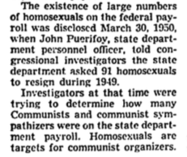

Slide 9
Certainly the rhetoric that vilified “pinks,” “lavenders,” and “reds” was strategically and opportunistically employed as a weapon with which to stigmatize political opponents. But that rhetoric relied on (and mobilized) real anxieties about both Communism and sexual disorder in American life. (Cuordileone, 39)

Slide 10
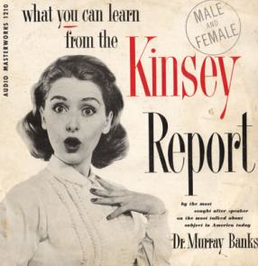
Alfred C. Kinsey et al. Sexual Behavior in the Human Male (1948)
_____. Sexual Behavior in the Human Female (1953)
5300 white males and 5940 white females
majority of participants younger white adults with some college education
Found that premarital and extra-marital sex and homosexuality were much more common than people wanted to believe
For report findings, see http://www.kinseyinstitute.org/research/ak-data.html.
Dr. Murray Banks, “What You Can Learn from the Kinsey Report” [LP-Vinyl], Audio Masterworks, 1956.
Notes:
Dr. Murray Banks ‎– What You Can Learn From The Kinsey Report
Label:
Audio Masterworks ‎– LPA 1210
Format:
Vinyl, LP
Country:
US
Released:
1956
Genre:
Non-Music
Style:
Education, Speech

Slide 11
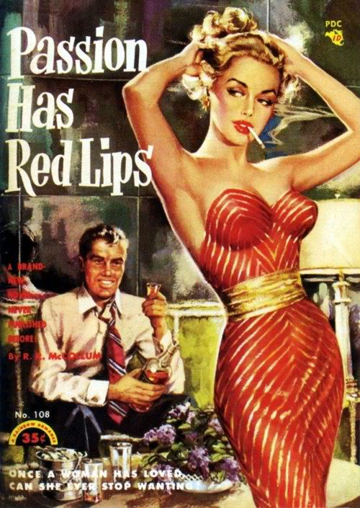
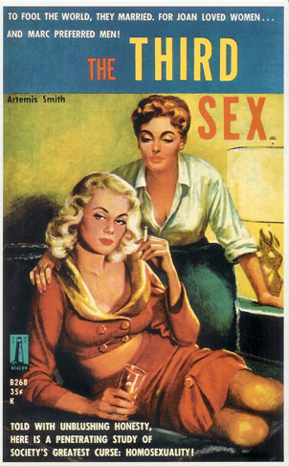
Novels with sexually explicit content made the best-seller lists.
Mickey Spillane’s Mike Hammer novels
Grace Metalious's Peyton Place (1956)
“depicts the sexual intrigue (including such taboos as incest and abortion) behind a small-town facade.”
"Sex." American Decades. Ed. Judith S. Baughman, et al. Vol. 6: 1950-1959. Detroit: Gale, 2001. 272-274. Gale Virtual Reference Library. Web. 25 Sept. 2013.
Notes:
Thirdsex_bookcover_1959.jpg

Slide 12
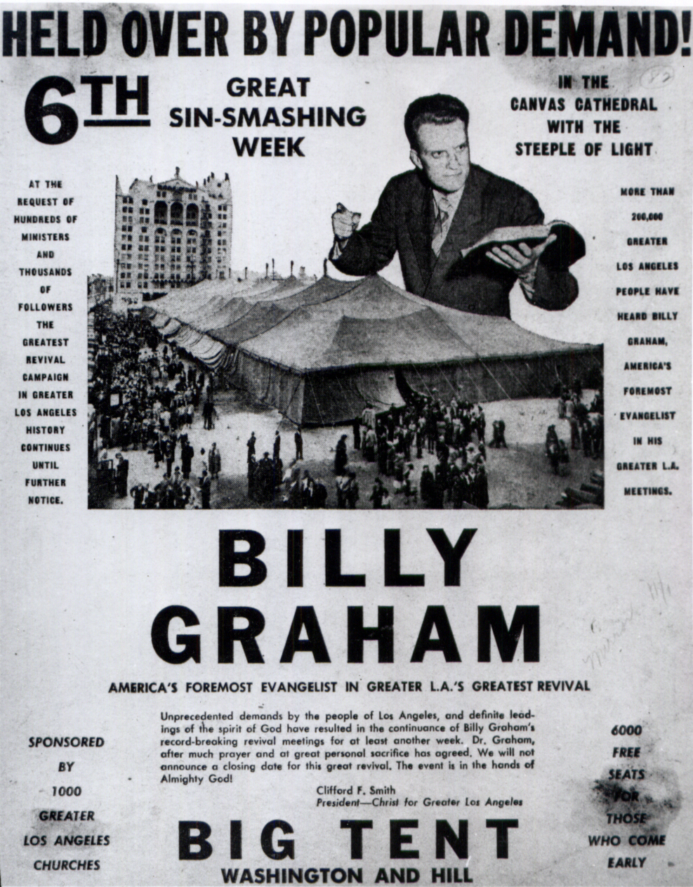
Notes:
http://blogs.newsobserver.com/pasttimes/a-lifetime-of-ministry, accessed 9-25-13.
. . . right-wing conservatives in the 1950s…deplored the decline of traditional small-town American values, the advent of secularism, juvenile delinquency, sexual immorality, divorce, pornography, crime, apathy, welfare statism, the corrosive effects of commercialism, popular entertainment, and (for the most reactionary conservatives) racial or ethnic integration. (39)

Slide 13
In the end, the images of decadent leftists and Communists that surfaced in conservative anti-Communist discourse reveal anxieties that were less about Communism and more about a changing America – an America that appeared to be nourishing ever more neuroses and a creeping sexual disorder. While anti-Communism became a vehicle for the expression of extra-Communist concerns, the specter of sexual immorality and chaos, projected on to red and pink enemies, added a potent and subterranean dimension to anti-Communism. 87

Slide 14
Sources
Baughman, Judith S., Victor Bondi, Richard Layman, Tandy McConnell, and Vincent Tompkins, eds. “Sex.” In American Decades, 6:272–274. 1950-1959. Detroit: Gale, 2001. http://go.galegroup.com/ps/i.do?id=GALE%7CCX3468301964&v=2.1&u=vol_m58c&it=r&p=GVRL&sw=w.
Cuordileone, K. A. Manhood and American Political Culture in the Cold War. Hoboken: Taylor and Francis, 2012.

