Slide 1
The Atom bomb and the Cold War
“The advent of the bomb. . .fatally undermined any hope of reversing Soviet–American hostility which, in turn, made a credible postwar security order impossible.”
    David Gill, “The atomic bomb and the origins of the Cold War,”
    Cold War History 9:3(2009), 442.

Slide 2
The Arms Race
It has never been the habit of the scientists of this country or the policy of this Government to withhold from the world scientific knowledge. Normally, therefore, everything about the work with atomic energy would be made public.
But under present circumstances it is not intended to divulge the technical processes of production or all the military applications, pending further examination of possible methods of protecting us and the rest of the world from the danger of sudden destruction.
  Harry S. Truman, “Statement Announcing the Use of the A-Bomb at Hiroshima” (August 6, 1945)

Slide 3
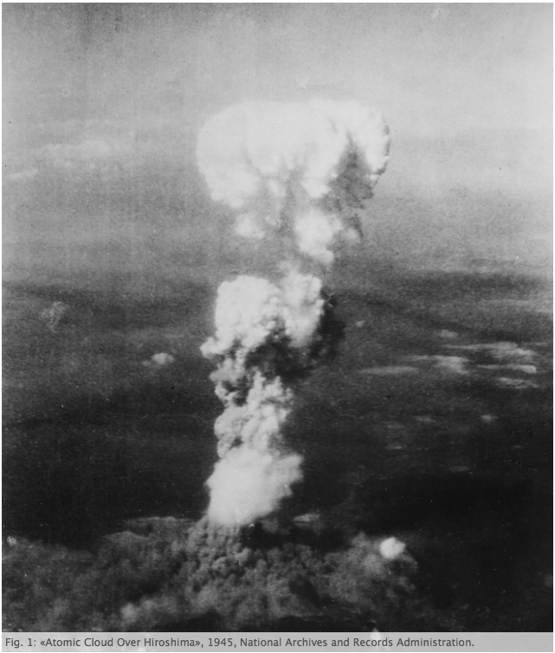
Boyer, 5.
Notes:
The efficiency and scale of destruction strained the moral imagination as the two cities were immediately reduced to rubble and the combined death toll reached between 150,000 and 250,000 people within four months of the attacks. The spectacle of the blast would be compared, in Robert Oppenheimer’s words, both to the “radiance of a thousand suns” and to Shiva, the “destroyer of worlds.” 1 The almost unimaginable power of the weapon prompted President Truman to declare that possession of this “new force” was “an awful responsibility.” He concluded, “We thank God it has come to us, instead of to our enemies.” 2
http://oic.uqam.ca/fr/remix/seeing-the-bomb-imagining-the-future-allegorical-vision-in-the-post-cold-war-nuclear-optic

Slide 4
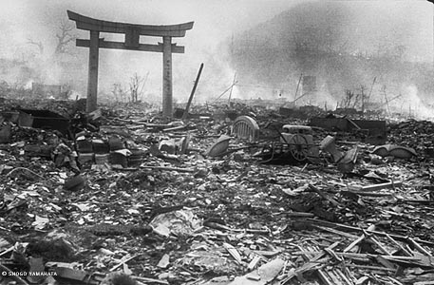
…From the earliest moments, the American people recognized that things would never be the same again…
http://home.earthlink.net/~platter/common/images/nagasaki-07.jpg

Slide 5
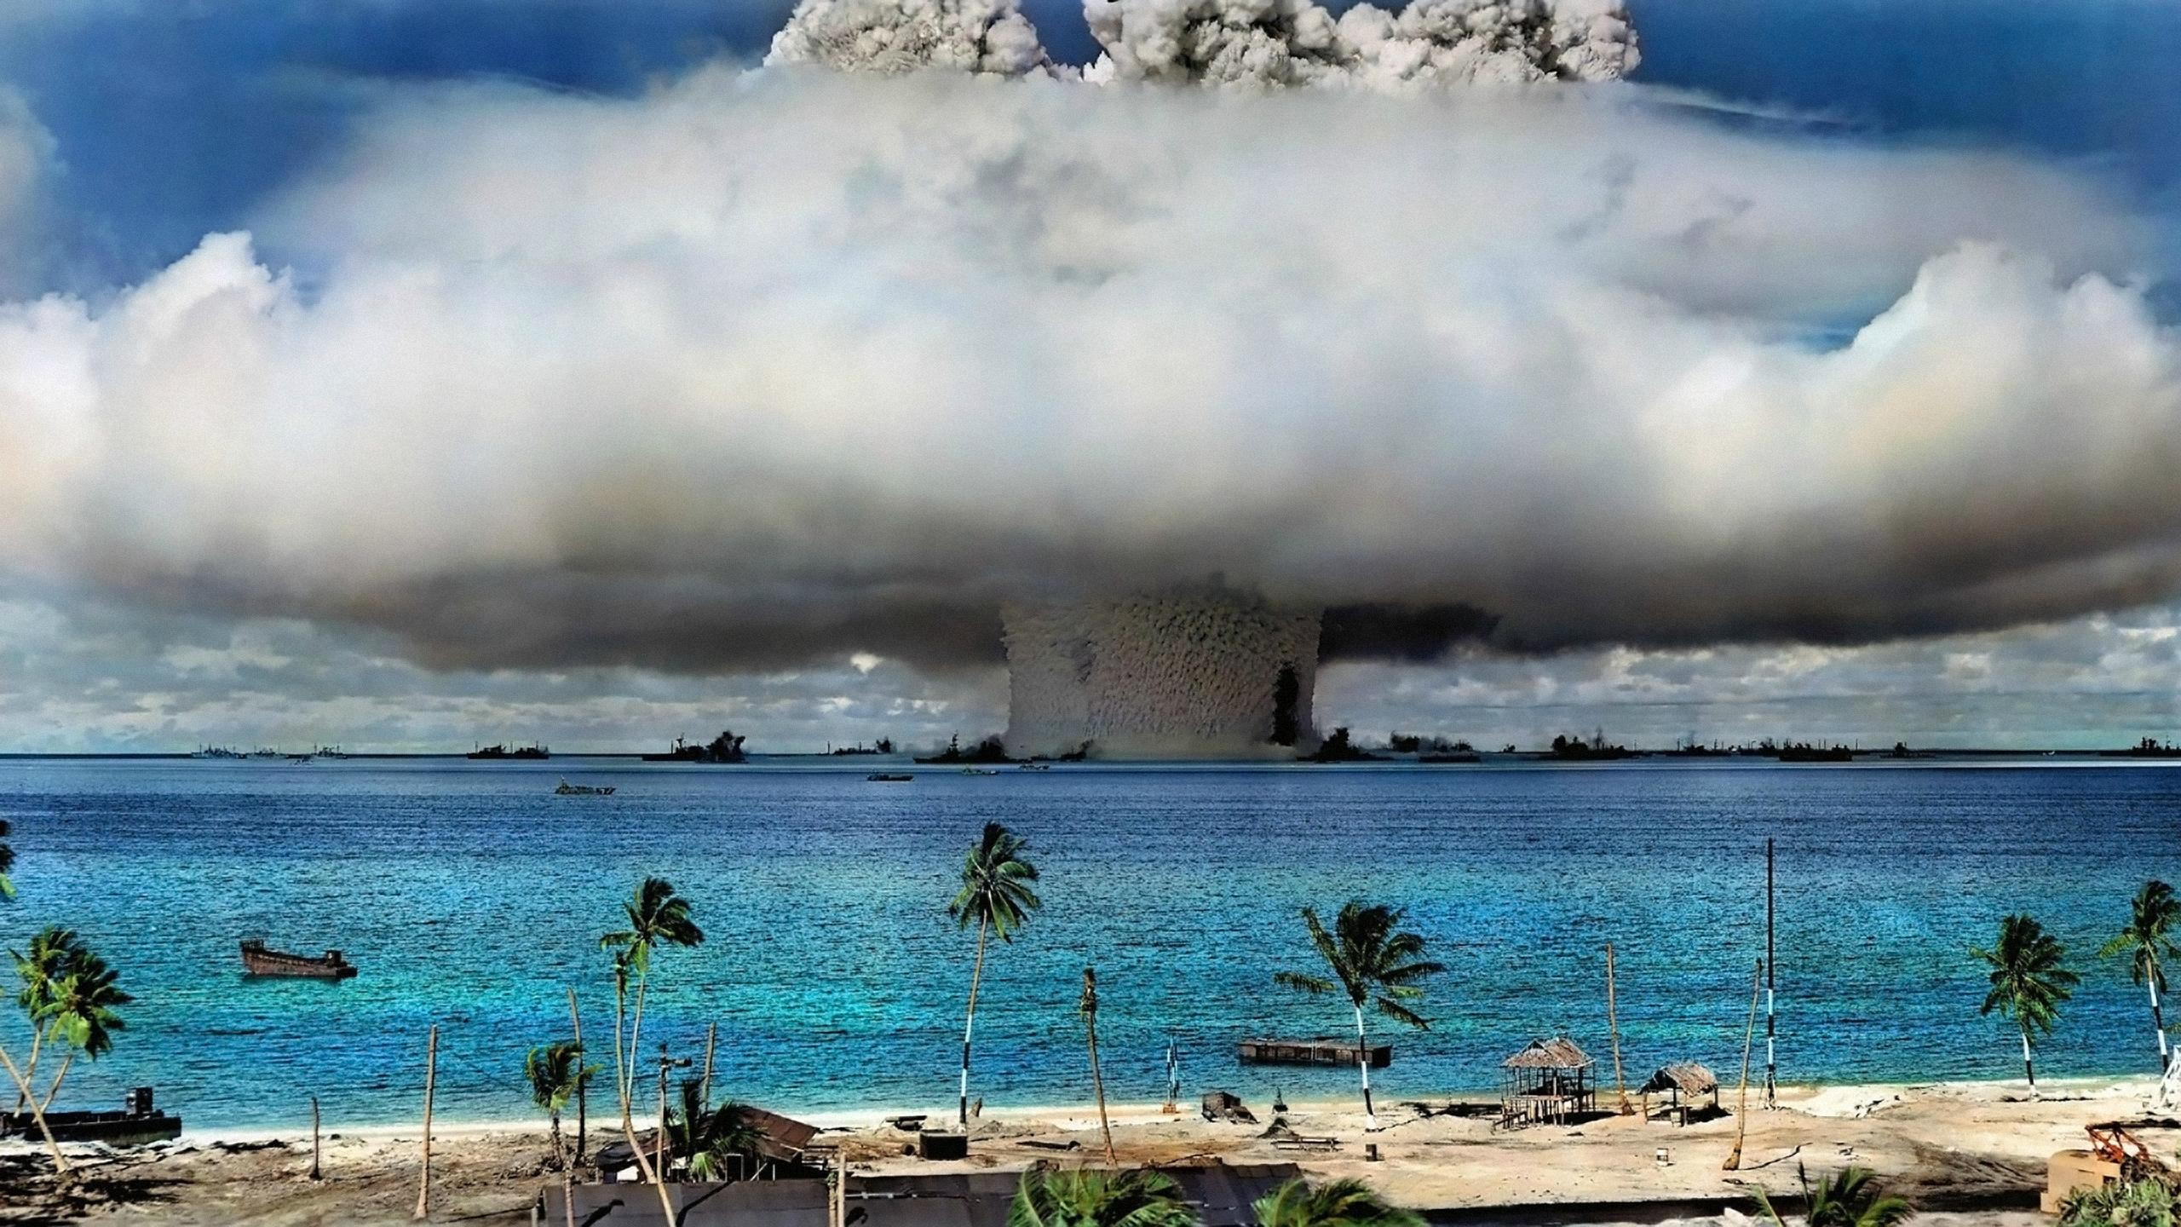
The central icon of the atomic culture is the mushroom cloud, rising above the lush tropical atolls of the South Pacific or the wastelands of the Great American Desert. Today it has become so deeply imprinted in the myths and matrices of the postwar era that it has come to seem natural, a fundamental, even a necessary aspect of everyday life. But the atomic explosion was not always an inextricable part of the planet. Indeed, it arrived as something close to what Roland Barthes has called a “pure sign” – a visual icon so unprecedented that, for a moment at least, it lay outside the webs of signification that comprised a watching culture.
  Peter B. Hales, “The Atomic Sublime,” American Studies 32:1(Spring 1991), 5.
Notes:
Image source: http://i.imgur.com/Y8uc2Vj.jpg

Slide 7
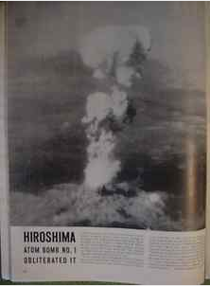
Life Magazine, August 20, 1945

Slide 8
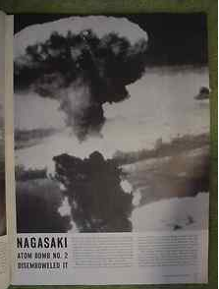
Life Magazine, August 20, 1945

Slide 9
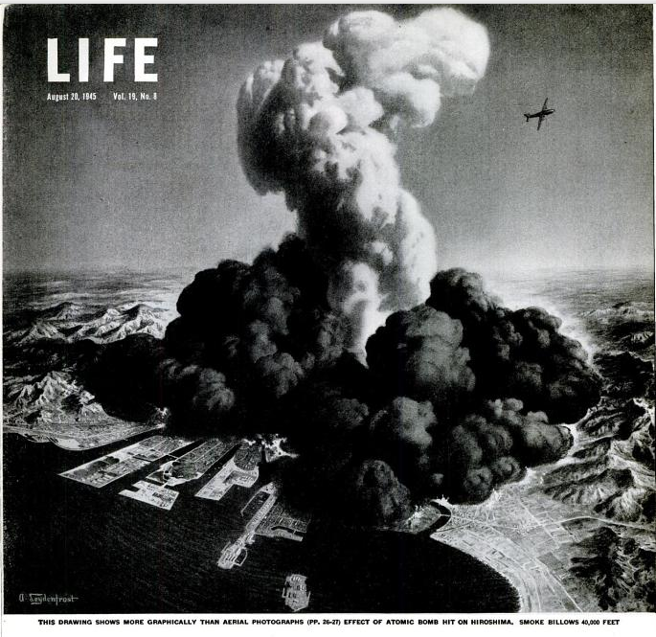
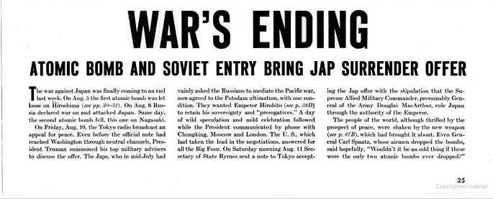
Notes:
http://books.google.com/books?id=hkgEAAAAMBAJ&printsec=frontcover&source=gbs_ge_summary_r&cad=0#v=onepage&q&f=false

Slide 10
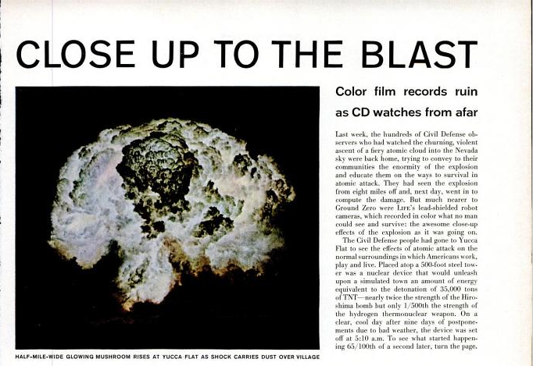
LIFE, May 30, 1955
Notes:
Cited in Peter B. Hales, “The Atomic Sublime,” American Studies, 5-6.

Slide 11
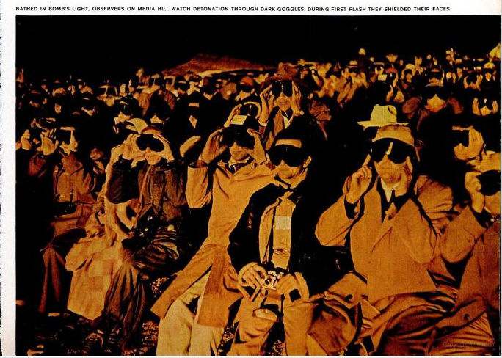

Slide 12
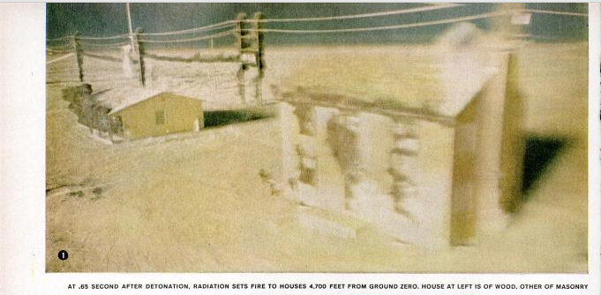

Slide 13
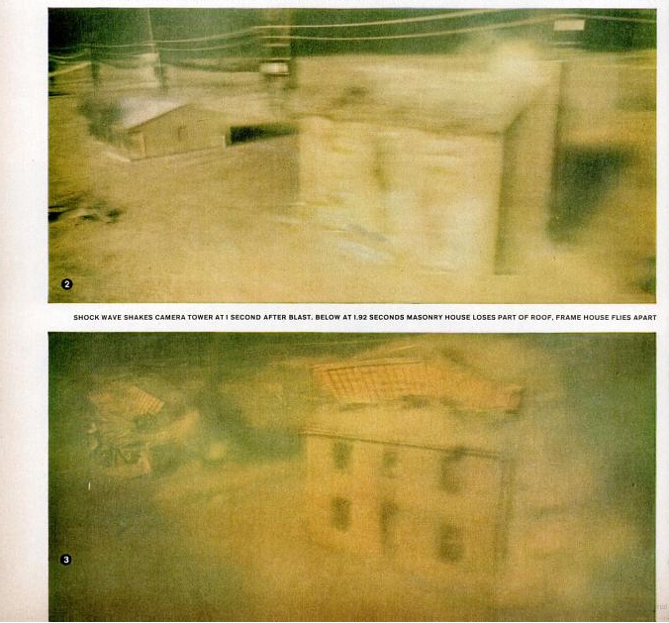

Slide 14
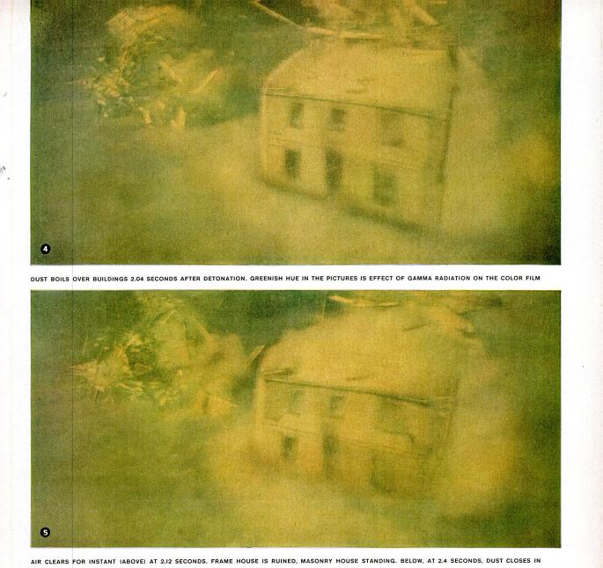

Slide 15
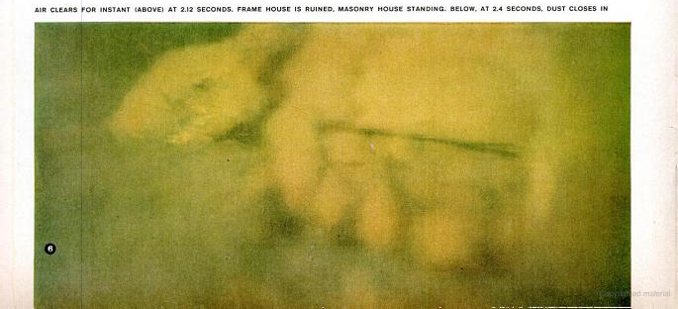

Slide 16
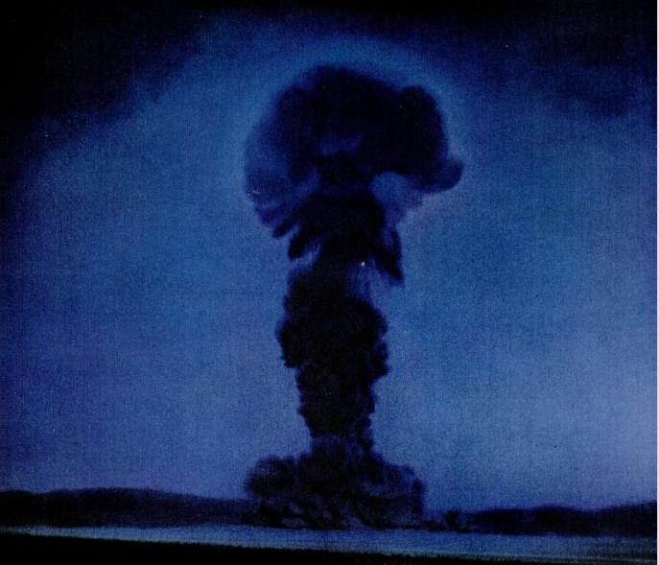
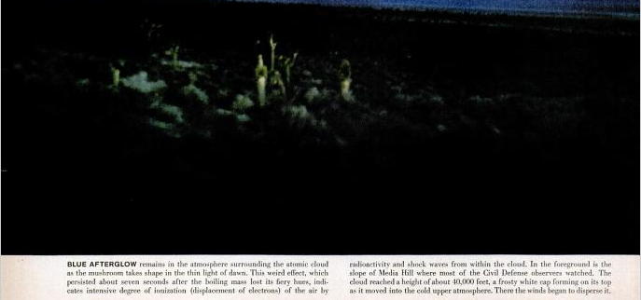
spliced image
Notes:
http://books.google.com/books?id=kFYEAAAAMBAJ&printsec=frontcover&source=gbs_ge_summary_r&cad=0#v=onepage&q&f=false

Slide 17
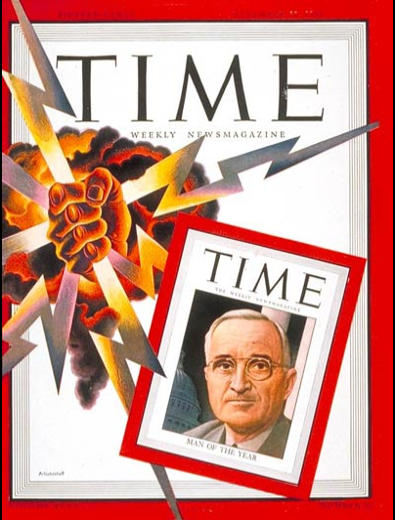
When Time named Harry Truman “Man of the Year” on December 21, 1945, the president’s picture on the cover was dwarfed by a mushroom-shaped cloud and a hand gripping a lightning bolt. All the year’s great events, said Time, including the deaths of FDR and Hitler and the surrender of Germany and Japan, paled before the awesome reality of the bomb.
Boyer, 20.

Slide 18
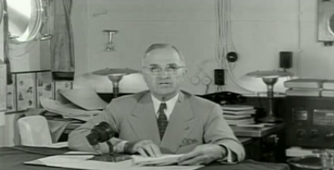
It is an atomic bomb. It is a harnessing of the basic power of the universe. The force from which the sun draws its power has been loosed against those who brought war to the Far East.
          Harry S. Truman, “Statement Announcing the Use of the A-Bomb at Hiroshima” (August 6, 1945)

Slide 19
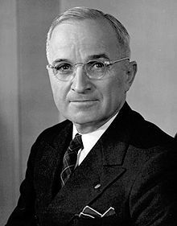
It is an awful responsibility which has come to us. We thank God it has come to us instead of to our enemies; and we pray that He may guide us to use it in His ways and for His purposes.
    Harry S. Truman, Radio Address, August 10, 1945,
    Cited in Boyer, By the Bomb’s Early Light, 5.

Slide 20
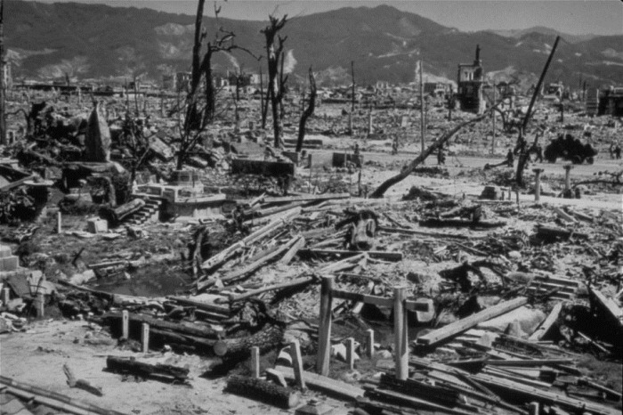
We are now prepared to obliterate more rapidly and completely every productive enterprise the Japanese have above ground in any city. We shall destroy their docks, their factories, and their communications. Let there be no mistake; we shall completely destroy Japan's power to make war.
    Harry S. Truman, “Statement Announcing the Use of the A-Bomb at Hiroshima” (August 6, 1945)
Notes:
If they do not now accept our terms they may expect a rain of ruin from the air, the like of which has never been seen on this earth.

Slide 21
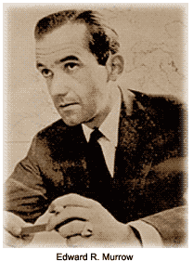
“Seldom, if ever, has a war ended leaving the victors with such a sense of uncertainty and fear, with such a realization that the future is obscure and that survival is not assured.”
    Edward R. Murrow, August 12, 1945, cited in Boyer, 5.

Slide 22
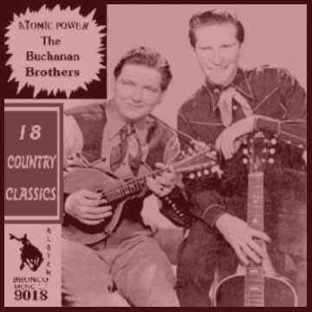
Atomic Power: The Buchanan Brothers [1946]
Oh this world is at a tremble with its strength and mighty power
There sending up to heaven to get the brimstone fire
Take warning my dear brother, be careful how you plan
You're working with the power of God's own holy hand
Refrain: Atomic power, atomic power
Was given by the mighty hand of God
Atomic power, atomic power
It was given by the mighty hand of God
You remember two great cities in a distant foreign land
When scorched from the face of earth the power of Japan
Be careful my dear brother, don't take away the joy
But use it for the good of man and never to destroy
Refrain
Hiroshima, Nagasaki paid a big price for their sins
When scorched from the face of earth their battles could not win
But on that day of judgment when comes a greater power
We will not know the minute and we'll not know the hour
Refrain
The Buchanan Brothers [1946]
Atomic Power
(Fred Kirby)
RCA Victor 20-1850
Fear, trembling, brimstone, images of cosmic destruction: the themes of “Atomic Power” are wholly in keeping with the national mood so frequently described by cultural observers in the months after the atomic bomb burst upon the American consciousness.
Boyer, 25.

Slide 23
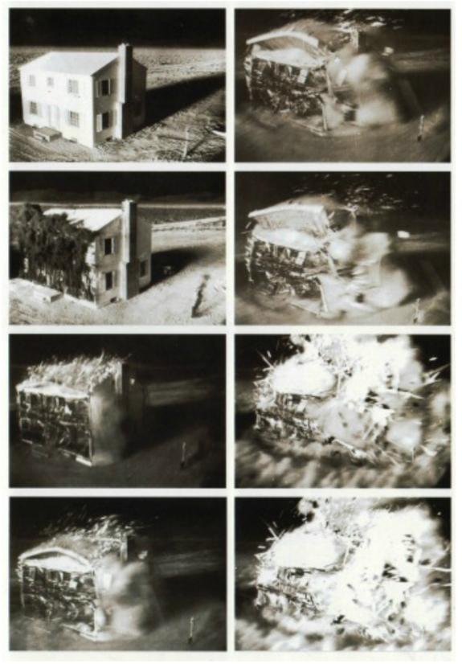
Notes:
At Home with the Nuclear Family (L) A series of images that ran in Life Magazine are from a government film as part of an Atomic Bomb test taken of a house closest to the detonation of the 3/53 Operation Doorstep
http://envisioningtheamericandream.com/2013/04/09/nuclear-jitters/

Slide 24
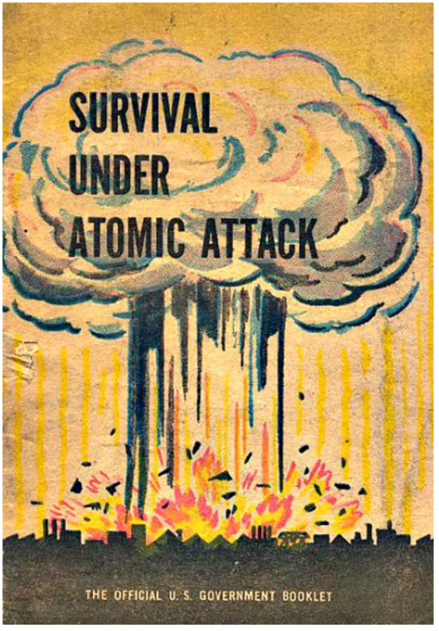
Notes:
US Government booklet 1950
http://envisioningtheamericandream.com/2013/04/11/an-atomic-fairy-tale/

Slide 25
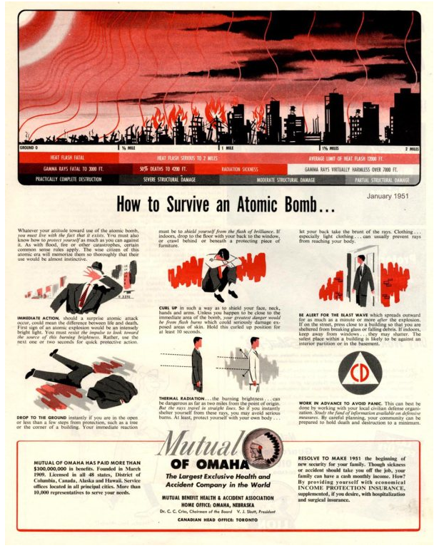
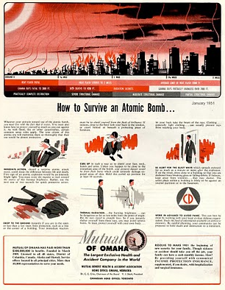
Notes:
http://roguesrookery.wordpress.com/2010/01/27/mutual-of-omaha-presents-how-to-survive-an-atomic-bomb/

Slide 26
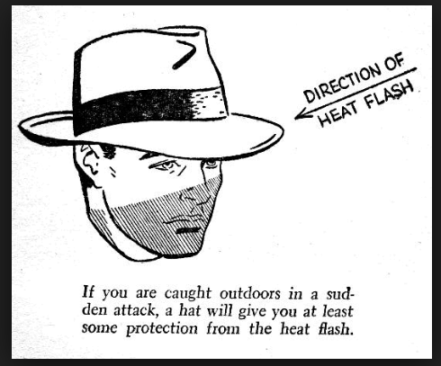
Notes:
From How to Survive an Atomic Bomb, by Richard Gerstell, Ph.D., Consultant to the Civil Defense Board (Bantam Books, NYC, 1952).

Slide 27
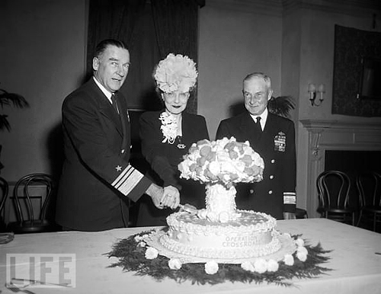
The caption to this story from Life magazine (1946) reads: "U.S. Navy Vice Admiral William H. P. Blandy, his wife, and Rear Admiral Frank J. Lowry cut a cake made in the shape of a mushroom cloud at a reception for Operation Crossroads, November 6, 1946."
Notes:
http://longstreet.typepad.com/thesciencebookstore/2011/03/miss-atomic-bomb-the-a-bomb-in-popular-culture-comics-cakes-and-god.html

Slide 28
The fact that we can release atomic energy ushers in a new era in man's understanding of nature's forces. Atomic energy may in the future supplement the power that now comes from coal, oil, and falling water. . . .
    Harry S. Truman, “Statement Announcing the Use of the A-Bomb at Hiroshima” (August 6, 1945)

Slide 29
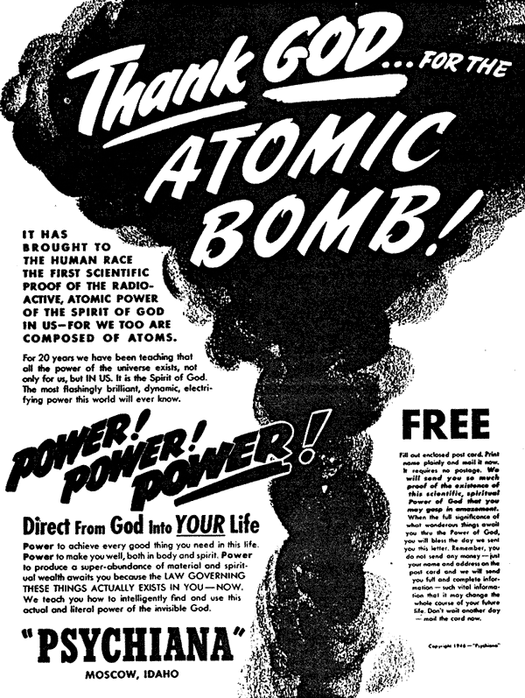
Notes:
http://longstreet.typepad.com/.a/6a00d83542d51e69e20147e381ffd0970b-pi

Slide 30
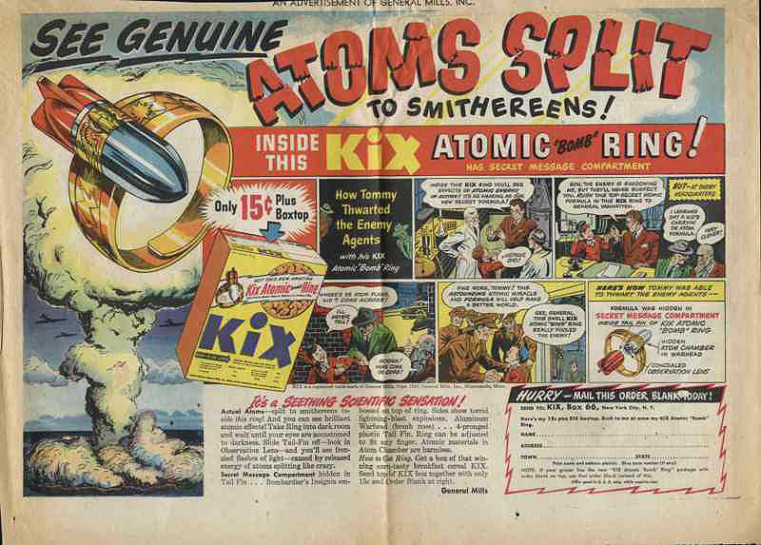
Notes:
Espionage and nuclear weapons – the Cold War begins

Slide 31
Sources Cited
Paul Boyer, By the Bomb’s Early Light (UNC Press, 1994 [@1985]), excerpt, 1. http://sites.middlebury.edu/coldwarculture/files/2013/08/boyer-excerpt.pdf.
Hales, Peter B. “The Atomic Sublime.” American Studies, 32:4 (1991), 5 - 31
Gill, David. “The Atomic Bomb and the Origins of the Cold War,” Cold War History 9:3(2009), 442.
Hariman, Robert and John Louis Lucaites. “Seeing the Bomb, Imagining the Future: Allegorical Vision in the Post-Cold War Nuclear Optic,” Dans Imaginaires du présent: Photographie, politique et poétique de l'actualité. Cahier ReMix, 1(May 2012). Montréal : Figura, Centre de recherche sur le texte et l'imaginaire. En ligne sur le site de l’Observatoire de l’imaginaire contemporain. http://oic.uqam.ca/fr/remix/seeing-the-bomb-imagining-the-future-allegorical-vision-in-the-post-cold-war-nuclear-optic, consulted 8 September 2013.
  Truman, Harry. “Statement Announcing the Use of the A-Bomb at Hiroshima.” 6 August 1945.
“War’s Ending: Atomic Bomb and Soviet Entry Bring Jap Surrender.” LIFE, August 20, 1945.http://books.google.com/books?id=hkgEAAAAMBAJ&printsec=frontcover&source=gbs_ge_summary_r&cad=0#v=onepage&q&f=false.

