Slide 1
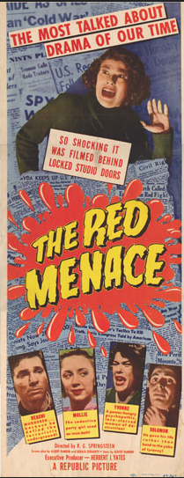
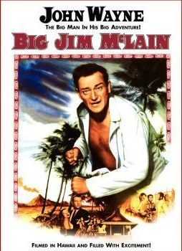
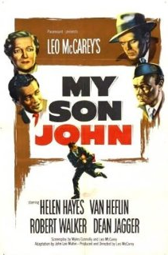
Filmic Mediations of the Cold
Notes:
WarExplicitly anti-Communist films
Big Jim McClain (1952)
U.S. House Un-American Activities Committee investigators Jim McLain (John Wayne) and Mal Baxter (James Arness) attempt to break up a ring of Communist Party troublemakers in Hawaii (from imdb.com)
My Son John (1952)
John Jefferson comes home from a trip overseas a strangely changed man. His already nervous wreck of a mother is distraught by the way he seems to be feigning feelings for her and his father that he no longer has. Plus, his odd refusal to accompany the family to church on Sunday not only disturbs her but their priest as well.
The Red Menace (1949)
A disillusioned, bitter ex-GI gets involved with the Communist party, and winds up falling in love with one of his "instructors."
For every anti-communist picture released in the wake of the 1947 HUAC hearings, there was another that arracked the scapegoating and with-hunting tactics of the committee

Slide 2
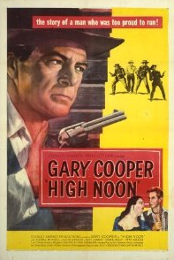
High Noon (1952)
Criticizes Hollywood’s failure to stand up to HUAC
Notes:
High Noon Fred
A marshall, personally compelled to face a returning deadly enemy, finds that his own town refuses to help him.
Director: Fred Zinnemann
Writers: Carl Foreman (screenplay), John W. Cunningham (magazine story "The Tin Star")
Stars: Gary Cooper, Grace Kelly, Thomas Mitchell | See full cast and crew
Imdb.com

Slide 3
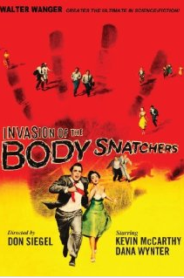
Science Fiction
“These works captured the decade’s greatest fears – fear of the bomb and fear of a Communist takeover—but did so without the crude tactics of the more flagrantly political films that merely restaged the HUAC hearings in a somewhat more dramatic form or simply reworked revent events that had taken place in Korea.” (Belton, 312)
Look at trailers
1956
Notes:
“Us versus Them”: Science fiction and Paranoia
“covert war films” – successful at the box office
Invasion of the Body Snatchers (1956)
exploited the association of Communism with brainwashing
Once they have been taken over by the pods, the film;s characters lack individuality, feeling, and emotion; thay have, in short, become Communist dupes. (Belton, 312-13)
In Hollywood films of the 1950s, any number of foreign humans and humanoids came to the United States or its territories, usually through a technology at least as good as, and often superior to, anything American scientists had imagined. Appearing as they do in movies made during a period of cold war and McCarthyism, these un-Americans clearly represent the perceived Soviet threat. (Smoodin, 35)
Any number of anti-Soviet films of the 1950s stress this notion that even our next door neighbors might be communists. In Invasion of the Body Snatchers, for instance, the pods from outer space grow into lookalikes of folks in the community. (Smoodin, 37)

Slide 4
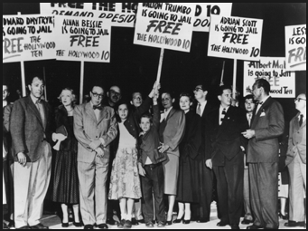
HUAC and Hollywood
Notes:
HUAC came to Hollywood in 1947
HUAC had eyed Hollywood with suspicion for years, motivated by a mix of old-fashioned anti-Semitism and growing fears of domestic subversives. Matters intensified in 1947 when HUAC brought contempt charges against a group of studio employees, the “Hollywood Ten,” which refused to cooperate with their investigations. The movie industry surrendered, agreeing in 1948 to fire the ten and actively purge itself of suspected Communists. The age of “the blacklist” had arrived. Michael Wakeford , “None without Sin” 88.
Chairman = J. Parnell Thomas, a Congressman from Illinois.
“right-wing extremist whose animus would find fertile soil with the Committee.” (Shaman 4)
“As far as Thomas was concerned, witnesses who claimed a constitutional right to refuse to answer questions were all part of ‘a concerted effort on the part of the Communists, their fellow travelers, their dupes, and paid apologists to create a lot of fog about constitutional rights, the First Amendment, and so forth.’” (Shaman, 4)
Waldorf statement: Waldorf statement – Motion Pictures Producers Association (history of self-censorship)
Suspend H 10 without pay
Deny employment to anyone who did not cooperate with HUAC
Refuse to hire communists
By mid-1950s, more than 200 suspected Communists had been blacklisted
Blacklist remained unchallenged until 1960
Many artists, as well as other persons in Hollywood and elsewhere, were not strong enough to withstand the threat of being blacklisted. It is not difficult to understand why. Careers were ruined, friendships and even families were split apart, all by the blacklist. The blacklist was the very antithesis of freedom of speech. Operating through suspicion and innuendo, it punished people for holding unpopular beliefs, for criticizing the government, for aspiring to a better life. It embodied guilt by association; nothing more than membership in the Communist Party was enough to taint an individual, perhaps for life. (Shaman, 6)

Slide 5
How did the Supreme Court judge the constitutionality of HUAC?
Notes:
In the Court's reconstructed view, the right of association finally was recognized as a "cherished freedom" (79) specifically protected by the First Amendment, (80) and guilt by association was denounced as a doctrine "which has no place here." (81) The Court also became less deferential in reviewing legislative authority to conduct investigations and began to place First Amendment limits on legislative inquiries. (82) In 1958, the Court ruled that the government may not compel disclosure of an individual's membership in an organization unless the government can demonstrate a genuinely compelling need for the disclosure. (83) "Inviolability of privacy in group associations [the Court stated] may in many circumstances be indispensable to the preservation of freedom of association, particularly where a group espouses dissident beliefs." (84) Finally, in 1967, the Court struck down a federal statute that was the equivalent of the blacklist in that it denied employment to persons who were members of Communist organizations. (85) Since then the Court has adhered to an expansive view of the First Amendment, granting wide protection to freedom of expression and association.
(Shaman)
In 1949, the Court declined to review the convictions of the Hollywood Ten, paving the way for their imprisonment. (42) Two years later, the Court announced its decision in Dennis v. United States, (43) upholding the convictions of eleven persons for violating the Smith Act, a federal statute that made it a crime to advocate, abet, advise, or teach the desirability or propriety of overthrowing the government by force or violence. The defendants in Dennis, convicted of conspiring to organize the Communist Party, were sentenced to long terms in prison. The Court's decision in Dennis represents the low point for freedom of speech and association in the United States. It allows mere membership in the Communist Party, or simply the expression of an opinion in support of Communism, to be made a crime. The defendants in Dennis, after all, had done little more than teach about Marxist-Leninist doctrine, (44) yet in the eyes of six learned Justices of the august Supreme Court of the United States, neither the convictions nor the Smith Act itself violated the First Amendment.
The plurality opinion in Dennis, (45) written by Chief Justice Vinson, is a bold example of legal sophistry. It acknowledges the value of freedom of speech and purports to follow the philosophy of Justices Holmes and Brandeis, proponents of a strong First Amendment, who advocated that speech may only be restricted when there is a "clear and present danger" that it will cause a substantive public evil. (46)

Slide 6
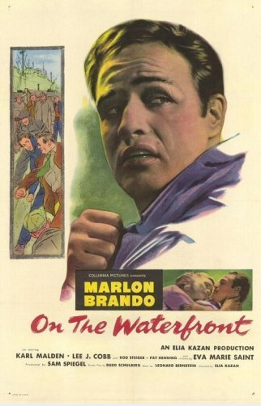
On the Waterfront Elia Kazan and Naming Names
Notes:
Winner of eight Academy Awards, including best motion picture of 1954, On the Waterfront is one of the greatest movies ever made. (Shaman, 1)
Full of pain and anguish, Waterfront also reflects the sensibilities of its time,... Like the plays of Arthur Miller, Waterfront was meant to prove that great drama didn't have to be about kings and queens or the upper classes. The common people, it seems, can be just as interesting as royalty. As Miller showed, even traveling salesmen could suffer from the same sort of tragic flaws that beset Shakespearean kings and queens, and this made for great theater. (Shaman)
“written and directed by two men, Elia Kazan and Budd Schulberg, who had co-operated in the expansion of the Hollywood blacklist by “naming names.”
This movie depicts the longshoreman’s union—accurately—as a mobster-controlled organization, and provides a starring role for a marginal worker and former boxer who “names names” in an attempt to clean up the local. Consistent with other movies about the working-class, On The Waterfront features an individual inspiring a collective struggle”
(From The Encyclopedia of Class—publishing in early 2007)
Films and the depiction of class
Bill Barry

Slide 7
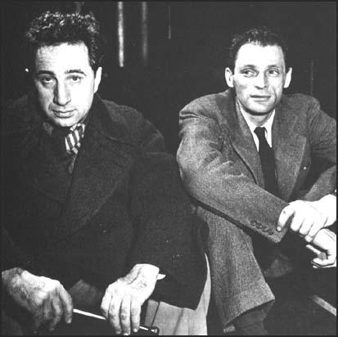
Notes:
Elia Kazan was called to testify before the Committee in 1952
First time -- answered all Committee's questions except those about other persons.
called back to testify again a few months later -- gave the Committee the names of eight colleagues from the Group Theater with whom he had been in a Communist "cell" seventeen years before.
Wakeford: “Kazan was as disdainful of the committee’s demagoguery as he was of Communism, and at first refused to cooperate, but the prospect of the blacklist left him with a stark choice. The film portrays him as a man authentically torn. Called again, however, he publicly identified the names of old acting friends and others who he knew to have been Communists. Kazan had saved his career, but lost his friendships, including his almost brotherly bond with Miller, who himself would defy HUAC in 1954. They would not speak again for a decade”. Michael Wakeford, 88.
Kazan and Miller:
“Director Elia Kazan and playwright Arthur Miller met in 1947, when Kazan directed a Miller script (All My Sons) on Broadway. Fast friends, their collaborations brought both acclaim—Kazan earned a Tony for All My Sons, while Miller garnered the 1949 Pulitzer for the next play they brought to the stage, Death of a Salesman. On the heels of these successes, the two looked to take their partnership to Hollywood. But in departing the confines of the theater, Miller and Kazan were stepping on to a bigger stage and into a personal and political drama that would destroy their friendship and bring American culture into painful confrontation with itself.” (Michael Wakeford , “None Without Sin: Elia Kazan, Arthur Miller, and the Blacklist,” Film & History, Volume 37.2, 88.
Kazan and Miller sat atop the entertainment world as they began peddling a screenplay for “The Hook” to major studio executives. One by one, studios turned them away – the screenplay’s narrative of unionized dockworkers fighting off the encroach of organized crime was politically untouchable. Michael Wakeford, 88.
Miller was addressing not just red-baiting tactics of HUAC, but what he judged to be Kazan’s profound moral failing. Kazan shot back on film with On the Waterfront (1954), which was a transparent adaptation of “The Hook.” Once a stridently working-class statement, “The Hook” had transformed into self-commentary, with Kazan’s protagonist, Terry Malloy (Marlon Brando), testifying against waterfront mob bosses in a murder trial. Miller’s pro-union story now unfolded as one celebrating a lone individual heroically confronting authority in an act of righteous self-sacrifice. As the documentary notes, On the Waterfront maintained a progressive temper that Kazan never abandoned. However, it was one that resonated with Cold War liberalism’s antiauthoritarian and individualist pretensions rather than the collectivist stance of Miller’s original script. Michael Wakeford, 88-89.

Slide 8
Tavenner: I understand that you have voluntarily requested the committee to reopen your hearing, and give you an opportunity to explain fully the participation of others known to you at the time to have been members of the Communist Party.
Kazan: That is correct. I want to make a full and complete statement. I want to tell you everything I know about it.
Notes:
“Under pressure from the FBI and the movie studios, he reversed himself. Since the committee already knew the names it wanted, "naming names" was a loyalty test and humiliation ritual, not part of a real investigation.” http://www.slate.com/articles/technology/the_browser/1999/01/blacklist_and_backstory.html
Frank Tavenner, Jr. was a lawyer for HUAC

Slide 9
"I believe that any American who is in possession of such facts has the obligation to make them known, either to the public or to the appropriate Government agency," he wrote. "Whatever hysteria exists--and there is some, particularly in Hollywood--is inflamed by mystery, suspicion and secrecy. Hard and exact facts will cool it."
Notes:
Text from Kazan’s full-page ad in the NYT justifying his HUAC testimony.

Slide 10
What do you think?
Kazan was hardly the only witness to cooperate with HUAC, and it is unfair to focus solely on him. Moreover, the real villains of this story are the congressional members of HUAC and the studio bosses who possessed the power to challenge the Committee, but were too frightened or greedy or narrow-minded (or, most likely, all three) to do anything but toe the line. On the other hand, the individuals who were forced into becoming informants were themselves victims, made to degrade themselves in a public ceremony designed to break their will.
(Shaman, 5)
Notes:
Kazan, though, insists that he did not regret his testimony, and he set out in On the Waterfront to make that clear. (Shaman, 5)
Yet some of the witnesses friendly to HUAC claimed that they named names out a sense of conscience. One of those friendly witnesses was Budd Schulberg, who wrote the screenplay for Waterfront. A few days after he was named to the Committee as a former member of the Communist Party, Schulberg sent a telegram to HUAC stating, "I will cooperate with you in any way I can." (36) When he appeared before the Committee, Schulberg described how he was made to suffer the heavy hand of thought control when other party members tried to make him rewrite a novel-in-progress to conform to the party line, and called him on the carpet when he refused to do so. (37) In his testimony, Schulberg named fifteen former party members. (38) Not long after that he began work on the Waterfront screenplay. (Shaman, 6)

Slide 11
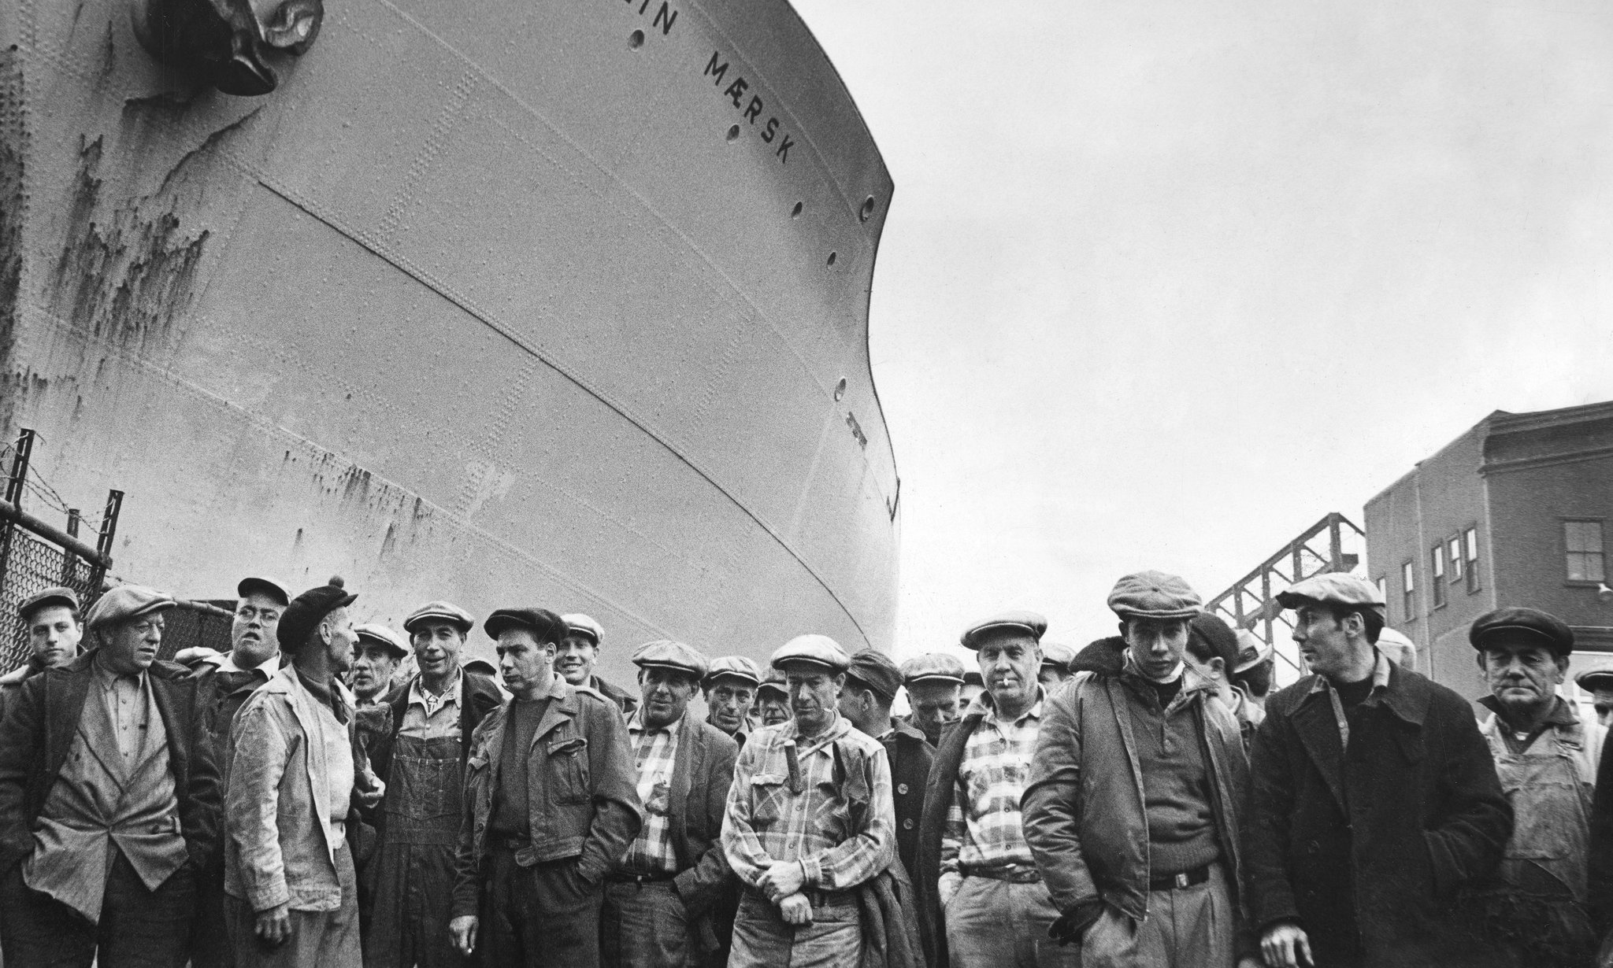
Longshoremen in Brooklyn, 1951. Sam Falk/ The New York Times.
Notes:
Dockworkers’ union in NJ was famously corrupt
“Under the guise of paying dues to their unions, honest dockworkers were coerced into giving much of their meager earnings to the mob, who also stole a share of every delivery that made its way through the ports. Men who tried to speak against the ruling gangsters were murdered, their bodies discovered floating in the Hudson River or buried in quicklime.”
For Kazan and Schulberg, both HUAC informers, On the Waterfront = perfect story through which to connect mob violence and corruption with Communist threat
IN On the Waterfront, longshoreman are powerless to speak up for their rights under the threat of being ostracized, beaten or even killed. Caught in the center of this corruption is Terry Malloy, an ex-prizefighter controlled by crime boss Johnny Friendly, who runs the local longshoremen’s union.

Slide 12
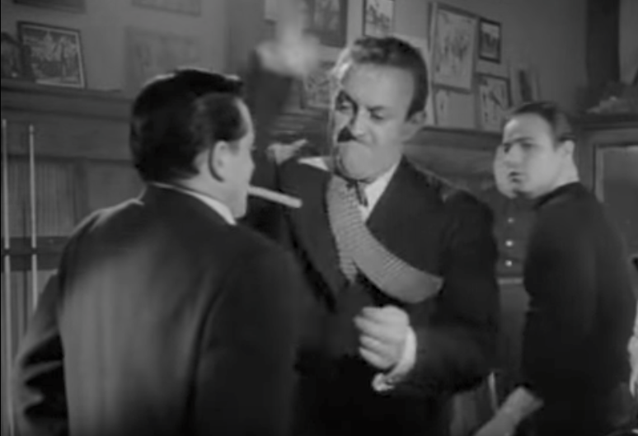
Kayo Dugan: One thing you have to understand, Father. On the dock, we’ve always been D&D.
Father Barry: D&D? What’s that?
Kayo Dugan: Deaf and dumb. No matter how much we hate the torpedoes, we don’t rat.
Notes:
In Waterfront, evil is represented by the ironically named Johnny Friendly (9) (played by Lee J. Cobb), the crude, vicious, brutal, cigar-chewing, corrupt mob boss of the docks who feeds like a vulture on the meager salaries of poor working people and orders the murder of anyone who challenges his iron reign over the docks. Despite his criminal behavior, Friendly is able to evade the law because no one, not even the good working people he abuses, will testify against him. On the docks, there is nothing worse than being a "stoolie," or a "rat." Nobody wants to have anything to do with a crummy "cheese eater," so the workers steer clear of the Waterfront Crime Commission which is investigating corruption on the docks. (Shaman, 2)

Slide 13
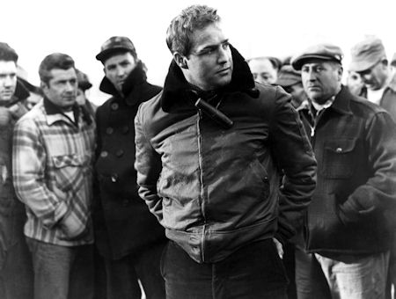
Who is Terry Malloy?
Notes:
Terry is strong, but simple and uneducated — a seemingly perfect tool to be used by the corrupt union. Yet his conscience weighs heavily on him after the murder of Joey Doyle, the one person who promised to testify against Friendly’s racketeering before the Waterfront Crime Commission. Terry is even further troubled after meeting Joey’s sister, Edie, and a local Catholic priest, Father Barry. Edie spurns the dockworkers for not standing up against Friendly’s unmitigated power, and Father Barry is convinced that corruption can be overturned so long as the dockworkers band together and fight for justice.
e dockworkers are too scared to ght what they see as a losing battle, however, and care little for the priest’s belief in justice and solidarity. A er all, they think, what would a priest know about living as a longshoreman on the waterfront? Is speaking the truth worth it, whatever the risk?
Knights of Columbus study guide

Slide 14
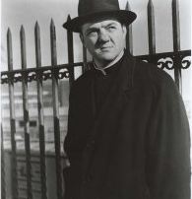
Who is Father Barry?

Slide 15
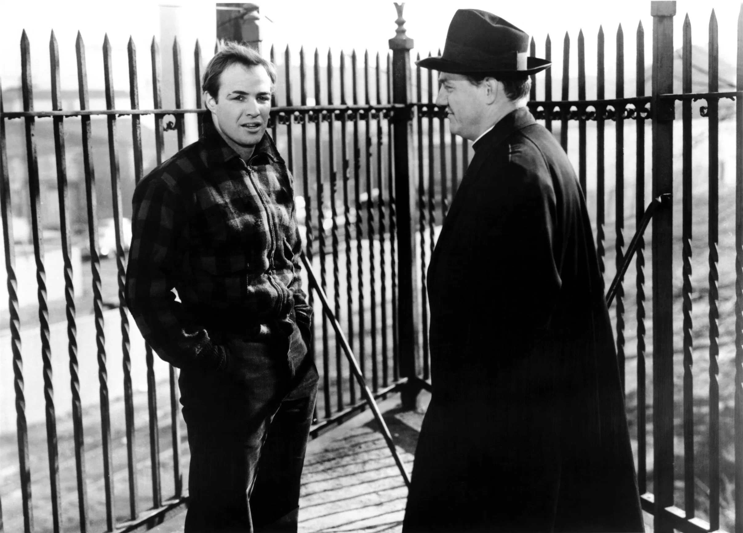
Terry: If I spill, my life ain’t worth a nickel.
Father Barry: And how much is your soul worth if you don’t?
Notes:
Eventually, Father Barry is able to convince Terry Malloy that testifying against Johnny Friendly to the Waterfront Crime Commission is the right thing to do. For Terry, testifying is an act of redemption that absolves him of his sins. Though he is vilified for being a rat by his fellow dock workers, by the neighborhood kids who previously idolized him, and even by the cops, Terry remains defiant. He shows up at the dock, demanding his right to work, and proclaiming that he is happy he testified. "I'm glad what I done--you hear me?--glad what I done!" he screams at Johnny Friendly while all the dock workers gape in silence at the spectacle of good rising up against evil. And finally good does triumph over evil, but not until Friendly's goons viciously beat Terry while the workers stand by and watch. But then the workers have a change of heart, and rally around Terry. They won't work unless he does, they say. Battered and bloody, Terry pulls himself up and walks--by himself--into the hold of a ship, ready for work.
In the context of the movie, there is no denying that it is an act of heroism when Terry Malloy finally decides to testify against Johnny Friendly to the Waterfront Crime Commission. (Shaman, 3)

Slide 16
When Brando, at the end [of On the Waterfront], yells at Lee Cobb, the mob boss, “I’m glad what I done — you hear me? — glad what I done!” that was me saying, with identical heat, that I was glad I’d testified as I had.
-Elia Kazan

Slide 17
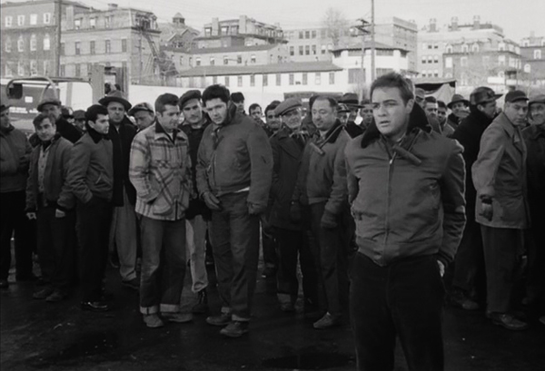
Representing Social Class in On the Waterfront
Notes:
What Kazan did was wrong, but what happened to American dockworkers in this period, arguably, was even worse. Though the bitterness against Kazan has lingered, we should see On the Waterfront as one of the important works for understanding what happened to American labor in the postwar period.
We do so not to redeem Kazan, but to honor the workers that he and Schulberg were trying to represent. (Kathy Newman)

Slide 18
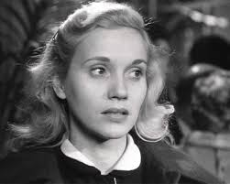
Representating Gender in On the Waterfront
Notes:
Who is Edie Doyle?

Slide 19
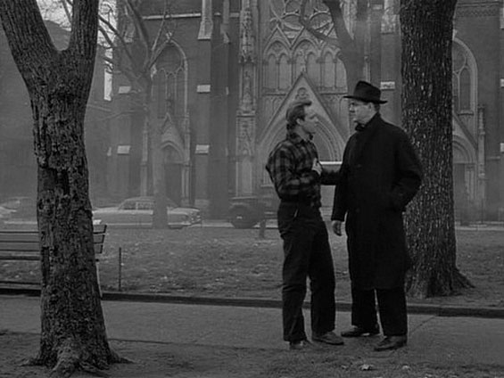
Role of religion in On the Waterfront?

Slide 20
How did Kazan, through his artwork, and Miller through his, engage in a pointed dialogue about the moral implications of Kazan’s testimony?
Notes:
Wakeford
s for justice for the real-life participants to the drama that surrounded On the Waterfront, the record is decidedly mixed. Some of the individuals who were blacklisted eventually were able to reclaim their careers, but many were not. Careers and, indeed, lives, were ruined by the blacklist. While there was no justice for the Hollywood Ten who went to prison for their political beliefs, they could perhaps enjoy a kind of vicarious poetic justice when J. Parnell Thomas, the mean- spirited chairman of HUAC, was convicted of taking kickbacks from his staff and was imprisoned in a federal correctional institution, where his fellow inmates included two of the Hollywood Ten. (90) Politics and corruption, it seems, make for strange cellmates. (Shaman, 11)

