Slide 1
VIETNAM AND COLD WAR CULTURE
Notes:
1959… Ho declares “Peoples’ War” to unite Vietnam.
1961… President Kennedy sends 400 Green Berets to Vietnam
Oct 1961… Maxwell Taylor visits Vietnam and reports “If Vietnam goes it will be exceedingly difficult to hold Southeast Asia.” (domino theory) Recommends sending combat troops.

Slide 2
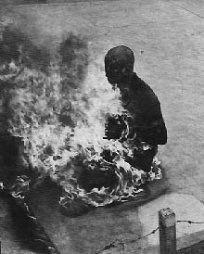
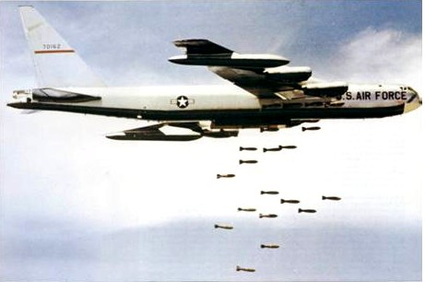
U.S. involvement
Notes:
1.Several Buddhist monks burned themselves alive to protest Diem’s religious oppression
2. Protesters in Saigon to express their dissatisfaction with the Diem government.
3. Op. Rolling Thunder
1963… Diem assassinated in US-backed coup.
Diem illegitimate and corrupt
Catholic in an overwhelmingly Buddhist society
Ignored Geneva Accords call for elections in 1956
Nepotism
Succession of military coups resulted in a revolving door government
1964… North Vietnamese patrol boats attack US destroyer in Gulf of Tonkin. US begins bombing.
2 Mar 1965… Operation Rolling Thunder begins.
8 Mar 1965… First US combat troops arrive. By the end of the year, 184,300 troops are in Vietnam.
The massive bombing campaign was plagued by restricted targeting and the non-industrialized nature of North Vietnam

Slide 3
Flag of the National Liberation Front
Notes:
Increasing North Vietnamese infiltration created a security threat in South Vietnam
In Dec 1960, the insurgents formed the National Liberation Front (typically called the Viet Cong or VC), a broad-based organization led by communists but designed to rally all those disaffected with Diem by promising sweeping reforms and genuine independence
The NLF skillfully combined political and military organizations and efforts
Politically they created special organizations to give status to such groups as farmers, women, and youth
Used agitation and propaganda (“agitprop”) to arouse the people to the government’s oppressiveness and lack of responsibility
Militarily they assembled a disciplined and potent force of an estimated 80,000 fighters by 1965
Relied on speed, surprise, and deception to strike targets selected for the maximum psychological effect
Used violence to coerce or win over the population and undermine the legitimacy of the South Vietnamese government

Slide 4
Cold War Context: Soviet Union and China support Viet Cong
Notes:
North Vietnam began constructing a massive supply route through Laos and Cambodia that allowed it to infiltrate supplies and personnel south
The Ho Chi Minh Trail
The Soviet Union and China provided equipment, advisors, and diplomatic support

Slide 5
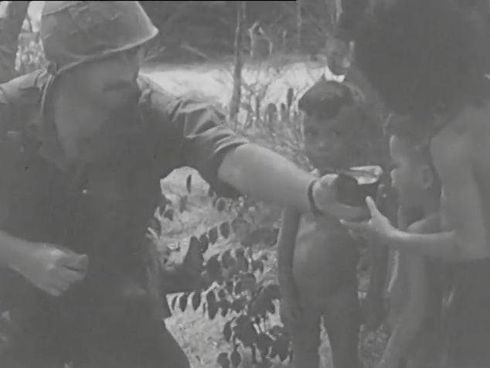
Pacification
A War Within a War
by U.S. Naval Photographic Center, 1965
Prelinger Archives
Notes:
Between 1961 and 1963, President Kennedy launched a full-scale counterinsurgency program in Vietnam, part of which would become the “pacification” program
Major goals
Strengthen the South Vietnamese government’s hold on the peasantry
Cut into the heart of the Viet Cong politico-military organization
Designed to “win the hearts and minds” of the South Vietnamese
Combined Action Program… Placed selected Marine squads within the village militia to eliminate local guerrillas
Very successful at the local level but required a degree of American-Vietnamese cooperation unable to be replicated on a wider scale
Drew American troops away from the “big war”
Instead, American troops concentrated on the “big war”and left pacification to the South Vietnamese who did not show an abundance of commitment to the task

Slide 6
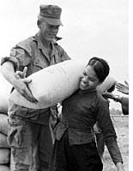
Pacification
Notes:
Strategic Hamlet Program… South Vietnamese peasants from scattered villages were brought together in defended and organized hamlets in order to protect them, isolate the Viet Cong, and show the superiority of what the SVN government could offer
Patterned after British experience in Malaya
Did not work in Vietnam because of traditional Vietnamese ties to the land

Slide 7
Pacification: Overall Assessment
Air Force Chief of Staff Curtis LeMay reportedly said, “Grab ‘em by the balls and their hearts and minds will follow.”
Notes:
Commonly considered a missed strategic opportunity
Suffered from being “too little, too late”
CORDS not activated until 1967
Perceived as competition with the “big war” and many military officers favored a “military solution”

Slide 8
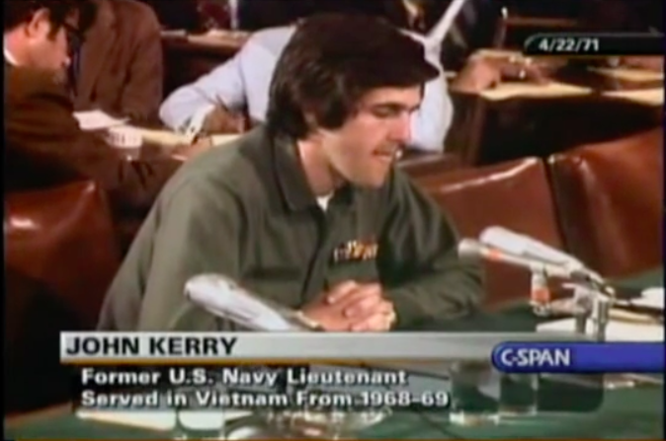
John Kerry testifies

Slide 9
US Troop Levels in Vietnam
1967 -- 485,600
1968 -- 536,100
1969 -- 475,200
1970 -- 334,600
1971 -- 156,800
1972 -- 24,200
1973 -- 50
1959 -- 760
1960 -- 900
1961 -- 3,205
1962 -- 11,300
1963 -- 16,300
1964 -- 23,300
1965 -- 184,300
1966 -- 385,300
Notes:
Limited War: When the Soviet Union and the US nuclear programs reached the point of Mutually Assured Destruction, the US faced the dilemma of responding to communist challenges in peripheral areas by either risking starting a nuclear war or doing nothing
The alternative strategy of limited war was developed to harness the nation’s military power and employ only that force necessary to achieve the political aim
The objective was not to destroy an opponent but to persuade him to break of the conflict short of achieving his goals and without resorting to nuclear war
Led to a “body count” mentality
Many reports were exaggerated or falsified
North Vietnamese were always able to replace their losses while Americans became disillusioned with the mounting death toll
Nightly news broadcasts reported US deaths versus North Vietnamese deaths
If ours were less, we were winning!
North Vietnamese showed a remarkable capability to cope, rebuild, and repair
The enemy will was never broken

Slide 10
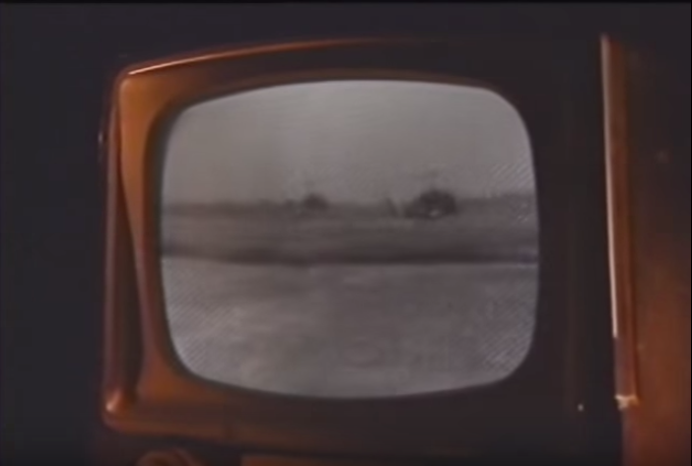
Vietnam and Television
Notes:
Notes are from Elizabeth J. Burnette asks the following questions in her article, “The 6:00 Follies: Hegemony, Television News, and the War of Attrition” (http://xroads.virginia.edu/~MA05/burnette/thesis/home.html).
Vietnam (which was never formally declared a war) is often characterized as the "living-room war" or the "television war."
first war to be systematically televised,
televised during a period when television was becoming a more compelling presence in American life.
1964 survey -- Americans depended equally on television and newspapers for information.
1972, the percentage of Americans who relied primarily on television for their news had jumped significantly.
By 1966, 93% of US homes had a television (contrast to only 9% in 1950)

Slide 11
War Protests

Slide 12
My Lai
Notes:
On March 16, 1968, an infantry company entered the village of My Lai
They found no insurgents but, being psychologically prepared for battle and poorly disciplined, they proceeded to kill between 347 and 504 mostly old men, women, and children
Word of the massacre did not reach the American public until November 1969 when it then fueled national outrage and further undermined support for the war

Slide 13
Notes:
Richard Nixon was elected president in 1968 campaigning for “peace with honor”
Under Nixon the process of “Vietnamization”– the gradual transfer of primary responsibility of the war to the South Vietnamese that Johnson had begun on a small scale after Tet– was accelerated
Nixon’s involvement in Watergate, his impeachment, and resignation hamstrung America’s ability to influence peace negotiations through sustained offensive operations
Nixon was succeeded by Gerald Ford. By this point the US was traumatized by war-weariness and economic recession. Ford had almost no maneuver room to help the South Vietnamese.

