Slide 1
After the Cold War

Slide 2
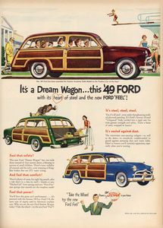
Postwar American Dream
widespread postwar affluence
Democratization through shared abundance (Cohen)
by 1953, average US family enjoyed twice as much real income as in the 1920s
Notes:
automobile as symbol of postwar consumerism
in 1950s, Americans purchased a record 58 million new cars
number of registered automobile owners rose by 21 million
total motor vehicle miles traveled rose by 75%
critics complained of “autosclerosis” – the clogging of urban arteries
auto industry kept the public buying by promising glamour and status in bigger and flashier models with gleaming chrome, two-tone colors, and tail fins
seat belts remained unadvertised extra-cost option
fancy new car models nevertheless were powered by engines capable of propelling them more than twice as fast as any existing speed limit
also: rise in highway deaths, air pollution, and oil consumption
creeping sprawl of motels, gas stations, and fast-food outlets
not to mention shopping malls
automobile also spurred “white flight” from the cities to the suburbs
so automobile as symbol of postwar America had positive and negative aspects

Slide 3
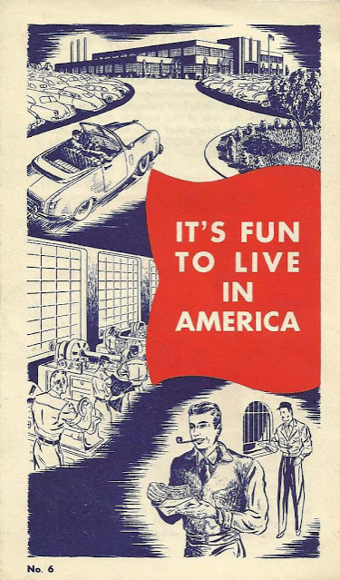
Notes:
Kiwanis Club brochure, 1950s. http://letterology.blogspot.com/2012/04/boy-are-we-having-fun-now.html, accessed 10-5-13.

Slide 4
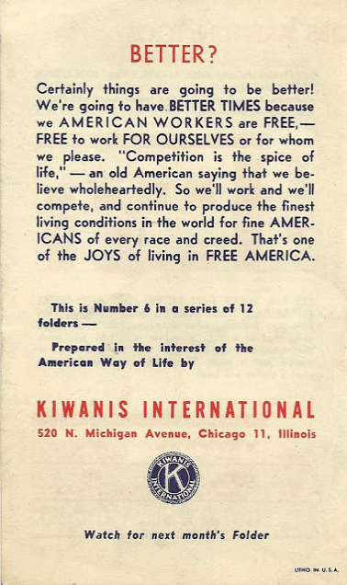
Notes:
Kiwanis Club brochure, 1950s. http://letterology.blogspot.com/2012/04/boy-are-we-having-fun-now.html, accessed 10-5-13.

Slide 5
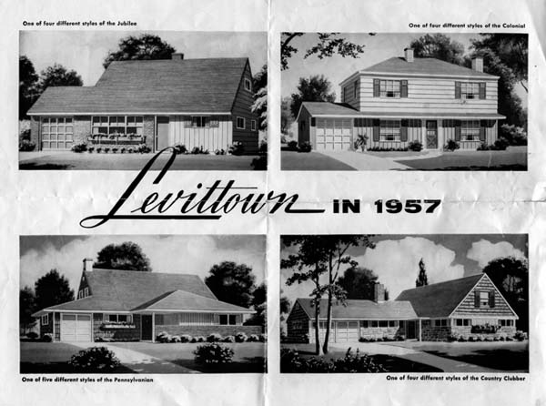
http://www.statemuseumpa.org/levittown/one/d.html

Slide 6
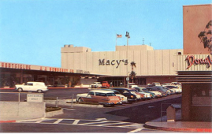
Hillsdale Shopping Mall, San Mateo, California circa 1960

Slide 7
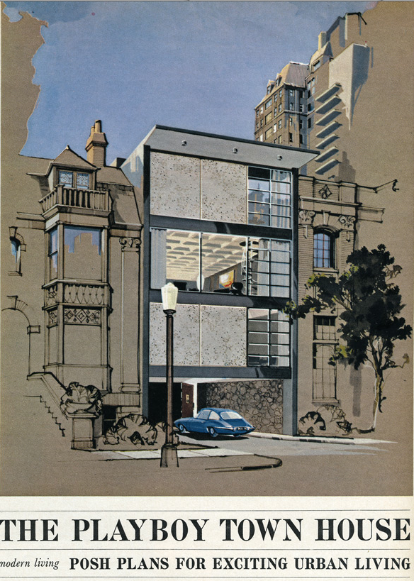
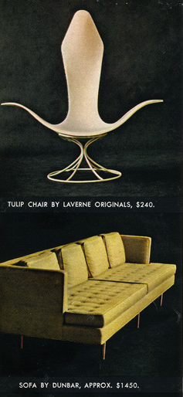

Slide 8
“In the Cold War, everyone was encouraged to view the world as a dichotomy. There were two competing ideologies (capitalism and communism), and we were in a gigantic struggle to save ‘the free world.’ That was the basic theme, and it played out pretty much from the instant World War II was over right up to the collapse of the Berlin Wall and the Soviet Union -- roughly two generations' worth of time. Boy, those were the days, eh? The world was supposed to be clearly black and white, and there was absolutely no question about who was wearing the white cowboy hats.”
Chris Weigant, “Friday Talking Points -- Cold War Nostalgia.”
http://www.huffingtonpost.com/chris-weigant/friday-talking-points_b_3923782.html

Slide 9
“The awful truth is that in many ways the Berlin Wall, where at least 136 people were killed over 28 years, was almost as important in forming our sense of identity during the Cold War as it was to the people who were hemmed in by it.
“A menacing symbol of global division, the wall required us to vehemently declare which side we were on, ideologically speaking. It could induce even the hardiest campus leftist -- someone who was reflexively appalled by President Reagan labeling the Soviet Union "the evil empire" -- to start belting out "The Star-Spangled Banner." To peer east into no-man's land from an observation post in West Berlin was to look our proverbial evil twin in the face in order to reassure ourselves that we were on the right side.”
Gregory Rodriguez, “Cold War Nostalgia.” Los Angeles Times, Nov. 9, 2009
http://articles.latimes.com/2009/nov/09/opinion/oe-rodriguez9

Slide 10
“Today, 20 years after the wall fell and in the wake of a global financial meltdown, it's gotten harder to rally around capitalism. We in the West have our enemies and demons, but they aren't so monolithic, and we can't always see ourselves as blameless in comparison. There's no longer such a perfect evil twin to point at to make us feel better about the imperfections and pitfalls of the system we live in. Without the stark divide between us and them, we miss that absolute certainty as to who we are and what we stand for.”
Gregory Rodriguez, “Cold War Nostalgia.” Los Angeles Times, Nov. 9, 2009
http://articles.latimes.com/2009/nov/09/opinion/oe-rodriguez9

Slide 11
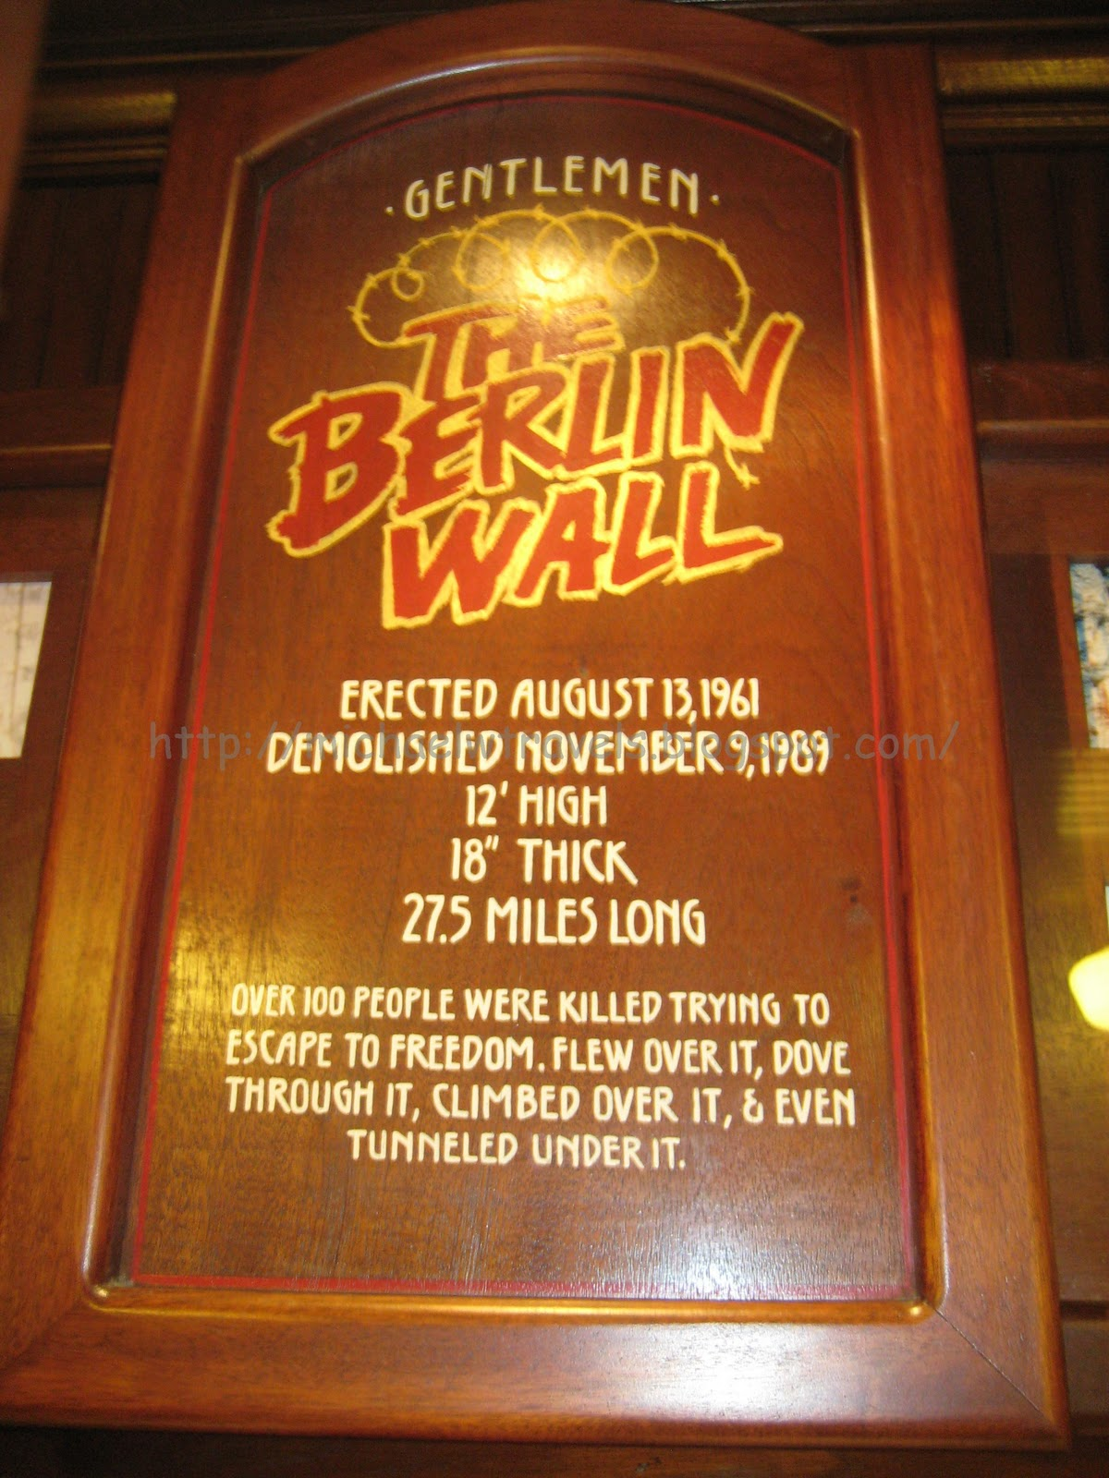
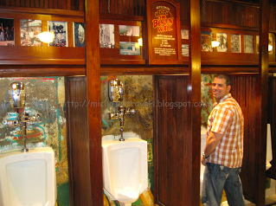
Jon Wiener, “Hippie Day at the Reagan Library” (2012)
Men’s Room at the Main Street Station Casino, Las Vegas, Nevada
Notes:
Last sentence of the piece: Back at the Reagan Library in Simi Valley, one can only imagine the dismay at the range and diversity of public com- memorations of the Berlin Wall and the end of the Cold War.

Slide 12
In “Hippie Day at the Reagan Library,” Jon Wiener laments Americans’ historical amnesia regarding the weightiness and complex conclusion of the Cold War. He discusses various museum exhibits to fortify his argument that Americans either misunderstand or trivialize the Cold War decades after its conclusion. Among the examples he discusses is a 2009 event for which the the Wende Museum erected two “Berlin Walls” along Wilshire Avenue in Los Angeles. Invited artists covered the walls with images expressing “their creative response to [all of] the Walls in our lives” (27), and then participants were invited to tear down one of them.
This example from Wiener’s text prompts me to ask two questions. Feel free to answer one or both of them.
How does Wiener’s analysis resonate with that of Rodgers?
In your view, have our ways of thinking about “the Walls in our lives” changed since Wiener published his essay in 2009? Consider the Trump slogan, “Build the Wall!” What role do walls (real or imagined) play in the construction of U.S. national identity?

Slide 13
Losing the Words of the Cold War
According to Daniel Rodgers, what were “the words of the Cold War”?
When and how were they lost?
Importance of Reagan’s presidency

Slide 14
According to Rogers,
“The freedom which hung so urgently in the balance in 1950s and 1960s America was ballasted by and contained within its complements: responsibility, destiny, justice, morality, and society.”
Notes:
Jacob mentions this in his response to question on following slide

Slide 15
In “Losing the Words of the Cold War” (2011), Daniel T. Rodgers writes:
As the force seeped out of the older, mid-twentieth-century ways of imagining society, talk of freedom did not diminish.. But its meanings changed. Individualized and privatized, released of it larger burdens, freedom was cut loose from the burdens and responsibilities that had once so closely accompanied it. (40)
Are you persuaded by Rodgers’ argument? Does his characterization of freedom resonate with your experiences and aspirations?

Slide 16
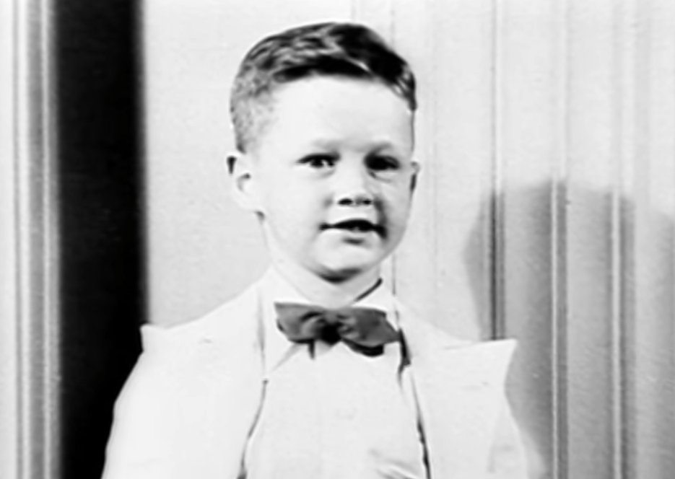
In 1992, the Clinton campaign released the following campaign commercial, titled “Journey.” How might this commercial relate to Rodgers’ discussion of post-Cold War presidential rhetoric?

Slide 17
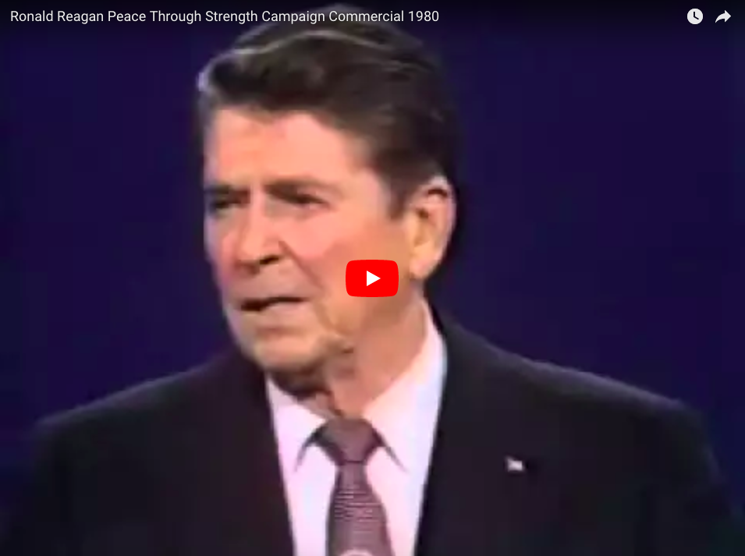
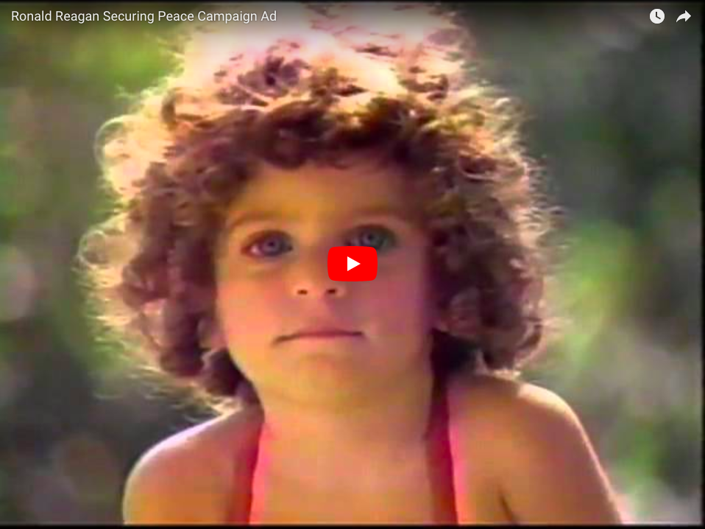
Discuss the following two campaign commercials as they relate to Rodgers’ analysis in “Losing the Words of the Cold War.” The first, “Peace through Strength,” is from Reagan’s 1980 campaign. The latter, titled simply “Peace,” is from his 1984 campaign. Rodgers notes that Reagan moderated his Cold War rhetoric of “peace” and “freedom” after 1983. Do you see evidence of that moderation in the contrast between the two commercials?

Slide 18
The Cold War and the War on Terror
Trust in government
National security
Communists and terrorists
Engendering a false sense of security: fallout shelters and airport security measures
McCarthyism and the USA Patriot Act

Slide 19
9/11 revealed the United States' involvement with a broader world
a. more than 80 nationalities represented among the victims of the attacks
b. global capitalism, cultural imperialism, and resentment against the United States
c. "Jihad vs. McWorld"

Slide 20
According to May, what frames of reference did Americans use to make sense of the September 11 attacks?
How productive were those frames of reference?
9/11 and Pearl Harbor
9/11 and the Cold War
9/11 and Popular Culture:
Alan Jackson and Toby Keith
Michael Lewis, “Mourning without Meaning,” Commentary Magazine (November 2002) http://www.commentarymagazine.com/article/mourning-without-meaning/, accessed December 3, 2013.

Slide 21
When the president declared “war on terrorism” immediately after the September 11 attacks, he announced that his would be a “new” type of war. But the war he initiated was not really a new type of war. It was modeled on older wars—not on World War II, but on the various military actions of the Cold War. It was the Cold War that echoed most loudly across the post-9/11 landscape. The terrorists seemed to have brought into reality national nightmares that dated back more than half a century. Although the weapons they used were not nuclear bombs—they were in fact remarkably low-tech instruments such as box cutters—the villains seemed to personify the characteristics of the Communist threat: foreigners who infiltrated the nation, studied our technology, and used our own power against us. They blended into society, plotting against us while enjoying the good life they professed to disdain. They turned out own proud monuments of postwar technological and consumer triumph, commercial airliners and towering skyscrapers, into the means of our destruction. Like the suspected Communist spy, they represented the enemy within, loyal to a foreign foe. The worst Cold War fears seemed to have become a reality, more than a decade after the end of the Cold War. (Elaine Tyler May, “Echoes of the Cold War,” 42)

Slide 22
Men in uniform—and they were almost all men—gained public reverence, while women faded into the background . . . As in the Cold War, the time had arrived for an image of reinvigorated manhood. Powerful men appeared as the major players on both sides of the “good” and “evil” equation, while women and children seemed vulnerable, in need of protection, whether it was the widows of 9/11 firefighters or the women of Afghanistan. Of course. These women and children did need support and protection. But the framing of the media images, focusing on heroic men and dependent women, reinforced gender constructions that date back half a century. (May, 50)

