Slide 1
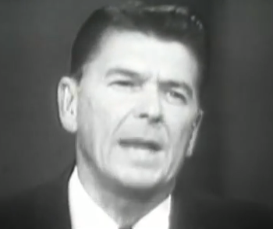
Reagan supports Goldwater, 1964
"If all of this seems like a great deal of trouble, think what's at stake. We are faced with the most evil enemy mankind has known in his long climb from the swamp to the stars. There can be no security anywhere in the free world if there is no fiscal and economic stability within the United States. Those who ask us to trade our freedom for the soup kitchen of the welfare state are architects of a policy of accommodation.”
Ronald Reagan, speech in support of Barry Goldwater, October 27, 1964
Ronald Reagan, 1964

Slide 2
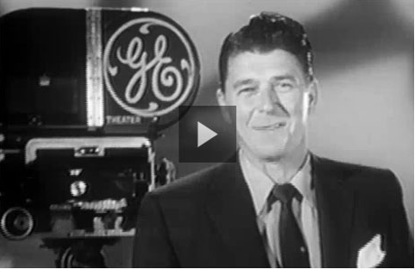
Reagan and Television

Slide 3
Reagan Revolution
Demographics – growth of elderly population, shift to Sun Belt
Revival of evangelical religion
Backlash against feminism and other liberation movements of late ’60s/’70s
Notes:
Jerry Falwell, “Moral Majority”: economic deregulation, reverse Rose v. Wade, creationism and prayer in public schools, strong military
By 1980, Falwell’s Moral Majority claimed over 4 million members

Slide 4
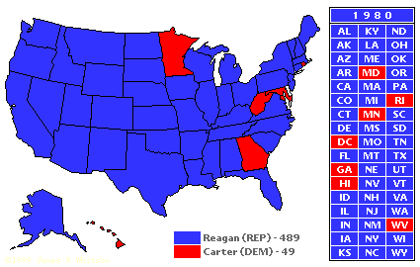
Reagan’s 1980 Campaign Promises
Less government
Lower taxes
Renewed prosperity
Waning inflation
Revived military strength and national pride
Electoral outcome: Reagan received 489 electoral votes to Carter’s 49
http://presidentelect.org/e1980.html, accessed 11-12-13
Notes:
Carter carried only 6 states, received 41% of the popular vote to Reagan’s 51% (John Anderson 7%)
Lots of people simply didn’t vote – only 53% of eleigible voters cast a ballot in 1980
Who didn’t vote? Working-class Democrats

Slide 5
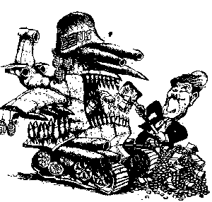
Reagan’s Military Buildup
Believed Soviets were not abiding by SALT II
Buildup intended to:
Strengthen military in case of war
persuade European allies that U.S. would not abandon them
Encourage Soviets to come to bargaining table.
Budgetary implications: "Defense is not a budget issue. You spend what you need.”
Source: American President A Reference Resource – Ronald Reagan
(http://millercenter.org/president/reagan/essays/biography/5, accessed 11-9-13)
http://www.psychohistory.com/reagan/rp1x11.htm, accessed 11-12-13.
Notes:
And spend they did. While the Carter administration and the Democratic Congress greatly increased the defense budget in the late 1970s, Reagan on Weinberger's advice in March 1981 set the price tag at $220 billion—the largest peacetime military budget in history. Moreover, Reagan's budget planners called for 7-percent increases in defense spending between 1981 and 1985, totaling nearly $1 trillion. These funds were allocated for a wide array of new weapons systems, research and development, and improvements in combat readiness and troop mobility.

Slide 6
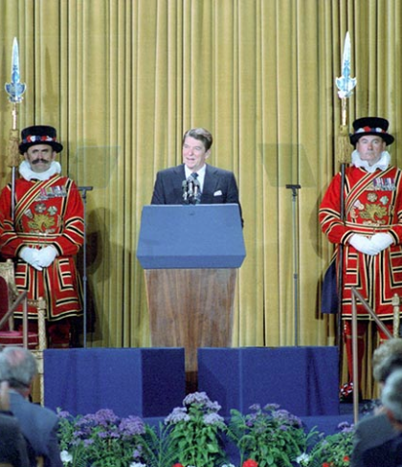
Reagan’s Cold War Ideology
“[T]he march of freedom and democracy . . . will leave Marxism-Leninism on the ash-heap of history.”
Address to the British Parliament (June 8, 1982)
Backed away from language of détente
Expressed distrust of the Soviet system and Marxist ideology.
http://www.reagan.utexas.edu/archives/photographs/large/c8466-23.jpg
Notes:
“At his first press conference, Reagan stated that Soviet leaders reserved "unto themselves the right to commit any crime, to lie, to cheat" in order to gain an advantage in U.S.-Soviet relations.” (http://millercenter.org/president/reagan/essays/biography/5)
“President Reagan warned that the USSR had more ICBMs than the U.S., opening up a Window of Vulnerability that would leave the U.S. susceptible to nuclear blackmail should the USSR decide to launch a first strike. ” (http://instruct.westvalley.edu/kelly/Distance_Learning/History_17B/Lecture28/Lecture28_p03.htm)

Slide 7
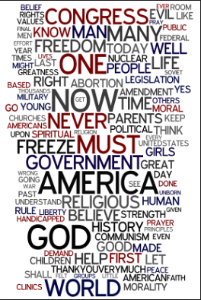
1981-83: Years of Tension
Soviet deployment of intermediate nuclear missiles, the SS-20, in Eastern Europe
U.S. deployment of nuclear missiles in Germany, Britain, and Italy
March, 1983:
“Evil Empire” speech
Reagan announces Strategic Defense Initiative
Word cloud of Reagan’s “Evil Empire” speech http://www.ibhistorytopics.com/?p=1367, accessed 11-12-13
Notes:
Soviets imposed martial law in Poland during winter 1981

Slide 8
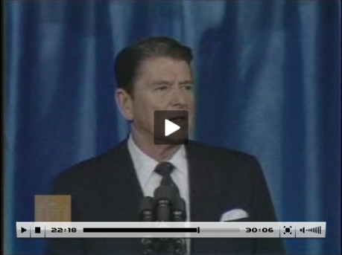
“Evil Empire” Speech
Go to 21:30 for discussion on “Evil Empire”

Slide 9
"Let us beware that while they [Soviet rulers] preach the supremacy of the state, declare its omnipotence over individual man, and predict its eventual domination over all the peoples of the earth, they are the focus of evil in the modern world.... I urge you to beware the temptation ..., to ignore the facts of history and the aggressive impulses of any evil empire, to simply call the arms race a giant misunderstanding and thereby remove yourself from the struggle between right and wrong, good and evil.”
Address to the National Association of Evangelicals, March 8, 1983
Notes:
http://www.pbs.org/wgbh/americanexperience/features/general-article/reagan-quotes/

Slide 10
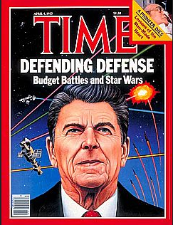
“Star Wars”
“I call upon the scientific community in our country, those who gave us nuclear weapons, to turn their great talents now to the cause of mankind and world peace, to give us the means of rendering those nuclear weapons impotent and obsolete.”
Reagan addresses nation about SDI, March 23, 1983
Ronald Reagan and his ‘Star Wars’ defense initiative on Time’s cover, April 4, 1983.
http://www.pophistorydig.com/?tag=sting-reagan
Notes:
http://www.pbs.org/wgbh/americanexperience/features/general-article/reagan-quotes/
“As part of an expanded national defense system, Reagan's Strategic Defense Initiative (SDI) was to make use of the latest technology—and develop new technologies where necessary—in deploying a protective shield (based both in space and on earth) around the United States in the SDI had two essential components: first, surveillance of Soviet activities so that a launch could be detected at the earliest possible moment; and second, the necessary weaponry to incapacitate Soviet nuclear warheads before they reached the United States.”
event of a Soviet nuclear missile attack. "Star Wars." American Decades. Ed. Judith S. Baughman, et al. Vol. 9: 1980-1989. Detroit: Gale, 2001. Gale Virtual Reference Library. Web. 10 Nov. 2013.

Slide 11
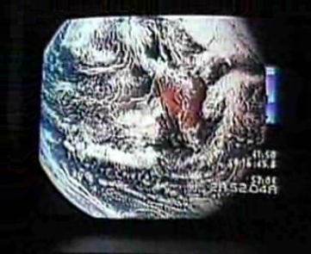
“Killer Weapons in Space” (1984 Mondale campaign ad)

Slide 12
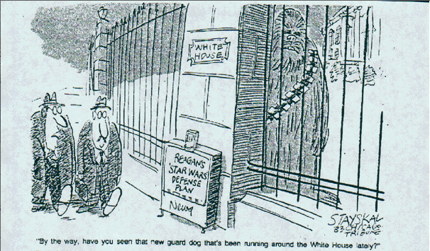
Stayskal at the Chicago Tribune
http://www.presidentialufo.com/old_site/Reagan_starwars3.gif

Slide 13
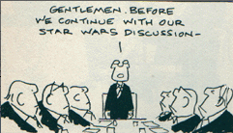
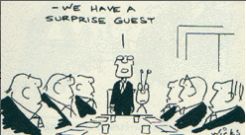
http://www.presidentialufo.com/old_site/Wicks_Reagan3.gif

Slide 14
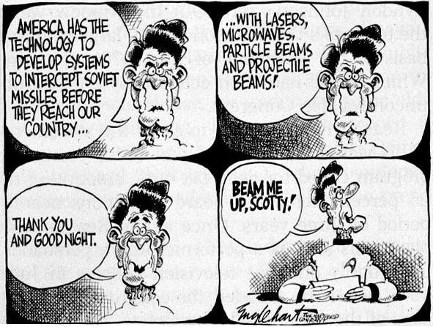
http://instruct.westvalley.edu/kelly/Distance_Learning/Images/17B_L28/sdi.JPG

Slide 15
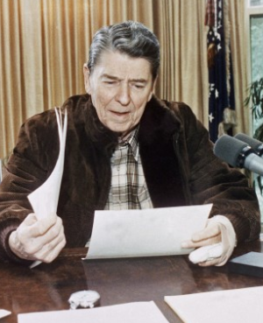
"My fellow Americans, I'm pleased to tell you today that I've signed legislation that will outlaw Russia forever. We begin bombing in five minutes.”
Reagan jokingly speaking into an open microphone just before a speech that was to be broadcast, August 1984
Notes:
http://www.pbs.org/wgbh/americanexperience/features/general-article/reagan-quotes/

Slide 16
Three Minutes to Midnight
In January 1984, the Doomsday Clock’s hand crept to three minutes to midnight. (as close to midnight as it had stood since 1953 when US developed the hydrogen bomb.)
Between 1980 and 1983
Soviet Union invaded Afghanistan
United States pulled out of the Moscow Olympics
Communication between the two superpowers all but ceased.
http://chicagotonight.wttw.com/2012/01/12/doomsday-clock

Slide 17
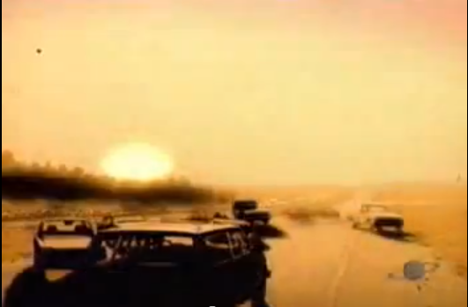
1983 Gallup poll found 40 percent of respondents thought it likely a nuclear war would occur within ten years.
Scene from The Day After (ABC television, 1983)

Slide 18
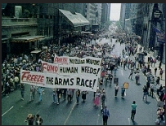
Growing Antinuclear Movement
Diverse grassroots movement
Sought a "freeze" on all nuclear weapons testing, production, and deployment
In 1982, polls indicated that 70 percent of the American public favored a weapons freeze.
"The Antinuclear Movement." American Decades. Ed. Judith S. Baughman, et al. Vol. 9: 1980-1989. Detroit: Gale, 2001. Gale Virtual Reference Library. Web. 10 Nov. 2013.

Slide 19
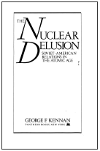
"We have gone on piling weapon upon weapon, missile upon missile, new levels of destructivencss upon old ones. We have done this helplessly, almost involuntarily: like the victims of some sort of hypnotism, like men in a dream, like lemmings headed for the sea, like the children of Hamlin marching blindly along behind their Pied Piper. And the result is that today we have achieved, we and the Russians together, in the creation of these devices and their means of delivery, levels of redundancy of such grotesque dimensions as to defy rational understanding.”
George F. Kennan, diplomat, in an address accepting the Albert Einstein Peace Prize in 1981
Source: "The Antinuclear Movement." American Decades. Ed. Judith S. Baughman, et al. Vol. 9: 1980-1989. Detroit: Gale, 2001. Gale Virtual Reference Library. Web. 10 Nov. 2013.
Pantheon Books, 1982

Slide 20
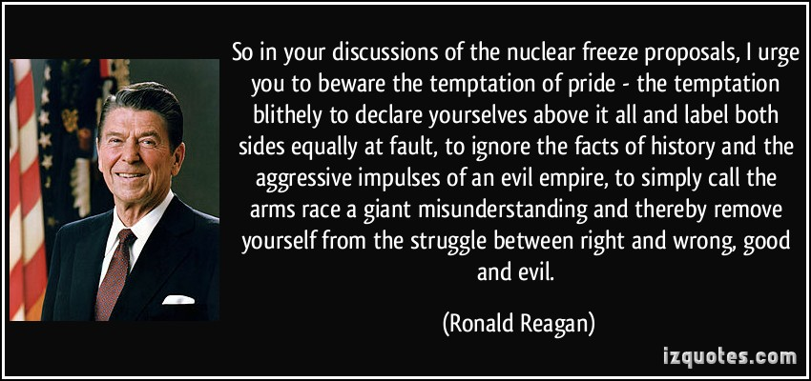
Reagan's March 8, 1983, speech to the National Association of Evangelicals in Orlando, Florida
Notes:
http://izquotes.com/quotes-pictures/quote-so-in-your-discussions-of-the-nuclear-freeze-proposals-i-urge-you-to-beware-the-temptation-of-ronald-reagan-349792.jpg

Slide 21
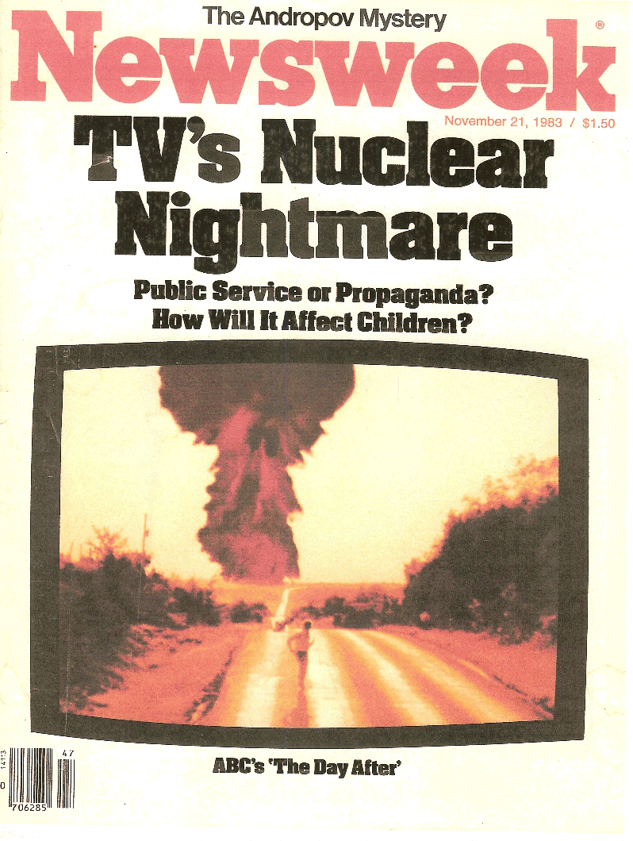
In November, 1983, ABC broadcast The Day After, a fictional dramatization of a nuclear attack on Kansas City and 100 million Americans tuned in.
"The Antinuclear Movement." American Decades. Ed. Judith S. Baughman, et al. Vol. 9: 1980-1989. Detroit: Gale, 2001. Gale Virtual Reference Library. Web. 10 Nov. 2013.

Slide 22
Ending disclaimer: The catastrophic events you have just witnessed are, in all likelihood, less severe than the destruction that would actually occur in the event of a full nuclear strike against the United States. It is hoped that the images of this film will inspire the nations of this earth, their peoples and leaders, to find the means to avert that fateful day.
(http://www.imdb.com/title/tt0085404/trivia?tab=qt&ref_=tt_trv_qu)

Slide 23
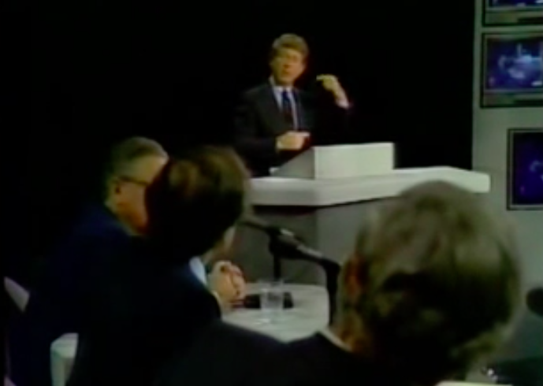
Following the film, aired a live debate, hosted by Nightline's Ted Koppel
"Imagine a room awash in gasoline, and there are two implacable enemies in that room. One of them has nine thousand matches, the other seven thousand matches. Each of them is concerned about who's ahead, who's stronger.”
-Carl Sagan
Notes:
There were no commercial breaks after the nuclear attack.
featured “the scientist Carl Sagan, former Secretary of State Henry Kissinger, Elie Wiesel, former Secretary of Defense Robert McNamara, General Brent Scowcroft and the conservative writer William F. Buckley, Jr.. Sagan argued against nuclear proliferation, while Buckley promoted the concept of nuclear deterrence.”
http://en.wikipedia.org/wiki/The_Day_After#Reaction

Slide 24
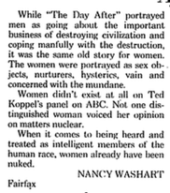
After 'The Day After'
NANCY WASHART Fairfax. The Washington Post (1974-Current file) [Washington, D.C] 24 Nov 1983: A26.

