Slide 1
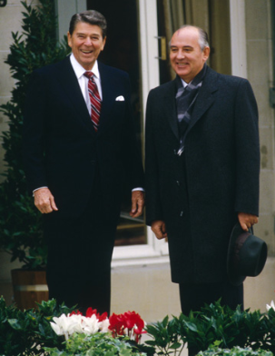
The Cold War Ends
Mikhail Gorbachev rises to power in 1985
Meetings between Gorbachev and Reagan
The fall of the Berlin Wall in 1989
Germany's reunification
The collapse of the Soviet Union in 1991
Boyer and Idsvoog, 203
Notes:
series of nuclear-arms treaties -- INF (1987), START I (1991), START II (1993)—re-versed years of nuclear escalation.

Slide 2
Cold War Nostalgia
As Harry Angstrom complains in John Updike's 1990 novel, Rabbit at Rest: "It's like nobody's in charge of the other side any more. I miss it, the cold war. It gave you a reason to get up in the morning." In the same vein, a character in the 1995 movie Crimson Tide pines for "the good of days of the Cold War, [when] the Russians could . . . be depended upon to do what was in their own best interest." (Boyer and Idsvoog, 208)
Notes:
Rabbit at Rest ends the saga Updike began in 1960 in Rabbit, Run but brilliantly continues the history that Updike has been writing through the four volumes. Harry “Rabbit” Angstrom is fifty-five when the novel opens in 1989, and as the Reagan years are winding down, so is Harry. He has ballooned to 230 pounds, and his addiction to junk food foreshadows his final demise. Harry’s problems are also the problems of America, for Updike is telling two complex histories here at once. In fact, readers see more of America in this final volume, for the first and last sections of the three-part novel take place in Florida, where Harry and his wife Janice live half the year in their condo. (https://www.enotes.com/topics/rabbit-rest)

Slide 3
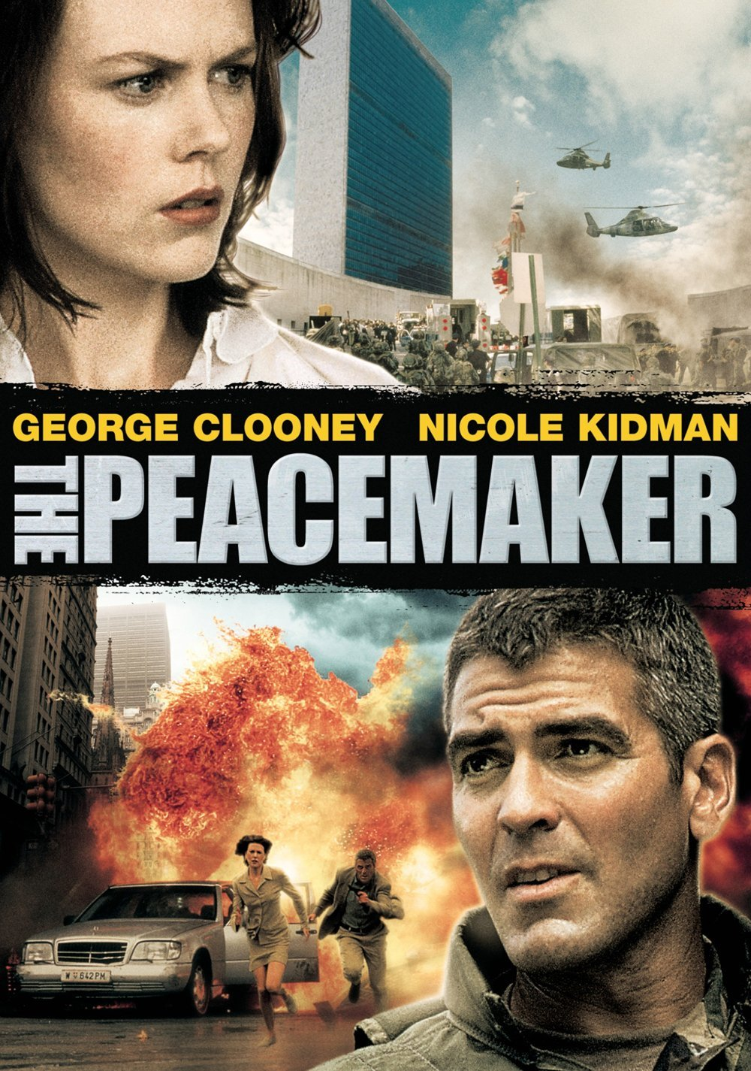
Despite the end of the Cold War, the waning of the nuclear arms race, and the disappearance of "global thermonuclear war" from pollsters' lists of Americans' greatest worries, U.S. mass culture of the late 1980s and the 1990s was saturated by nuclear themes. Images of nuclear menace continued to pervade the movies, video games, and mass-market fiction.
Boyer and Idsvoog, 199
Notes:
Also permeated culture and language of everybay life (204)
1997 -- A US Army colonel and a civilian woman supervising him must track down stolen Russian nuclear weapons before they're used by terrorists.

Slide 4
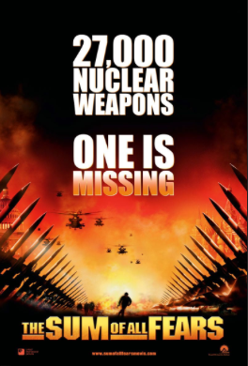
Sources of nuclear menace in the 1990s
Chaos in the former Soviet sphere
Tom Clancy, The Sum of All Fears (1991)
Crimson Tide (1995)
Rogue States, Terrorist Groups
Under Siege (1992) – terrorists named “Francois and Muhammed”
True Lies (1994) – enemy is “Crimson Jihad”
Nuclear Technology Run Amok
Building Bombs (1994), Plutonium Circus (1995)
The Cape (1996)
Terrorists, Loners, Madmen and Amoral Scientists
The Sum of All Fears (1991)
Notes:
Crimson Tide similarly viewed political turmoil in Russia as the spawning ground of nuclear holocaust. The plot, drawn from current headlines, featured an ultra-nationalist demagogue, Vladimir Radchenko, who exploits the international protests against Russia's brutal crushing of the breakaway province of Chechnya. Rallying dissident military officers against the Russian president, Radchenko gains control of much of eastern Russia, including Vladivostok, a nuclear missile base and home port to a fleet of nuclear-armed submarines.
Boyer and Idsvoog, 211.
Tech. run amok:
A series of documentaries heightened public awareness of the dangers of nuclear technology. Building Bombs (1994), an Academy Award nominee, dealt with mismanagement at the Savannah River nuclear- weapons facility in South Carolina. Plutonium Circus (1995) focused on the Pantex hydrogen-bomb assembly plant in Amarillo
(216)
The Cape (1996), a nuclear- powered Russian spy satellite malfunctions and threatens to crash to earth, spewing deadly radioactivity.

Slide 5
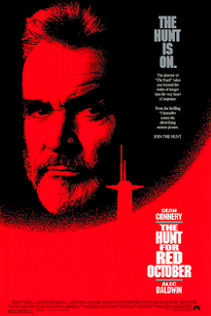
Hunt for Red October (1990)
The Hunt for Red October, the first of Clancy's popular "Jack Ryan" novels of espionage, high-level intrigue, and military derring-do, told of a rogue Soviet submarine captain, Marko Ramius, who realizes that his sub has been selected to launch a nuclear first strike against the United States. As he desperately tries to defect to the West, the KGB falsely warns Washington that Ramius himself is the threat. As both Soviet and U.S. vessels close in, and as a nuclear showdown seems inevitable, only the CIA analyst Ryan grasps the truth, and by amazing heroics prevents World War III.

Slide 6
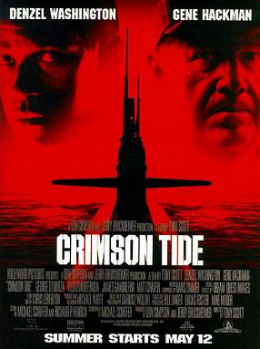
Chaos in the Soviet Sphere
Directed by Tony Scott, 1995)
Notes:
“Crimson Tide is a 1995 American submarine film directed by Tony Scott, produced by Don Simpson and Jerry Bruckheimer. It takes place during a period of political turmoil in the Russian Federation, in which ultranationalists threaten to launch nuclear missiles at the United States and Japan. It focuses on a clash of wills between the new executive officer (Denzel Washington) and the seasoned commanding officer (Gene Hackman) of a nuclear missile submarine, arising from conflicting interpretations of an order to launch their missiles.” http://en.wikipedia.org/wiki/Crimson_Tide_(film)

Slide 7
Saddam Hussein, supervillain
Saddam Hussein's Iraq in the 1990s replaced the Soviet Union as the paradigmatic nuclear threat. Demonized by the media (often with good reason), Iraq and its supreme ruler were seen as unambiguously evil and menacing. Having long associated nuclear danger with a single, clearly defined enemy, Americans for a time elevated Saddam (sometimes in tandem with North Koreas Kim II Sung) to that role. (214)
Notes:
R. J. Pinero's
Ultimatum (1994), the story of a second Gulf War (led by President Clinton) against a nuclear-armed Saddam. (214) - not a major film
Video game – Back to Baghdad - "Time to Finish the Job . . . Time to Go Back to Baghdad.”

Slide 8
The post-Cold War mass culture visions of nuclear menace portray a world not of government versus government, but of individuals maneuvering in an anarchic, film noir-like environment. Loners . . . take desperate measures against the irrational, dangerous, or unfair actions of their superiors. But the nuclear catastrophes threatened by such alienated individuals are typically averted by other loners who must act in the face of the inept stupidity of their superiors. (221)
Under Siege (1992)
An ex-Navy Seal turned cook is the only person who can stop a group of terrorists when they seize control of a U.S. battleship.
imdb.com
Notes:
– terrorists named “Francois and Muhammed”

Slide 9
“Trust No One”
Representations of nuclear menace in the 1990s differed radically from those of the 1950s or even the early 1980s. No longer involving two superpowers posturing across an Iron Curtain, the menace now unfolded in a destabilized, decentered world where deadly hazards arise in unexpected places and assume many guises. The emblematic slogan of this new genre of nuclear horror might be the incantatory phrase used on The X-Files: "Trust no one." The prospect of a future in which nuclear weapons and nuclear know-how form a constant of the human condition is hardly reassuring. (224)

Slide 10
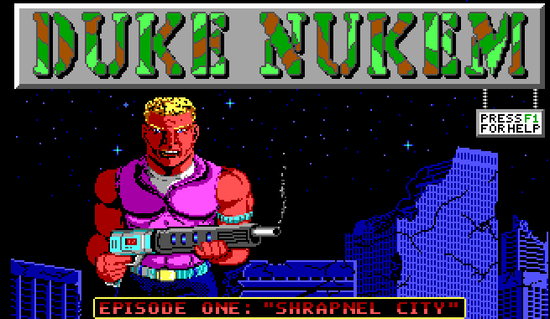
Trivialization: Video Games
Duke Nukem (1991 video game)
Notes:
Duke Nukem only uses one weapon in this game: the atomic pistol, which fires large green zig-zag nuclear bolts. It can only be fired straight ahead (i.e. left or right) and not up or down, The atomic pistol can be upgraded by picking up a special upgrade item which looks like the atomic pistol itself. Each time an upgrade is picked up, an extra nuclear bolt icon is displayed in the item panel on the right. This indicates the number of nuclear bolts that can appear on the screen at the same time. The highest level of upgrade is 5. (http://dukenukem.wikia.com/wiki/Duke_Nukem_(video_game)#Weapon)
The game is set in the year 1997. Dr. Proton is a madman, determined to take over the world with his army of Techbots. Duke Nukem, the eponymous hero, takes upon the task of stopping him. The first episode takes place in the devastated city of Los Angeles. In the second episode, Duke chases Dr. Proton to his secret moonbase. In the third episode, Dr. Proton escapes into the future, and Duke pursues him through time, to put an end to his mad schemes. (https://en.wikipedia.org/wiki/Duke_Nukem_(video_game)
Whatever the level of trivialization, one thing was clear as the twentieth century ended. Neither the reality of nuclear danger nor the continued presence of nuclear fear in American mass culture had disappeared with the end of the Cold War. Like the radiation-affected creatures in the science-fiction stories and movies of the 1950s, the cultural expression of that fear had simply mutated into sometimes bizarre new forms. (225)
While these films exploit the hard-wired cultural awareness that nuclear weapons are scary and dangerous things, they rarely bother to dramatize their actual effects. (224)
With some exceptions, post—Cold War novelists, moviemakers, and video game designers exploited nuclear danger mainly for its capacity to stir fear and build tension. Seriousness of purpose beyond the desire to elicit a passing frisson of fear was rarely evident. (225)

Slide 11
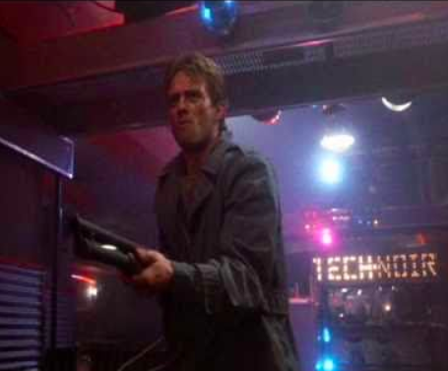
Beard, “Science Fiction Films of the Eighties”
[M]any cinematic glimpses of tomorrow from the 1980s are quite different from those of previous decades. From 1980 to 1990, the imaginary vision of the future that dominated American film turned almost universally dark, broken, and decaying – and audiences loved it. (Beard, 2)

Slide 12
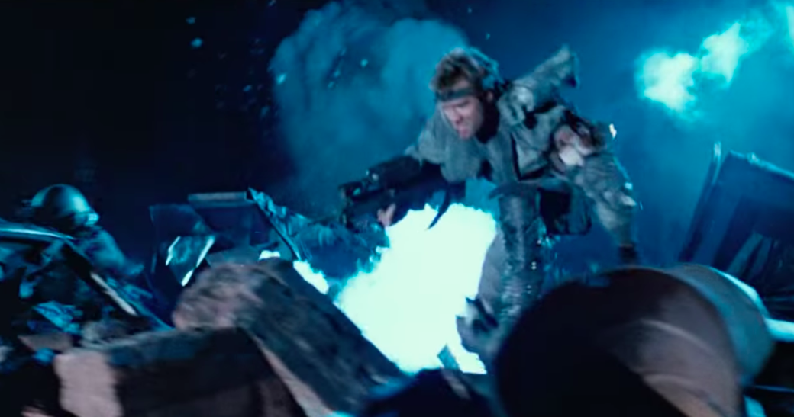
Scrap Heap Futurism

Slide 13
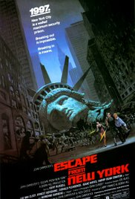
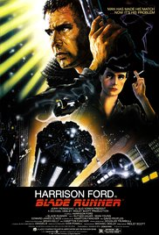
Most of the new technology … must be added on or layered over the old, so buildings and machinery mix old and new to create a strange and somewhat threatening vision of future techno-junk. (Beard, 5)
Notes:
Escape from New York (1981) : In 1997, when the U.S. president crashes into Manhattan, now a giant maximum security prison, a convicted bank robber is sent in to rescue him.
Blade Runner, 1982: A blade runner must pursue and try to terminate four replicants who stole a ship in space and have returned to Earth to find their creator. (imdb.com)

Slide 14
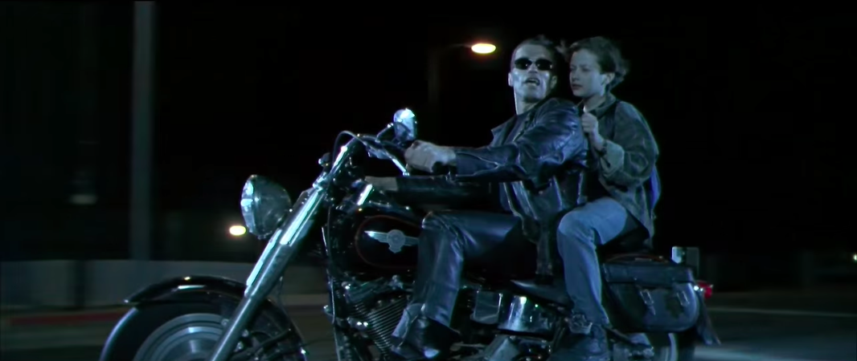
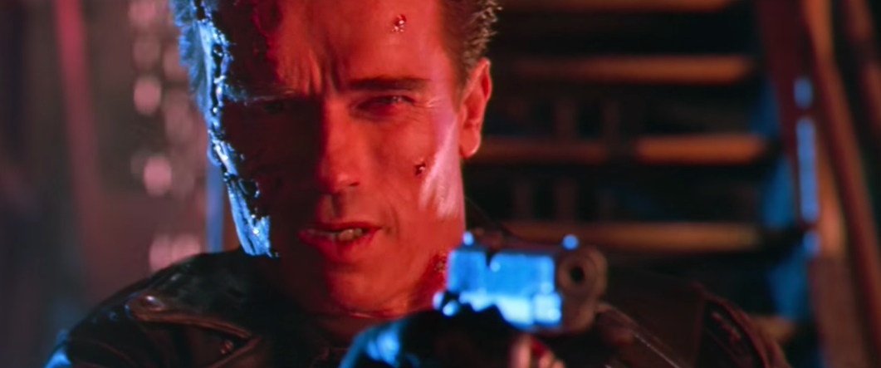
[T]he imaginative vision of the future in the films of the Eighties was not a warning. They asked to be taken as fact. . . . Such futures were based on extrapolation of present trends, and our worst fears were often realized in film. (Beard, 7)

Slide 15
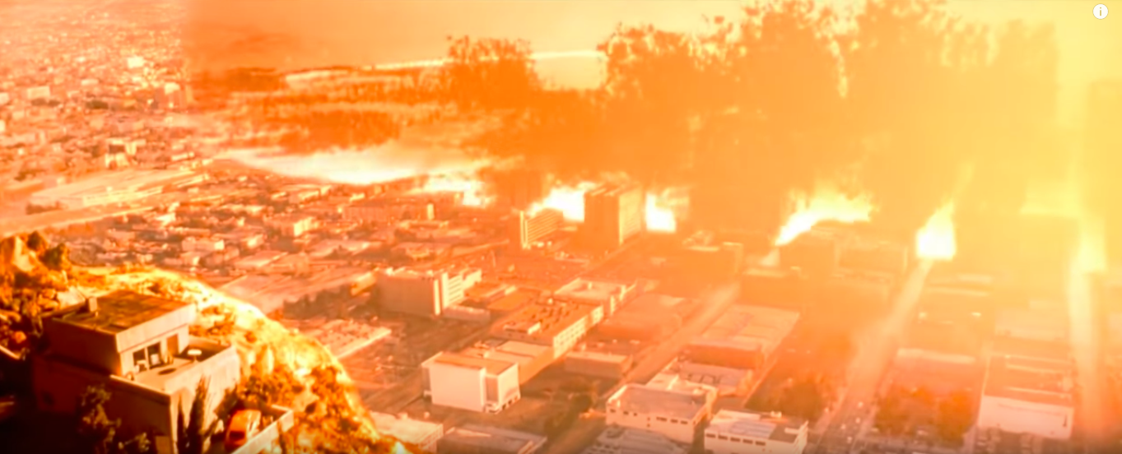
[A]udiences really enjoyed these films. They chose—in the form of repeated ticket sales and popular acclaim—to accept this bleak and grimy tomorrow as their imaginary future home. At least in their imaginations, as play, the audience felt comfortable accepting this as entertainment, a source of enjoyment, but what made it fun? (Beard, 8)

Slide 16
What made it fun?
the “I-told-you-so payoff”
possibility of rebirth in the midst of decadence and decay
punk aesthetic: “celebration of resignation…anomie as artistic impulse” and “aggressive egalitarianism” (John Lewis quoted in Beard, 8)
“grudging respect Americans have traditionally awarded mongrel determination” (Beard, 9)

Slide 17
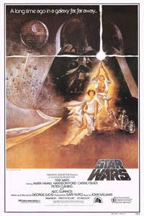
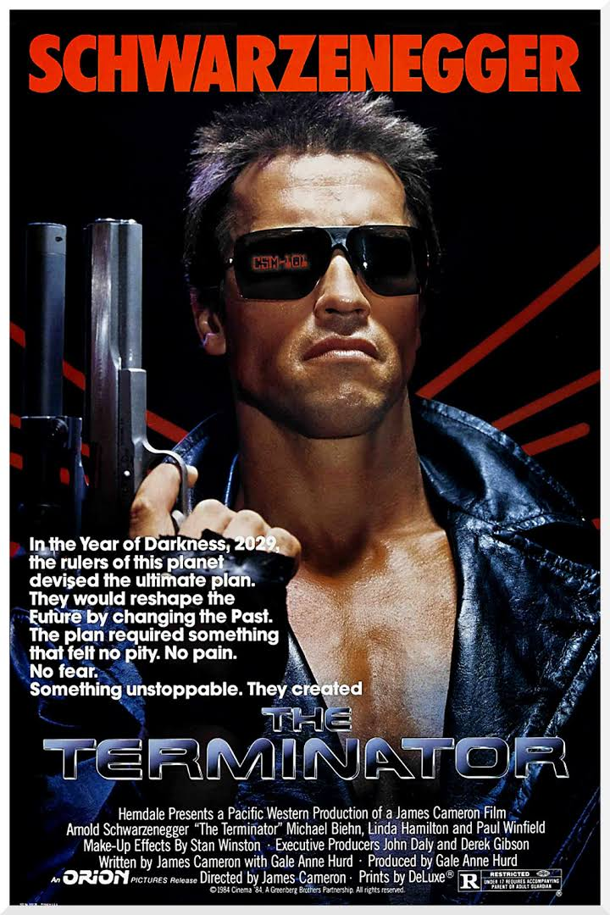
Both Terminator (1984) and Star Wars (1977) pit a ragtag rebellion against a more organized and technologically sophisticated foe. If, as John Beard argues, science fiction futures are always projections of present-day anxieties, what might these films suggest about audiences’ attitudes toward technology in the waning years of the Cold War?

