Slide 1
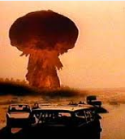
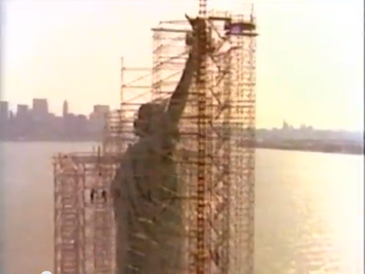
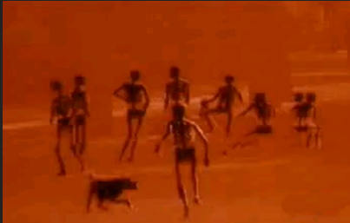
Nuclear Anxiety in Reagan’s America

Slide 2
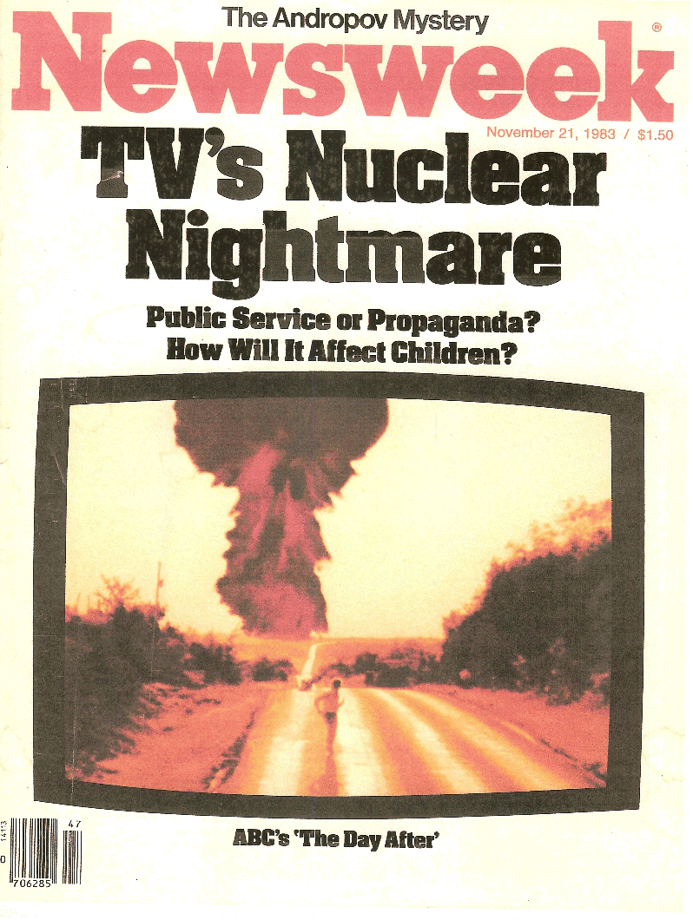
In November, 1983, ABC broadcast The Day After, a fictional dramatization of a nuclear attack on Kansas City and 100 million Americans tuned in.
"The Antinuclear Movement." American Decades. Ed. Judith S. Baughman, et al. Vol. 9: 1980-1989. Detroit: Gale, 2001. Gale Virtual Reference Library. Web. 10 Nov. 2013.

Slide 3
The Day After thus provides an important case study for understanding the intersection between reception theories that promote an active, engaged viewer and structural theories that emphasize the limits capital and ideology place on media texts.
Deron Overpeck (2012): ‘Remember! it’s Only a Movie!’ Expectations and Receptions of The Day After (1983),” Historical Journal of Film, Radio and Television, 32:2, 267-292

Slide 4
Discussion questions
What is the significance of the film’s Midwestern setting?
How are ordinary Americans depicted?
How are women and men depicted?
Is the film explicitly political? What is its relationship to the antinuclear movement?

Slide 5
The Day After neither compelled vast numbers of people to march on Congress to demand a nuclear weapons freeze nor to drove them panicked into the streets and deliver the nation into the hands of the Soviets. Instead those viewers either interpreted the film through their previously held political perspectives or understood that it was a work of fiction; the upset responses were far fewer than expected. And while the film might have been the proximate cause of specific pro-freeze activities, this must be considered in the light of the already existing nuclear freeze movement and its actions in the early years of the Reagan administration. The Day After did not by itself inspire public action; it was caught up in an already contentious public debate and used by the participants to further their own goals. The film-makers catered to both sides, changing the script to remove politically charged references but also offering media kits to pro-disarmament forces. The Day After did not change the terms of the nuclear debate; the nuclear debate shaped The Day After and the popular response to it.
Deron Overpeck (2012): ‘Remember! it’s Only a Movie!’ Expectations and Receptions of The Day After (1983),” Historical Journal of Film, Radio and Television, 32:2, 267-292

Slide 6
Ending disclaimer: The catastrophic events you have just witnessed are, in all likelihood, less severe than the destruction that would actually occur in the event of a full nuclear strike against the United States. It is hoped that the images of this film will inspire the nations of this earth, their peoples and leaders, to find the means to avert that fateful day.
(http://www.imdb.com/title/tt0085404/trivia?tab=qt&ref_=tt_trv_qu)

Slide 7
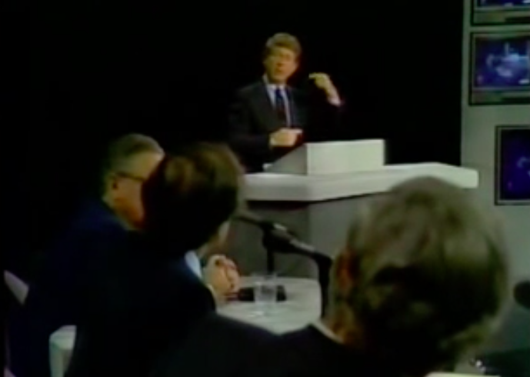
Following the film, aired a live debate, hosted by Nightline's Ted Koppel
"Imagine a room awash in gasoline, and there are two implacable enemies in that room. One of them has nine thousand matches, the other seven thousand matches. Each of them is concerned about who's ahead, who's stronger.”
-Carl Sagan
Notes:
There were no commercial breaks after the nuclear attack.
featured “the scientist Carl Sagan, former Secretary of State Henry Kissinger, Elie Wiesel, former Secretary of Defense Robert McNamara, General Brent Scowcroft and the conservative writer William F. Buckley, Jr.. Sagan argued against nuclear proliferation, while Buckley promoted the concept of nuclear deterrence.”
http://en.wikipedia.org/wiki/The_Day_After#Reaction

Slide 8
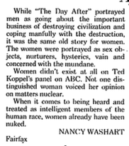
After 'The Day After'
NANCY WASHART Fairfax. The Washington Post (1974-Current file) [Washington, D.C] 24 Nov 1983: A26.

Slide 9
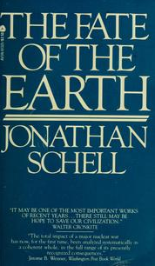
Jonathan Schell, The Fate of the Earth (1982)

Slide 10
''A Republic of Insects and Grass”
Millions upon millions of people, Schell informs us, will be incinerated, irradiated, crushed or simply blown to bits in the opening barrage of a nuclear exchange of any appreciable size. Anyone who manages to survive that ''single huge concussion'' will then have to cope with a world in which food and water supplies are full of radiation, injuries fester and turn rank from lack of medical care, shelter is difficult to find and epidemics blow across the land like winds.
Kai Erikson, “A Horror Beyond Comprehension,” New York Times (11 April 1982), Section 7, p. 3.
Notes:
A graphic description of the consequences of a nuclear holocaust.

Slide 11
''The Second Death”
Schell's main point here, if I can do it justice, is that humankind would suffer two distinct deaths in the event of the kind of nuclear holocaust he has asked us to imagine - the slaughter of every living human being, for one thing, and the cancellation of all future generations, for another. We are not only threatening our own lives by the reckless way we conduct our political affairs; we are threatening to bring about the extinction of the species and, in a sense, to abort the countless billions of people who would otherwise be destined to take our places on a healthy planet. Schell is urging us to respect the humanity and maybe even the divinity of those unborn people, and he is suggesting, too, that if we cannot find a way to save the world for love of ourselves, we may be able to do so for love of distant descendants.
Kai Erikson, “A Horror Beyond Comprehension,” New York Times (11 April 1982), Section 7, p. 3.
Notes:
Schell, then, regrets that we may all be exterminated one day, but he also regrets, almost as a separate matter, that no one will be left to mourn or protest or even to record our passing - that the historical and genetic inheritances of which we are the momentary trustees will die with us.

Slide 12
“The Choice”
Schell does an absolutely remarkable job of describing the awkward logics that form the core of deterrence theory, and, in doing so, he may help many people to find a new way of envisaging and talking about nuclear arms. He begins with the relatively familiar notion that - from a modern point of view, at least -man's original sin was the development of sovereignty. War is the agency by which people who have gathered into nation states protect what they take to be their ''vital interests''; our present predicament is that recourse to all-out warfare on the part of any of the nuclear powers would be so devastating that no conceivable interest, vital or otherwise, could be served by it. . .
Notes:
The final essay is called ''The Choice,'' and it is far and away the most prescriptive of the three.

Slide 13
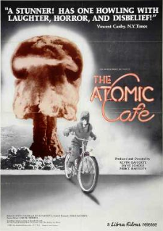
Other filmic imaginings of nuclear war and U.S.-Soviet conflict in the 1980s

Slide 14
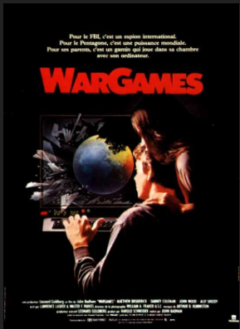
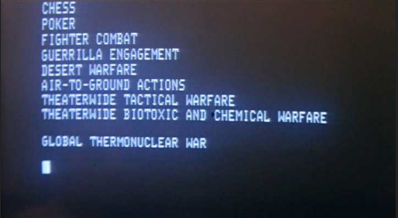
WarGames (1983)
To David Lightman, "Global Thermonuclear War" will just be one hell of a game. To everybody else, it will be hell waiting to happen.
http://www.imdb.com/title/tt0086567/taglines?ref_=tt_stry_tg
http://www.imdb.com
Notes:
A young computer whiz kid accidentally connects into a top secret super-computer which has complete control over the U.S. nuclear arsenal. It challenges him to a game between America and Russia, and he innocently starts the countdown to World War 3. Can he convince the computer he wanted to play a game and not the real thing ? Written by Colin Tinto <cst@imdb.com>

Slide 15
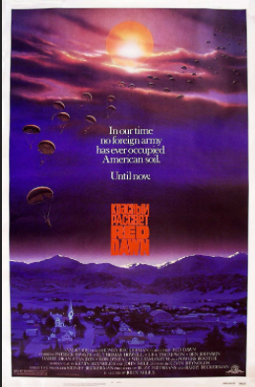
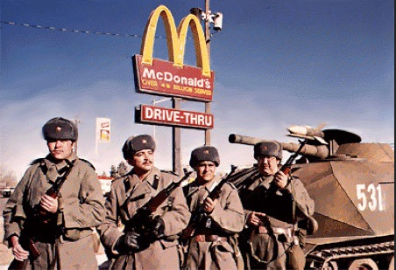
Red Dawn (1984)
In our time, no foreign army has ever occupied American soil. Until now.
http://www.imdb.com
Notes:
From out of the sky, Soviet, Nicaraguan, and Cuban troops begin landing on the football field of a Colorado high school. In seconds, the paratroopers have attacked the school and sent a group of teenagers fleeing into the mountains. Armed only with hunting rifles, pistols, and bows and arrows, the teens struggle to survive the bitter winter and the Soviet KGB patrols hunting for them. Eventually, trouble arises when they kill a group of Soviet soldiers on patrol in the highlands. Soon they will wage their own guerrilla warfare against the invading Soviet troops-under the banner of 'Wolverines!' Written by Derek O'Cain

Slide 16
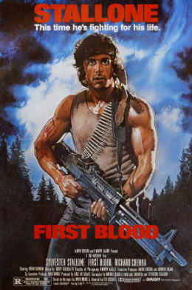
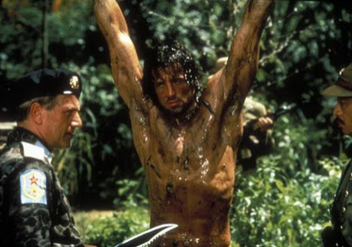
Rambo: First Blood Part II (1985)
They sent him on a mission and set him up to fail. But they made one mistake. They forgot they were dealing with Rambo.
No man, no law, no war can stop him.
http://www.imdb.com
Notes:
John Rambo is removed from prison by his former superior, Colonel Samuel Troutman, for a top-secret operation to bring back POW's still held in Vietnam. Rambo's assignment is to only take pictures of where the POWs are being held, but Rambo wants to get the POWs out of Vietnam. Teamed up with female Vietnamese freedom fighter Co Bao, Rambo embarks on a mission to rescue the POWs, who are being held by sadistic Vietnamese Captain Vinh and his Russian comrade, Lieutenant Colonel Padovsky. Rambo starts killing every enemy in sight while still focusing on his intentions to rescue the POWs. There are also corrupt American officials involved in the mission, including Marshall Murdock, one of Rambo's superiors. Written by Vishal

Slide 17
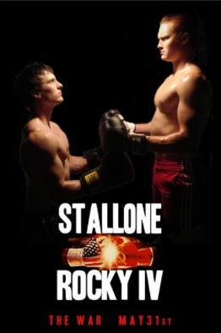
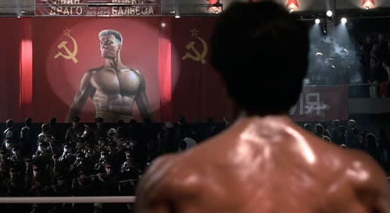
Rocky IV (1985)
When East Meets West, the Champion remains standing.
Get ready for the next world war.
http://www.imdb.com
Notes:
Rocky Balboa, heavyweight champion of the world, is the trainer for Apollo Creed in an exhibition match against Ivan Drago, a "superman" boxer from the Soviet Union. When Apollo is killed in the ring by the brutal Drago, Balboa blames himself and promises to avenge his friend's death in the ring. Written by Murray Chapman muzzle@cs.uq.oz.au

