Slide 1
Peace Activism, the New Left, and the Cold War

Slide 2
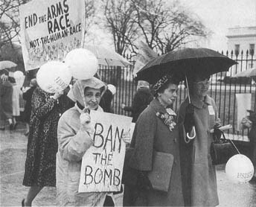
Topics
Reactions to Cold War Policy:
Anti-nuclear activism: Women Strike for Peace
The New Left
Women Strike for Peace demonstration outside of the White House on 15 January 1962. UPI/Bettmann.
http://harvey.binghamton.edu/~hist266/week10/ban.htm

Slide 3
Big Questions
How did women in civil society challenge McCarthyism in ways that men could not?
How did young people in civil society challenge McCarthyism in ways that their elders could not?

Slide 4
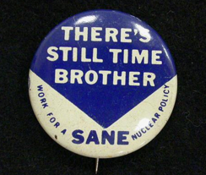
Anti-Nuclear Activism
SANE (established 1957)
conducted a witch-hunt to find and expel communists.
was slow to respond to international crises (like fallout from Soviet nuclear tests)
ignored “motherhood" issues, such as the contamination of milk.
SANE pin, circa 1963
Notes:
Quickly attracted sponsorship by powerful antinuclear voices from Hollywood to Washington, D.C.,
sought to expand its grassroots appeal by forming student chapters on college campuses and through advertisements targeted at mass audiences.
powerful voice for disarmament and arms control, SANE initially enjoyed cordial relations with the Kennedy and Johnson White Houses until executive policies in Vietnam led SANE to publicly break with the president in 1967.

Slide 5
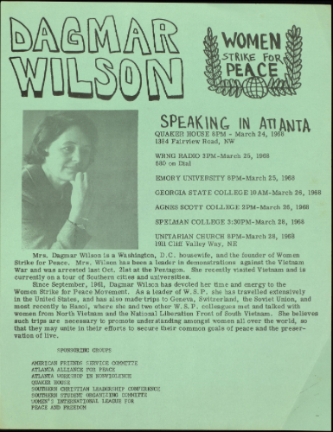
Women Strike for Peace
Establsihed 1961 by Dagmar Wilson
Membership consisted of housewives and working women
In their 30s and 40s
Participated in baby boom, and in middle-class, suburban consumer society
Notes:
Wilson bio: 45 y/o
called of a few friends at her home to discuss the nuclear crisis in 1961.
author of best-selling children's books, who nevertheless identified herself as a housewife.
free from the self-conscious timidity of those who had joined the CP or other left political movements in the 30s or 40s.
-- not employed, so could not be as easily intimidated by the threat of losing their jobs.

Slide 6
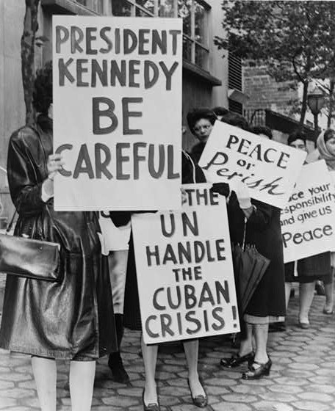
Causes
Inadequacy of SANE
radioactive cloud from recent Russian test and contamination of milk through "fall out" from atomic bomb testing at Nevada Test Site in the 1950s.
New political climate with election of JFK
Photo Credit: Phil Stanziola/Library of Congress

Slide 7
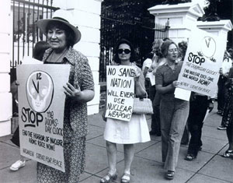
Strike for Peace 1961
1961 -- coordinated a national day of protest.
Nov. 1. 1961 - called a "strike for peace" WSP had local chapters in 60 communities and offices in 10 cities.
50,000 participated in the inaugural protest against nuclear proliferation
A `Strike for Peace,' they called it, and-carrying placards, many wheeling baby buggies or strollers-they marched on city halls and Federal buildings to show their concern about nuclear fallout.”
-Newsweek, November 1962
Notes:
Newsweek:
"They were perfectly ordinary women, with their share of good looks. They looked like the women you would see driving ranch wagons, or shopping at the village market, or attending PTA meetings. It was these women by the thousands, who stages demonstrations in a score of cities across the nation last week, protesting atomic testing. A `Strike for Peace,' they called it, and-carrying placards, many wheeling baby buggies or strollers-they marched on city halls and Federal buildings to show their concern about nuclear fallout."

Slide 8
Grassroots structure
No well-known leaders
Activities varied by community
No paid staff
Utilized women’s networks (PTA, church and temple groups, etc.)
Many did not hold jobs and so did not fear employment repercussions of their activism
Made anti-nuclear activism into a woman’s issue: safe milk, protecting children

Slide 9
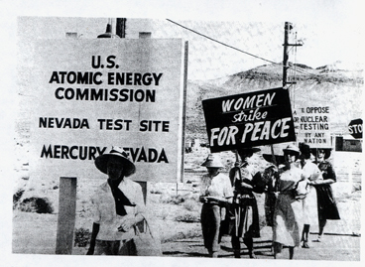
WSP women attempt to enter the Nevada test site in July 1962 to prevent a scheduled atmospheric explosion. Records of Women Strike for Peace, Swarthmore College Peace Collection. See http://harvey.binghamton.edu/~hist266/week10/atomic.htm.
Notes:
strength came from
their grass roots, local qualities,
very able leaders,
and their ability to do things that men could not.
Utilized women's networks throughout civil society. (PTAs, church & temple groups, & established women's peace organizations, esp. WILPF) No unifying organization,

Slide 10
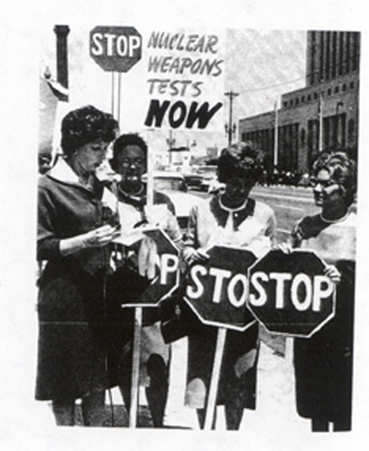
Los Angeles WSP, 1962. See http://harvey.binghamton.edu/~hist266/slides/nuclear150.jpg

Slide 11
"With the fate of humanity resting on a push botton, the quest for peace has become the highest form of patriotism."
First press release, Women Strike for Peace, 1961
"If fear, mistrust, and hatred are ever to be lessened, it will be by courageous individuals who do not hate and fear and can get together to work out tolerable compromises.”’
Los Angeles statement of the WSP, 1962

Slide 12
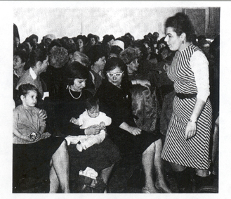
Congressional space becomes women's and babies' space at the OId House Office Building, Washington, D.C., on 11 December 1962, as WSP prepares to challenge the HUAC Hearings on Communist Infiltration into the Peace Movement. Standing at right is Blanche Posner, of Scarsdale, N.Y., the first WSP witness. UPI/Bettmann. See http://harvey.binghamton.edu/~hist266/week10/huac.htm.
Notes:
Yet despite their identity as "average women," FBI survelliance of WSP was heavy and filled 43 volumes. FBI records became available under the Freedom of Information Act after 1980.
6. l962 HUAC subpoenaed WSP to answer questions.
The women organized: -- a legal defense -- a national support system for those subpoenaed. -- a broad national campaign of public protest against the committee.
They appeared three weeks after subpoena. (very fast). Came from 11 states. -- when they were subpoenaed, 100 women sent wires to the chair of HUAC offering to testify. (They were refused) Chairman of the Committee represented cold war ideology with opening statement: "Communists believe that there can be no real peace until they have conquered the world." 1st witness - volunary organizer of the NYC office. All the women in the hearing room rose with her when she rose to testify.

Slide 13
When the first woman headed to the witness table, the crowd rose silently to its feet. The irritated Chairman Clyde Doyle of California outlawed standing. They applauded the next witness and Doyle outlawed clapping. Then they took to running out to kiss the witness. Finally, each woman as she was called was met and handed a huge bouquet. By then Doyle was a beaten man. By the third day the crowd was giving standing ovations to the heroines with impunity.
Vancouver Sun, British Columbia
Notes:
Chairman of the Committee represented cold war ideology with opening statement: "Communists believe that there can be no real peace until they have conquered the world."
"The dreaded House Un-American Activities Committee met its Waterloo this week. It tangled with 500 irate women. They laughed at it. Kleig lights glared. Television cameras whirred,, and fifty reporters scribbled notes while babies cried and cooed during the fantastic inquisition.”-Vancouver Sun

Slide 14
"I don't know sir, why I am here, but I do know why you are here, I think. . . . because you don't quite understand the nature of this movement. This movement was inspired and motivated by mothers' love for children. . . When they were putting their breakfast on the table, they saw not only the wheaties and milk, but they also saw strontium 90 and iodine 131. . . . They feared for the health and life of their children. That is the only motivation.”
Blanche Posner, 1962 HUAC testimony
Notes:
In 1970 a scholar of the limited Test Ban Treaty that was signed by JFK in 1963, said that JFK's chief science advisor, Jerome Wiesner, "gave the major credit for moving Pres. Kennedy toward the limited Test Ban Treaty of 1963, not to arms controllers inside the government, but to Women Strike for Peace and to Sane and Linus Pauling." 2. U.S. signing of (limited) Nuclear Test Ban Treaty in 1963, due to WSP more than to arms control advocates within the government.
3. infused new social conscience into American political culture.
4. showed that (because gender remained a principle of social organization), women were able to achieve goals that men could not.
5. used the gender construction of the l950's to legitimize dissent from US military policies.
6. thereby set the stage for other forms of dissent by middle-class white women after 1962.
7. WSP an early opponent of the Vietnam War.

Slide 15
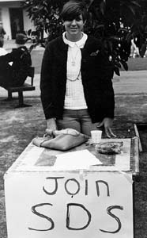
The New Left and the Vietnam War
Students for a Democratic Society
Inaugural statement, "The Port Huron Statement“1962
"We would replace power rooted in possession, privilege, or circumstance, with power rooted in love, reflectiveness, reason, and creativity." -SDS, "Port Huron Statement“

Slide 16
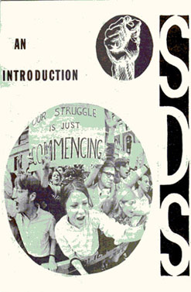
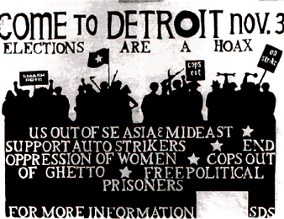
Emphasis on "participatory democracy”
Influences: civil rights, disarmament, JFK-style civic idealism, Beats and 1950s pop-culture rebels

Slide 17
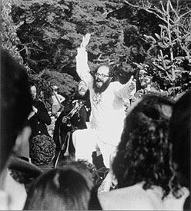
Poet Allen Ginsberg, Human Be-In festival, Golden Gate Park, San Francisco, 1967. Ginsberg, known for his poem Howl, lived and symbolized the bohemian ideals of the Beat Generation of the 1950s and embraced the counterculture of the sixties. (Lisa Law website)

Slide 18
When we were kids the United States was the wealthiest and strongest country in the world; the only one with the atom bomb, the least scarred by modern war, an initiator of the United Nations that we thought would distribute Western influence throughout the world. Freedom and equality for each individual, government of, by, and for the people--these American values we found go0d, principles by which we could live as men. Many of us began maturing in complacency.

Slide 19
While these and other problems either directly oppressed us or rankled our consciences and became our own subjective concerns, we began to see complicated and disturbing paradoxes in our surrounding America. The declaration "all men are created equal..." rang hollow before the facts of Negro life in the South and the big cities of the North. The proclaimed peaceful intentions of the United States contradicted its economic and military investments in the Cold War status quo.

Slide 20
Loneliness, estrangement, isolation describe the vast distance between man and man today. These dominant tendencies cannot be overcome by better personnel management, nor by improved gadgets, but only when a love of man overcomes the idolatrous worship of things by man. As the individualism we affirm is not egoism, the selflessness we affirm is not self-elimination. On the contrary, we believe in generosity of a kind that imprints one's unique individual qualities in the relation to other men, and to all human activity. Further, to dislike isolation is not to favor the abolition of privacy; the latter differs from isolation in that it occurs or is abolished according to individual will.

Slide 21
We would replace power rooted in possession, privilege, or circumstance by power and uniqueness rooted in love, reflectiveness, reason, and creativity. As a social system we seek the establishment of a democracy of individual participation, governed by two central aims: that the individual share in those social decisions determining the quality and direction of his life; that society be organized to encourage independence in men and provide the media for their common participation.

Slide 22
Importance of higher education to the New Left
Any new left in America must be . . . a left with real intellectual skills, committed to deliberativeness, honesty, reflection as working tools. The university permits the political life to be an adjunct to the academic one, and action to be informed by reason.
A new left must be distributed in significant social roles throughout the country. The universities are distributed in such a manner.
A new left must consist of younger people who matured in the postwar world, and partially be directed to the recruitment of younger people. The university is an obvious beginning point.
A new left must include liberals and socialists, the former for their relevance, the latter for their sense of thoroughgoing reforms in the system. The university is a more sensible place than a political party for these two traditions to begin to discuss their differences and look for political synthesis.
A new left must start controversy across the land, if national policies and national apathy are to be reversed. The ideal university is a community of controversy, within itself and in its effects on communities beyond.
A new left must transform modern complexity into issues that can be understood and felt close up by every human being. It must give form to the feelings of helplessness and indifference, so that people may see the political, social, and economic sources of their private troubles, and organize to change society. In a time of supposed prosperity, moral complacency, and political manipulation, a new left cannot rely on only aching stomachs to be the engine force of social reform. The case for change, for alternatives that will involve uncomfortable personal efforts, must be argued as never before. The university is a relevant place for all of these activities.

Slide 23
Some student radicals identified not with SDS but with "the Movement"
Movement gains momentum with escalation of war in 1965
click here for timeline of Vietnam War
Major protest years: 1967-68

Slide 24
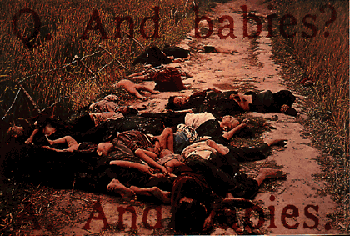

Slide 25
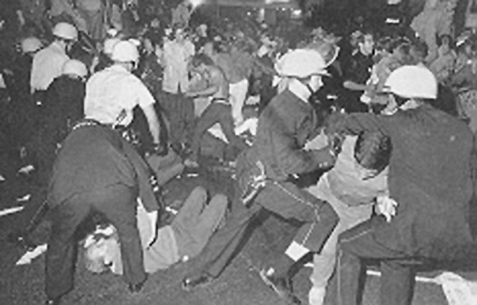
1968 Democratic National Convention – the battle of the streets – television redirects attention away from convention floor to protests outside

Slide 26
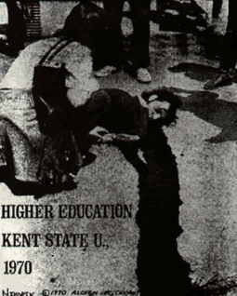
Year of decline: 1970
violence at Kent State University on May 4, 1970
bombing of science building at University of Wisconsin that summer
new mood on campuses in the fall of 1970

Slide 27
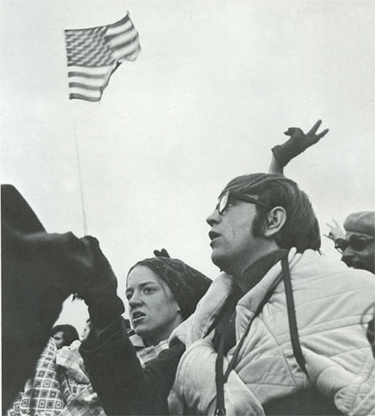
Middlebury College responds to Vietnam and Kent State

Slide 28
Legacy
conservative backlash: Joe Kelly and Archie Bunker
prevailing interpretation: America's youth “preferred pot to politics”

Slide 29
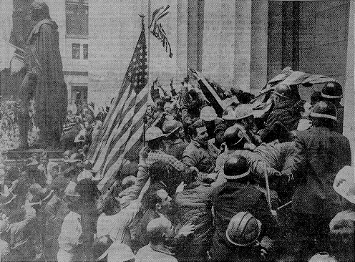

Slide 30
Sources cited
Amy Swerdlow,”Ladies’ Day at the Capitol: Women Strike for Peace versus HUAC,” Feminist Studies 8:3 (Autumn, 1982), 493-520.
K.Sklar lecture and visuals, “Women and Social Movements in the 1950s & 1960s,” http://harvey.binghamton.edu/~hist266/week10/peace1p.htm, accessed Nov. 5, 2013.
Students for a Democratic Society, “Port Huron Statement,” 1962. http://www2.iath.virginia.edu/sixties/HTML_docs/Resources/Primary/Manifestos/SDS_Port_Huron.html, accessed Nov. 5, 1962.

