Slide 1
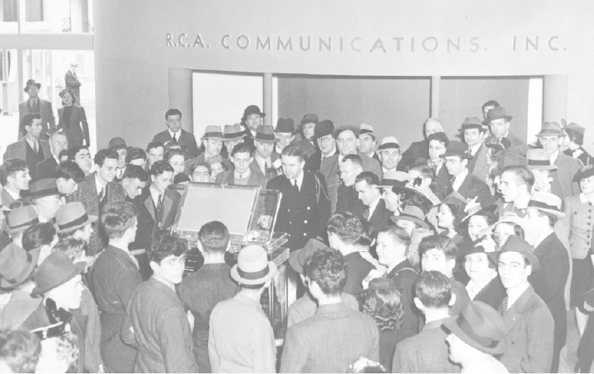
Television and Politics in the McCarthy Years
Notes:
Television had been in development since the ’20s and there were experimental broadcasts in the ’30s. TV was introduced to the public at the 1939 New York World’s Fair, but development stalled during WWII. David Sarnoff, the head of RCA, and William Paley, the head of CBS, became instrumental in the growth of the television industry.
10 television stations were on the air in 1945. By the end of the decade, more than half the population had access to television.

Slide 2
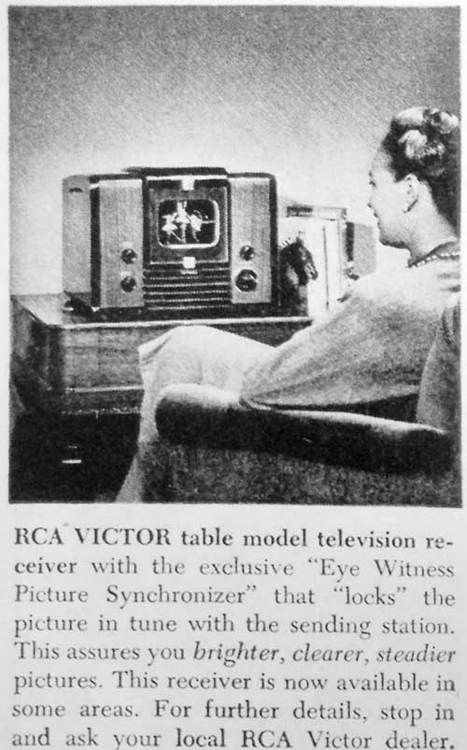
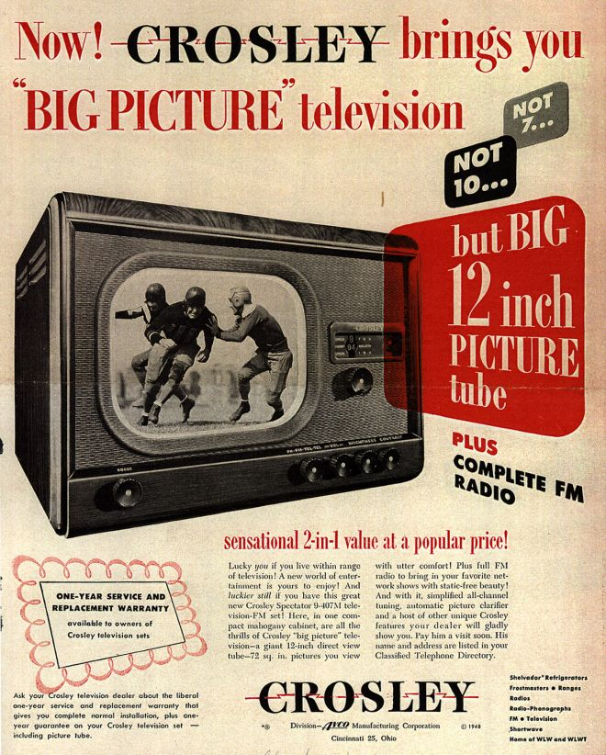
Notes:
Doherty calls television “A thrilling new household appliance”
What were the effects of television on the culture generally in the 1950s?
TV sets went on sale in 1946. A small black and white set cost $200, a console $2500. The median income in the United States was $3000. TV grew so fast and the demand for station licenses was so great that the FCC declared a freeze on new stations.
Left-hand set – 7” screen circa 1946 – right-hand set – 12” 1948

Slide 3
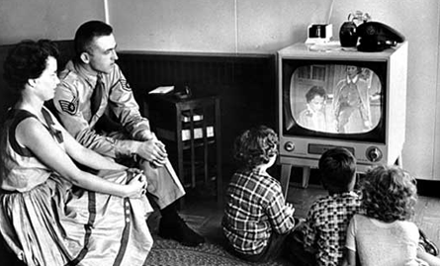
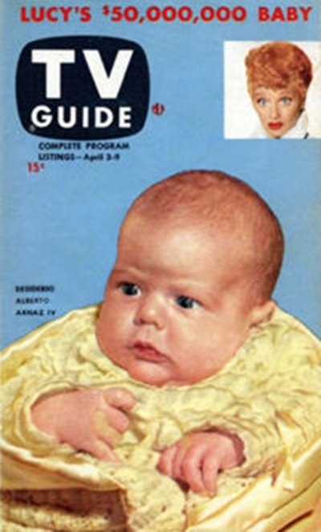
Family watches television in the 1950s
TV’s Golden Age
1st issue of TV Guide, 1953
Notes:
The fifties became the golden age of television. In the fifties, more TV sets (70 million) were sold than children born (40 million).
In 1952 there were 108 TV stations. Ten years later there were 541
Early programming included news, sports, game shows, sitcoms, children’s programming, variety shows and dramas. Most programming was live. Videotape was also introduced late in the decade.
The big three networks – ABC, CBS and NBC – dominated programming. On any given night more than 90 percent of viewers were watching one of the big three.
The first issue of TV Guide appeared April 3, 1953, at the cost of 15 cents.
Television's revolutionary impact on American culture
Decline of movie industry
B. Television
the "major discursive medium in postwar America" (Lipsitz)
2. reinforces postwar emphasis on comfort, consumerism, and complacency
helps Americans to adapt to changing cultural landscape of postwar America
C. Impact on family life: "the electronic hearth“
D. Impact on business and consumerism
competition for ad revenues reshapes t.v. programming
2. Commercials: "the message of the medium is the commercial"

Slide 4
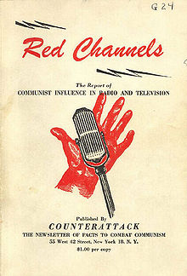
Issued by Counterattack, June 22, 1950
Notes:
Red Channels: The Report of Communist Influence in Radio and Television was ananti-Communist tract published in the United States at the height of the Red Scare. Issued by the right-wing journal Counterattack on June 22, 1950, the pamphlet-style book names 151 actors, writers, musicians, broadcast journalists, and others in the context of purported Communist manipulation of the entertainment industry. Some of the 151 were already being denied employment because of their political beliefs, history, or association with suspected subversives. Red Channels effectively placed the rest on the industry blacklist. (https://en.wikipedia.org/wiki/Red_Channels)

Slide 5
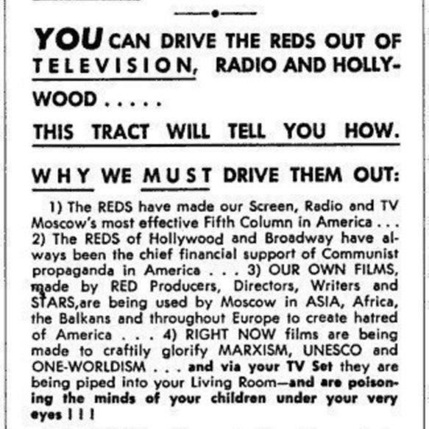
Notes:
Image: posted by anonymous to wikimedia commons.

Slide 6
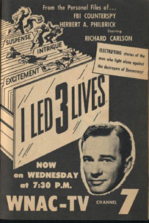
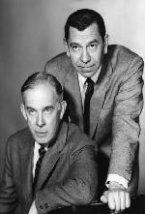
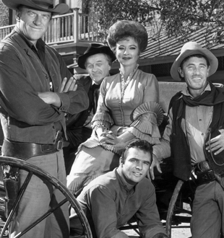
I Led Three Lives, 1953-1956
Gunsmoke, 1955-1975
Dragnet, 1952-1959
Notes:
Episodes began with a prologue promising that "the story you are about to see is true; the names have been changed to protect the innocent," then faded in on a pan across the L.A. sprawl. Webb's mellifluous voice intoned, "This is the city. Los Angeles, California”
Sitcoms focusing on middle-class family life: | I Love Lucy, The Adventures of Ozzie and Harriet, Father Knows Best
Game shows
Police dramas and westerns
Urban, ethnic sitcoms: I Remember Mama, The Amos 'n' Andy Show
reflect television's function in helping audiences to adapt to new social and cultural realities
reinforce ethnic and racial stereotypes
Overall, television reinforces consumerism and conformity

Slide 7
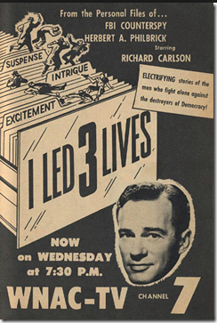
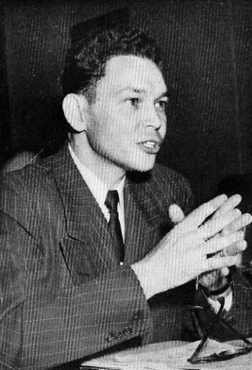
I Led 3 Lives: Tense because it’s Factual! Gripping because it’s Real! Frightening because it’s True!. . . . Not just a script writer’s fantasy—but the authentic story of a Commie’s attempt to overthrow our government! You’ll thrill to the actual on-the-scene photography . . . factual from the records dialogue . . . Authentic sets and scripts personally supervised by Herbert Philbrick, the man who for nine agonizing years lived in constant danger as a supposed Communist who reported daily to the FBI! Never before has such a dramatic document appeared on TV!
Notes:
1953—56, 117 episodes Ziv television
based on a book by Herb Philbrick about the nine years he spent as a counterspy for the FBI

Slide 8
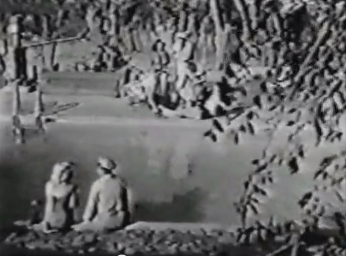
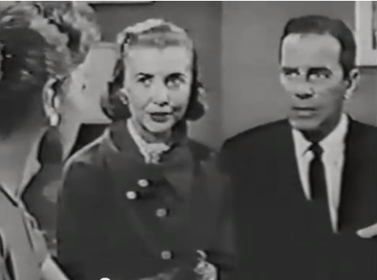
Communist women
“Iron-Gray Disciplinarians and Ruby-Red Vixens”: The Feminized Bureaucracy
Notes:
According to Kackman, “a key distinction is made between loyal American women who knew their place and those who are overzealous in their attempts to assume political power.” (Kackman, Citizen Spy, 33)

Slide 9
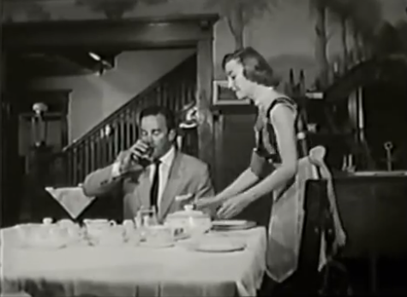
The role of Philbrick’s family
Notes:
Kackman: “it is to the home that Philbrick ultimately retreats – to the family that depends upon his leadership, and to the secret office and darkroom where he can produce his own knowledge of his experiences. In his struggle to act as agent of his own historical narrative, Philbrick must retreat to a place of refuge in the private sphere where he can escape the prying eyes of the FBI and the Communist Party.” (Citizen Spy, 37)
“Like program such as Leave It to Beaver and Father Knows Best, I Led 3 Lives presents ‘idealized versions of family life, often pitted against outsider, dysunctional units.’” (Citizen Spy, 43)

Slide 10
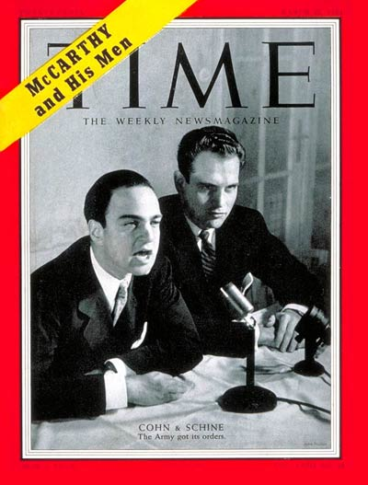
Senator Joseph McCarthy and the Army-McCarthy Hearings

Slide 11
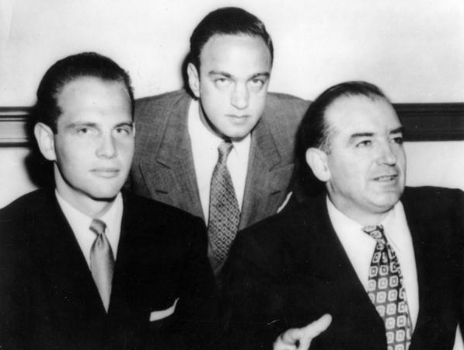
The Army-McCarthy Hearings
Televised from the Senate Caucus Room
Acting Committee Chair: Karl Mundt of South Dakota
Dominated national television from April 22 to June 17, 1954 (188 hours of broadcast time, 22 million viewers – ABC-TV)
McCarthy frequently interrupted proceedings, shouted “Point of Order”
Approval ratings in public opinion polls began sharp decline
The Reader’s Companion to American History. Eric Foner and John A. Garraty, eds., Harcourt Mifflin, 1991.
G. David Schine, Roy Cohn, and Joseph McCarthy
Notes:
In the Senate Subcommittee for Investigations, Senator McCarthy applied the methods of HUAC to the American government, military, and defense industry.
ABC carried the Army-McCarthy hearings in full – riveted the public, gained AB lots of credibility
Doherty : first nationwide transmission of a constitutional crisis -- this becomes a US tradition – anticipates Watergate, Iran-Contra, Hill-Thomas, Clinton impeachment (Doherty, 189)
Heated bombast of McCarthy verus calm demeanor of Joseph Welch, of Boston law firm Hill and Dorr hired by Army to act as Atty (190)
Roy Cohn and David Schine | Mar. 22, 1954
Read more: http://content.time.com/time/covers/0,16641,19540322,00.html#ixzz2gBrBJSaL
http://content.time.com/time/covers/0,16641,19540322,00.html

Slide 12
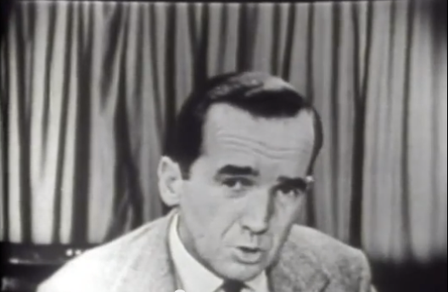
Television and McCarthy
Murrow, See It Now, CBS, March 9, 1954
Notes:
considered himself anti-communist
mccarthy skeptic
most respected journalist in American when he exposed the senator and his tactics on March 9, 1954
Wanted to be sure the show was air-tight – spent two months editing the film before putting it on the air
program featured excerpts from the senator’s own speeches, interspersed with Murrow’s comments, which pointed out the contradictions in McCarthy
Doherty calls Murrow's final commentary in McCarthy episode "the most dramatic, eloquent, and influential oration
ever delivered by a television journalist” (Doherty, 174)

Slide 13
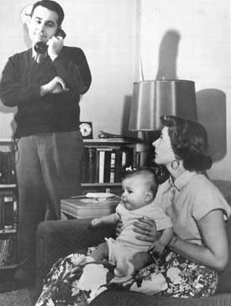
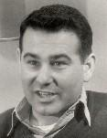
See It Now: The Case Against Milo Radulovich, October 20, 1953
Notes:
Milo Radulovich takes a phone call as his wife Nancy holds their daughter.
First extensive televised critique of McCarthyism
Air Force subsequently reinstated Radulovich – victory for CBS and Murrow
In 1953, Radulovich, a lieutenant in the Air Force Reserve in Dexter, Michigan, was discharged because his father and sister were accused of being communists or communist sympathizers. It is believed that the basis of this determination was that his father, a Yugoslav immigrant, kept up on events in his homeland by subscribing to a number of Serbian newspapers. One of these papers was associated with the American Slav Congress, which had been labeled as Communist by the American government. His sister, Margaret Radulovich, was a supporter of liberal causes, but she maintained that she was "apolitical." Whatever evidence there was against the lieutenant or his family was contained in a manila envelope not shared with Radulovich or his attorney.
Radulovich demanded an Air Force hearing, aided by retired lawyer Charles Lockwood, who worked pro bono. Lockwood contacted an editor at the Detroit News, which ran a story about the situation. Among the readers was a former classmate of Radulovich, attorney Kenneth Sanborn (who went on to become a State Representative and Macomb County Circuit Judge in Michigan). He also was an Air Force lieutenant and also accepted no fee for his services. Radulovich was granted a hearing at which the sealed manila envelope was brandished and waved by the attorney for the Air Force. However, the envelope was never opened and neither the board members nor anyone in the Radulovich camp were permitted to see its contents.
The Air Force stripped Radulovich of his commission, which came to the attention of Edward R. Murrow, host of the popular See It Now program on CBS. For months, Murrow, producer Fred Friendly and the See It Now team had debated how to address McCarthy's witch hunt, until the Radulovich affair. A crew (Reporter/Assistant producer Joseph Wershba and cameraman Charlie Mack) went to Dexter and filmed impassioned interviews with the lieutenant and his family. Lockwood also appeared, and declared on national television "In my 32 years of practicing... I have never witnessed such a farce and travesty upon justice as this thing has developed into."
The program aired on October 20, 1953. The image of the lieutenant and his immigrant father led many viewers to question the impact of McCarthyite tactics for purging the government and military of potential security risks. Radulovich was reinstated one month after the broadcast.
Radulovich moved to California where, despite his reinstatement, he had trouble getting work…
https://en.wikipedia.org/wiki/Milo_Radulovich

Slide 14
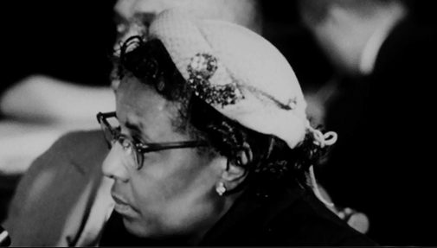
Annie Lee Moss testifies before the Senate Subcommittee on Investigations on March 11, 1954
Notes:
In March 1954, McCarthy began to investigate Annie Lee Moss, a middle-aged African American woman who worked for the Army Signal Corps
Moss lost her job with the Army and was interrogated on national television
“The humble, poverty-stricken [Moss] had dawned a sambo mask to shelter herself behind the veil of white racism. As confidential FBI reports made clear several years late, Annie Lee Moss was almost certainly a CP member since 1940 and thus knew the name of Karl Marx.” (Doherty, 184)
Annie Lee Moss (August 9, 1905 – January 15, 1996) was a communications clerk in the US Army Signal Corps in the Pentagon and alleged member of the American Communist Party. She was believed to be a security risk by the FBI and her superiors at the US Army Signal Corps and was questioned by United States Senator Joseph McCarthy in his role as the chairman of the Senate Permanent Subcommittee on Investigations.^{[3][4]} The highly publicized case was damaging to McCarthy's popularity and influence.
McCarthy's popularity was on the wane at the time of the Moss hearing, and the publicity around the case accelerated the process. He would soon be embroiled in the Army–McCarthy hearings which also significantly eroded his standing with the public and in the Senate. In December 1954 he was censured by the Senate, and spent the rest of his career in relative obscurity. He died in 1957.
Moss had been suspended from her position when McCarthy announced his interest in the case. In January 1955 she was rehired to a non-sensitive position in the army's finance and accounts office, and she remained an army clerk until her retirement in 1975. She died in 1996, aged 90.
https://en.wikipedia.org/wiki/Annie_Lee_Moss

Slide 15
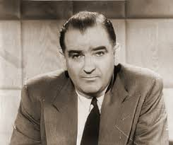
McCarthy’s rebuttal to Murrow on See It Now, April 6, 1954
Notes:
According to the Fairness Doctrine, since CBS had aired half-hour expose of McCarthy, the network had to give McCarthy a half-hour time slot for rebuttal -- that took place on April 6, 1954 and was disastrous
Attacked Murrow personally, calling him “the leader of the jackal pack”
Increasing pressure on CBS from sponsor, Alcoa
See It Now and other documentary programs were being pushed to the margins in the mid-1950s

Slide 16
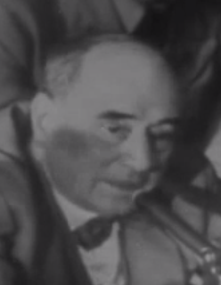
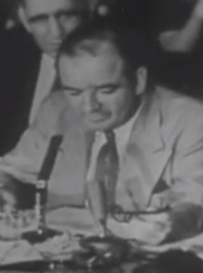
June 9, 1954: “Have you no sense of decency?”
Welch
McCarthy
Notes:
http://www.youtube.com/watch?v=Po5GlFba5Yg

Slide 17
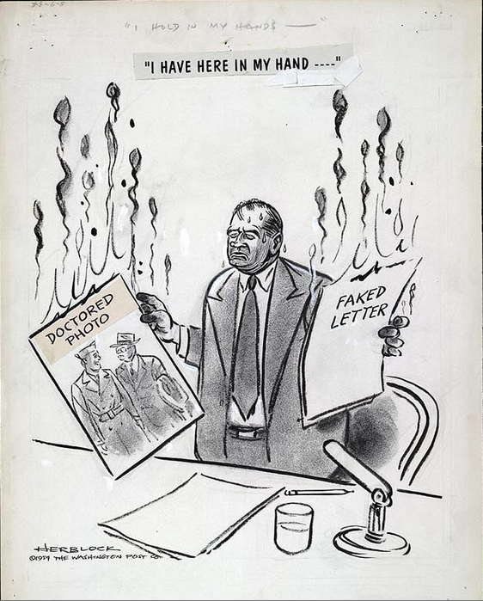
May 7, 1954. Published in the Washington Post
Notes:
The Senate held special hearings, known as the Army-McCarthy hearings, which were among the first to be televised nationally. In the course of testimony McCarthy submitted evidence that was identified as fraudulent. As both public and politicians watched the bullying antics of the Senator, they became increasingly disenchanted
On Dec. 2, 1954 the U.S. Senate formally reprimanded McCarthy for conduct unbecoming to a senator.
Continued to be senator for 2 and a half more years but his career was ruined. He died in 1957.
“McCarthy indeed was a liar (about some things) and opportunist who may have done more to harm the anti-Communist challenge than to help it. His name is a noun meaning vicious, unsubstantiated political attacks, a witch hunt: McCarthyism.
“Ironically, Venona showed that most of his claims were true.” Source: “The Early Cold War [ppt]” https://www.iss.k12.nc.us/site/handlers/filedownload.ashx?moduleinstanceid…, accessed 9/30/17)

Slide 18
The recent hearings were not the first Congressional proceedings to be broadcast, to be sure. But networks have been greatly extended and millions of sets have been sold since Senator Kefauver & Company had their crimebusting act on the air some three years ago. So it is safe to assume that more than half the people who viewed the Army-McCarthy hearings had never seen Congress in action before.
Probably they had formed some preconceptions. If they had envisioned Congressional procedure as something marked by statesmanship, responsibility, befitting seriousness and, above all, dignity, they must have suffered a rude disillusionment. But if they were among those who thoughtlessly sneer at politics and politicians—and we have listened to many such—their unflattering opinion could have been intensified.
"After the Brawl," Collier’s, August 6, 1954, 90.

Slide 19
What must many Americans have thought, knowing that tradition but seeing government in action for the first time! It was a carnival, a sprawling, brawling travesty. It was a performance to shame some of the leading participants, who seemed to forget that their hammy hokum and snarling words were being seen across the country and heard around the world.
How much damage was done cannot be calculated. But fortunately the carnival is over. Now let us hope that responsible members of party and government will take over and, without any further side-show diversions, guide us wisely through the crises that face the country. And let us also hope that those citizens who were shocked by the recent burlesque of responsible government will be assured that some of the performers are not typical of the men in the Capitol who, through the years, have helped to make America great and strong and just.
"After the Brawl," Collier’s, August 6, 1954, 90.

Slide 20
“Robert Sarnoff [of NBC] and William Paley [of CBS] had a great respect for news, and they helped democracy. They allowed their networks to be neutral and successful but didn’t expect them to be big moneymakers. I think there’s a different corporate view now in terms of the bottom line.”
-- Helen Thomas, quoted in Kristina Borjesson, Feet to the Fire: The Media after 9/11, p. 132.
“CBS [under Paley] was the gold standard of American radio and television news. It had the best documentary unit and the best news staff”
– Benjamin Bagdikian, The New Media Monopoly, p. 45.
Notes:
Since the early days of radio, federal law has restricted the ownership of mass media, on the grounds that a diversity of owners would help produce the “multitude of tongues” required of our marketplace of ideas. But these restrictions stood in the way of some of the most powerful corporations in the world as they moved to acquire some of the world’s most profitable media assets. Deferring, as we shall see in Chapter 6, to that corporate political power, the federal government obligingly removed most of these restrictions. For example, the Telecommunications Act of 1996 was a “Magna Charta” for multinational media corporations, unleashing a tidal wave of media mergers and acquisitions (McChesney 2004, p. 50). See Calvin F. Exoo, The Pen and the Sword: Press, War, and Terror in the 21st Century, p.13

Slide 21
Today, more than ever, profit is the king over television, the movies, and even the news. More than ever, the king’s decrees are absolute law. More than ever, the resulting media fare is a toothless politics, a mindless entertainment.
--Calvin F. Exoo, The Pen and the Sword: Press, War, and Terror in the 21st Century, p. 14.
Notes:
The result is that since Paley’s time CBS has been bought and sold by three different conglomerate corporations. Today, Sarnoff’s NBC is the property of the General Electric Corporation—which also owns Universal movie and television studios, TV and radio stations in every major market, Universal Studios’ theme parks, cable stations such as CNBC, MSNBC, USA Network, Bravo, and Telemundo, along with divisions that provide nuclear energy, military aircraft engines, plastics, financial services, oil and gas treatment plants, and, oh yes, lightbulbs. Inevitably, these corporate acquisitions have concentrated the ownership of the mass media in fewer and fewer hands.

