Slide 1
Stanley Kubrick’s Dr. Strangelove and the High Cold War
Notes:
Black Comedy: a ​film, ​play, etc. that ​looks at the ​funny ​side of things that we usually ​consider to be very ​serious, like ​death and ​illness (Cambridge English Dictionary)

Slide 2
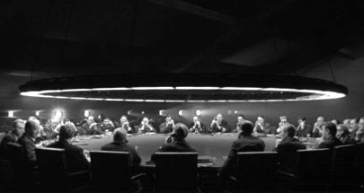
Shea asks, “Does popular culture modify the political process, or do political changes in values and attitudes affect modes of entertainment?” (3)
Notes:
“A rogue general decides to take the Cold War with the Soviet Union into his own hands and orders a nuclear attack on Russia, with various people in the government trying their (unsuccessful) best to stop the attack before the Soviets retaliate with a doomsday machine and mutually assured destruction ensues.” –Andrew Wyzan, http://iml.jou.ufl.edu/projects/fall11/wyzan_a/index.html
black comedy
drama is developed around several outlandish characters, yet the film remains close to the people and events of the 1950s and early 1960s
refers to many important aspect of American politics and foreign policy in the era

Slide 3
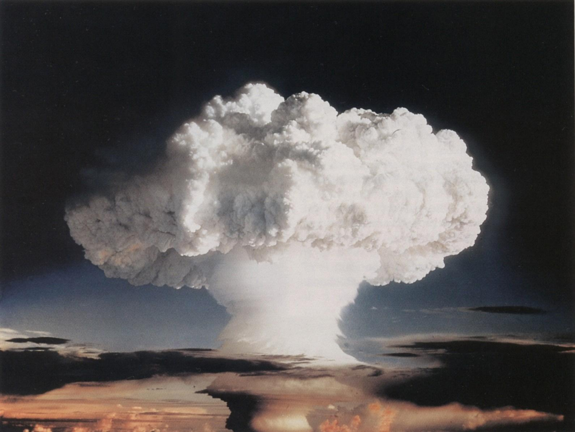
First “H” Bomb Test, Nov. 1952
Notes:
dangers of nuclear holocaust very present in the minds of Americans in the decade before Dr. Strangelove’s release
test explosions of thermonuclear weapons by the US in November 1952 and by the Soviets in August q953 revealed new generation of thermonuclearweapons that was many times more powerful than the atom bomb

Slide 4
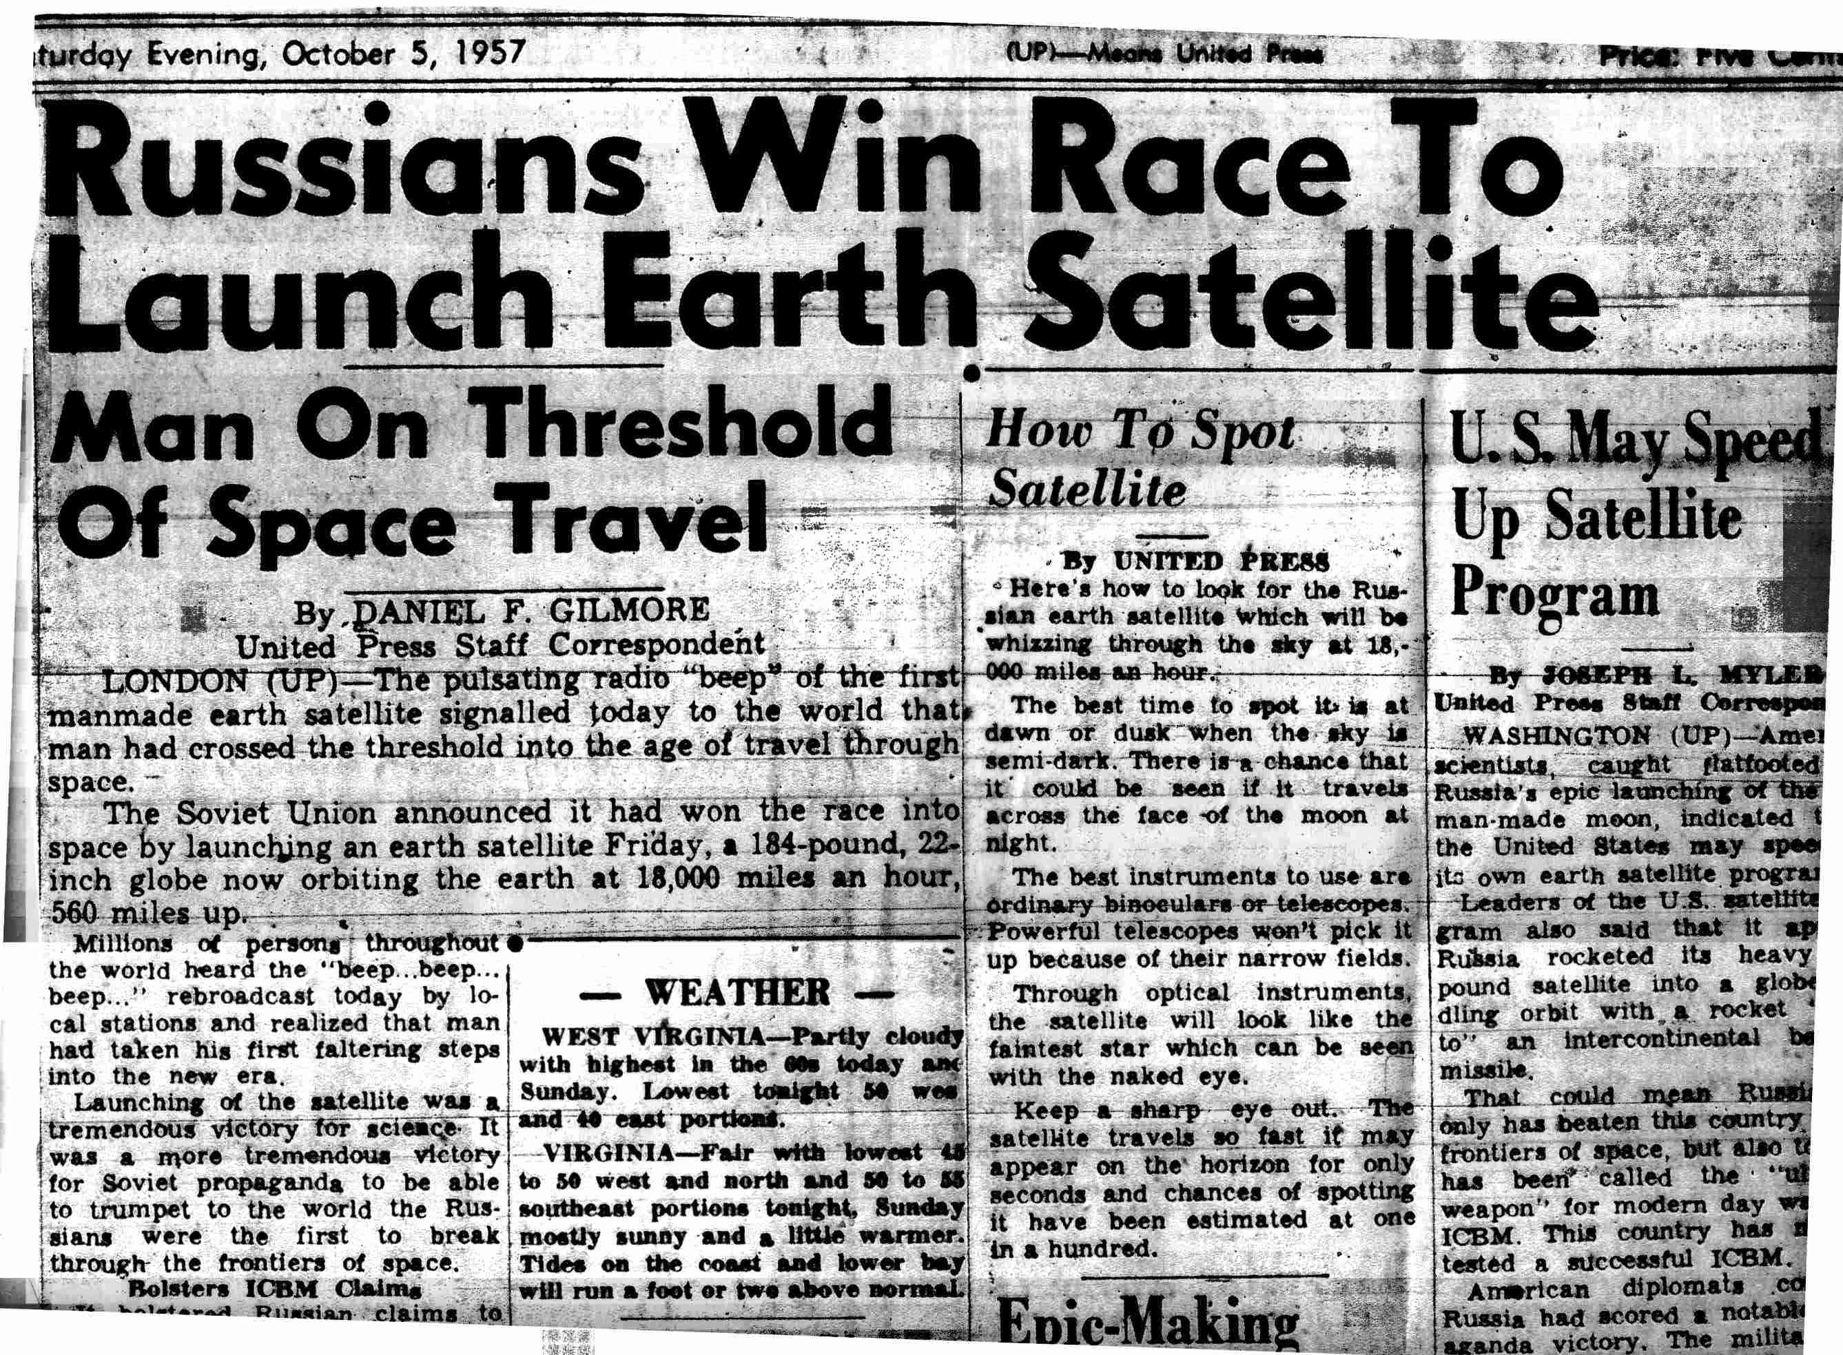
Notes:
4 October 1957 – Soviets successfully tested the firsts ICBM and launched their first satellite, Sputnik, into outer space

Slide 5
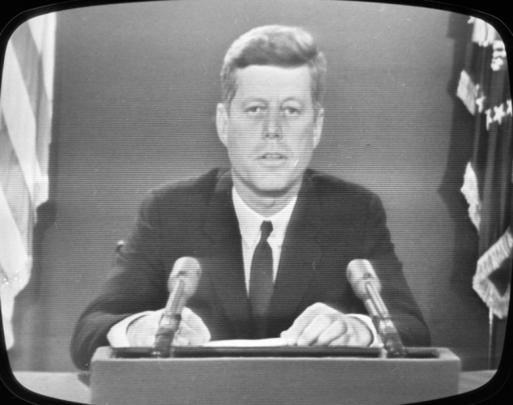
JFK addressing the nation during the Cuban Missile Crisis.
Notes:
John F. Kennedy spoke to this concern during his 1960 presidential campaign
Argued that the Republicans had not adequately prepared the S to deal with Soviet power and the nation was falling behind in the technology race
He warned of a “missile gap”
His call for a more vigorous military response to the Soviet Union helped him to win the close contest against NIxon

Slide 6
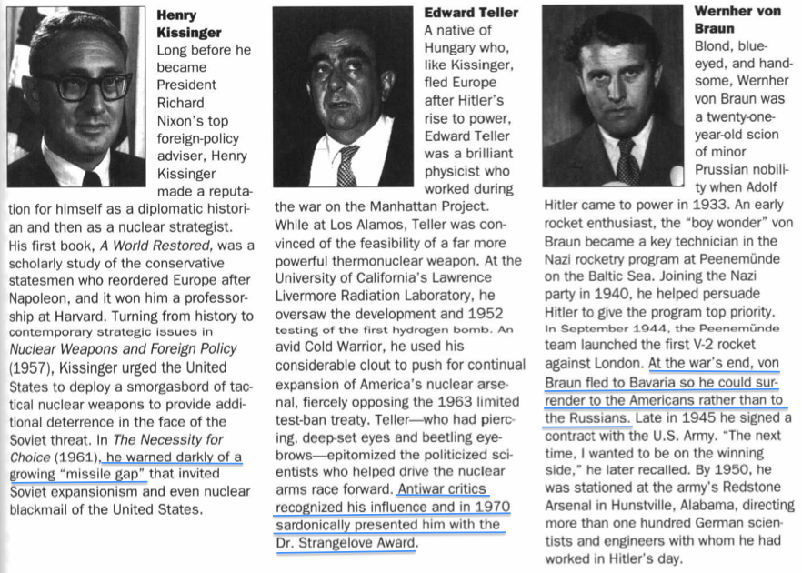
Boyer, “Dr. Strangelove, ” p. 267

Slide 7
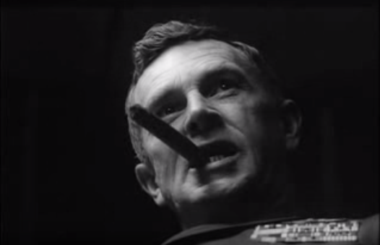
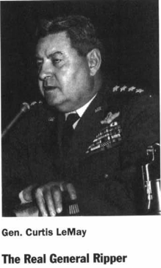
Stirling Hayden as General Jack D. Ripper explains his theory about “precious bodily fluids” to Group Captain Lionel Mandrake
Notes:
film's overarching mood is built on very serious actors saying very ridiculous things in very funny ways. To illustrate, watch the clip below, in which rogue General Jack. D. Ripper (played by Sterling Hayden) explains why he just ordered a nuclear attack on the USSR.
In the scene, Kubrick gets a great close-up shot of Hayden and his cigar, while keeping the smoke mostly in-frame, for no other reason but to build up the gravity of Hayden's speech up until he says the phrase "precious bodily fluids,"

Slide 8
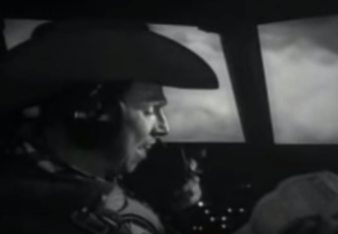
Major “King” Kong lists contents of crew members’ emergency sypply kit, which contains lipstick, nylon stockings and condoms.
Notes:
The film also shifts perspective to the soldiers carrying out General Ripper's nuclear attack, on-board a bomber called the "Leper Colony"
Here's a scene in which the bomber's commander, Major "King" Kong (played by Slim Pickens) is going through an emergency supply kit in case the plane crashes in "Rooskie territory.”
Use of music?

Slide 9
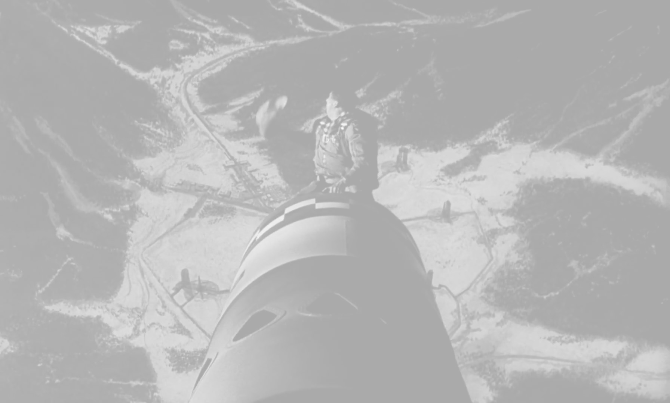
Does Kubrick’s technique of using dark comedy work? Could he have offered a more poignant criticism of nuclear policy with a serious treatment of the subject?
How does the film’s symbolism suggest political messages?
How do sexual imagery and references to sexual activity work in the film?

