Slide 1
Anti-Communism in Cold War America

Slide 2
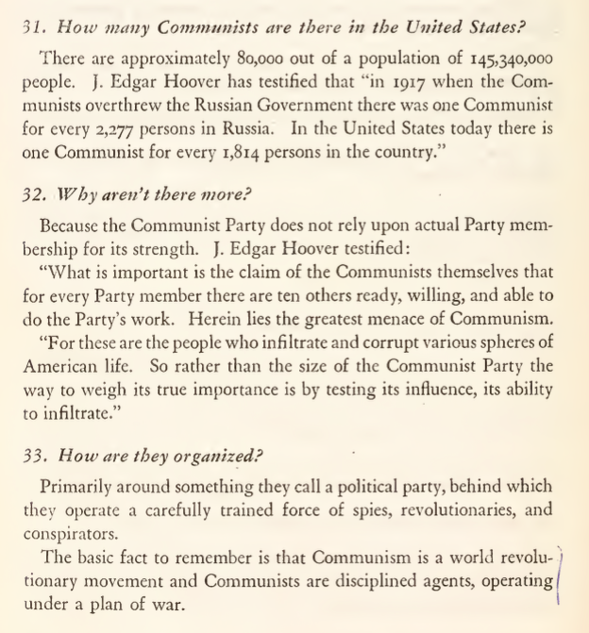
Anti-Communist Ideology

Slide 3
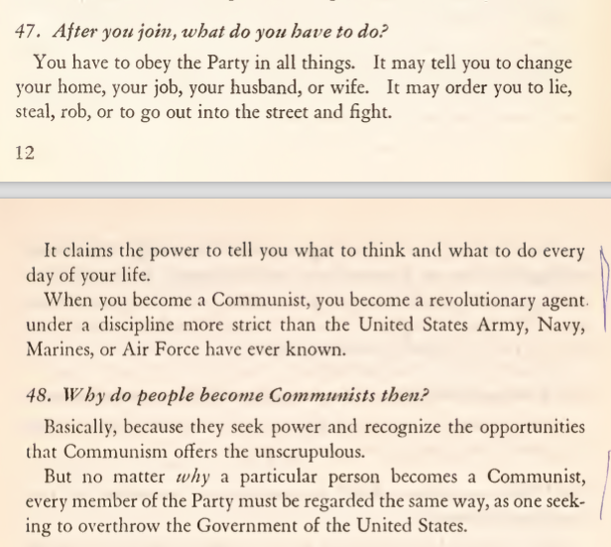

Slide 4
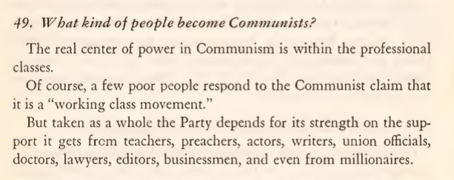
Notes:
anti-intellectualism
Hiss trial – Hiss = Harvard elite; Chambers = Columbia dropout from poor family; Nixon = working-class upbringing and Whittier College

Slide 5
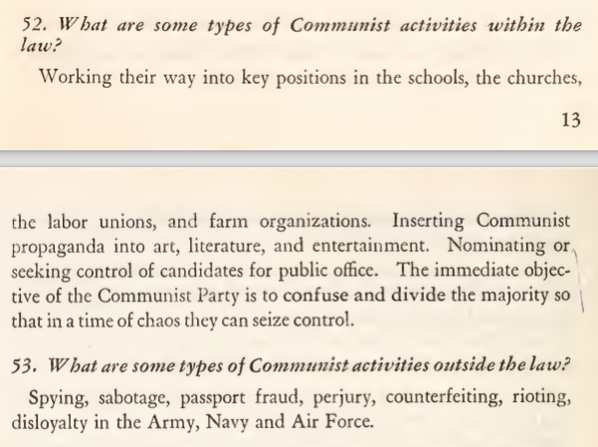

Slide 6
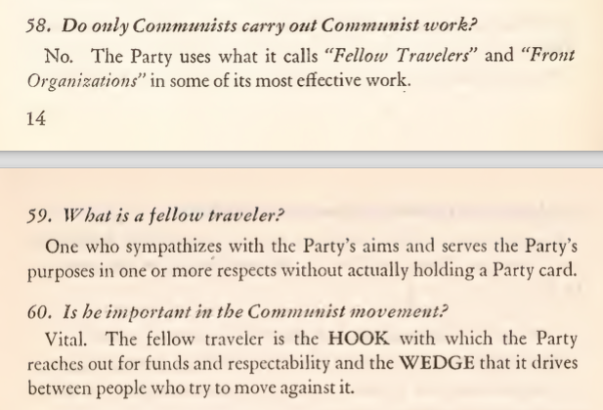

Slide 7
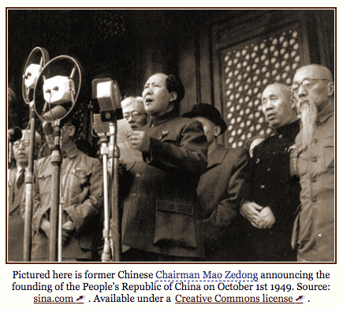
Contexts for Second Red Scare
Soviet nuclear capability
Espionage cases
Communist China, 1949
Korean War, 1950-1953
Notes:
Soviet a-bomb test 1949; h-bomb test 1953

Slide 8
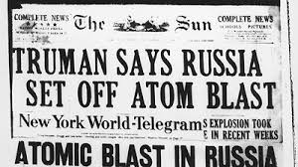
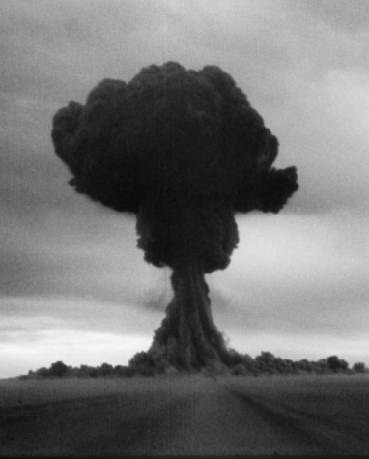
Notes:
1949

Slide 9
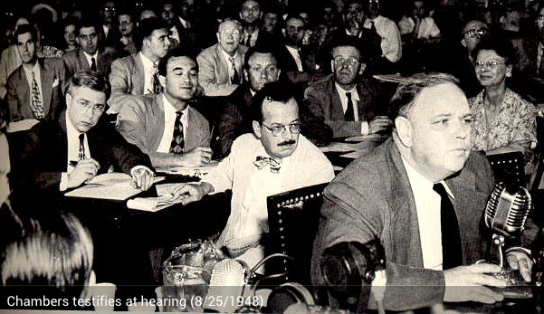
Anti-Subversion
Smith Act, 1940
Federal Loyalty Program, 1947
HUAC
The Hollywood Ten, 1947
Hiss case, 1948, 1950
Rosenberg trial and executions, 1950-53
McCarran-Walter Act, 1952
Notes:
Hiss: Chambers testifies before HUAC, names Hiss in 1948
Hiss convicted of perjury (thanks to Nixon’s dogged pursuit) in 1950
Rosenbergs – arrested for espionage in 1950, executed 1953
Otherwise known as the McCarran-Walter Act, the Immigration and Nationality Act of 1952 was meant to exclude certain immigrants from immigrating to America, post World War II and in the early Cold War. The McCarran-Walter Act moved away from excluding immigrants based simply upon country of origin. Instead it focused upon denying immigrants who were unlawful, immoral, diseased in any way, politically radical etc. and accepting those who were willing and able to assimilate into the US economic, social, and political structures, which restructured how immigration law was handled. Furthermore, the most notable exclusions were anyone even remotely associated with communism which in the early days of the Cold War was seen as a serious threat to US democracy. The main objective of this was to block any spread of communism from outside post WWII countries, as well as deny any enemies of the US during WWII such as Japan and favor “good Asian” countries such as China. The McCarran-Walter Act was a strong reinforcement in immigration selection, which was labeled the best way to preserve national security and national interests. President Truman originally vetoed the law, deeming it discriminatory; however there was enough support in Congress for the law to pass. (http://library.uwb.edu/Static/USimmigration/1952_immigration_and_nationality_act.html)

Slide 10
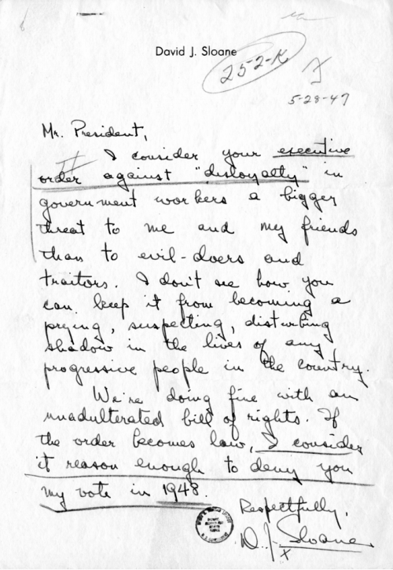
Truman’s Federal Loyalty Program, 1947
Background checks on all federal workers done by FBI
Anyone withquestionable” activities were accused of disloyalty
Notes:
Those accused were sent in front of the Loyalty Review Board.
Violated rights of privacy and freedom to associate.
Considered guilty until proven innocent.
Truman’s Loyalty Program has its origins in World War II, particularly in the Hatch Act (1939), which forbade anyone who “advocated the overthrow of our constitutional form of government in the United States” to work in government agencies. After the war, tensions between the U.S. and the Soviet Union grew, as did suspicion of workers in every government department. Several advisors, including Attorney General Tom Clark, urged Truman to form a loyalty program to safeguard against communist infiltration in the government. Initially, Truman was reluctant to form such a program, fearing it could threaten civil liberties of government workers. However, several factors shaped his decision to institute such a policy. Fear of communism was growing rapidly at home, and in the 1946 midterm election, Republicans gained control of Congress for the first time since 1931. To examine the issue, in November 1946 Truman created the Temporary Commission on Employee Loyalty, which stated, “there are many conditions called to the Committee’s attention that cannot be remedied by mere changes in techniques… Adequate protective measures must be adopted to see that persons of questioned loyalty are not permitted to enter into the federal service.” In March 1947, Truman signed Executive Order 9835, “prescribing procedures for the administration of an employees loyalty program in the executive branch of the government.”
The Loyalty Program has been criticized as a weapon of hysteria attacking law-abiding citizens. The Attorney General’s office compiled lists of “subversive” organizations, and prior involvement in protests or labor strikes could be grounds for investigation. As the Cold War intensified, investigations grew more frequent and far-reaching. As noted in Civil Liberties and the Legacy of Harry S. Truman, edited by Richard S. Kirkendall, “During the loyalty-security program’s peak years from 1947 to 1956, over five million federal workers underwent screening, resulting in an estimated 2,700 dismissals and 12,000 resignations… the program exerted its chilling effect on a far larger number of employees than those who were dismissed” (70).
https://www.trumanlibrary.org/dbq/loyaltyprogram.php
Do Cold War fears during the Truman Administration justify the institution of the government Employee Loyalty Program in a democratic society?

Slide 11
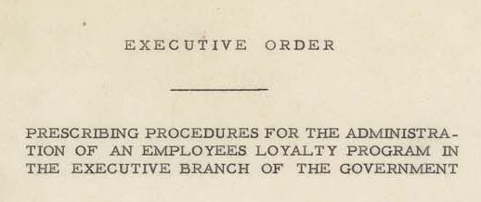
The Loyalty Program
Millions investigated
Few hundred removed from jobs
Added to the climate of suspicion in the nation

Slide 12
HUAC
House Un-American Activities Committee
Congressional committee to find Communists.
Focused partly on Hollywood

Slide 13
Hollywood in the 1950s
Many Communists in the 1930s
US govt. had encouraged films that were pro-Soviet during WWII.
Now they were out for the actors / writers / directors of “un-American” shows.

Slide 14
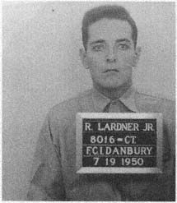
The Hollywood Ten
Celebrities accused of having “radical” politics.
Witnesses against the actors / directors / writers used flimsy evidence and rumors.
Then they would call the accused.

Slide 15
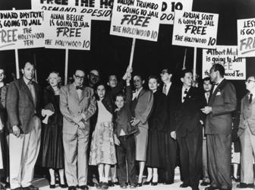
The Hollywood Ten
Are you now or have you ever been a member of the Communist Party?”
When some tried to answer – they were denied the right to respond.
Not responding – cited for contempt of Congress.
Members of the Hollywood Ten and their families in 1950, protesting the impending incarceration of the ten
Notes:
Image: https://en.wikipedia.org/wiki/Hollywood_blacklist
October 1947 -- 10 members of Hollywood film industry
HUAC = investigative committee of the U.S. House of Representatives
probed alleged communist influence in the American motion picture business.
10 prominent screenwriters and directors, who became known as the Hollywood Ten, publicly denounced the tactics employed by HUAC
They received jail sentences and were banned from working for the major Hollywood studios.
Their defiant stands placed them at the center of a national controversy about the anti-communist crackdown that swept through the United States in the late 1940s and early 1950s.
Besides the Hollywood Ten, other members of the film industry with alleged communist ties were later banned from working for the big movie studios.
Anyone with associations with the Hollywood Ten were afraid of being called Communist.
Backed off on films dealing with racism and anti-Semitism
The Hollywood blacklist came to an end in the 1960s.

Slide 16
The McCarran-Walter Act, 1952
Senator McCarran thought all Communists were immigrants from Communist areas of the world.
Passed a law reestablishing the 1924 quotas on immigration.
Vetoed by Truman as “most Un-American law I’ve ever seen.”
Congress overrode his veto and made the law.

Slide 17
Senator Joe McCarthy
1950- Wisconsin senator in trouble for his upcoming re-election.
Needed an issue to keep people from looking at the lies about himself.

Slide 18
The McCarthy Era
“I hold in my hand a list of 205 people who were known to the Secretary of State as being members of the Communist Party and who, nevertheless, are still working and shaping policy at the State Department.”
Senator Joe McCarthy (1950)

Slide 19
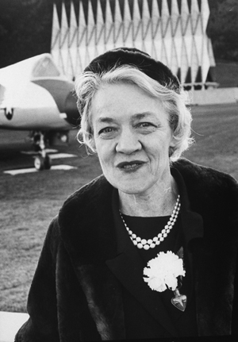
Margaret Chase Smith
1897-1995
First woman elected to both US House
and Senate; House 1940; Senate 1948
until 1972
Delivered “Declaration of Conscience”
Speech” against Senator McCarthy
in 1950

Slide 20
McCarthyism
Used innuendo and wild accusations against increasingly “big” targets.
The Army
Former General Marshall and then Secretary of State
Journalist Edward R. Murrow
President Eisenhower

Slide 21
McCarthyism
Hundreds were accused.
Lost jobs, lost families, ruined reputations.
No charges ever filed against anyone.

Slide 22
McCarthy’s Fall
1954
Accusations of trying to keep an assistant from being drafted.
Accusations of homosexuality.
Accusations against people that the public respected.

Slide 23
McCarthy’s Fall
1954 – censured by the Senate.
Lost credibility and respect.
No power.
Died of alcoholism in 1957.

