Slide 1
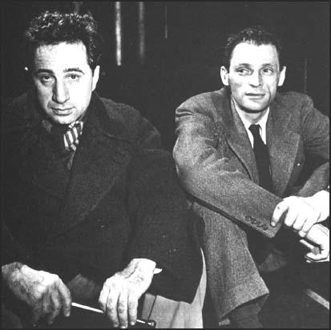
Arthur Miller and HUAC
Elia Kazan and Arthur Miller whileworking on Death of a Salesman (1949), Spartacus Educational
Arthur Miller, The Crucible, 1953
HUAC testimony of Paul Robeson, Lillian Hellman, Jack Warner, Louis Mayer, Ayn Rand, Ronald Reagan and Walt Disney
Miller, “Why I Wrote The Crucible,” New Yorker, 1996
Aamir Aziz, “Using the Past to Intervene in the Present: Spectacular Framing in Arthur Miller’s The Crucible,” New Theatre Quarterly 32:2(May 2016, 169-180.
Notes:
Aziz: “Arthur Miller’s The Crucible is a willful and purposeful theatrical response to” to HUAC. Miller “highlights the theatricality of the [HUAC] trials….” He uses “his play theatrically to unhinge the machinations of McCarthyism and the seemingly unassailable frame of an American democracy defending itself against Communist subversion” (169).

Slide 2
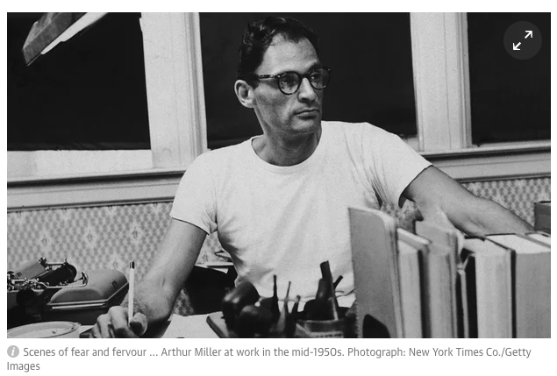
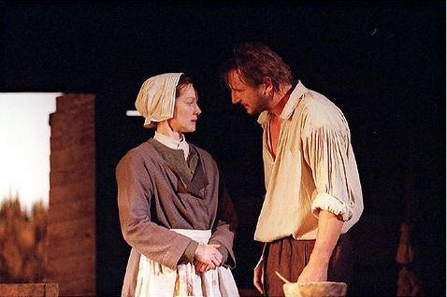
Laura Linney and Liam Neeson in a 2010 production of “The Crucible.” Photo from The New York Times.
It was not only the rise of "McCarthyism" that moved me, but something which seemed much more weird and mysterious. It was the fact that a political, objective, knowledgeable campaign from the far Right was capable of creating not only a terror, but a new subjective reality, a veritable mystique which was gradually assuming even a holy resonance. . . . It was as though the whole country had been born anew, without a memory even of certain elemental decencies which a year or two earlier no one would have imagined could be altered, let alone forgotten.
Miller quoted in Harold Bloom, ed., Arthur Miller, Chelsea House, 1987, 128

Slide 3
The Theatricality of HUAC Hearings
“We were living in an art form, a metaphor that had no long history but had suddenly, incredibly enough, gripped the country.” –Miller
“All relationships had become relationships of advantage or disadvantage. That this was what it all came down to anyway and there was nothing new here. That one stayed as long as it was useful to stay, believed as long as it was not too inconvenient, and that we were fish in a tank cruising with upslanted gaze for the descending crumbs that kept us alive.” -Miller
Notes:
Arthur Miller, ‘The Crucible in History. The Massey Lecture, Harvard University’, in Arthur Miller’s The Crucible: Bloom’s Modern Critical Interpretations, ed. Harold Bloom (New York: Infobase, 2008), p. 86.
3. Miller, Timebends: a Life (London: Methuen, 1987), p. 333–4, cited in Aziz, 170.
“Arthur Miller first learnt about the 1692 Salem episode in Marion Starkey’s 1949 book The Devil in Massachusetts.51 He saw a living connection between the ritualistic scene of the hearings in Washington and the proceed- ings in Salem. The former were ritualistic in that the Committee had already drawn its conclusions and its sole purpose was to ex- tract confessions from the witnesses accord- ing to a pre-formulated verdict, much as in the Salem trials. Each hearing was characterized by this notion of purge through confession” (Aziz, 176)

Slide 4
HUAC’s Purpose
To subpoena and investigate:
The extent, character and objects of un-American propaganda activities in the United States,
the diffusion within the United States of subversive and un-American propaganda that is instigated from foreign countries or of a domestic origin and attacks the principle of the form of government as guaranteed by our Constitution, and
all other questions in relation thereto that would aid Congress in any remedial legislation.
Notes:
David Caute, The Great Fear: the Anti-Communist Purge under Truman and Eisenhower (New York: Simon and Schuster, 1979), p. 88–9.

Slide 5
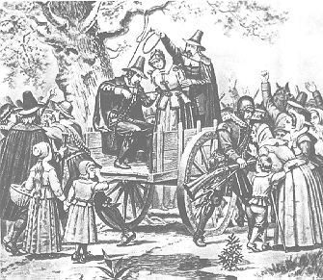
Parallels between Salem Witch Trials and the Second Red Scare
“[I]n The Crucible, Miller shows that the world is still gripped by the binary of right and wrong, good and evil, God and Lucifer” (Aziz, 171).
Notes:
Political movements are always trying to position themselves as shields against the unknown - vote for me and you're safe. The difference during witch hunts is that you are being made safe from a malign, debauched, evil, irreligious, wife-swapping, deceitful, immoral, stinking conspiracy stemming from the very bowels of hell. In Wisconsin in the early 50's, a reporter went door to door asking residents if they agreed with certain propositions, 10 in number, and discovered that very few people did, and that most thought the first 10 amendments to the United States Constitution, unnamed of course in the inquiry, were Communistic. To propose that we should be free to express any idea at all was frightening to a lot of people –Miller, 1989

Slide 6
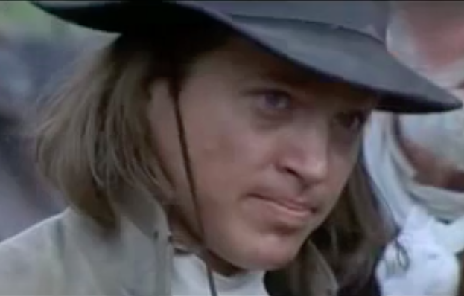
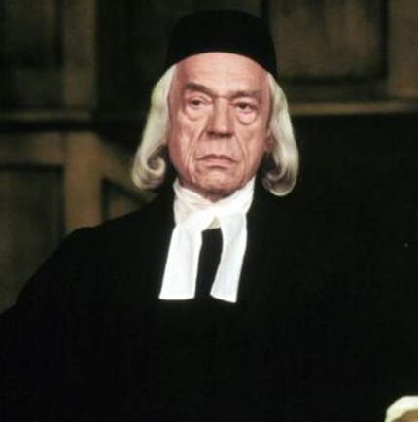
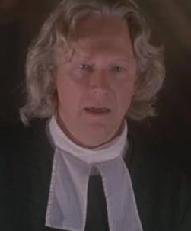
The Prosecutors
“The same misplaced pride that had for so long prevented the original Salem court from admitting the truth before its eyes was still alive here.” (Miller, Timebends, p. 337)
Photos from film adaptation of The Crucible (Nicholas Hytner, 1996)
Notes:
there was a clear affinity between the arrogance of the prosecutors in both the Salem and McCarthy periods. Miller notes: ‘The same misplaced pride that had for so long prevented the original Salem court from admitting the truth before its eyes was still alive here. And that was good for the play too, it was in the mood.’8 (Aziz, 170)

Slide 7
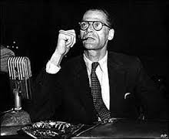
Arthur Miller testified before HUAC, 1956
Notes:
“Arthur Miller was subpoenaed by the HUAC on 21 June 1956, three years after the Broadway premiere of The Crucible and while he was under investigation for an allegedly unauthorized passport. The charges against him were: ‘Signing CRC statements against anti-Communist legislation and against HUAC itself; appealing on behalf of Gerhart Eisler and Howard Fast, attending five or six meetings of Communist writers in 1947.’… Miller only had to respond to the last of the charges in this instance. (Aziz 170)

Slide 8
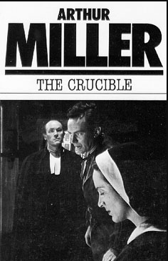
Notes:
his response to being framed by McCarthy and his affiliates was to produce his own frame, namely, a play in which he dramatized his- tory to comment on the present. Thus, the play became an artistic intervention in the public show on which the hearings relied. In The Crucible Miller used the famous Salem ritualistic witch trials of 1692 to expose the analogous nature of the McCarthy hearings in the 1950s. (Aziz, 170)

Slide 9
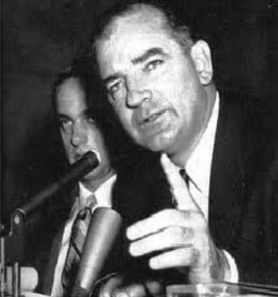
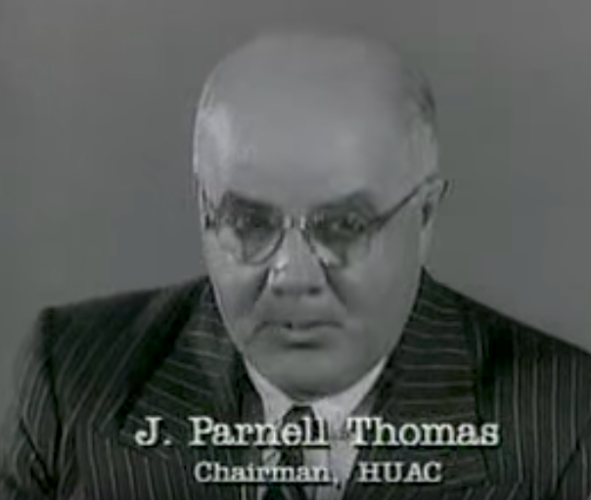
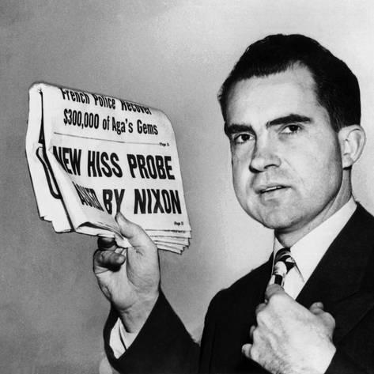
Notes:
“[L]eftist radicals argued against Stalinism and the corruption of the global socialist ideal. Yet, Schrecker continues, the main anti-Communist group consisted of conservative Republican men, who furthered their political careers by manipulating the national environment of popular myths and stereotypes according to their own partisan concerns. Richard Nixon and Joseph McCarthy are prime examples of this, along with the FBI’s J. Edgar Hoover.” (Aziz, 172)

Slide 10
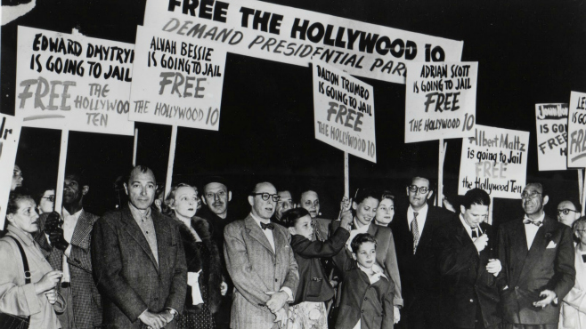
Support for the Hollywood artists blacklisted by HUAC
Notes:
Opaque proceedings and circular logic; guilt by association, hearsay – used to challenge intellectuals and elites
“Statesman Alger Hiss, for instance, was convicted on the basis of former Communist Party member Whittaker Chamber’s accusation that he had been a Communist spy.” (Aziz, 173)
“Richard Hofstadter observes that in the post-industrial environment, when people’s economic fortunes were in a state of flux and the old rich classes of Americans were being replaced by middle- and lower-middle-class immigrant groups, McCarthy’s right-wing campaign against the Communists was received like a clarion call by his supporters.38 These people found in McCarthy’s politics an expression of their grievances. Griffith characterizes this as the anti-intellectual and anti-establishment mood of McCarthyism, which relied heavily on scorning liberals, diplomats, and young men born with good fortunes.39” (Aziz, 173)

Slide 11
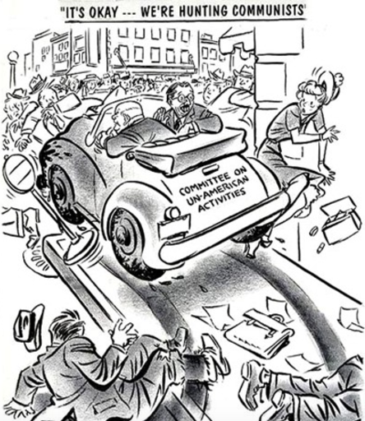
Notes:
“During HUAC hearings, the defendants were denied the protection of the First and Fifth Amendments, which enshrine the right to free speech and protection against self-incrimination respectively.” (Aziz, 173)
“Those defendants who refused to cooperate with Congress or Senate committees by invoking the Fifth Amendment were still considered guilty and labeled ‘Fifth Amendment Communists’.” (Aziz, 174)

Slide 12
Notes:
“Miller dramatizes this practice of confessing, accusing, and sacrificing others to save one’s own life in The Crucible. John Proctor exposes the processes at play in such trials when he condemns Reverend Hale’s bigoted reliance on the confessions and testimonies of the accused: ‘And why not, if they must hang for denyin’ it? There are them that will swear to anything before they’ll hang; have you never thought of that?’40” (Aziz, 174)

Slide 13
Notes:
“the judges and the ministers in Salem who persecuted the people were under the impression that they were defending God’s holy law against an attack from the Devil’s mercenaries in occult forms. They were thus able to execute any deviant without impunity.
Likewise, McCarthy and his associates launched a national purification initiative in the 1950s against Communist spies, leading Miller to observe, as noted earlier, that the state had by now replaced God. The state could now freely suppress people’s liberties through stringent congressional statutes and the politics of legislation that gave their investigations a constitutional cover.46 The Alien Registration Act or Smith Act (1940), the Magnuson Act (1950), the McCarran Internal Security Act (1950), the McCarran- Walter Act (1952), and the Communist Con- trol Act (1954) were part of the legislative process that contributed to the fully-fledged anti-Communist rage in the country.47” (Aziz, 174)

Slide 14
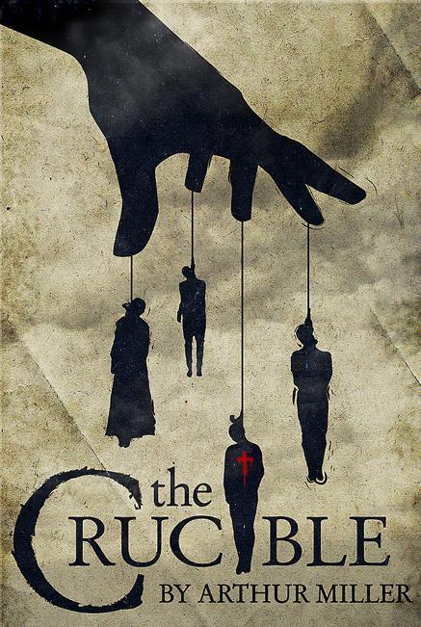
“But what could a play achieve in the face of such a massive spectacle?” (Aziz, 175)
Notes:
“Against the backdrop of right-wing supremacy, The Crucible acted as a conscious and purposeful theatrical response to the spectacular operations of McCarthy and his men.” (Aziz, 175)

Slide 15
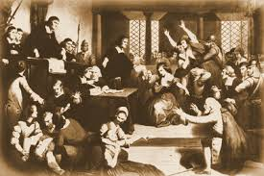
The theatrical form of ritual and the element of public confession
But gradually, over weeks, a living connection between myself and Salem, and between Salem and Washington, was made in my mind – for whatever else they might be, I saw that the hearings in Washington were profoundly and even avowedly ritualistic. After all, in almost every case the Committee knew in advance what they wanted the witness to give them: the names of his comrades in the Party. The FBI had long since infiltrated the Party, and informers had long ago identified the participants in various meetings. The main point of the hearings, precisely as in seventeenth-century Salem, was that the accused make public confession, damn his confederates as well as his Devil master, and guarantee his sterling new allegiance by breaking disgusting old vows – whereupon he was let loose to rejoin the society of extremely decent people. In other words, the same spiritual nugget lay folded within both procedures – an act of contrition done not in solemn privacy but out in the public air. (Miller, Timebends, p. 331, cited in Aziz, 175)

Slide 16
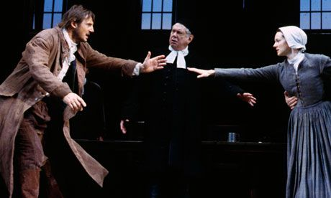
John Proctor – Miller’s mouthpiece
‘If she is innocent! Why do you never wonder if Parris be innocent, or Abigail? Is the accuser always holy now? Were they born this morning as clean as God’s fingers?’
-John Proctor to Reverend Hale, Act Two
Notes:
In many ways, John Proctor acts as Miller’s mouthpiece, condemning the spectacle. In Act Two, he vociferously marks his position vis-à-vis the accusers in the village when he asks Reverend Hale: ‘If she is innocent! Why do you never wonder if Parris be innocent, or Abigail? Is the accuser always holy now? Were they born this morning as clean as God’s fingers?’ Miller is here also questioning the legitimacy of the congressional committees and their summary trials in the 1950s.

Slide 17
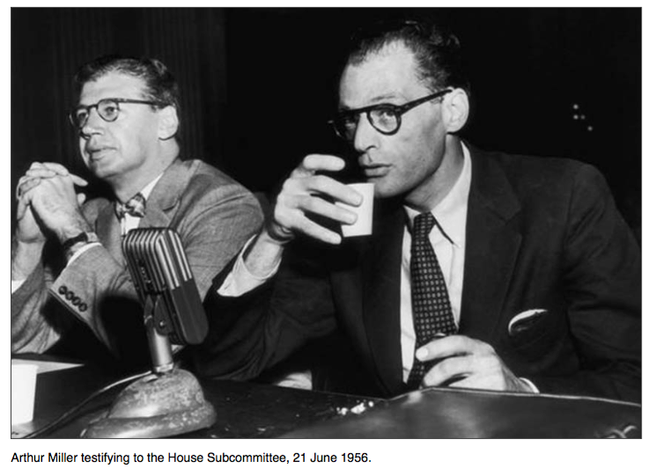
Miller and HUAC
Miller was asked for names of writers at meeting of Communist authors in NYC, 1947.
Notes:
“Miller faced this brutality himself on 21 June 1956, when the House Un-American Activi- ties Committee subpoenaed him, two years after he had tried to renew his passport in order to travel to Belgium to attend a pro- duction of The Crucible. His application was turned down on account of his so-called support of global Communist activities that could undermine and endanger American national security” (Aziz, 176).
“he did express regret about having been a Communist sympathizer in the past, having witnessed the Soviet leadership’s persecutions of their own citizens and intel- lectuals.55 But he refused to betray others. His defiance was such that he was charged with contempt of Congress and was forced to pay $40,000 in lawyer’s fees, a $500 fine, and he received a one-year suspended sentence.” (Aziz, 176)

Slide 18
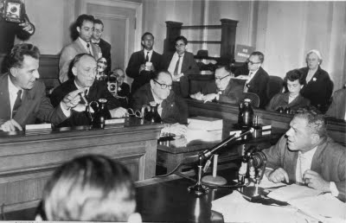
Mr. Arens: Can you tell us who was there when you walked into the room?
Mr. Miller: Mr. Chairman, I understand the philosophy behind this question and I want you to understand mine. When I say this, I want you to understand that I am not protecting the Communists or the Communist Party. I am trying to, and I will, protect my sense of myself. I could not use the name of another person and bring trouble on him. These are writers, poets, as far as I could see, and the life of a writer, despite what it sometimes seems, is pretty tough. I wouldn’t make it any tougher for anybody. I ask you not to ask me that question. . . .
Mr. Jackson: May I say that moral scruples, however laudable, do not constitute legal reason for refusing to answer the question. . . .
Mr. Scherer: We do not accept the reason you gave for refusing to answer the question, and . . . if you do not answer . . . you are placing yourself in contempt.
Mr. Miller: All I can say, sir, is that my conscience will not permit me to use the name of another person.
Excerpted in James F. Childress, ‘Appeals to Conscience’, Ethics, LXXXIX, No. 4 (1979), p. 316–17.
Notes:
Image: HUAC hearing May 6, 1953
Richard Arens, Donald L. Jackson, and Gordon H. Scherer
“The theatrical aspect of the McCarthy hearings thus lay in the fact that the accused were supposed to produce confessions, name their past affiliates, and vow to have renewed pacts of allegiance to the state and its official ideas through a public expression of remorse. Those who did so were amicably granted the status of decent citizen, whereas the dissidents, in line with the Salem Witch trials, were subjected to persecution and public vilification.” (Aziz, 177)
In the HUAC hearings “American society became hostage to the Red Scare, fabricated through public trials, enforced confessions, and televised displays of people’s alleged betrayal of, and disloyalty, to the official national creeds.” (Aziz, 178)

Slide 19
I have wondered if one of the reasons the play continues like this is its symbolic unleashing of the specter of order’s fragility. When certainties evaporate with each dawn, the unknowable is always around the corner. We know how much depends on mere trust and good faith and a certain respect for the human person, and how easily breached these are. And we know as well how close to the edge we live and how weak we really are and how quickly swept by fear the mass of us can become when our panic button is pushed. It is also, I suppose, that the play reaffirms the ultimate power of courage and clarity of mind whose ultimate fruit is liberty.
ARTHUR MILLER, “Again They Drink From the Cup of Suspicion,” NYT, November 26, 1989

Slide 20
With amazing speed McCarthy was convincing a lot of not unintelligent people that the incredible was really true, and that, say, General of the Army George Catlett Marshal was a Communist sympathizer, or that Senator Millard E. Tydings of Maryland was a buddy of Earl Browder, head of the American Communist Party. (A photo of both of them standing happily together would only much later be proved to have been a fake manufactured by Roy Cohn, McCarthy's right-hand bandido.) For a time it began to seem that Senator Joe was heading straight for the White House, the more so when the sheer incredibility of his claims appeared to be part proof that they were real; if the Communists were indeed hidden everywhere, it followed that they would certainly be found where common sense indicated they could not conceivably be.
The case being circular, it was finally all but unarguable. Worse yet, you could not rely on the too-trusting police, the naively legalistic courts or even the slow-moving F.B.I. to root out the conspiracy. As for the press, it was all but sold to Moscow, secretly, of course. Who then was absolutely reliable? McCarthy, naturally, and those who had his blessing.
This was colorful and fascinating stuff for the stage….
ARTHUR MILLER, “Again They Drink From the Cup of Suspicion,” NYT, November 26, 1989

Slide 21
Political movements are always trying to position themselves as shields against the unknown - vote for me and you're safe. The difference during witch hunts is that you are being made safe from a malign, debauched, evil, irreligious, wife-swapping, deceitful, immoral, stinking conspiracy stemming from the very bowels of hell. In Wisconsin in the early 50's, a reporter went door to door asking residents if they agreed with certain propositions, 10 in number, and discovered that very few people did, and that most thought the first 10 amendments to the United States Constitution, unnamed of course in the inquiry, were Communistic. To propose that we should be free to express any idea at all was frightening to a lot of people.

Slide 22
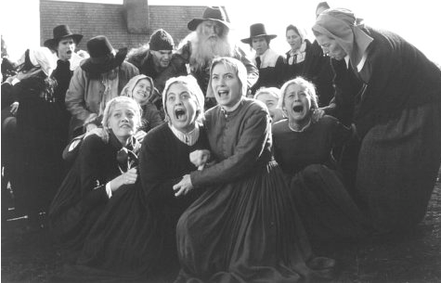
Gender and The Crucible

