Slide 1
Brian Eno
Notes:
To begin with, he’s a man of paradoxes.
A composer who never matered an instrument
Obstinate rebel, but obsessed with systems
Ambient music, also a rock star?

Slide 2
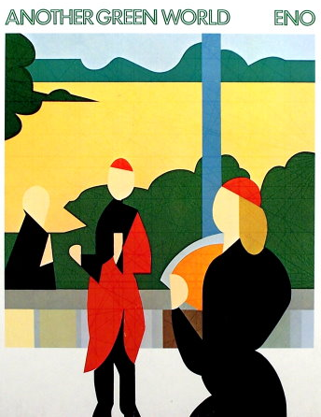
The Big Ship (3:02)
Another Green World (1975)

Slide 3
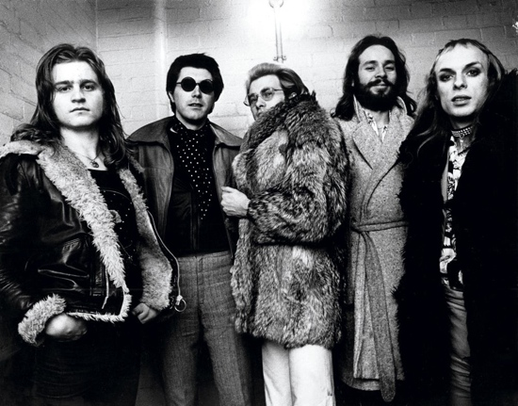
Influences
Art School
Minimalism
From playing the synthesizer to “playing the studio”
Roxy Music, London, 1972
Notes:
The Studio as an instrument, or generative
Process not product
Possibility and chance, but not free-form

Slide 4
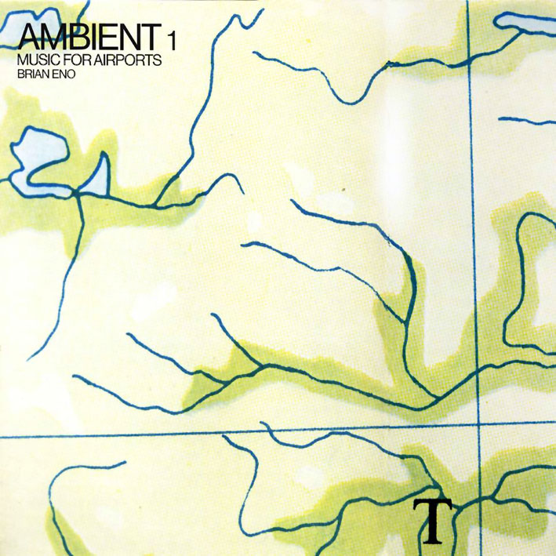
Excerpt from 1/1 (17:21)
Ambient 1: Music for Airports (1978)
Notes:
What can you remember?
A created space?
Peaceful, hypnotic, meditation

Slide 5
Ambient Music
“Well, for me, it was something to do with stillness and non-chaoticness—some sort of belonging… It was the sense of wanting to make something that felt like it had a place in the world, rather than something that you just kind of stuck on for a little while to see how it works.”

Slide 6
The Shutov Assembly (1992)
Stedelijk (5:29)

Slide 7
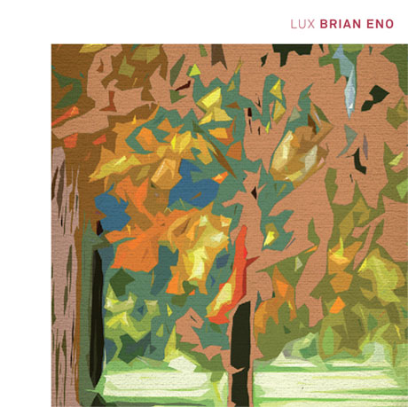
Excerpt from Lux 3
Lux (2012)
Notes:
Gallery in the palace of Venaria in Turin

Slide 8
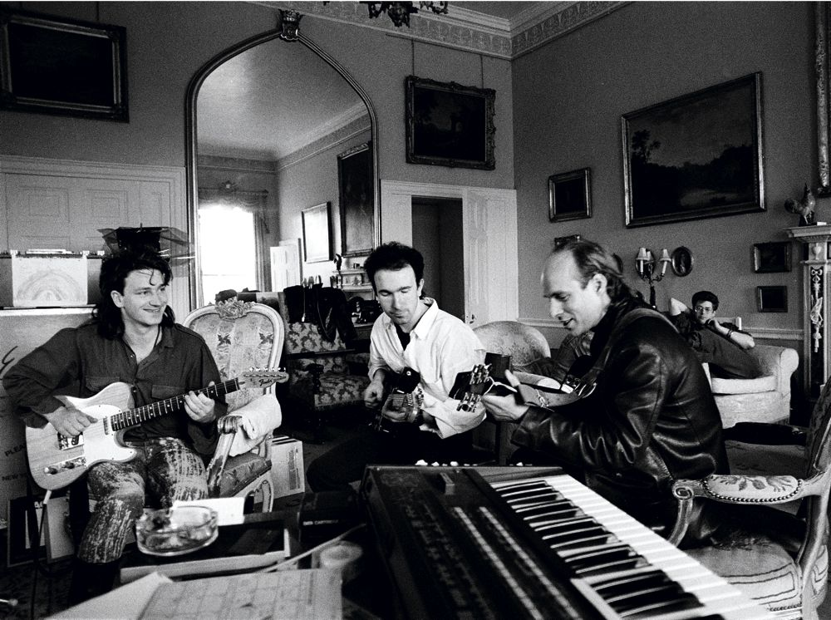
Influencees
British Pop/Rock
No Wave
(NYC, late 1970s)
Electronic music
Everybody?
Bono, The Edge, and Eno, 1984.
Notes:
Changes the language of music

