Slide 1
Socialist Realism
A combination of realism and socialist romanticism
Product of revolutionary fervor and optimism; independence and change of regime possible.
Dissemination of revolutionary ideas and is strongly associated with Marxist ideology.
Writers in the “socialist realist” vein “conceived of the development of society in terms of a battle for the future through revolutionary class struggle, in which the writer, under the guidance of the party, becomes the artist in uniform. So he is obliged to portray what is positive and reveal and condemn the imperfections that hinder the forward march of society.”
Begins to fade in the 1960’s as it falls out of fashion as a new, more nuanced – and often contradictory - sensibility develops that is “more faithful to the complex and changing realities of the Arab world.”
Sabry Hafez, “The Modern Arabic Short Story” in Modern Arabic Literature ed. M.M. Badawi, p. 299-301.
As a literary ideology, it has very clear limits and is not taken very seriously by readers and critics alike. However, it still has its proponents….

Slide 2
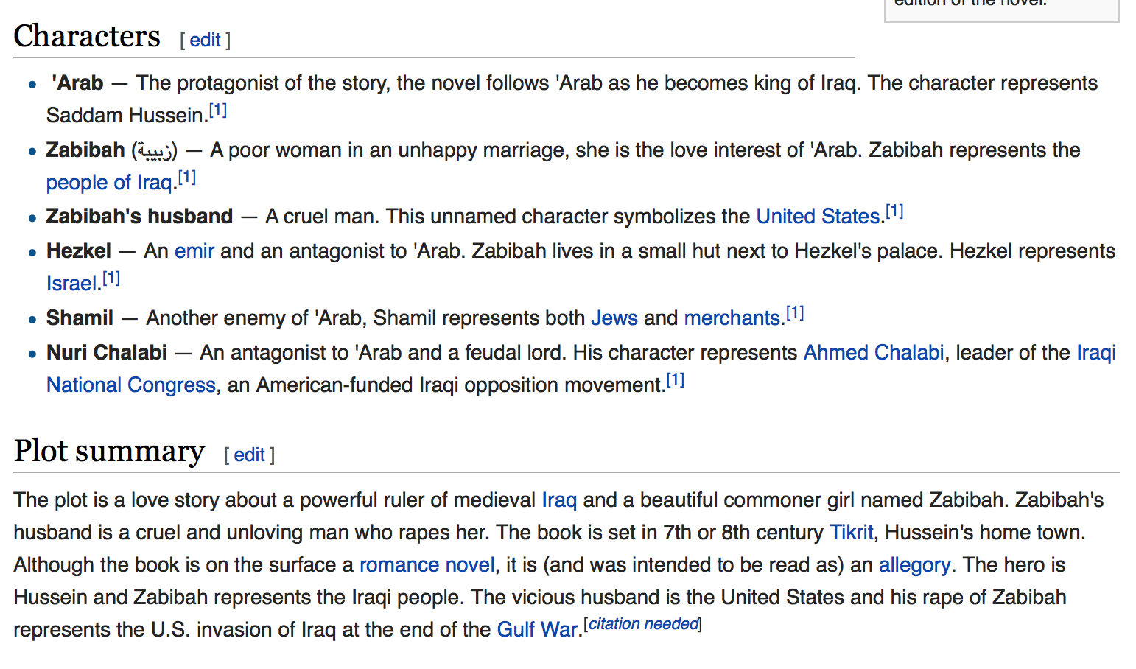
Zabiba and the King (2000) by Saddam Hussein (?)

