Slide 1
Leila Abouzeid’s Year of the Elephant:
Allegory or Autobiography or Something Else Entirely?

Slide 2
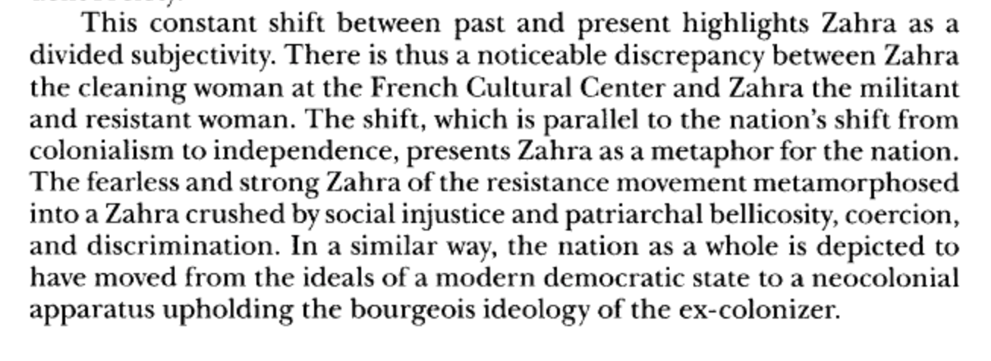
“Woman” as a national allegory?
from Salah Moukhlis, “A History of Hopes Postponed: Women’s Identity and the Postcolonial State in ‘Year of the Elephant’, Research in African Literatures, vol. 34 no. 3 (Autumn 2003), p. 71
What do you make of this idea? Can it be applied to Hamida from Midaq Alley with any success?

Slide 3
What do you believe to be the relationship of Leila Abouzeid to Zahra in Year of the Elephant?
The fallacy: Women novelists (esp. Arab women novelists) are equated with their female protagonists.
- psychoanalysis brought to bear in the interpretation of women’s writings
- imaginary prose interpreted as confessional autobiography
From Joseph Zeidan, Arab Women Novelists: The Formative Years and Beyond, (1992), p. 232:
“Even if women do prove their ability, there are still the problems of interpretation of their work and the belief that women should not write at all. Ghādah al-Sammān, for example, complains that her critics confuse her with her fictional characters, ‘they argue with me about the conduct of the heroines of my stories to the extent that I was once afraid of being jailed because one of my heroines had committed a crime!’”

Slide 4
Who is Leila Abouzeid?
“Leila Abouzeid, the first female Moroccan writer to be translated into English, is a trailblazer in that she writes in Arabic and not the French language preferred by her peers. She was born in 1950 and attended college in America before she began her career as a print and radio journalist, then segued into work as a press assistant in government ministries and the prime minister’s office. She is a former fellow of the World Press Institute in St. Paul, Minnesota.”
From http://arabwomenwriters.com/index.php/88-news/latest-news/316-100-most-powerful-arab-women-2011, accessed 10/13/2015
“For Abouzeid, English translation is not merely a means of international reception that circumvents French. It is also a device that forges a particular circuit of dialogue between America and the Arabic-literate world. The author entertains with America an intimate relationship that she developed while earning a degree in English at the University of Texas, Austin, and exposing herself to American literature. Abouzeid’s interest in introducing Arabic readers to the racial and religious complexities of American society and its points of intersection with the Arab world is most apparent in two titles: Malkum Iks, the author’s Arabic translation of Malcolm’s X’s autobiography with its exploration of the Nation of Islam in America, and Amrika: al-Wajh al-Akhar, which analyzes certain facets of the relations between America and Saudi Arabia. Abouzeid’s representation of America in Arabic texts ultimately returns to open a dialogue with American readers when Kamel Abdelmalek includes a translated excerpt of Amrika: al-Wajh al-Akhar in his anthology America in an Arab Mirror.”
From Marie-Therese Ellis-House, “Transcending the Nation and the Francophone Postcolonial: Abouzeid’s vectors of global reception for Moroccan Arabic literature” in International Journal of Francophone Studies, vol. 14 no. 4 (2011): pp. 460-61.

