Slide 1
Defining Social Class
Kendall, Framing Class (2011)
Michael Zweig, The Working-Class Majority (2000)

Slide 2
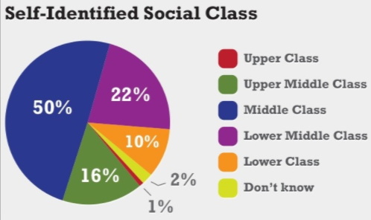
https://uncgbls.wordpress.com/2015/01/26/the-madness-of-the-middle-class/, accessed 2-13-19.
Notes:
“After all, most everybody wants to be middle class, it seems. And most people consider themselves middle class, regardless of the criteria used or the evidence to support it. So it makes sense for politicians and the media to fawn all over this group, since even those who might not be middle class still consider themselves as such.” (https://uncgbls.wordpress.com/2015/01/26/the-madness-of-the-middle-class/, accessed 2-13-19).

Slide 3
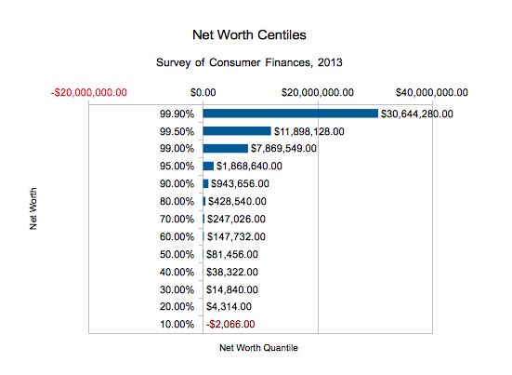
https://dqydj.com/net-worth-in-the-united-states-zooming-in-on-the-top-centiles/, accessed 2/15/17
Notes:
https://dqydj.com/net-worth-in-the-united-states-zooming-in-on-the-top-centiles/

Slide 4
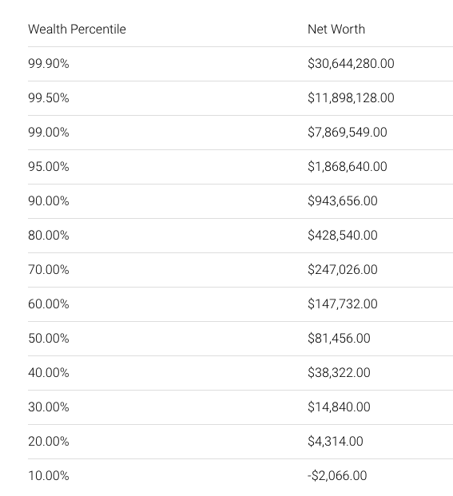
https://dqydj.com/net-worth-in-the-united-states-zooming-in-on-the-top-centiles/, accessed 2/15/17
Notes:
All numbers calculated from 2013 Survey of Consumer Finances microdata.

Slide 5
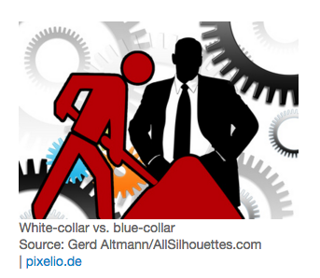
The meaning of social class in the United States is contested; various scholars value factors such as income, status, lifestyle, and occupation differently.
Notes:
What factors do you think are the most important in defining social class? What factors differentiate various groups such as the “ruling class,’ the “middle class,” the “working class,” and the “poor/underclass”?

Slide 6
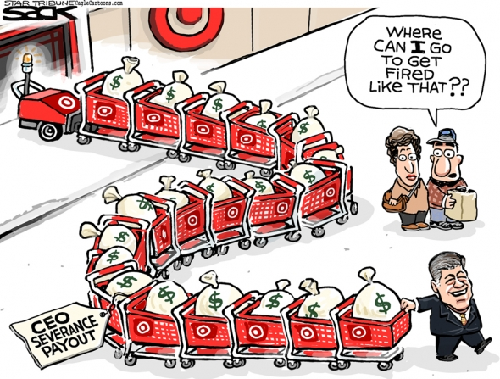
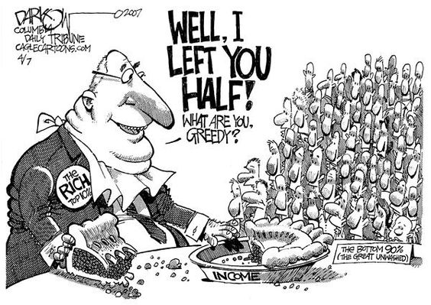
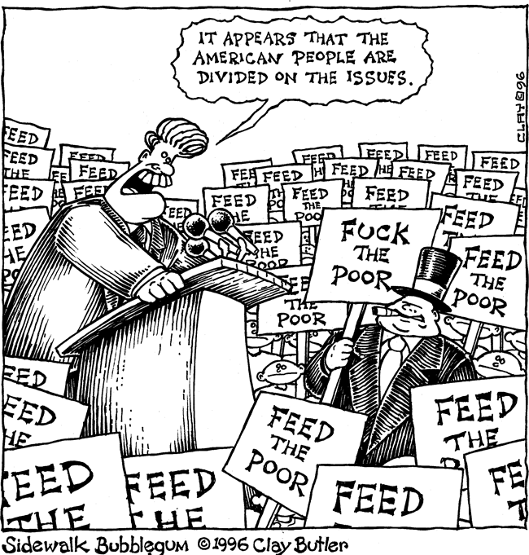

Slide 7
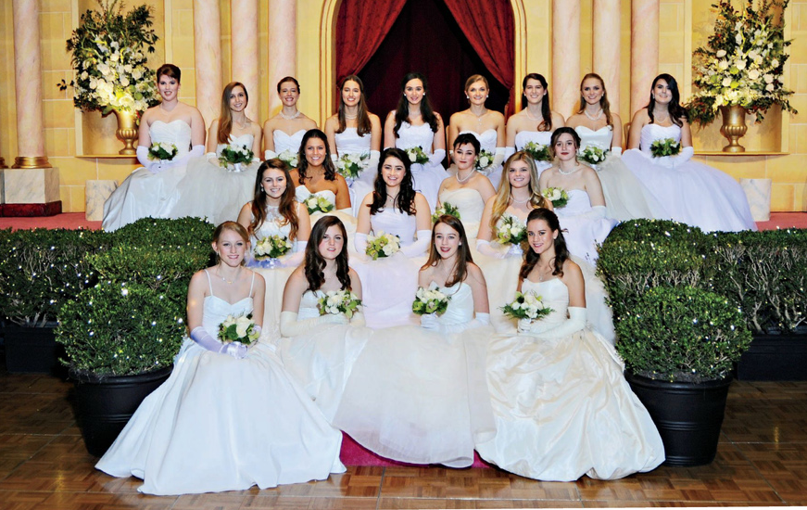
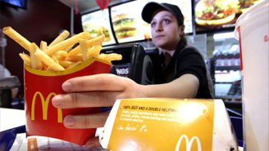
What is class?
Income?
Status?
Lifestyle?
“Class is about the power some people have over the lives of others, and the powerlessness most people experience as a result.”
(Michael Zweig, The Working-Class Majority 13)
Nobhill Gazette, Feb. 2017
http://thinkprogress.org/economy/2013/07/15/2300321/mcdonalds-buget-low-wage/

Slide 8
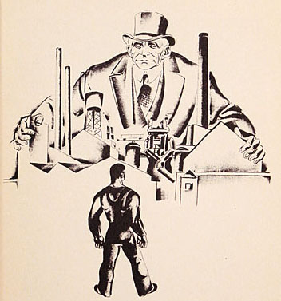
Social Class as Process
“Classes are not isolated and self-contained. What class we are in depends upon the role we play, as it relates to what others do, in the complicated process in which goods and services are made.“ (Zweig, 13)
Capitalist class: “those who own and operate the major corporations.” (Zweig, 14)
http://tx.cpusa.org/school/abcs/classx.htm
Notes:
owning the businesses, they have the money and social status, and, with these, power to influence the political and cultural life of the country. Their influence tends to define everyone's opportunities and limits according to what will be good for capitalists, what will continue, broaden, and deepen their power. Sometimes this power is visible; when it is not, it just is, baked in the cake. (Zweig, 14)
Capitalist class = the class with whom workers are most directly engaged. (14)
it makes sense to distinguish between big and small capitalists, to recognize the difference in power they have over their workers, in the market and in the political arena. Ross Perot and David Rockefeller don't belong in the same class as the guy who has a small plumbing business and employs an occasional helper when work is steady. 14

Slide 9
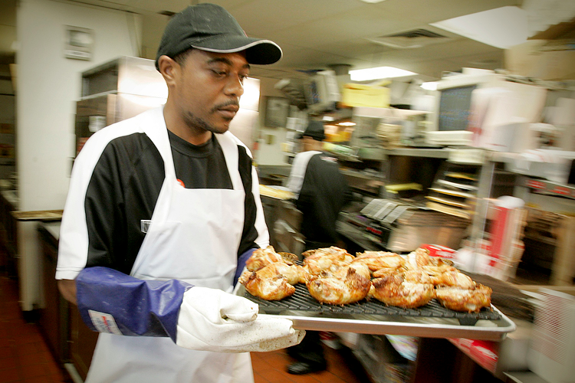
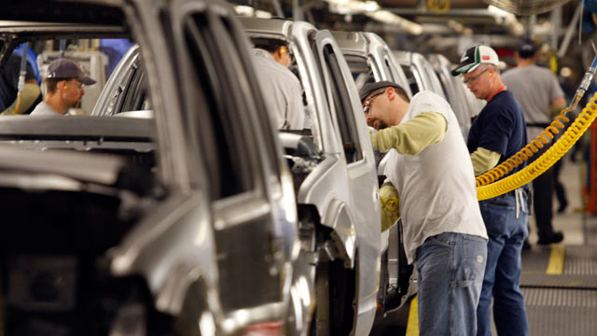
Have “the relative decline of manufacturing and the tremendous growth of service industries … changed the basic facts of life in capitalist society”? (Zweig, 12)
Notes:
The relative decline of blue-collar factory employment and the rise of white-collar service jobs is supposed to show that the working class is history. The fact that we no longer see pitched battles between masses of workers and squads of armed goons hired by the company to kill the union organizers is taken as proof that class struggle is over, that we've outgrown that sordid past. In short, the conventional wisdom is that post-industrial society is not industrial society.

Slide 10
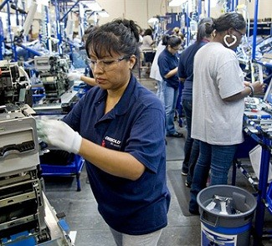
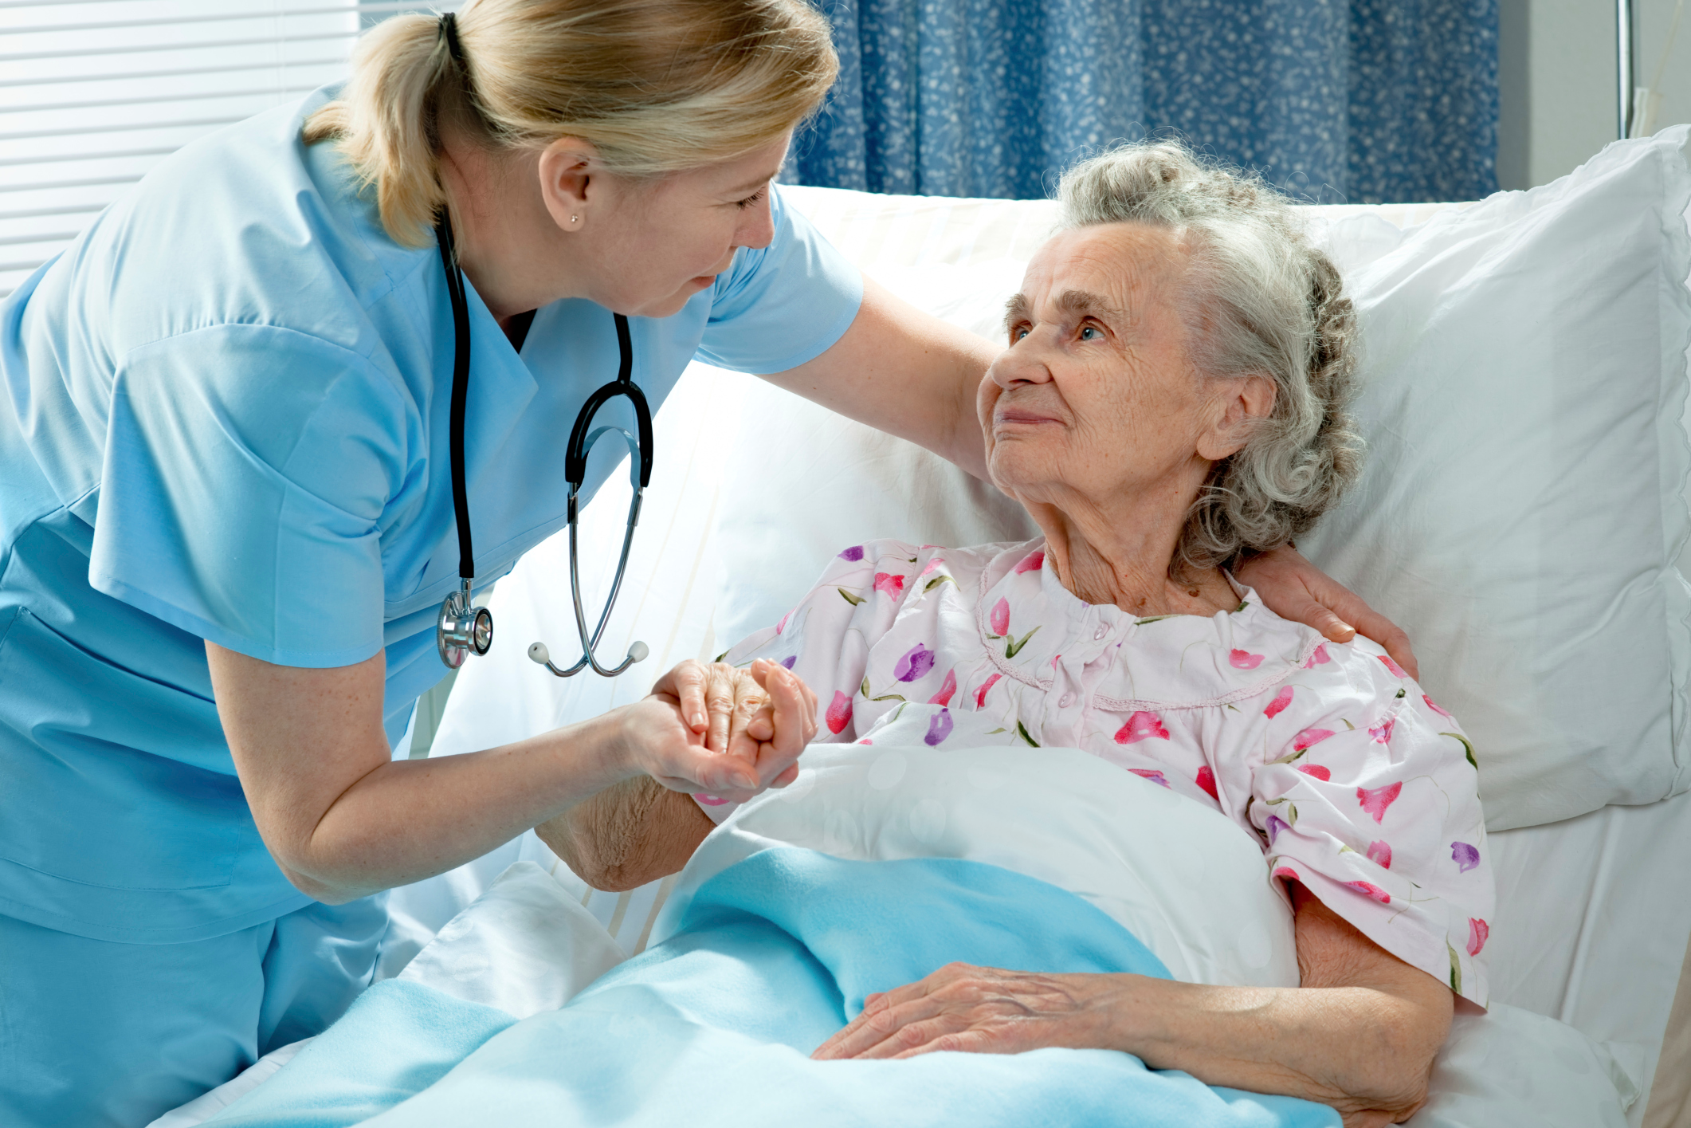
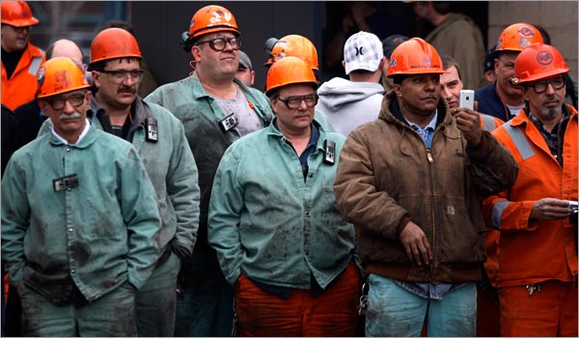
Working Class
http://www.houstontomorrow.org/livability/story/working-class-shrinking-in-america/
http://www.stylepinner.com/nurses-aide-videos/bnVyc2VzLWFpZGUtdmlkZW9z/
http://www.nytimes.com/2008/04/20/weekinreview/20uchitelle.html
Notes:
To be in the working class is to be in a place of relative vulnerability -- on the job, in the market, in politics and culture. On the job, most workers have little control over the pace and content of their work. They show up, a supervisor shows them the job, and they do it. The job may be skilled or unskilled, white collar or blue collar, in any one of thousands of occupations. Whatever the particulars, most jobs share a basic powerlessness in relation to the authority of the owner and the owner's representatives who are there to supervise and control the workforce. (Zweig, 14)

Slide 11
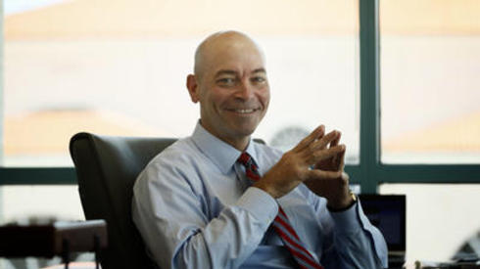
Middle Class
Notes:
Capitalists and workers are not the only classes in America. There is also a middle class, made up of professional people, supervisors and managers, and small business owners. We will see that it makes sense to put some people who are technically capitalists, those who own small businesses, into the middle class rather than the capitalist class, because of the very real differences in power that separate large and small business. (Zweig, 15)

Slide 12
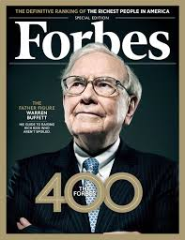
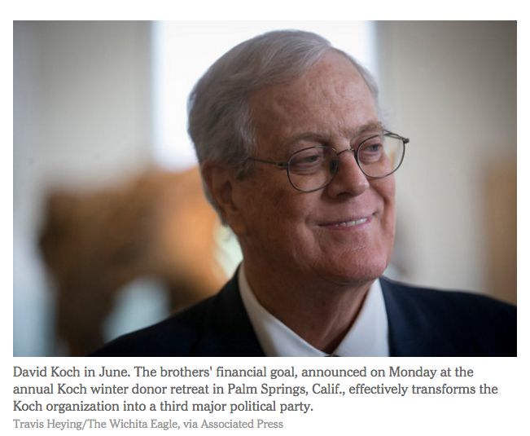
The Ruling Class
http://www.nytimes.com/2015/01/27/us/politics/kochs-plan-to-spend-900-million-on-2016-campaign.html
http://blog.ourcrowd.com/wp-content/uploads/2015/01/forbes-400-cover-092313-warren-buffett.jpg
Notes:
The entire U.S. ruling class could easily be seated in Yankee Stadium, which holds 57,000 people.
We can identify 200,000 or so individuals who together constitute the governing boards of national-scale corporations. They are the ``captains of industry'' who dominate the U.S. economy, the two-tenths of one percent of the private sector workforce who are the core of the capitalist class. From among these directors, a few tens of thousands sit on two or more boards and form a pattern of interlocking directorships among the major banks and non-financial corporations. This network, together with the top-level political and cultural leaders aligned with it, can fairly be called the ``ruling class.’’ (Zweig, 15)

Slide 13
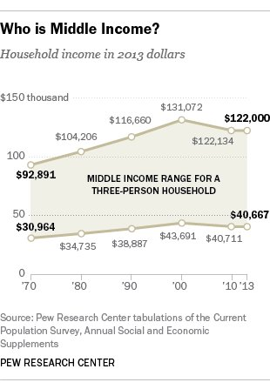
The Middle Class
“The middle class'' is under constant discussion in American political life.... Politicians appeal to the middle class. Tax cuts are designed for the middle class. Downsizing afflicts the middle class. Even union leaders almost always refer to their members as middle class. Most people think of the middle class in terms of income and lifestyle. In short, the middle class has a middling income. Its members are not the rich, who are a fringe group of celebrities and business millionaires; nor are they the poor, the fringe at the bottom of society who are chronically unemployed, on welfare, outside the mainstream, ``the underclass.'' The middle class are those people who, in Bill Clinton's phrase, ``work hard and play by the rules,'' going to work every day just to get by.” (Zweig, 15)
Why do so many people self-identify as “middle class”?
Notes:
Zweig asks, What is the middle class in the middle of? 15
Zweig uses the example of the family doctor: What that has actually meant is the penetration of big business and capitalist methods into the medical work process, in the doctor's office as well as the hospital. Under this regime, doctors are increasingly being changed into -- many would say, ``reduced to' -- employees, more like skilled craftsmen, less like independent agents. In response, some doctors are turning to unions for protection. To some extent they are concerned about their incomes. But in most of these unionization efforts, the real spur driving doctors to unions is the question of power and autonomy in their work life. 15-16
Some teachers, social workers, and other professionals I place in the middle class already think of themselves as workers. Others resist any association with people who are not professional and identify more closely with the capitalist class in their values and political leanings. In politics, as in economics, people in the middle class are in the middle, more or less strongly identifying themselves with labor or with capital, depending on their particular situation and depending on the relative power of working class movements compared with the power capitalists can demonstrate. 16

Slide 14
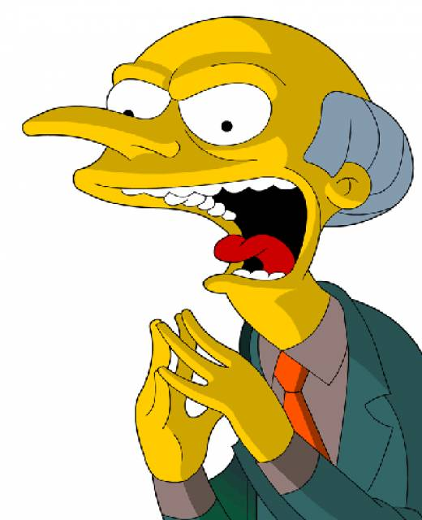
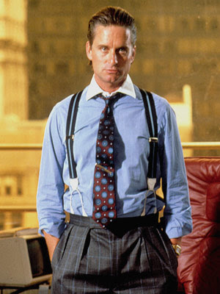
Framing Wealth
The consensus frame: the wealthy are like everyone else.
The admiration frame: the wealthy are generous and caring people.
The emulation frame: the wealthy personify the American Dream.
The price-tag frame: the wealthy believe in the gospel of materialism.
The sour-grapes frame: the wealthy are unhappy and dysfunctional.
The bad-apple frame: some wealthy people are scoundrels. (Kendall, 29)
Notes:
Which of these frames is evident in the Keeping Up with the Kardashians episode for today?

Slide 15
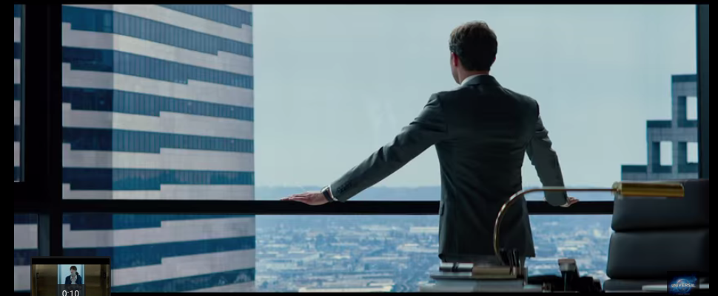
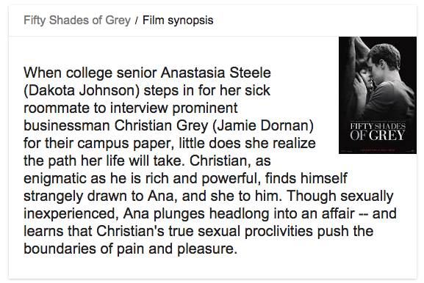
https://www.google.com/webhp?sourceid=chrome-instant&ion=1&espv=2&ie=UTF-8#q=fifty+shades+of+grey+summary
Notes:
If we look at the class structure of the United States, then, we see that neither the working nor the middle class is uniform in gender, racial, or ethnic composition. Each class presents a mosaic. Looking at the mosaic another way, we see that gender, racial, and ethnic groups are also not uniform. Each is divided by class. This complex set of relationships and identities is what we have to sort through to make sense of and then influence the politics and economics of U.S. society.
Fifty Shades of Grey has topped best-seller lists around the world, selling over 125 million copies worldwide by June 2015. It has been translated into 52 languages, and set a record in the United Kingdom as the fastest-selling paperback of all time.
Classes are formed in the dynamics of power and wealth creation and are by their nature a bit messy. Classes are more complicated, more interesting, and more real than the arbitrary income levels used to define class in the conventional wisdom.

Slide 16
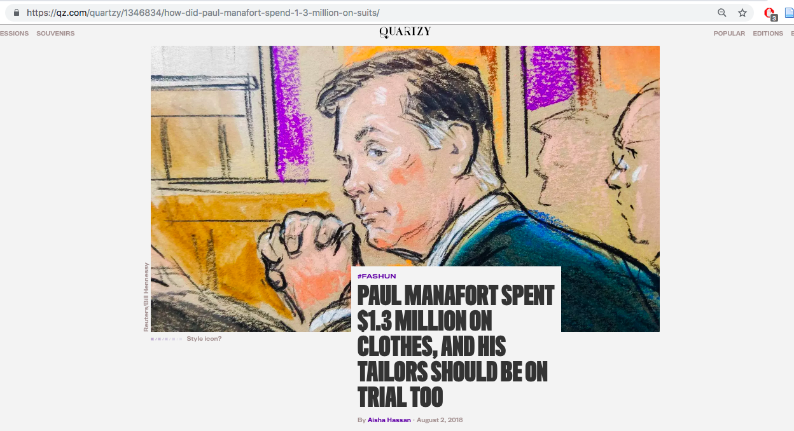
https://qz.com/quartzy/1346834/how-did-paul-manafort-spend-1-3-million-on-suits/, accessed 2-13-19)
Notes:
“The jury and public has been told of some massive shopping sprees during the trial. Ronald Wall, the CFO of House of Bijan, a Beverly Hills boutique that sells “wearable art” and calls itself “the world’s most expensive store,” testified Wednesday that Manafort spent $334,000 there over two years. Luxury menswear seller Maximillian Katzman told the jury that Manafort paid upwards of $929,000 at the now-closed Alan Couture between 2010 and 2014, mostly for suits.”

Slide 17
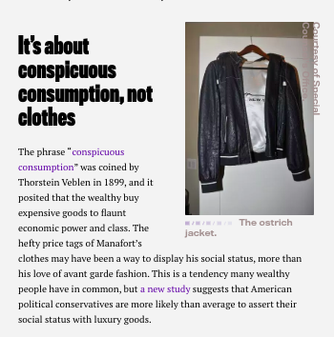
https://qz.com/quartzy/1346834/how-did-paul-manafort-spend-1-3-million-on-suits/, accessed 2-13-19.

Slide 18
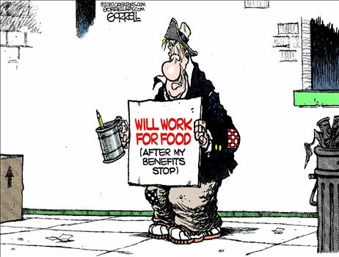
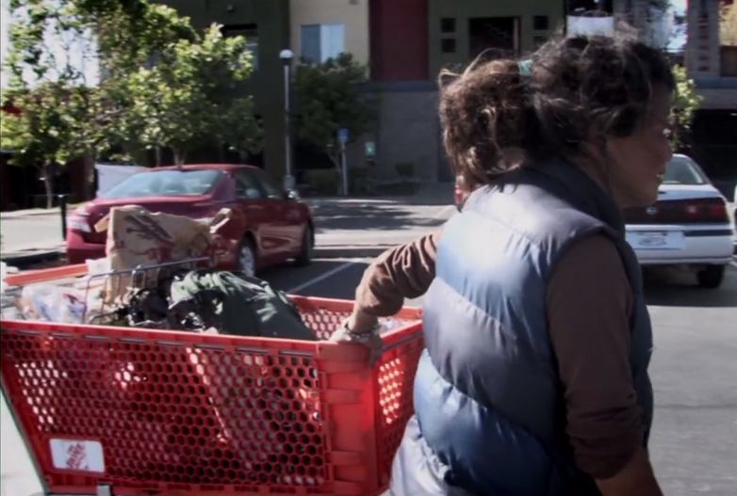
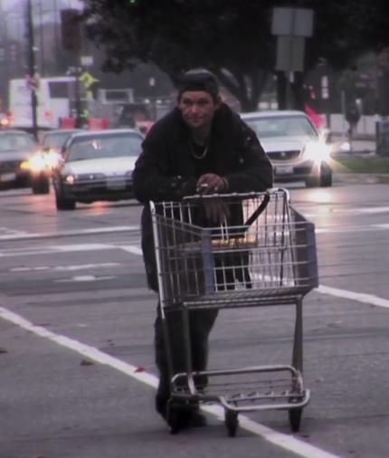
Framing Poverty
Thematic framing
Episodic framing:
Sympathetic
Negative image-framing
Dogtown Redemption (2015) https://vimeo.com/138927139
Notes:
“The impoverished most likely to receive sympathetic media portrayal are children, the elderly, and the chronically ill” (Kendall, 95)
Negative image=framing: dependency and deviance
“Two topics that frequently form the subject of such framing are welfare programs and homelessness” (Kendall, 99)

Slide 19
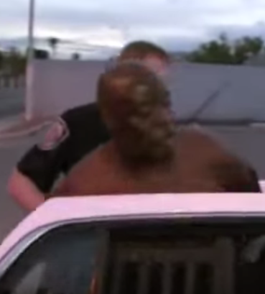
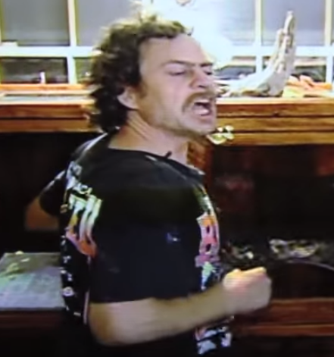
COPS
How far can the boundaries be pushed when two people of different social classes come into contact with each other?
Notes:
Did the officer abuse his power?
Do the consequences of abuse of power by the more powerful classes trickle down to the lower classes?

Slide 20
More questions
What is your favorite television show? Is it consistent with Diana Kendall's analysis of the media framing of social class?
Does Kendall's discussion of consumerism remind you of any of your own recent purchases?
Do you think your view of social class has been influenced by the media as much as Kendall would argue?

