Slide 1
THE HANDMAID’S TALE AND THE PORNOGRAPHY DEBATES
Robin Morgan, “Theory and Practice: Pornography and Rape” (1974)
Ann Snitow, “Retrenchment vs. Transformation” (1983)
Margaret Atwood, The Handmaid’s Tale (1985), IX-XII, 143-255.

Slide 2
Pornography in The handmaid’s tale
Sometimes the movie she showed would be an old porno film, from the seventies or eighties. Women kneeling, sucking penises or guns, women tied up or chained or with dog collars around their necks, women hanging from trees, or upside-down, naked, with their legs held apart, women being raped, beaten up, killed. Once we had to watch a woman being slowly cut into pieces, her fingers and breasts snipped off with garden shears, her stomach slit open and her intestines pulled out.
Consider the alternatives, said Aunt Lydia. You see what things used to be like? That was what they thought of women, then. Her voice trembled with indignation.
Moira said later that it wasn’t real, it was done with models; but it was hard to tell. (III, Ch. 7, 118)
Notes:
What counts as pornographic depends on context..

Slide 3
Antipornogaphy and the abrogration of civil liberties
The Pornomarts were shut, though, and there were no longer any Feels on Wheels vans and Bun-Dle Buggies circling the Square. But I wasn’t sad to see them go. We all knew what a nuisance they’d been.
It’s high time somebody did something, said the woman behind the counter, at the store where I usually bought my cigarettes. It was on the corner, a newsstand chain: papers, candy, cigarettes. The woman was older, with grey hair; my mother’s generation. Did they just close them, or what? I asked.
She shrugged. Who knows, who cares, she said. Maybe they just moved them off somewhere else. . . She punched my Compunumber into the till, barely looking at it: I was a regular, by then. People were complaining, she said. (X, Ch. 28, 174)
Notes:
Broader context for this quote --

Slide 4
Obscenity as resistance
What we're aiming for, says Aunt Lydia, is a spirit of camaraderie among women. . . Camaraderie, shit, says Moira through the hole in the toilet cubicle. Right fucking on, Aunt Lydia, as they used to say. How much you want a bet she's got Janine down on her knees? What you thing they get up to in that office of hers? I bet she's got her working away on that dried-up old withered--.
Moira! I say.
Moira what? She whispers. You know you've thought it.
It doesn't do any good to talk like that, I say, feeling nevertheless the impulse to giggle.
But I still pretended to myself, then, that we should try to preserve something resembling dignity.
You were always a wimp, Moira says, but with affection. It does so do good. It does.
And she's right, I know now, as I kneel on the undeniably hard floor, listening to the ceremony drone on. There is something powerful in the whispering of obscenities, about those in power. There's something delightful about it, something naughty, secretive, forbidden, thrilling. It's like a spell, of sorts. It deflates them, reduces them to the common denominator where they can be dealt with. In the paint of the washroom cubicle someone unknown had scratched Aunt Lydia sucks. It was like a flag waved from a hilltop in rebellion. There idea of Aunt Lydia doing such a thing was in itself heartening. (XII, Ch. 34, 222)

Slide 5
What counts as pornographic?
Some of them have on outfits like mine, feathers and glister, cut high up on the thighs, low over the breasts. Some are in olden-days lingerie, shortie nightgowns, baby-doll pajamas, the occasional see-through neligee. Some are in bathing suits, one piece or bikini… Some are in jogging shorts and sun halters, some in exercise costumes like they ones they used to show on television, body-tight, with knitted pastel leg warmers. There are even a few in cheerleaders’ outfits, little pleated skirts, outsized letters across the chest. I guess they’ve had to fall back on a mélange, whatever they could scrounge or salvage. (XII, Ch. 37, 235)

Slide 6
WOMEN AGAINST PORNOGRAPHY
“[P]ornography is central in creating and maintaining the civil inequality of the sexes.”
Andrea Dworkin and Catherine MacKinnon
Notes:
Dworkin-MacKinnon Antipornography Civil Rights Ordinance (1983)
It proposed to treat pornography as a violation of women's civil rights and to allow women harmed by pornography to seek damages through lawsuits in civil courts.

Slide 7
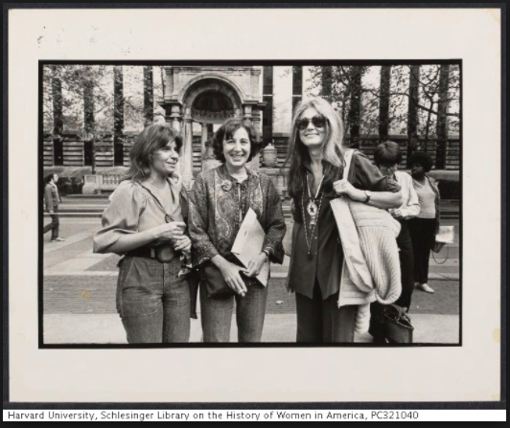
“[R]ape is the perfected act of male sexuality in a patriarchal culture—it is the ultimate metaphor for domination, violence, subjugation, and possession.”
Robin Morgan, “Theory and Practice: Pornography and Rape,” 134.
Robin Morgan, Susan Brownmiller, and Gloria Steinem at Women Against Pornography march
Notes:
Morgan’s expansive definition of rape (136) – is Atwood pushing back against this?
Pornography is sexist propaganda, no more, no less. (Morgan, 139)

Slide 8
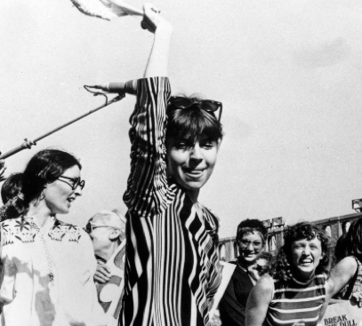
Notes:
139-140

Slide 9
How could it be that, in spite of the vitality of our movement, change was so much slower than we had hoped? The lively antipornography campaigns of this period [circa 1977] are one expression of a general discouragement among women, and among all progressive movements during this period of backlash. The terms the antipornography movement uses to described women’s condition betray a loss of heart about women’s ability to challenge men’s power directly.
(Snitow, 12)
Women Against Pornography (WAP) demonstrators march on Times Square, New York City, Getty Images.
Notes:
Snitow also states, “One reason… why the antipornography movement became a focus of feminist energy in the late ‘70s lies in its claim to explain the recalcitrance of the male power structure. (12)

Slide 10
The same people who want sex education removed from schools now join feminists in the fight against porn.
Ann Snitow, 15
"Pornography really should be defined as the degradation of women. Nearly all porn involves the use of women in subordinate, degrading poses for the sexual, exploitative, and even sadistic and violent pleasures of men.”
-Phyllis Schlafly
Notes:
This was in the early days of the feminist anti-porn movement, when legislative strategies against pornography were mere gleams in the eye of the feminist writer Andrea Dworkin, when it seemed possible to raise consciousness about pornography without arousing demands for censorship. That period of innocence did not last long. By 1981 the New Right had mounted a nationwide censorship campaign to purge schools and public libraries of sex education and other secular-humanist forms of "pornography." Sex education was "filth and perversion," Jerry Falwell announced in a fund-raising letter that included, under the label "Adults Only. Sexually Explicit Material," excerpts from a college health text. By the mid-1980s right-wing advocates of traditional family values had co-opted feminist anti-porn protests—or, at least, they'd co-opted feminist rhetoric. The feminist attorney and law professor Catharine MacKinnon characterized pornography as the active subordination of women, and Phyllis Schlafly wrote, "Pornography really should be defined as the degradation of women. Nearly all porn involves the use of women involves subordinate, degrading poses for the sexual, exploitative, and even sadistic and violent pleasures of men." Just like a feminist, Schlafly worried about how pornography might "affect a man who is already prone to violence against women." President Ronald Reagan deplored the link between pornography and violence against women. (Wendy Kaminer, https://www.theatlantic.com/magazine/archive/1992/11/feminists-against-the-first-amendment/305051/)

Slide 11
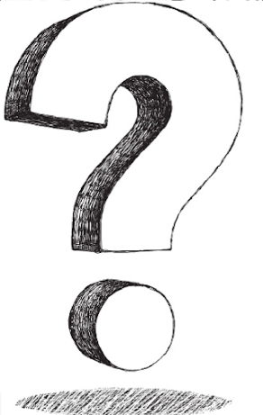
Robin Morgan and Ann Snitow take opposing positions in the second-wave feminist pornography debate. Which author do you find more persuasive, and why?
Notes:
Maya, Anthony

Slide 12
As feminists opposed to anti-porn legislation have pointed out, countries in which commercial pornography is illegal—Saudi Arabia, for example—are hardly safe havens for women.
Wendy Kaminer, “Feminists against the First Amendment,” The Atlantic, Nov. 1992
Notes:
Afghanistan about ten years after the publication of The Handmaid's Tale. Taliban views include:
A refusal to allow girls to be educated
Insistence on women being fully covered, including the face, by a head-to-toe veil or burqa
The imposition of brutal sentences, such as amputation and public stoning to death, for what are perceived as breaches of Sharia Law.
Echoes of the attitudes and methods of such fundamentalist groups can be seen in the strict dress codes imposed in Gilead and the public punishments and executions which Offred witnesses. She notes in chapter 42 that reading would be punished by having ‘only a hand cut off'.
Punishments such as flogging and amputation are still inflicted under Sharia law in Sudan and in Saudi Arabia, where currently women are not supposed to drive cars or to travel without being escorted by a male relative. Atwood's feminism makes her particularly hostile to such attitudes, which she observed at first hand in Afghanistan during her world tour in 1978. (http://crossref-it.info/textguide/The-Handmaid's-Tale/31/2090)

Slide 13
That’s it: she said we were going to feed the ducks.
But there were some women burning books, that’s what she was really there for. To see her friends; she’d lied to me, Saturdays were supposed to be my day. I turned away from her, sulking, towards the ducks, but the fire drew me back.
There were some men, too, among the women, and the books were magazines. They must have poured gasoline, because the flames shot high, and then they began dumping the magazines from boxes, not too many at a time. Some of them were chanting; onlookers gathered.
Their faces were happy, ecstatic almost. Fire can do that. Even my mother’s face, usually pale, thinnish, looked ruddy and cheerful, like a Christmas card; and there was another woman, large, with a soot smear down her cheek and an orange knitted cap, I remember her.
You want to throw one on, honey? She said. How old was I?
Good riddance to bad rubbish, she said, chuckling. It okay? She said to my mother.
If she wants to, my mother said; she had a way of talking about me to others as if I couldn’t hear.
The woman handed me one of the magazines. It has a pretty woman on it, with no clothes on, hanging from the ceiling by a chain wound around her hands. I looked at it with interest. It didn’t frighten me. I thought she was swinging, like Tarzan from a vine, on the TV.
Don’t let her see it, said my mother. Here, she said to me, toss it in, quick.
I threw the magazine into the flames. It riffled open in the wind of its burning; big flakes of paper came loose, sailed into the air, still on fire, parts of women’s bodies, turning to black ash, in the air, before my eyes. (38)

Slide 14
“If misogyny is everywhere, why target its sexual manifestation? … Why assume that the cordoning off of particular sexual images is likely to lessen women’s oppression? This overemphasis placed on sex as cause is continuous with the very old idea that sex is an especially shameful, disturbing, guilt provoking area of life. …We need to be able to reject the sexism in porn without having to reject the realm of pornographic sexual fantasy.” (Snitow)
Notes:
Rosie

Slide 15
“Porn cannot fully define the situation in which we find ourselves. It symbolizes some, but not all, of our experiences—with men, with sexuality, with culture. In the liberation struggles of the ‘60s, American radicals insisted that everything is connected: what was happening in Vietnam was connected to what was happening in imperialist America. In the analysis and rhetoric of the antipornography movement, this tendency is carried to a distorting extreme.”
Notes:
Molly

Slide 16
‘It’s impossible to say a thing exactly the way it was, because what you say can never be exact, you always have to leave something out, there are too many parts, sides, crosscurrents, nuances; too many gestures, which could mean this or that, too many shapes which can never be fully described, too many flavors, in the air or on the tongue, half-colors, too many. But if you happen to be a man, sometime in the future, and you’ve made it this far, please remember: you will never be subject to the temptation or feeling you must forgive, a man, as a woman. It’s difficult to resist, believe me. But remember that forgiveness too is a power. To beg for it is a power, and to withhold or bestow it is a power, perhaps the greatest.”
Notes:
Kira
This quote stood out to me as one of the most profound reflections from Offred throughout this section of the book. Not only does she reflect on the uncertainty of life and the events that have occurred, but she also looks to the future. Offred is clearly stuck in Gilead with no solace or comfort, she is abused and taken advantage of and yet still surmises enough empathy to feel for “men” in the future. She does not tell them to listen or to truly change, but simply to use their power of forgiveness. Forgiveness is a complex theme in this narrative, because quite frankly not much of it happens. The world is turned upside down for every person and despite there being a clear entity to blame, that entity (Commanders/puritans in charge) is not required to forgive or even feel any remorse. Instead, those who are to blame are rather celebrated and encouraged to continue their evil ways. Thus making forgiveness and the power to bestow or withhold it the greatest of powers. Who has the right/the power to forgive? This book twists our perception of power and privilege because of the intense class and work dynamics embedded into Gilead.
In addition to the theme of forgiveness, Offred also touches on the idea of temptation. She remarks that she personally understands the difficulty in resisting temptation, but also that in of itself is a great power as well. This passage does an impeccable job at weaving in the themes of the narrative and of Gilead (power, forgiveness, temptation, etc.) in with the reflections of Offred. She stands as the ultimate symbol of the changes and sufferings of society and has an innate way to reflect on the world around her. Offred’s insights humanize and help us to analyze the disgusting and off-putting events that occur in Gilead.

Slide 17
“Well. Then we had the irises…There is something subversive about this garden of Serena’s, a sense of buried things bursting upwards, wordlessly, into the light, as if to point, to say: Whatever is silenced will clamor to be heard, though silently…Goddesses are possible now and the air suffuses with desire.” (153-54)
Notes:
Vanessa
I trimmed down these two paragraphs describing the nature in Serena’s garden. I chose these paragraphs because of the connection between the natural world and the female. In describing nature vs. society, society is man-made, whereas nature is mystical and more ambiguous, similar to the stereotyped complexities of women. The strict society and government of Gilead is dominated by men and works to keep women contained and reproducing according to strict guidelines. Serena’s control over the garden emphasizes the female connection to the natural world. The air in the garden “suffuses with desire” and reflects the free sexuality present in the natural world. Serena is not granted that freedom in her normal life, but is granted free sovereignty in the garden, distinctly in connection to the abundant reproduction of the plants in the summertime. Although she is unable to reproduce herself, she can facilitate the growth of other forms of life in her garden.
Positioned as a counter to man-made society, the natural world is void of the rules and norms that oppress and abuse women in Gilead. In reading “The Handmaid’s Tale,” I have been continually looking for references to “The Scarlet Letter” (Nathaniel Hawthorne). In Hawthorne’s novel, Pearl, the daughter of an ostracized woman, finds happiness and freedom in the forest, away from her town’s scrutiny of her and her mother’s intensely inferior social position. The natural world acts as an oasis, a break from the overbearing expectations of man-made society. In the garden, Serena is granted a break from her role as a Wife. In the home, Serena has a role to fulfill. In the garden, she can make her own rules.
However, it is important to note that Serena’s access to the garden is directly granted from her elite social position as a Wife of a Commander. As well, the times she can access the natural world are undeniably regimented. Her access, therefore, is another form of privilege. This acknowledges the danger that mass accessibility to the natural world for women could have on their own perceptions of freedom and the social forms of oppression that keep them subjugated in Gilead.

Slide 18
“So. More waiting. Lady in waiting: that’s what they used to call those stores where you could buy maternity clothes. Woman in waiting sounds more like someone in a train station. Waiting is also a place: it is wherever you wait. For me it’s this room. I am a blank, here, between parentheses. Between other people.”
(pp. 227-228).
Notes:
Talia
This passage struck me because it reflects Offred’s self-awareness and it reconciles the relationship between women and waiting. Offred recalls how “Lady in waiting” used to refer to maternity stores; the lady in waiting was the soon-to-be mother. “To wait” means “to stay where one is or delay action until a particular time or until something else happens.” Interestingly, a pregnant woman, while she is waiting to give birth, is far from waiting for anything else; many biological changes are happening that ensure the growth and development of her fetus. It is significant that even before Gilhead, women were associated with waiting. Waiting seems to be a passive verb; one is passive, physically delaying and remaining stagnant until an action happens. This stillness implies first, that until women give birth, they engage in no substantial action. The act of giving birth, therefore, entitles women with action and movement; prior to giving birth, women are passive and insignificant. The second part of this passage also stuck out to me because it highlights how Offred again feels as though others define her, specifically the men she “waits” for as she is “between other people.” She refers to herself as “a blank here” thus associating herself with nothingness. Just as waiting is associated with contrasts action, blankness contrasts fullness. Offred feels passive, incapable of substantial action which is complemented by her bare, empty presence. To be blank is to be lifeless and desolate, lonely and dead.

Slide 19
The Handmaid’s Tale contains several references to pornography and the feminist antipornography movement in the time before Gilead was established. Based on one or more textual references, how do you think Atwood regards the pornography debate? Would her politics be closer to Morgan’s or Snitow’s, or is it hard to tell?
Notes:
Greyson

Slide 20
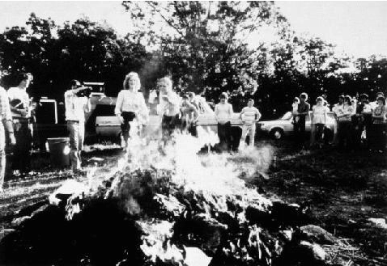
https://biblioklept.org/category/sci-fi/

Slide 21
PEN IS ENVY
(148)
THOUGHTS?
Notes:
pp. 186

Slide 22
Storytelling in The Handmaid’s Tale

Slide 23
What do you feel the historical notes at the book’s end add to the reading of this novel? What does the book’s last line mean to you?
Notes:
Jamison, Annemarie

Slide 24
The Handmaid’s Tale is a work of speculative fiction. In what ways does it reflect what is happening in the world today?
” If I was to create an imaginary garden I wanted the toads in it to be real. One of my rules was that I would not put any events into the book that had not already happened in what James Joyce called the ‘nightmare’ of history, nor any technology not already available. No imaginary gizmos, no imaginary laws, no imaginary atrocities. God is in the details, they say. So is the Devil.”
Notes:
Lucy, Norah, Eliza, Emma S

Slide 25
In “What ‘The Handmaid’s Tale’ Means in the Age of Trump,” Atwood writes the following about the Aunts:
Yes, [some women] will gladly take positions of power over other women, even — and, possibly, especially — in systems in which women as a whole have scant power: All power is relative, and in tough times any amount is seen as better than none. Some of the controlling Aunts are true believers, and think they are doing the Handmaids a favor: At least they haven’t been sent to clean up toxic waste, and at least in this brave new world they won’t get raped, not as such, not by strangers. Some of the Aunts are sadists. Some are opportunists. And they are adept at taking some of the stated aims of 1984 feminism — like the anti-porn campaign and greater safety from sexual assault — and turning them to their own advantage.
Do you see how the Aunts take “some of the stated aims of 1984 feminism — like the anti-porn campaign and greater safety from sexual assault — and turn them to their own advantage”?
Notes:
Melanie, Lily

Slide 26
Atwood is credited with making the following statements:
“War is what happens when language fails.”
“A word after a word after a word is power.”
“A voice is a human gift; it should be cherished and used, to utter fully human speech as possible. Powerlessness and silence go together.”
In what ways do you think The Handmaid’s Tale reflects and/or comments on these statements?
Notes:
Phoebe

Slide 27
“Yes, women will gang up on other women. Yes, they will accuse others to keep themselves off the hook: We see that very publicly in the age of social media, which enables group swarmings. Yes, they will gladly take positions of power over other women, even — and, possibly, especially — in systems in which women as a whole have scant power: All power is relative, and in tough times any amount is seen as better than none.” (Atwood article
“no empire lacks this control of the indigenous by members of their own group.”
Notes:
Maggie and Rosie

Slide 28
Once we had the transcription in hand–and we had to go over it several times, owing to the difficulties posed by accent, obscure referents, and archaisms–we had thus so laboriously acquired. Several possibilities confronted us. First, the tapes might be a forgery. As you know, there have been several instances of such forgeries, for which publishers have paid large sums, wishing to trade no doubt on the sensationalism of such stories. It appears that certain periods of history quickly become, both for other societies and for those that follow them, the stuff of not especially edifying legend and the occasion for a good deal of hypocritical self-congratulation. (302)
“unwomen” and “unbabies”
Notes:
Maddy

Slide 29
But whose fault was it? Aunt Helena says, holding up one plump finger.
Her fault, her fault, we chant in unison. (72)
Notes:
Alex H.

