Slide 1
Savitzky-Golay Filter Algorithm for Large One-Dimensional Data Sets
Prof. Jeffrey S. Dunham
William R. Kenan Jr. Professor of Natural Sciences
Middlebury College
Middlebury, Vermont
dunham@middlebury.edu
July 11, 2017
Colfax Research MC² 004: Signal Processing
https://colfaxresearch.com/mc2-series/
Notes:
Good afternoon from Middlebury Vermont. My name is Jeff Dunham, and I'm a professor in the Department of Physics. If you’re logged in to the chat window, could you let us know where you are attending from?

Slide 2
Notes:
Middlebury college is in the town of Middlebury. In this photo you can see most of the town and the college. Middlebury is an undergraduate liberal arts institution with about 2500 students. It's not a graduate research institution. In the physics department, we graduate about 15 majors a year and there are six physics faculty. I'm speaking to you from the 5th floor of the large building in lower left of the picture, McCardell Bicentennial Hall; it's the second largest building in the state of Vermont. The bicentennial of the college was in 2000, when Prof. John McCardell was college president.
The best thing about coming to a place like Middlebury is it is necessary to take one’s specialist training and learn new physics that is compatible with needs and resources of a small institution.

Slide 3
Outline
1. Chaos experiment - physics
2. Savitzky-Golay (SG) filter for chaos data set – “embarrassingly parallel” stencil calculation
3. Compute-only (“speed of light”) code for KNL
Notes:
For a number of years, I taught a course entitled Chaos, Complexity and Self-Organization, mostly for non-science students. The course used many videos and a small number of pieces of demonstration apparatus. In 2008, I decided that we should have a robust chaotic pendulum apparatus for demonstrations, as well as potentially an experiment in our advanced laboratory course. Everything I will talk about today has been coming together since then.
I received no specific training on these topics in undergraduate or graduate school, so I've had to learn a lot; but as I said earlier, that's been the best part of the job. I never expected to spend so long on an experiment that does not involve Planck’s constant explicitly.
There are three parts to today's webinar.
The first part will be a description of a physics experiment and why it is necessary, even easy, to generate large data sets, and why I became interested in learning modern code. I will move through the physics rather quickly because most of you are here to learn only about how I’ve used the Xeon Phi processor in my work.
The second part will be a description of a specific algorithm—one that is usually dismissed as embarrassingly parallel--but I'm not embarrassed to tell you about it--that was a bottleneck for analysis of our data. It been important to understand its performance.
In the third part I treat the Xeon Phi processor as piece of experimental apparatus whose behavior is to be studied. It shows how modern code techniques can be used to demonstrate peak performance of the processor, and illustrate, by animation, topics such as thread affinity, instruction latencies, instruction, and so on, in a simple case.

Slide 4
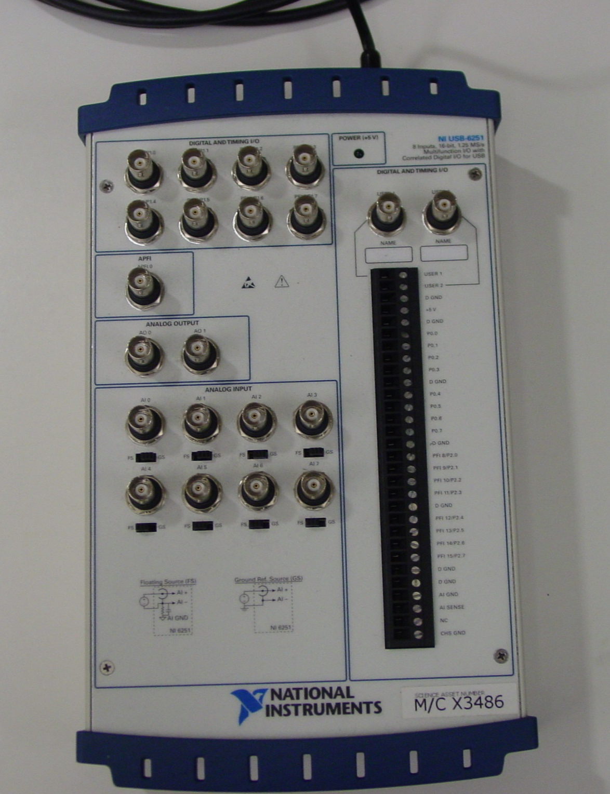
“Big” data in a “small” lab
National Instruments NI-USB-6251
1.25 MS/s (MS = MegaSamples)
16-bit resolution A/D
counters, D/A, etc.
USB with laptop or desktop
NI LabVIEW data acquisition software
108 GS/24 hr
216 GB file/24 hr
“If you build it, they will come.” Field of Dreams [altered slightly]
Notes:
It is now easy for an investigator at a small institution to acquire large data sets using a data acquisition device that costs about $2000 with analog-to-digital converters, counters, digital-to-analog converters. It can acquire data at a rate faster than one megasample per second, where a sample is a 16-bit integer. If you round that capability to one megasample per second that means in one day, which is 86,400 seconds, that you'll acquire 86.4 billion samples. For the example above, if you write that data to disk as 2-byte quantities, then you're going to have a 200 GB file pretty quickly .
The question is : are you ever going to be able to analyze that much data with a workstation at a small institution?
What I’ve learned is that the available workstation is not the limiting factor, but rather an understanding of parallel programming techniques. It’s great to have a fancy Developer Access Program Xeon Phi machine, as I do, but the machine itself will not make your code run faster. You will have to master the techniques of what Intel has called “modern code”. Today, I will show what can be done to analyze a 1 gigasample files, but my real interest is analyzing files in the 10 to 100 gigasample range, such as a 90 gigasample file I acquired more than 7 years ago, but could only analyze once, because it took more than 3 days on campus server set up expressly for that purpose.
I have all the workstations I need, 4, to be exact, but I need more skill at exploiting them: modern code.
Noah’s ark (false origin to the quotation). When God gave Noah the task of building an ark to survive a great flood, Noah spoke to God and told him that he though he could build the ark, but he didn’t know how he was going to collect all of those animals. And God replied, “If you build it, they will come”. Intel has profited from this wisdom for nearly half a century.
At the beginning of my career: What could anyone possibly do with a 10 MHz processor, 1 MB of RAM, or a 10 MB hard drive?

Slide 5
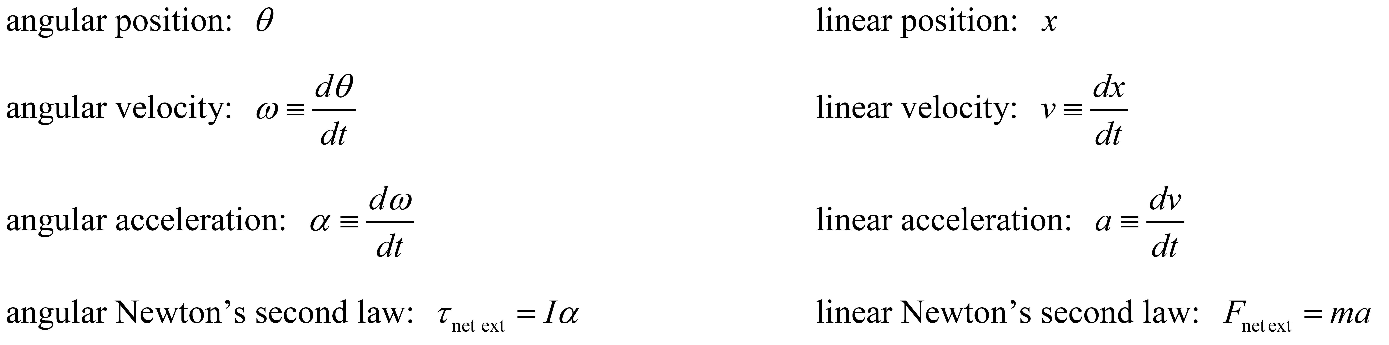
Videos
The driven chaotic pendulum in action
http://go.middlebury.edu/dunham-lab-pendulum-motion.mp4
4096 Poincaré sections per drive motor revolution
http://go.middlebury.edu/dunham-lab-pendulum-motion-plot.mp4
Kinematics and mechanics reminder:
Notes:
If you registered for this webinar you ‘ve already seen these videos, so I will show them quickly and make a few comments that are especially pertinent to the data analysis problem I will be describing.
Show video 1.
Show video 2.

Slide 6
Apparatus
Notes:
With every “tick” of the stepper motor, the pendulum tick count is read and recorded in a file, making the sampling rate typically 3000-4000 times per second.
Notice the effective potential energy function of above the pendulum is a double-well potential. If the stepper motor is not rotating, the straight up position of the pendulum is an unstable equilibrium point; two stable equilibria lie to the left and to the right. This is essentially Duffing’s oscillator.
For those who don’t know this field well, don’t feel bad. There is no written record from Newton or Einstein that they ever witnessed this phenomenon, and they certainly did no theoretical work regarding it. Although Poincare, a contemporary of Einstein, first uncovered chaos in the context of trying to solve the three-body problem, visualization and careful study of chaos had to await the arrival of the computer.

Slide 7
“Right” SG filter parameters radius (= n) and order (= o)
“just right”
“too little”
“too much”
Notes:
Let me keep my comments brief here.
The horizontal axis for each of these plots is angular position, theta, and the vertical axis is angular velocity, omega, when the stepper motor is in position 141 of 4096. We have 4096 plots like this for every day of data.
The plot at left is what you hope to get: a self-similar object known as a fractal. With too little filtering of the raw data you get what's in the middle plot. With too much filtering you get the plot on the right.
How much or how little filtering is applied to the raw data depends on the value of the radius n of the filter and the order o of a polynomial that is fitted to each neighborhood in the data set, This will be explained in the next couple of slides.
“Just right” is more of an aesthetic evaluation. We don’t know what filter settings are optimal. In fact we don’t have a optimality criterion. This smoothing and filtering is not as easy as it is for gamma ray, optical, and NMR spectra, where one can optimize resolution; it’s not as easy as filtering of images. That’s why were doing this work.

Slide 8
Raw Data
32-bit integers:
4219
4220
4221
4222
. . .
-4379
-4379
-4379
-4379
Notes:
On the left is a short segment of pendulum tick values from a raw data file. Integer tick values represent the position of the pendulum (10,000 ticks per revolution) at each tick of the stepper motor.
The plot at right shows this raw data for the first 5 drive motor revolutions. You’re looking at the data points themselves, not a line drawn through them.
The line is so near-perfect that you may wonder why we need smoothing or filtering at all.
To make a Poincare plot, one also needs the angular velocity at every sample. But calculating a numerical derivative can be rather tricky when angle measurements are so similar in adjacent samples.

Slide 9
Finding derivatives from small integer differences!
24 hours of data in histogram.
Pendulum moves 5 or fewer ticks (CW or CCW) per drive motor step!
Tick counts are integers.
Derivatives obtained from small integer differences at adjacent motor steps, , will form a small set of discrete values.
Need to find derivatives from large neighborhood (stencil) around a given point.
Notes:
The histogram above is for 24 hours of data. The horizontal axis shows pendulum angle change in tick units between samples ; the vertical axis is the number of occurrences of that tick change in the 24-hour data set.
What you see is that between samples, the pendulum angle tick count never changes by more than 5 in the clockwise or counterclockwise direction. If, for example, you attempt to form a numerical derivative from such a small tick change between adjacent sample, you will get a very small set of 11 possible numerical derivatives, which is similar to the plot shown earlier, where it was indicated that “too little” smoothing or filtering had been applied. Horizonal banding in the Poincare plot is a sure sign that a numerical derivative is not being formed from a sufficiently large neighborhood of raw data points.

Slide 10
Chaotic trajectory in phase space
100 drive motor rotations
major angle around torus is drive motor angle φ
red spheres indicate phase (θ, ω) of pendulum when drive motor in position 1
of 4096 (φ)
4096 Poincaré planes around torus
phase-space trajectory is non-intersecting
Notes:
Let me pass over this slide quickly. It shows that if the stepper motor angle is used as an angular coordinate around a torus or doughnut, and the pendulum angle and angular velocity are plotted in the cross-sectional planes of the torus, then one can plot the data in a 3-dimensional phase space as indicted above. The red dots are the places where the 3-dimensional trajectory of the pendulum pierces a particular cross-sectional plane, and the red dots correspond to the points that get plotted in one of 4096 Poincare planes. The video animation shown at the beginning, shows all 4096 Poincare planes as a movie.

Slide 11
Phenomena we see
1. Periodic
period-1, period-2, period-3, period-5, period-7, etc.
(data-taking times: minutes)
2. Chaos
data-taking times: 24 hours minimum
10-50 days for excellent quality Poincaré sections
(stability of apparatus components?)
Notes:
The pendulum can also exhibit periodic behavior in response to the uniform stepper motor rotation, but periodic behavior does not require long data-acquisition times or large data sets.
Chaotic motion is the more difficult data acquisition and analysis problem. Only about 65,000 points are put into a single Poincare section in one 24-day. Ideally, 10-100 days of data should be combined, but how will all of that filtering get done in a timely fashion?

Slide 12
Experiment history
Original paper:
Robert DeSerio, “Chaotic pendulum: The complete attractor”, American Journal of Physics 71, March 2003, pp. 250-257.
“smoothed”
“corrected”
Junda (2009) our first attempts →
Notes:
The original work on this problem was done by Bob DeSerio in 2003, and you can see our first attempts when we started in 2009.

Slide 13
Experiment improvements
Intelligent Motion Systems MDrive34Plus microstepping drive motor with integrated 4096 ticks/revolution optical rotary encoder
US Digital optical rotary encoder 10,000 ticks/revolution
(coming soon: 40,000 ticks/revolution)
Notes:
As Bob showed, one can make a number of improvements to the original apparatus by using a precision stepper motor and a precision optical rotary encoder attached to the pendulum axle. We bought a stepper motor and optical rotary encoder that promised to deliver at least 10 times the angular resolution as the components used in Bob’s experiment.
Unfortunately, or fortunately, depending on how you look at it, with the increased angular resolution came at least 20 times as much data, but of higher quality.

Slide 14
Improved resolution of fractal
Notes:
Shown above is a small portion of a Poincare section formed from 10 days of data, from the senior thesis of Shujaat Khan. The full plot is a 40 in x 40 in poster that I keep in my office. The fine structure of the fractal was especially clear. Not a single data point of about 650,000 data points in the poster was out of place. We were excited to improve its quality by improvements to the apparatus and to the data-analysis procedure.
The problem was that it took 3.5 hours to filter the data for 24 hours of data taking. The ten-day plot represented 35 hours of computing, using an old version of Mathematica, in 2010, on a computer that was then already about 5-10 years old. I suspect it’s resting comfortably in a landfill now.
Things have changed a great deal, but Mathematica code today still takes 1.5 minutes to perform the SG filter operation that is precondition for making Poincare plots, determining fractal dimension, Lyapunov exponents, etc. Mathematica is powerful, with many parallel functions, interactive, and convenient, but I knew that modern hardware and modern code should do much better.

Slide 15
Understanding the data
Correctness!
Fractal dimension
Lyapunov exponents
Optimal SG filter parameters
Figure of merit for a fractal extracted from experimental data
Quantify discretization and environmental “noise” contributions
None of these possible without filtered (“smoothed”) data!
Notes:
Let me emphasize the point at the bottom of the page. The other algorithms depend on optimally smoothed data, and one of our core problems is determining optimal smoothing. We need an a smoothing algorithm that runs as fast as is possible on modern workstation-level hardware.

Slide 16
Typical 24-hour run
0.755 Hz drive motor frequency
Raw Input:
276,030,000 32-bit integers pendulum angle ticks (1.1 GB file)
SG Filter Output:
275,988,480 (= 67,380 × 4,096) DP (or SP) smoothed values of θ, ω, and α
67,380 full motor rotations (67,380 points per Poincaré section)
Notes:
Now Part 2.
So how much data needs to be processed for 24 hours of data?
How does that translate into floating-point operations (FLOPs)?

Slide 17
Why use Savitzky-Golay (SG) Filter?
Preserves heights and widths of features in data.
We need smoothed 0th, 1st, and 2nd derivatives of data: θ, ω, and α.
But, computationally expensive.
Numerical Recipes: The Art of Scientific Computing, 3rd edition, W.H. Press, S.A. Teukolsky, W.T. Vetterling, and B.P. Flannery, (Cambridge University Press, 2007) pp. 766-772
Notes:
You would not want to use a computationally expensive filter, like the SG filter, unless you absolutely have to. We have to, in order to preserve the fine detail we want to see in our final data.
The top plot shows a simulated signal with an increasing frequency that increases going to the right. The signal amplitude stays the same. Added to the well-defined signal is simulated Gaussian noise.
The goal of the filter is to recover the original well-defined signal and reject the noise.
The middle plot shows what happens if one applies a generic “democratic” moving average filter. For every specific element in the data set, one considers the data values of 16 elements to the left, the data value of the central (specific) element, and the data values of 16 elements to the right, adds up the 33 values and divides by 33. “Democratic” means all of the data elements have the same vote, i.e., the same weight in deciding how the central value should be replaced to produce the “smoothed” output. The result is the solid line in the middle plot, where we see that this kind of smoothing reduces the amplitude of high-frequency peaks and increase their widths. The recovery of the original signal is poor. This is unacceptable.
The bottom plot shows the SG filter. For every element in the data set, a least-squares polynomial fit of order o is fitted to the data values all of the elements in a neighborhood of radius n around the central element. Fortunately, the coefficients one obtains from the least- squares fitting to a polynomial can be calculated in advance. The derivatives of the best-fit polynomial are also known in advance.

Slide 18
“Small” SG filter example: n = 2, order = 2 (quadratic)
Notes:
In this simple example, a stencil of SG coefficients is applied to every element of a data set. At every element of the data set, n = 2 elements to the left and n = 2 elements to the right, and the central elements itself (indicated in red) are multiplied by a SG coefficient. These products are summed and the central element is replaced with the new value. Note that the stencil above can be implemented as 5 fused multiply-add instructions in code; in general, one needs 2 n + 1 fused multiply-add for each derivative order.
This stencil must be applied at every element of the raw data set and there is a separate set of SG (stencil) coefficient for the 0th , 1st, and 2nd derivatives.
Note how the weighting is not democratic. Note the negative values.

Slide 19
How many FLOPs for a one-day data set?
320 billion ≈ 275,988,480 (data set values)
× 193 ( = 96 + 1 + 96, for n = 96 SG-filter radius)
× 2 (FMA = fused multiply-add)
× 3 (smoothed derivatives: θ, ω, and α)
(This calculation took more than 3 hours seven years ago!
Less than ½ second now on KNL.)
Notes:
It’s good to do a calculation with realistic numbers to find out how many FLOPs are required to do what we need done . Our filter radius is not n = 2, but something more like n = 96.
When I did this calculation seven years ago, I realized that we should expect to do better than 3.5 hours with modern hardware and modern coding.

Slide 20
Code snippet for SG filter
VITO ≡
vectorize inner,
thread outer
Notes:
At right, I show a mnemonic, VITO, for how modern code is usually structured. Just think of Vito Corleone, Marlon Brando’s memorable character in the movie The Godfather.
Point out the OpenMP threading construction at the beginning.
Point out the vector/SIMD construction at the middle.
FOLDED means we took advantage of the symmetry of the SG filter values around the central element. It’s quite possible this did not help much because if these values are aligned properly for unit stride access on one side of the central element, they are in the opposite order on the other side.

Slide 21
Single-Precision SG Filter (320 billion SP FLOPs)
snb | “Sandy Bridge” | Xeon e5-2690 | AVX | 32
ivb | “Ivy Bridge” | Xeon e5-2697v2 | AVX | 48
hsw | “Haswell” | Xeon e5-2697v3 | AVX2 | 56
bdw | “Broadwell” | Xeon e5-2699v4 | AVX2 | 88
knl7210 | DAP workstation | Xeon Phi 7210 | AVX512 | 256
knl7250 | Colfax Cluster | Xeon Phi 7250 | AVX512 | 272
Notes:
Given that our data has only 16 bits of precision, it might well be the case that we require only single precision in our data analysis, but it was easy to calculate in double precision for comparison to legacy calculations. Both SP and DP results will be presented.
The SG filter operation for one day of data can done in about 0.3 s on the Xeon Phi 7210 DAP workstation in my office. That corresponds to over 1 TFLOP/s of SP calculation performance.
I was happy to see that the performance improvements I made when tuning for optimal performance on Xeon Phi also leads to good performance on the many traditional Xeon processors of the Colfax Cluster, because it may be necessary here, at times, to use traditional Xeon processors for some of our analysis.
The Broadwell processor on the Colfax Cluster is very powerful, and for performance FLOP/s gives KNL a run for its money, but Broadwell requires 290 Watts, whereas the KNL processors requires only 215 Watts. So the KNL completes more FLOPs per Watt than Broadwell. That’s not a consideration for me, because I don’t pay the power bills for my college or for Colfax, but power efficiency is a big concern of the HPC community and needs to be considered in addition to FLOP/s performance.
Also, the Broadwell machine is very expensive compared to the Xeon Phi.

Slide 22
Double-precision SG filter (320 billion DP FLOPs)
snb | “Sandy Bridge” | Xeon e5-2690 | AVX | 32
ivb | “Ivy Bridge” | Xeon e5-2697v2 | AVX | 48
hsw | “Haswell” | Xeon e5-2697v3 | AVX2 | 56
bdw | “Broadwell” | Xeon e5-2699v4 | AVX2 | 88
knl7210 | DAP workstation | Xeon Phi 7210 | AVX512 | 256
knl7250 | Colfax Cluster | Xeon Phi 7250 | AVX512 | 272
Notes:
The double precision efficiency is also very good.
But, rather naively, I expected to do better than this because of the advertising of SP6+ TFLOP/s and DP 3+ TFLOP/s.
I thought I had amazing arithmetic intensity in the SG algorithm
579 FMA instructions for a total of 16 bytes of memory traffic (SP) (1 SP in, 3 SP out)
arithmetic intensity = instructions/bytes of approximately 36!!
Fantastic! Wrong.

Slide 23
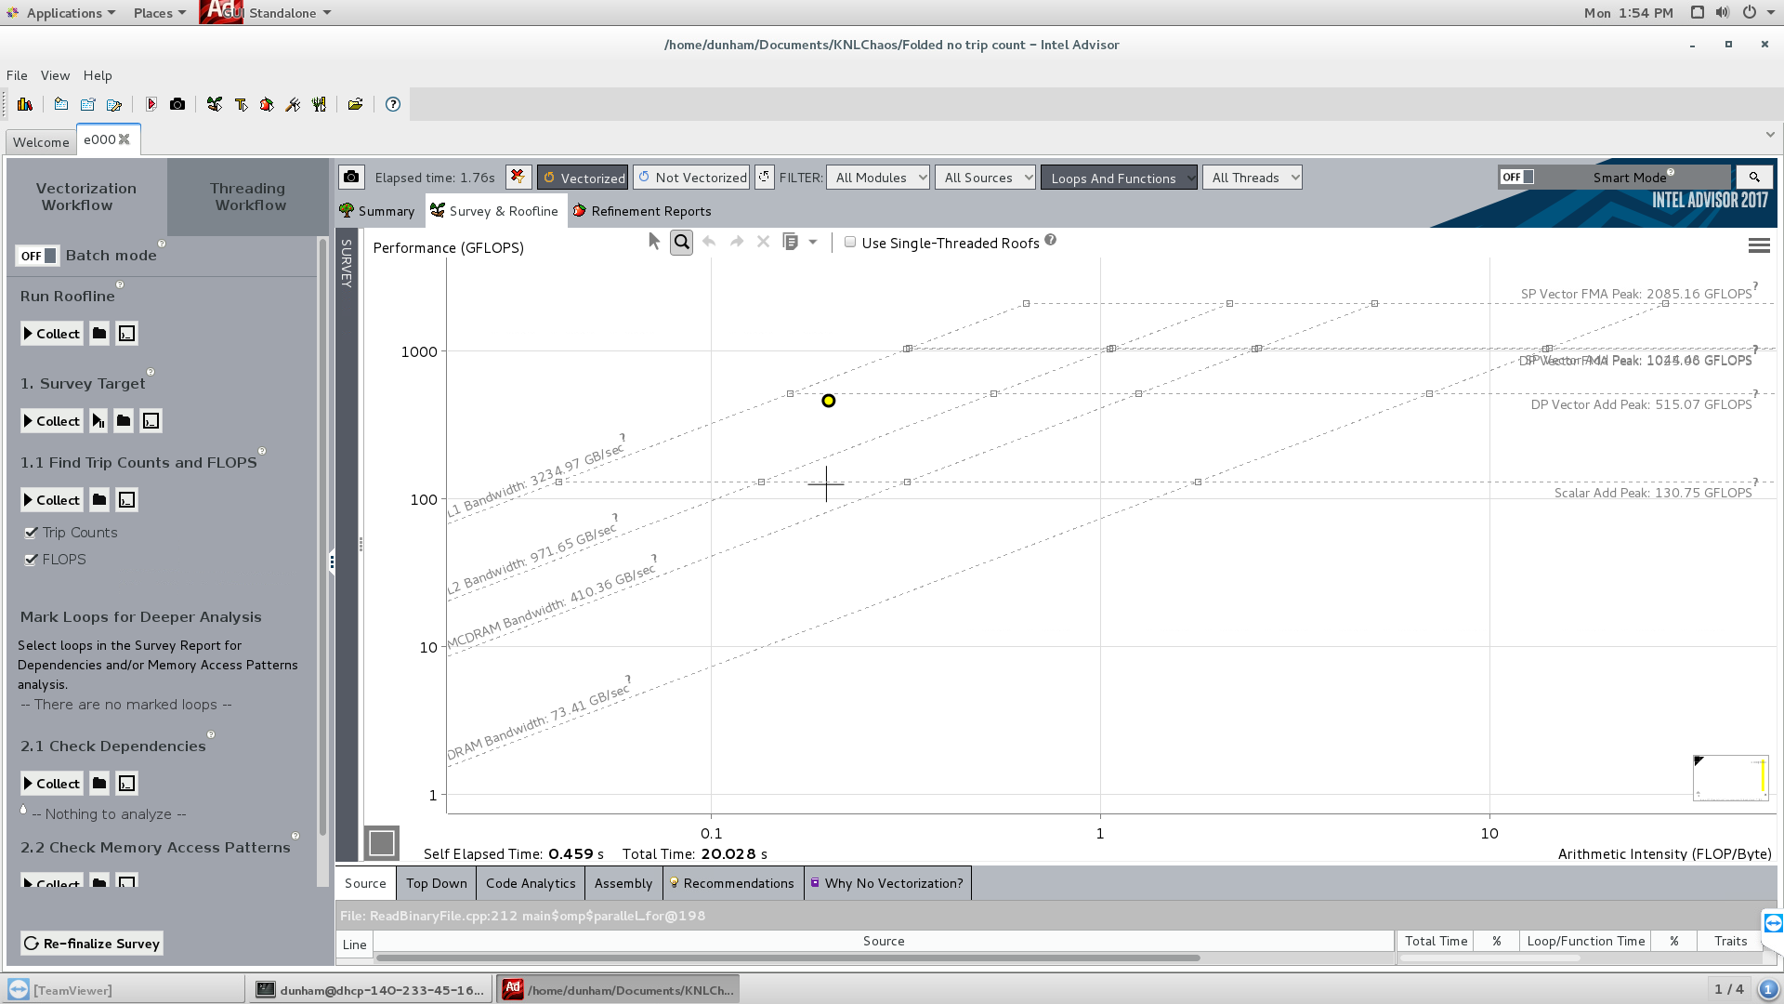
Intel Advisor Roofline Analysis
On KNL, performance limited by L1 cache bandwidth: 193 x 3 4-byte (SP) cache accesses of SG coefficients for each of 276 million points.(640 billion bytes must be transferred for SG coefficients)
Notes:
The SG coefficients are too numerous (579) to reside in the 32 512-bit wide registers and all of them must be retrieved from the L1 cache for every data point in the entire data set.
A democratic filter would not have this limitation, since there is only one coefficient. But a democratic filter could not give good 1st and 2nd derivatives either.
A quick estimate suggests that 0.2 seconds of the compute time involves moving the SG coefficients in from L1 cache.
Computation is cheap, usually free, but memory access, even to a fast L1 cache will cost you dearly.

Slide 24
Welcome back to 2001?
Time, in seconds, on Xeon Phi 7210 for SG filter, using double-precision (DP), to analyze 24-hour data set for different instruction sets and compiler option settings, using Intel compiler.
4000 times slower
Notes:
Could my claim of 3.5 hours in 2010 be true?

Slide 25
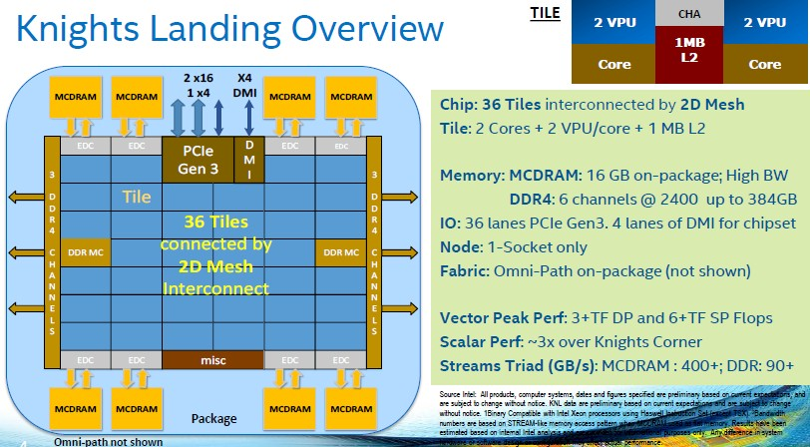
Compute-only code (“speed of light” code)
No memory accesses whatsoever.
Registers and VPU only. Fused multiply-add (FMA) instructions only.
How to verify
3+ TFLOP/s DP
6+ TFLOP/s SP
stated in various places?
Notes:
Now Part 3.
”Speed of light” alludes to the way the speed of light in vacuum functions as speed limit in physics, especially special relativity
Did I get what I paid for?
What does code look like that gets peak performance?
Let’s make the workstation catch on fire. Just what you would do with a new sports car. You wouldn’t ask to borrow it for a few hours to see what kind of gas mileage you get in town. You would go to a long, flat stretch of road in the country, and put the pedal to the metal. What is the peak acceleration and peak velocity of that new Lamborghini?
That’s a pretty silly thing to do, but people always do it, even though they break the law.
The good news is that writing a “speed of light” code and observing its behavior is legal and can illustrate a great number of basic truths modern code.

Slide 26
Compute-only (“speed of light”) code expectations
(128 threads on 64-core Xeon Phi 7210 DAP workstation, nominal 1.3 GHz* clock)
SP: 4.51 TFLOP/s = (64 core)×(2 VPU/core)×(2 FLOP/FMA)
×(16 SP operands/vector)×(1.3 1.1×10⁹ clock/s)
DP: 2.25 TFLOP/s = (64 core)×(2 VPU/core)×(2 FLOP/FMA)
×(8 DP operands/vector)×(1.3 1.1×10⁹ clock/s)
[*”Frequency listed is nominal (non-AVX) TDP frequency. For all-tile turbo frequency, add 100 MHz. For single-tile turbo frequency, add 200 MHz. For high-AVX instruction frequency, subtract 200 MHz.” Footnote 3, p. 4 Product Brief: Intel Xeon Phi Processor. PDF online.]
Notes:
If you put in the numbers for the latest 7290, nominal 1.5 GHz* clock and 72 cores, you will get exactly
SP = 6.00 TFLOP/s
DP = 3.00 TFLOP/s
So my 7210 is like the first pancake from the griddle—not quite up to specs, but a good indicator of what is to come.

Slide 27
Assembly for compute-only code: 10 FMA’s in loop body
ps ≡ packed single precision
zmm ≡ 512-bit register
fma = fma * b + c
..B1.260: # Preds ..B1.260 ..B1.259
# Execution count [1.00e+06]
addl $1, %eax #251.3 c1
vfmadd213ps %zmm0, %zmm12, %zmm11 #256.15 c1
vfmadd213ps %zmm0, %zmm12, %zmm10 #257.15 c1
vfmadd213ps %zmm0, %zmm12, %zmm9 #258.15 c7 stall 2
vfmadd213ps %zmm0, %zmm12, %zmm8 #259.15 c7
vfmadd213ps %zmm0, %zmm12, %zmm7 #260.15 c13 stall 2
vfmadd213ps %zmm0, %zmm12, %zmm6 #261.15 c13
vfmadd213ps %zmm0, %zmm12, %zmm5 #262.15 c19 stall 2
vfmadd213ps %zmm0, %zmm12, %zmm4 #263.15 c19
vfmadd213ps %zmm0, %zmm12, %zmm3 #264.15 c25 stall 2
vfmadd213ps %zmm0, %zmm12, %zmm2 #265.16 c25
cmpl $50000000, %eax #251.3 c25
jb ..B1.260 # Prob 99% #251.3 c27
VITO ≡
vectorize inner,
thread outer
vfmadd213ps:
latency 6
throughput 0.5
=
c
+
b
*
fma
Notes:
I hate to put assembly first and C/C++ code second, but this will make more sense if I show you what I was targeting and why the C/C++ code looks as it does.
In cycle c1 two ps fma’s are performed—that‘s a total of 64 FP arithmetic operations (multiply and add) in one clock cycle. If 64 cores are all doing these 64 FP operations in the same cycle, then 4096 FP operations are being done over the entire process in one clock cycle. Multiply 4096 FP operations per cycle by 1.1 billion cycles per second and you get 4.51 trillion FP operations per seconds as calculated in earlier slide.
Emphasize latency of 6 clocks and the fact that two ps fma’s are done at once
Note that the integer housekeeping operation of incrementing and comparing an index are done in the same cycles as fma operations in the VPU
Speculative execution is used—it’s highly probably that the jump will be taken!
The 10 fma instructions must be independent!

Slide 28
Code for compute-only (“speed of light”)
Use intrinsics for definiteness and speed: fma = fma * b + c
Example “skeleton” code: 10 vector FMA instructions in main iteration loop
Notes:
Note the dot-dot-dot ellipsis: repeat 10 times
fma, a, b, c must be in registers, not cache, or DDR4, or MCDRAM

Slide 29
Initialization details
Notes:
Note the strange values used in the b and c vectors. Needed for a semi-robust correctness check for SP. Correctness check for DP is robust.

Slide 30
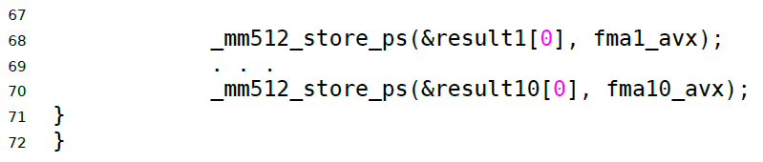
Main timed loop
VITO ≡
vectorize inner,
thread outer
Notes:
Between the two blue comment lines is the vector inner loop.
Note especially that each thread executing this loop has a thread-private time
Having 10 vector instructions each doing 1/10 of the work is “instruction-level parallelism”.

Slide 31
Animation
For 1, 2, 3, . . . , 256 OpenMP threads, have each thread compute 50 million iterations of a loop body containing nfma = 10 single-precision FMA instructions.
How much time does it take each individual OpenMP thread to complete its loop?
default KMP_AFFINITY=scatter
Notes:
Show video for 10 fmas in the loop body.
Emphasize the significance of default thread affinity of “scatter”. That’s what you’re seeing as the animation runs.
Quiz question: what would you see if you had KMP_AFFINITY=compact

Slide 32
Single precision (SP) results (Xeon Phi 7210, 64 cores)
default KMP_AFFINITY=scatter
“reasonable, fair” ✓
“conservative, pessimistic” ✓
Notes:
Took about 11 hours to sweep through nfma = 1, 2, 3, . . . , 25 for 1, 2, 3, . . . , 256 OpenMP threads.
Be sure to FIRST explain the blue to red legend for 1 through 25 fmas in the loop body!
Then the horizontal and vertical axes.
5 trials
Total workload given to all threads/ “average” time for threads to complete.
“average” time = MEAN, MAX, MEDIAN, and MIN time
Note the scattered low value points for the curves based on MAX time; the Linux OS needs to steal a core now and then to run background processes.

Slide 33
Single precision (SP) results (Xeon Phi 7210, 64 cores)
default KMP_AFFINITY=scatter
“too optimistic” ✗
“much too optimistic” ✗
Notes:
These estimates are both wrong because they suggest physically impossible FLOP/s performance.
The “average” times are too short, hence the FLOP/s values can become too large.

Slide 34
Double precision (DP) results (Xeon Phi 7210, 64 cores)
default KMP_AFFINITY=scatter
“reasonable, fair” ✓
“conservative, pessimistic” ✓
Notes:
Similar curves.

Slide 35
Double precision (DP) results (Xeon Phi 7210, 64 cores)
default KMP_AFFINITY=scatter
“too optimistic” ✗
“much too optimistic” ✗
Notes:
Similar curves. Similar 11 hours to do 5 trials at every fma and OpenMP thread setting.

Slide 36
Lesson learned
Beyond multithreading and vectorization, must optimize instruction-level parallelism (ILP). (same story on GPUs)
“There should always be FMA instructions ready to execute in the VFU [VPU] . . . .”
Intel Xeon Phi Processor High Performance Programming (Knight’s Landing Edition), James Jeffers, James Reinders, and Avinash Sodani, (Morgan Kaufmann, 2016) p. 119.
Notes:
Need a new 3-levels-of-parallelism mnemonic/acronym, beyond VITO, that includes instruction-level parallelism as an innermost nesting level.
I’m working on it.
The “speed of light” code exercise was well worth doing—it has set the performance bar for my optimizations.
Nobody got hurt, nobody got a speeding ticket, and my workstation didn’t catch on fire.
I think I got smarter.
I believe a simple deterministic model based on what is openly available can explain all of the curves you see, except the hiccups due to OS stealing time. After all, the Xeon Phi is just a machine.

Slide 37
Summary
“Small” experiments can have “big” data analysis problems
Code modernization is for everyone
“Trickle down” from supercomputing to everyday computing
Good to develop definite, but reasonable, expectations for code modernization and code optimization
Notes:
Emphasize last line.
Dare to calculate actual numerical values for FLOP counts, expected execution times, etc. Your first estimates will almost always be wrong, but it is still worth doing.
Use the Parallel Studio Advisor and VTune Amplifier tools.

Slide 38
Acknowledgments
Asa Phillips ’17
Jovita Ho ’16
Shujaat Khan ’10
Jonathan Spencer ’10
Max Junda ’09
Prof. Noah Graham
Cris Butler
Lance Ritchie
Jonathan Kemp
Special thanks to
Colfax Research:
Andrey Vladimirov
Gautam Shah
Notes:
Especially Asa Phillips ’17 who helped refine and test the SG filter and fractal dimension algorithms during Spring Term this year. using KNL.

Slide 39
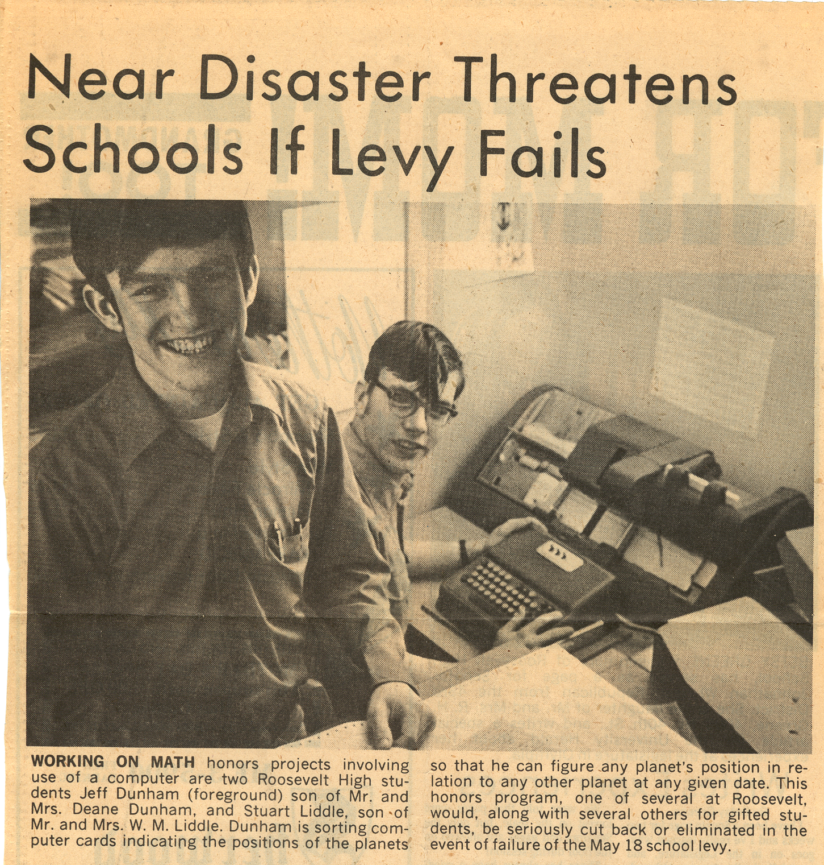

Who needs to learn about modern code?
Me!
You?
Attend Colfax HOW series course.
Notes:
Model 026 keypunch in background
Thanks to Andrey for letting me take the HOW series course twice.

Slide 40
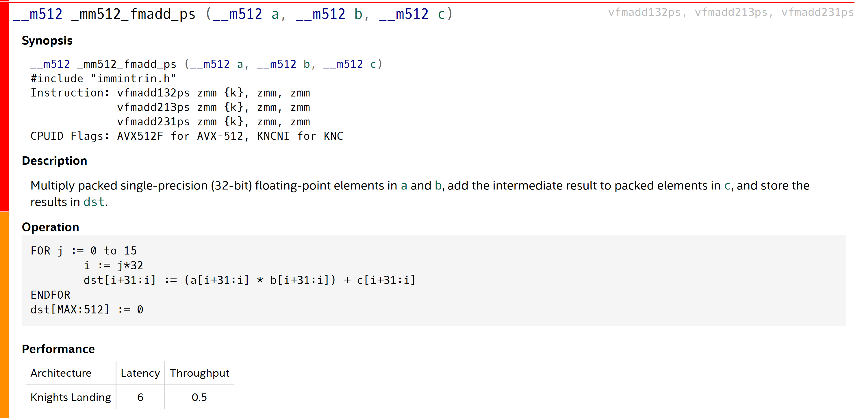
Intrinsics reference
https://software.intel.com/sites/landingpage/IntrinsicsGuide/#
Notes:
Useful to know where to find these details.

